Slide 1



Centre for Policing Research
and Learning
  An illustration of Q-methodology
  through research on policing priorities
Quoc Vo and Jean Hartley
SEBP Conference
February 2018
Open University, Milton Keynes
Notes:
J

Slide 2



Centre for Policing Research
and Learning
Aims of this session
Introduction to the team and research
What is Q-methodology? How can it be useful to police research?
Our research into public value and policing priorities to illustrate the usefulness of Q-methodology.
Steps in developing a Q study
Q board potential in research and beyond
Notes:
J

Slide 3
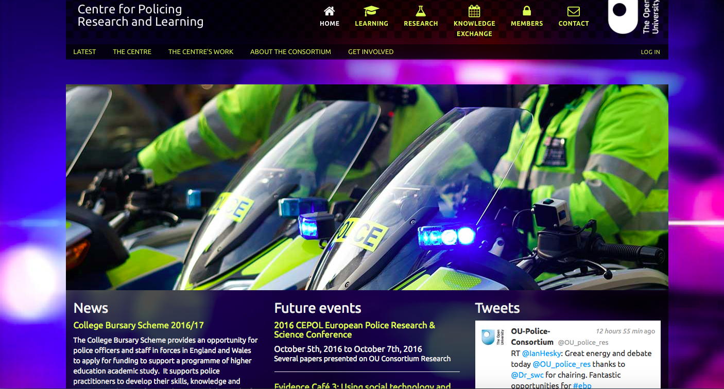
Centre for Policing Research and Learning
http://centre-for-policing.open.ac.uk/http://centre-for-policing.open.ac.uk/
Notes:
Website

Slide 4


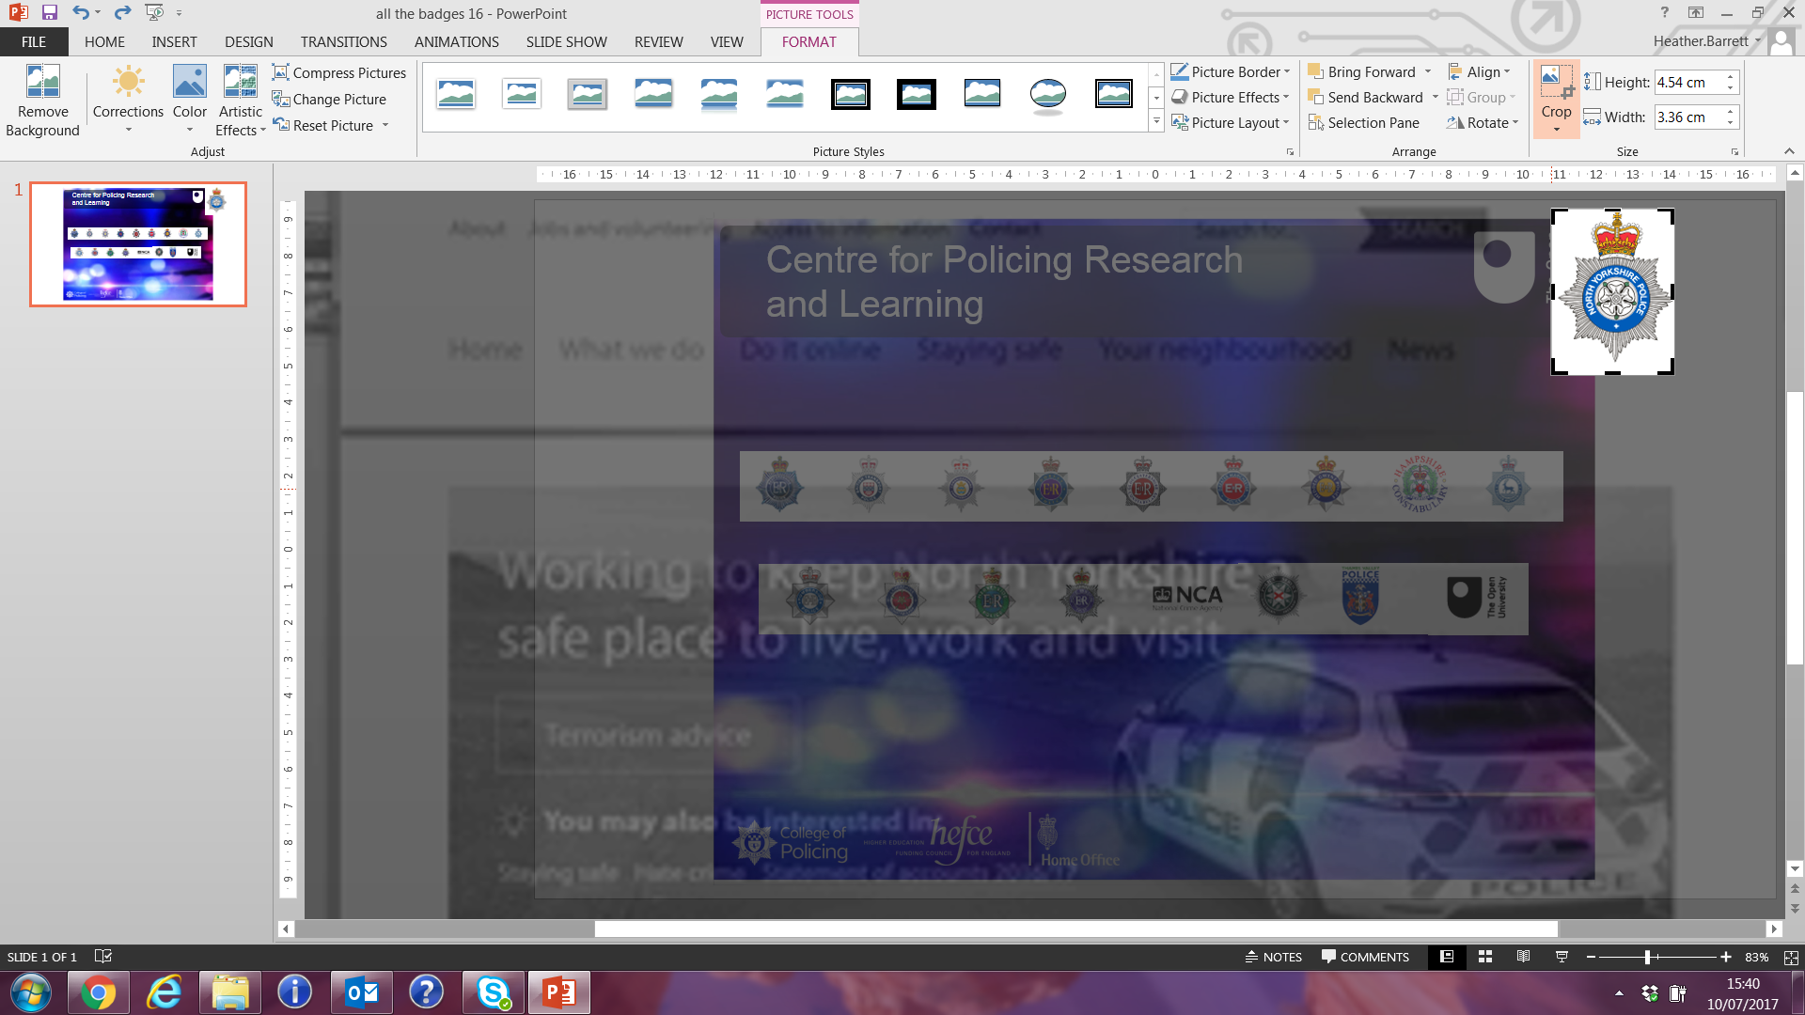
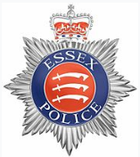

Centre for Policing Research and Learning
Notes:
One university (with presence across the whole UK) and 18 police forces across the UK, varying in size, key issues, and performance
Rich set of contexts in which to explore and test new ideas and practices
Academics from a range of disciplines (e.g. criminology, computer science, psychology, leadership & management, organization studies)
Quarterly steering group meetings chaired by the police

Slide 5
Centre for Policing Research
and Learning
The team and the research
Research team made up of police officers (seconded full time) and academics, led by Prof. Jean Hartley
Part of a wider piece of research exploring the leadership of public value in policing
Q methodology used to examine what policing priorities are chosen (i.e. the value attached to particular policing activities)
The research questions were:
  What are the views of police, public service partners and the public on policing priorities
  How far do police, public service partners and public have similar or different views about policing priorities?
  How useful is Q methodology as a tool to assess public value?
Notes:
J

Slide 6
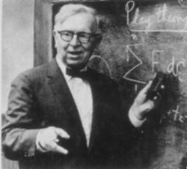
Centre for Policing Research
and Learning
Q methodology
  Q-Method, a mixed research method (quantitative and qualitative).
  Developed by William Stephenson in 1930s. Greater interest since 2000s, especially in public admin.
  Capturing subjectivity in an analytical and systematic way (Stephenson, 1953)
  Explorative in nature and helps to understand a complex issue.
  Less about ‘who said what about X?’ and more about ‘what is currently being said about X?’ (Watts and Stenner, 2005)
  Q seems ideally suited to explore a highly subjective topic such as what should the police be prioritising?
                “a science for all that is subjective,
                for what is behind the eyes,
                as well as before them”
                (Stephenson, 1993/1994)
Notes:
Q

Slide 7
Centre for Policing Research
and Learning
Q – some past applications
Limited use in policing research – time, expertise, cost?
Scarborough et al. (1999): police promotion process in Kentucky, USA - promotion did not foster officer motivation and found hostile attitudes towards promotion itself.
Ratcliffe (2016) South American gang violence - gangs shared many success traits making it easier for police to try dismantle successful gangs.
Waddington and Braddock, 1991 - Perceptions of police amongst adolescent UK black, white and Asian boys - black boys almost exclusively viewed police as ‘bullies’ rather than ‘guardians’.
Young (2007) women’s response after a domestic violence incident – enabled tailor-made interventions to help women escape the cycle of abuse.
Notes:
Q

Slide 8
Centre for Policing Research
and Learning
Using Q to research policing priorities through the concept of public value
Public value is now part of the discourse about public organizations
More and more scholars are writing about ‘public value’, drawing on Mark Moore’s seminal (1995) book and on developments since (e.g. Benington, 2011)
BUT
Where is the empirical research? A few case studies, not much else
“most publications are….theoretical, conceptual, scholarly, synthetic or descriptive” (Hartley et al, 2017)
Notes:
J

Slide 9
Centre for Policing Research
and Learning
Concept of Public Value
  There are many and varied definitions of public value.
‘In this study we use: Benington (2011) Public Value concept – two dimensions:
  ‘What the public value’
  ‘What adds value to the public sphere’
These two dimensions can be in conflict with each other:
  A “contested democratic practice”, public value is often assessed through debate, dialogue and exploration of alternative meanings, values and priorities.
Notes:
J

Slide 10
Centre for Policing Research
and Learning
Why Policing and Public Value
Policy interest: Sara Thornton, (NPCC): “Public value” theory prompts us to think about the value we are trying to create. What outcomes are we delivering for the citizen?.....So what are the police for? What is the value we are trying to create in policing?”
Academic interest: Policing provides services which are sometimes regulatory and even coercive - not always wanted by the public, though providing value to society.
Opportunity to undertake fieldwork to explore public value in practice
Notes:
J

Slide 11
Centre for Policing Research
and Learning
Public value and priorities
“Much current discussion of public service tends to focus on notions of client or public satisfaction, but in order to establish more robust measures of public value it may be necessary for the public to be asked to make trade-offs between competing sources of satisfaction. (Benington, 2011, p.42)
The Cabinet Office report on public value (Kelly et al, 2002) argues that what the public values is meaningful only when linked to questions of what it is willing to give up in exchange for any benefits,
Q methodology is based on trade-offs
Notes:
J

Slide 12
Centre for Policing Research
and Learning
The research questions
What are the views of police, public service partners and the public on policing priorities
How far do police, public service partners and public have similar or different views about public value?
How useful is Q methodology as a tool to assess public value?
Notes:
J

Slide 13
Centre for Policing Research
and Learning
The Stages of Q-methodology
Adapted from Ellingsen et al. (2010)
Identification of the concourse on the topic of interest
Development of a representative set of statements
Q sort design
The participants
Q sort administration (sorting of statements by participants)
Findings and interpretation
Notes:
Q

Slide 14
Centre for Policing Research
and Learning
Stage 1 – The Concourse
The term concourse is specific to Q Methodology.
We must first identify and assemble a wide and varied volume of thoughts and communication on the topic (in this case on the theme of policing priorities) (Stephenson, 1953; Jeffares and Skelcher, 2011).
The concourse is represented through a collection of self-referable statements (or comments) about a particular topic.
Value of practitioner-led concourse development.
Notes:
Q

Slide 15
Centre for Policing Research
and Learning
510 Objectives
2 Focus Groups
5 PCC Crime Plans
NHT Public Priorities Survey
Interactive Event
Policing Literature
TVP
GMP
MET
PSNI
Gwent
Group 1 – PCs
Group 2 – Sgt, Insp. and CI
Gwent Your Voice Survey
8 groups of Police and Academics
HMIC - Policing in Austerity: Rising to the Challenge
COP analysis:
Estimating demand on the police service
Stage 1 –
Concourse
Sources
Not about popularity of a statement
Notes:
Q

Slide 16
Centre for Policing Research
and Learning
Stage 2 – The Q Statements
A methodical and systematic process of statements reduction resulting in 62 statements.
The final set of statements (the Q sample) is much smaller than the initial collection - limit to how many statements a participant could be expected or willing to sort through (Durose et al. 2015).
Final set of statements to be manageable and need to preserve the diversity of the sample (Fisher, 1960).
Vital that a deliberate and conscious attempt is made not to control the meaning of a statement (Jeffares & Dickinson, 2016) otherwise researcher bias will be inadvertently introduced into the final Q sample (McKeown & Thomas, 1988).

Slide 17
Centre for Policing Research
and Learning
Stage 3 – Sorting Design
Design the grid - used by the participants to sort the statements.
Advantage of a Q sort over a survey with Likert scales = participant forced to prioritise some statements over others.
Forced-choice frequency distribution - participants must rank the statements within the grid in terms of ranking across columns = Allows for beliefs to emerge which may otherwise be lost if it were a free distribution where participants are not forced to make choices (McKeown & Thomas, 2014).
A quasi-normal distribution shape of the grid is used. for subjects where participants are expected to be uninformed or interested – smaller sale, whereas, for highly controversial subjects, a flatter distribution may be used – larger scale (Brown 1980, p. 200)
Notes:
Q

Slide 18
Centre for Policing Research
and Learning
Stage 4 – The Q Board
Scale of +1 to +9 for the columns - a balance between giving participants enough to think about but at the same time not to make it onerous as to make the sorting exercise too long.
Notes:
Q

Slide 19
Centre for Policing Research
and Learning
Stage 4 – The Participants
A large number of participants is not required in Q:
“It is rather like dipping into an aquarium known to contain only, say, seven kinds of fish. One does need more than the odd specimen to know that there are goldfish in the tank or that an angel-fish is differently configurated from an angler fish. Around 40 to 50 'dips' should give a good picture of the speciation present. So it is with a Q study. Similarly, just as no particular 'dip' matters in exploring the tank contents, neither does the having of (or failure to have) any particular individual participant in a Q study.” - Rogers (1995:182)
Notes:
Q

Slide 20
Centre for Policing Research
and Learning
Stage 4:The participants in study
The participants:
  Police officers and staff (from 3 forces; n= 76 of which 36/40)
  Partners; (2 organisations, n= 31)
  Members of the public (2 localities, n= 18).
Such a ‘multiplex’ of individuals consisting of those familiar with policing as well as ordinary members of the public increases the possibility of exposing unexpected views (Rogers, 1995).
Q seeks to reveal patterns in these views, rather than exploring in the individuals who hold the views.
Notes:
Q

Slide 21
Centre for Policing Research
and Learning
Stage 5 – Sorting Administration
Online vs Offline
Benefits of face-to-face, but time consuming and costly.
Our solution: Two physical Q-Board with magnetic tiles – tactile and colourful.
List of instructions
125 sorts completed over 15 days (average of 8 sorts per day).
Collecting and recording
  Photograph, handwritten notes and excel spreadsheets.
  Zero loss of sorts; i.e. all sorts could be used.
Notes:
Q

Slide 22
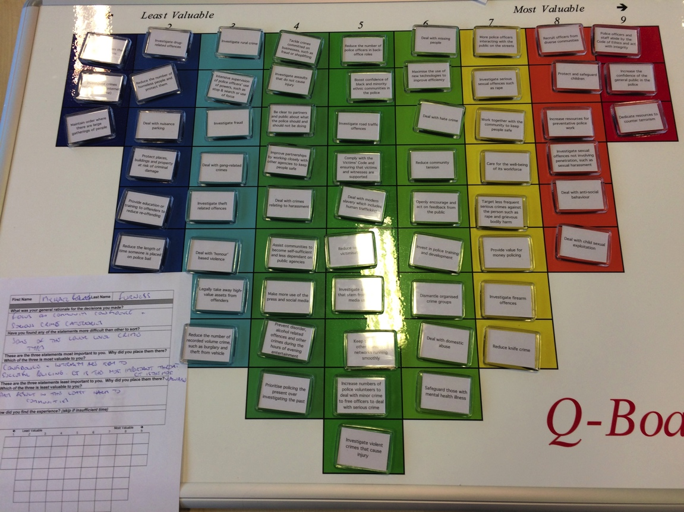
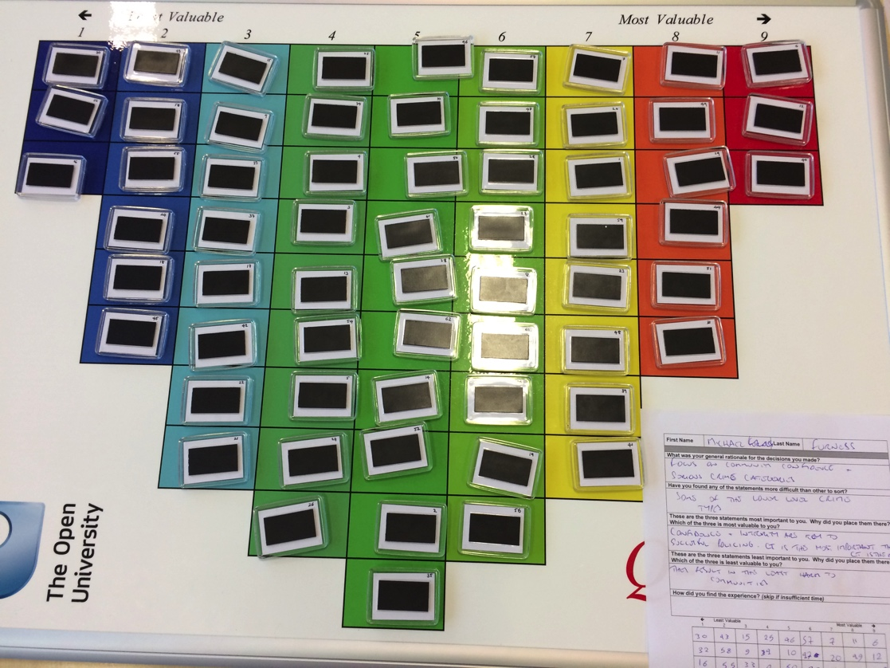
Centre for Policing Research
and Learning
Stage 5 – Sorting Administration

Slide 23
Centre for Policing Research
and Learning
Stage 6 - Research Analysis
Examine the priorities of the participants in two main ways.
  Most likely and least likely to be seen as priorities
  Apply multivariate analysis to the whole Q sorts - factor analysis adapted to the Q methodology (Watts and Stenner, 2005).
Factor analytic procedures, by-person correlation and factor analytic procedure (Watts & Stenner, 2005) i.e. it is the person who becomes the variable (Watts & Stenner, 2012).
We understand the “life lived from the standpoint of the person living it” (Brown, 1996:561).
Reveal patterns and connections in opinions, potentially uncovering insights (Raje, 2007:468).
A ‘factor’ indicates a cluster of persons who have similar Q-sorts and therefore share a viewpoint (Brown, 1980).
Notes:
Q

Slide 24
Centre for Policing Research
and Learning
Stage 6 – Research Findings
Notes:
Q

Slide 25
Centre for Policing Research
and Learning
Stage 6 – Research Findings
Notes:
Q

Slide 26
Centre for Policing Research
and Learning
Stage 6 – Research Findings
  From the factor analysis, four major patterns or viewpoints revealed:
    Personal Harm
    Engagement
    Crime-Fighter
    Good Cop
  Public view of Q sorting:
    Found it really interesting and absorbing to complete the Q board.
    Some said if they had known everything police do, they would not dream of complaining
    Some questioned whether our partners were sharing the workload
Notes:
Q

Slide 27
Centre for Policing Research
and Learning
Using Q methodology in policing research
A method which combines some of the richness of qualitative research with some of the rigour of quantitative research
Increasingly being used in public admin research
Time consuming – but intellectually valuable – to define the concourse
Participants find Q sorting interesting and engaging.
A guide to Q methodology as a method in policing is being finalised (Vo and Hartley).
Notes:
Q

Slide 28
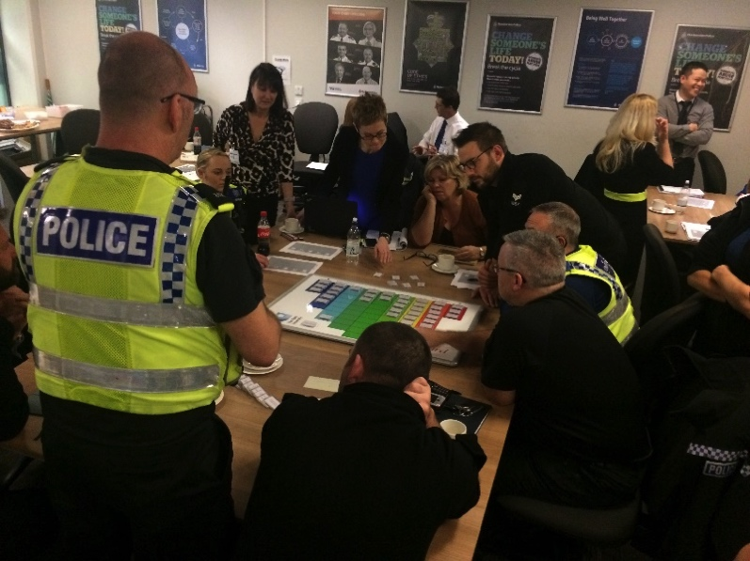

Centre for Policing Research
and Learning
The Potential of the Q-Board
for discussion about policing priorities
with police and education/engagement
with public
Perhaps other topics longer term
Interest as far away as Australia
Evidence Café
World Cafe
Use at TVP Force Strategy Day
Use in Inspectors’ Conference
Humberside Police Evidence Cafe
TVP World Café Event
Notes:
Q

Slide 29
Centre for Policing Research
and Learning
Further information and papers
Quoc.vo@thamesvalley.pnn.police.uk
Jean.Hartley@open.ac.uk
Papers:
Vo, Q., Hartley J, Khalil, L., Beashel, J. and Parker, S. (2017) Understanding public value through policing priorities. Report to CPRL. (Executive summary and full report)
Vo Q and Hartley J (in draft) Q methodology: A how-to guide to conducting research using Q for police and other public services.
Notes:
Q

