Slide 1
Law Enforcement and Citizen Science over the nQuire-it Platform
Tracie Farrell, Christothea Herodotou
Open University.

Slide 2
Aims of the project
The nQuire-it platform
Policing missions online
Tomorrow’s world nQuire: the future of nQuire-it

Slide 3
“Building policing-practitioners communities online”
Challenge: time and effort to develop and maintain personal relationships with citizens
Solution: online policing community
constant information about community issues,
live and synchronous portal of interaction between the public and practitioners,
generate questions,
produce data by the public to raise and resolve problems.
Notes:
One year project started in July 2016 and will end this year.
Research team: Trace Farrell-Frey and myself and several police practitioners and community groupes we contacted.

Slide 4
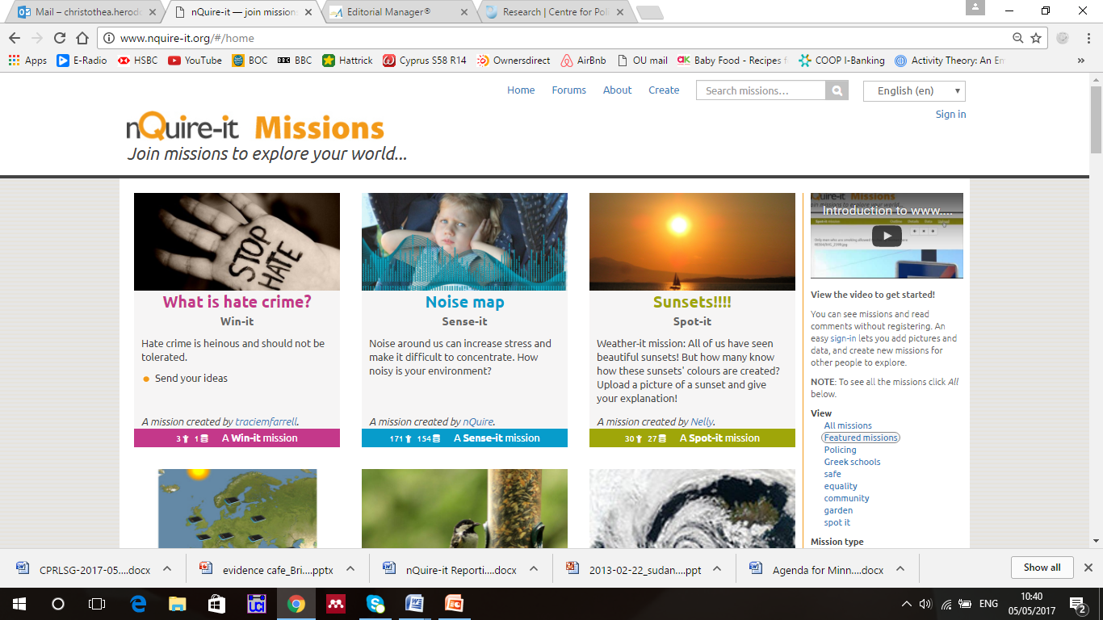
www.nquire-it.org
What is crowdsourcing?
Notes:
Based on crowd sourcing e.g. Wikipedia, kickstarter, bird watc count: the crowd collects data or generates money or contributes content to online projects initiated by scientists of members of the public themselves.
In the case of nquire-it, it is about projects – we call missions – asking from the bublic or specific groups such as police prcatitioners to contribute ideas or share experiences etc. 3 types win-it, spot-it, sense-it.

Slide 5
Types of projects - ‘missions’
Sense-it missions make use of the
Sense-it mobile app to collect and share data using smartphone sensors.
Spot-it missions allow users to capture images and spot things around them.
Win-it missions text-based missions, set challenges with prizes for the winners.
Social features: comments, forums, SNS
Notes:
Example Mission:
Which areas of my town feel unsafe?
This example mission to identify areas that feel unsafe could crowdsource photographs of unsafe locations that include time of day and brief description of the characteristics that render it unsafe. An alleyway may feel unsafe at night due to poor lighting. This is something that could be communicated to the council with the mission data as evidence that more lights need to be put in. A street could feel unsafe at a particular time because of repeated suspicious behaviour. The identification of suspect activity at a particular time could call for increased police presence at that time which could uncover criminal activities and help prevent or solve crime.

Slide 6
www.nquire-it.org
Notes:
e.g., detect and prevent crime

Slide 9
Challenges
Defining the purpose of the community
Monitoring contributions
Raising Awareness
Solutions
Raise the profile of the platform
Support text-based contribution
Create a more intuitive design
Notes:
One year project started in July 2016 and will end this year.
Research team: Trace Farrell-Frey and myself and several police practitioners and community groupes we contacted.

Slide 10
Tomorrow’s world nQuire
A research collaboration between BBC & OU
Development of a web platform for running large-scale public experiments (e.g., psychology, social science).
BBC: expertise in running mass-participation experiments (Lab UK, 2009 – 2015)
Open University: nQuire-it project to help people learn by doing large-scale science
Aim: Redevelopment and extension of the nQuire-it platform to
Support survey-based missions
Support spot-it and sense-it missions
Reach and engage thousands of people through BBC
Notes:
Give you some more information – contextual as to how what we are doing at the moment, in particular the survey type missions, fits the broader aim of the BBC-OU collaboration. What Kevin presented is only the first milestone of this joint collaboration. There are more developments taking place till summer in alignment with the aims of this project.
Experiments that explore issues such as attitudes and personality characteristics
Redevelopment means: new ways to enter responses, secure handling of personal data, and ways for participants to see overview results

Slide 11
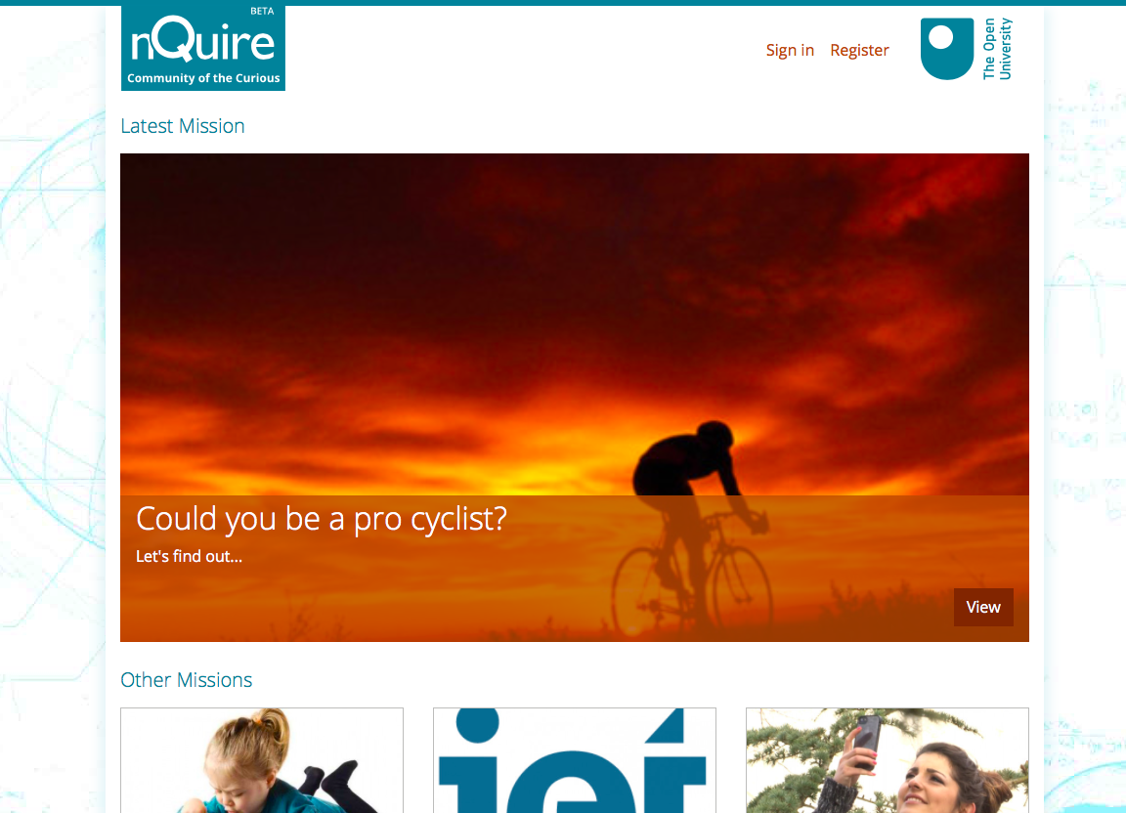
Notes:
The new platform is under development – it is in BETA version.
2 main functionalities: participate in existing projects set by others, scientists etc
Set up your own projects and have all necessary tools to help you collect and analyse data. Such as setting up questions, collecting images, collecting sensor data, perhaps accessing tools such a virtual microscope and other plug-ins that can visualise data and help you understand relationships in your data.

Slide 13
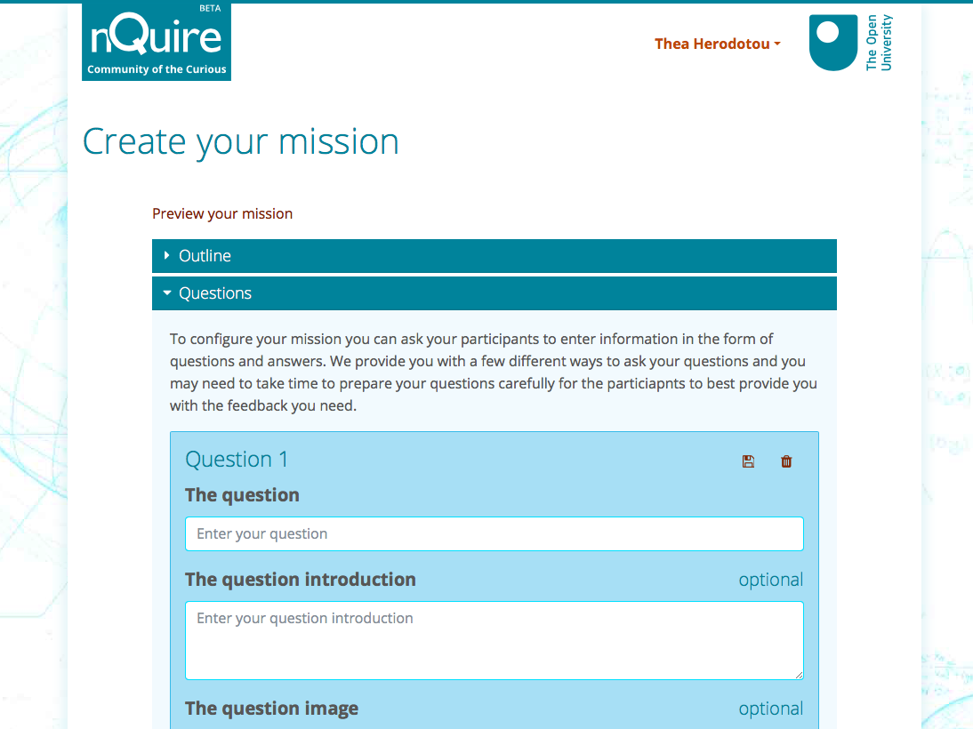

Slide 14
What is the vision behind the BBC/OU collaboration?
Citizen inquiry as a means to
help people think scientifically,
engage with real science,
break misconceptions about STEM.
Methodology to assist research community (e.g., police, scientists) answer big questions across disciplines.
Scaffolds to the process of data collection and analysis.

Slide 15
How can you help?
Join the nQuire-it platform www.nquire-it.org
Try the policing missions
Have you got a new idea?
Set up your own mission
Share it with colleagues, public etc.
Notes:
Aim to take forward some of your ideas and implement these – Tracie works on the missions and will try and do this within the next few weeks

Slide 16
Thank you, questions?
@T_M_Farrell
@herodotouc

