Slide 1
Operation Jigsaw
Prevent for OCG’s
Results
DCS John Denley & Dr Barak Ariel
With
Richard Agar, Ronan Tyrer and Paul Foster
10 Aug 2017

Slide 2
The WMP Prevent experiment
In Sacramento, CA, Ariel and Englefield (2014) targeted offenders, with an aim of reducing their offending behaviour and their co-offenders
50% fewer arrests in the target population (‘focused deterrence’)
50% fewer arrests in co-offending population (no action taken)
Can the same be done with WMP?

Slide 3
Research settings
No One View
Operating Level 1 – Level 3
Increased Risk
Current Threat
SIO lead
Organised crime is big business - even the most conservative estimates form OCGM (which assumes 144 OCGs are not earning any money) suggests that the organised crime population of the West Midlands holds assets exceeding £125,875,000
You cannot arrest your way out of this problem – of 2,219 organised criminals in the WM region – only 219 are in prison and 10 are on lifetime offender management
Good evidence shows short prison sentences increases the totality of an individual’s offending across their criminal lifespan
Lots of programmes aimed at prevention before people become prolific offenders (vulnerability, terrorism, public protection) but lack of evidence to support the hypothesis that “prevention works” undermines ability of police to confidently redirect resources from pursue activity to prevent activity.

Slide 4
RCT Objectives
No One View
Operating Level 1 – Level 3
Increased Risk
Current Threat
SIO lead
Targeting: Develop a predictive tool that can identify and prioritise individuals who pose greatest future threat to communities of WMP
Central actors identification
Testing: Develop programs to mitigate this threat
Police-led prevent interventions
Third-sector prevent intervention
Tracking: chase every £ to assess cost-effectiveness

Slide 5
Causes of organised crime
No One View
Operating Level 1 – Level 3
Increased Risk
Current Threat
SIO lead
No single cause or cure
Occurs when individual or group has motive and either a need or desire
Motives = Money, sexual gratification, belief in a cause, belonging
Need = a need to achieve at least on of the above
Need arises form vulnerability – requires prevent programme that removes need
Desire = a desire to obtain more of at least one of the above
Desire arises from a rational choice – require prevent programme that changes psychology / mind-set
Treatment needs to be cognisant of both possibilities and tailor intervention accordingly

Slide 6
Data
No One View
Operating Level 1 – Level 3
Increased Risk
Current Threat
SIO lead
OCGM Tracker
Not perfect, but this is the operational tool currently in our hands
Social Network Analysis
With whom are these OCGM’s offending, and who are NOT already OCGMs?
(remember, our primary objective is to PREVENT, not to PURSUE)
But wouldn’t it be awesome if an axillary outcome is pursue?

Slide 7
Scientific Approach
No One View
Operating Level 1 – Level 3
Increased Risk
Current Threat
SIO lead
RCTs are generally recognised as ‘the gold standard’ of evaluation research (Farrington 2003)
Randomised Controlled Trial methodology used to assess causal inference between treatment received and offending behaviour
Random assignment of entire OCG, to avoid treatment contamination
The sample size in this RCT was far bigger than statistically required.
More reliable than before an after analysis as an individuals offending rates vary throughout a year and reduce over a criminals life cycle

Slide 8
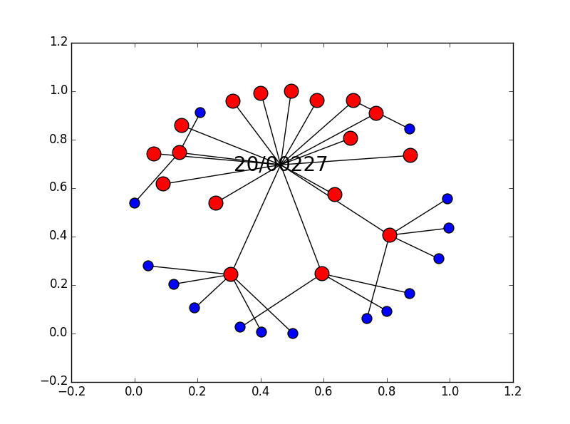

Slide 9
Treatment programmes
No One View
Operating Level 1 – Level 3
Increased Risk
Current Threat
SIO lead
Exclusion criteria: persons “too dangerous” + already subject to another major treatment
Randomisation of remaining offenders into one of three groups:
Police-led programme
Private-led programme
Control group

Slide 10
Treatment programmes
No One View
Operating Level 1 – Level 3
Increased Risk
Current Threat
SIO lead
Developing three programs, based on existing best practice, focussed on deterrence, desistance, defiance and disruption:
200 people allocated to Police-led program – Force CID / LPU
200 people allocated to Private-led program – Catch 22
200 people allocated to Social-media program – Force CID
200 people remain subject to current policing response
Each program to run for twelve months
Individually tailored disruption plans for non-compliance

Slide 11
Treatment programmes
No One View
Operating Level 1 – Level 3
Increased Risk
Current Threat
SIO lead
Each programme to run for twelve months
Individually tailored disruption plans for non-compliance (the stick)
All results captured via tablets to enable monitoring of treatment integrity

Slide 12
Treatment Integrity
No One View
Operating Level 1 – Level 3
Increased Risk
Current Threat
SIO lead
Between 68 – 78% of people either undertook this treatment or knew we were trying to locate them and were actively avoiding contact
We cannot determine how many of the other individuals were passively avoiding contact or unaware of the treatment
Following all contacts the Snap Survey was completed along with Corvus IOM Pages being updated
The second phase was making referrals (carrot), if required to provide any support or guidance, addressing any of the 9 offending pathways
In terms of referrals not all of the individuals that were contacted (currently 108) required help/support or guidance, approximately only 20-25% of individuals required support or guidance

Slide 13
Evaluation
No One View
Operating Level 1 – Level 3
Increased Risk
Current Threat
SIO lead
Evaluate impact of treatments on reoffending
by individuals
Co-offenders in the OCG
Entire OCG
Cost-benefit-analysis of each treatment (TBD)
Cost-benefit-analysis of FCID prevent team (TBD)

Slide 14
Results So Far

Slide 15
The “Recruits”
Eligible N = 2,253
Control Group = 235 → business as usual
Police-Led Group = 219 → premium service
Third-Party Group = 219 → lesson learned=cannot be done

Slide 16
The “Recruits” – Baseline Comparability
 | Police-Led Group | Control Group
N | 219 | 235
Percent Male | 99.04% | 98.99%
Mean Age (SD) | 29.52 (4.33) | 30.22 (4.54)
Born in Birmingham | 103 | 114
Total Arrests | 5,662 | 5,770
Mean Arrests per offender (SD) | 19.13 (17.67) | 18.49 (15.85)

Slide 17
The “OCGM”
Eligible N = 2,219
Control Group = 118 → business as usual
Police-Led Group = 106 → business as usual

Slide 18
The “OCGM” – Baseline Comparability
 | Police-Led Group | Control Group
N | 106 | 118
Percent Male | 99.06% | 98.3%
Mean Age (SD) | 31.94 (6.95) | 31.68 (7.21)
Born in Birmingham | 38.67% | 36.4%
Total Arrests per age (for standardisation of data) | 1.25 (0.46) | 0.95 (0.87)
Mean Arrests per offender (SD) | 28.78 (21.36) | 38.22 (26.57)

Slide 19
Recidivism → Recruits

Slide 20
Total arrests =
222
Total arrests =
184

Slide 22
Recidivism → OCGM

Slide 25
1%
+31%
+43%

Slide 26
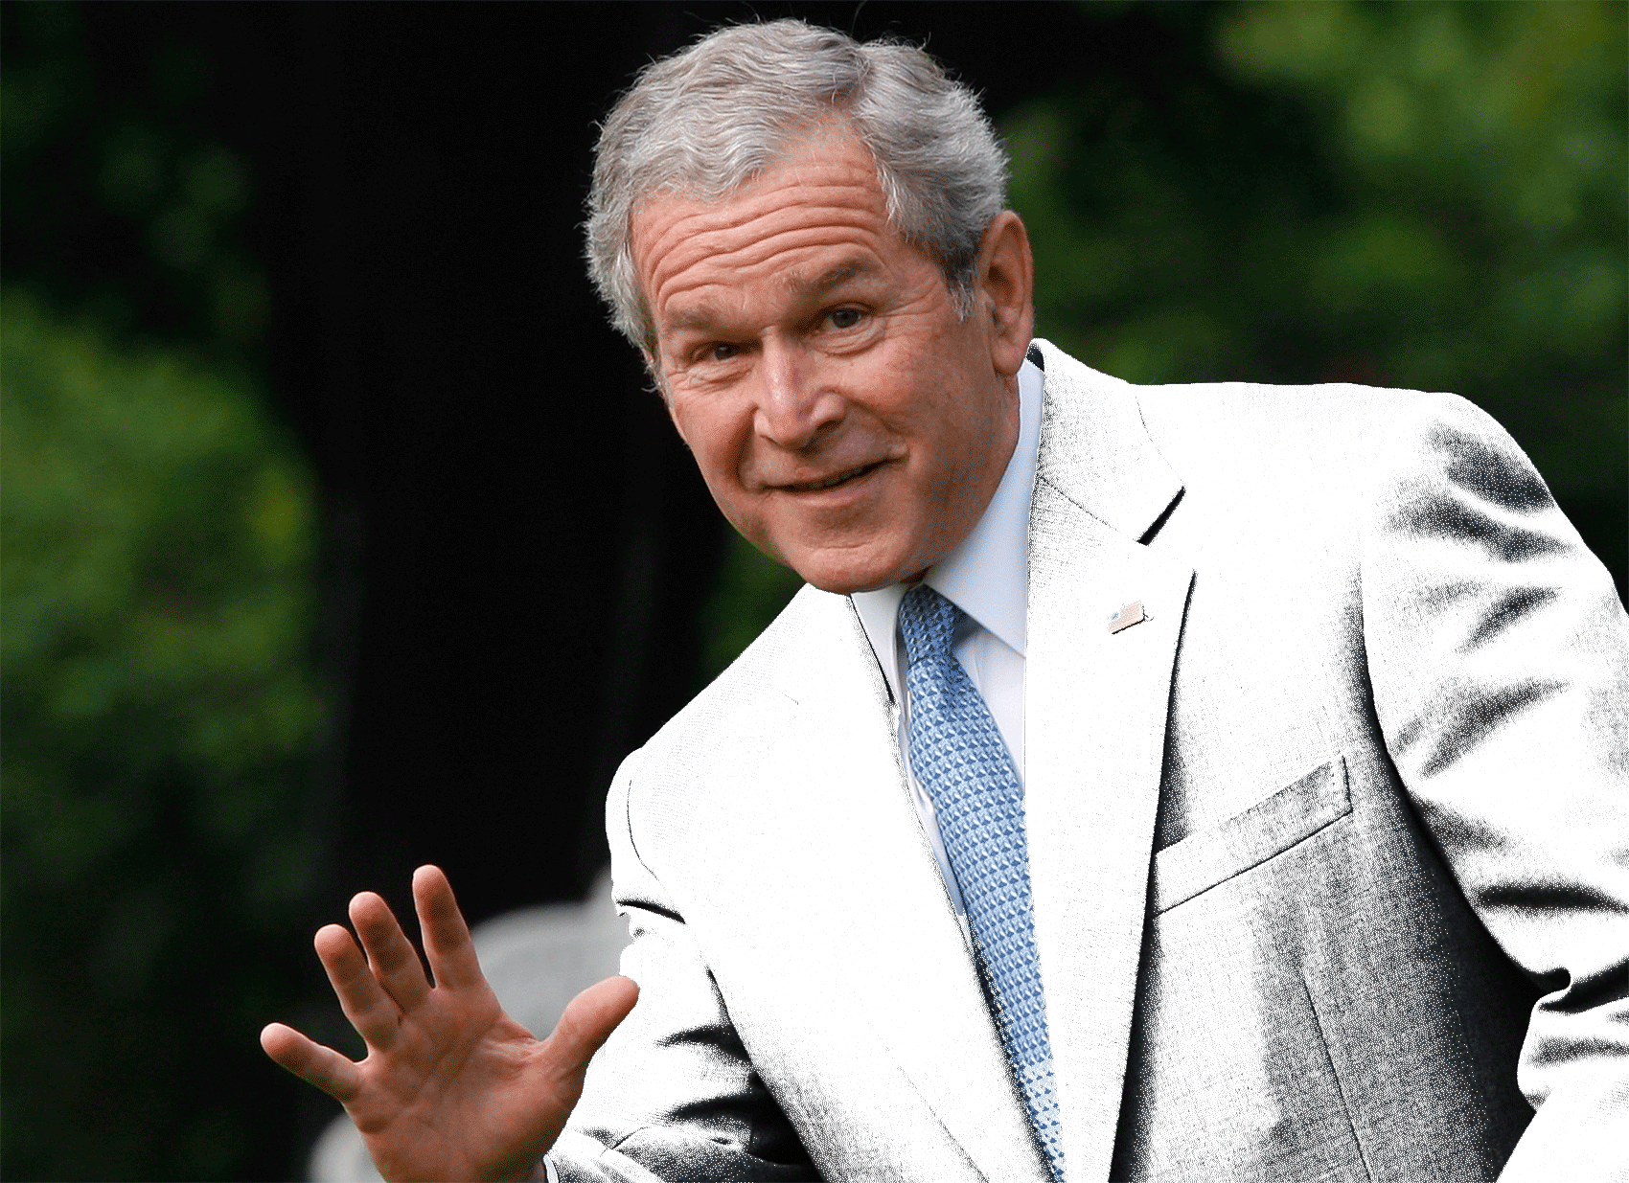
we will smoke them out of their holes; we will get them running and we'll bring them to justice

Slide 27
Findings - Summary
Third-sector interventions → challenging in this space
Creaming
Unwillingness of offenders to engage
Our SNA approach worked
“Deterrence and Desistance Messages” work → and we see the behavioural effect
57% Reductions in offending by those we target (prevent)
Double the arrests by OCGMs (pursue)

Slide 28
Findings - Conclusions
It is the psychological impact of the police visiting the cohort that is likely to have had the greatest impact on reduced offending
It had an impact even though:
we know some officers did not have confidence that the tactic would work
the subjects convinced a lot of the officers that they were no longer offenders
we were unable to contact over 20%
only had 40 trigger plans to provide a stick as well as a carrot

Slide 29
A thought about the wider context: why did previous specific deterrence initiatives did not work?
No attempt to ignite desistance
Age of offenders much lower than ours
American targeted gangbangers are ‘a bit different’
No systematic application (i.e., no tracking of delivery)

Slide 30
Next Step - Analysis
Linking delivery to outcomes (“protocol based analysis”)
Is there a deterrence decay? (long-term effect measures)
The ‘total effect’ on OCGs
CBA
The big elephant in the room → the Tracker is not ideal

Slide 31
Next Step – Policy Implications
A straightforward tactic that can be generalised on a large scale
No need to worry about sorting out third-sector providers for managing change and pathway referrals
No need for additional intel or pursue tactics to monitor them after the visit
All you need is:
A reliable list of targets
The priority you are looking to tackle (in this case OCGM membership but could be burglaries, robberies, vehicle crime, etc.)
A clear script and a confident officer to go and do the prevent visits

Slide 32
Next Step – Policy Implications
In medical research, there is a moral imperative to quit experiments if the treatment group is doing exceedingly better than the control group, even if the RCT is not over yet.
Are we there?
If yes – stop the experiment
If no – continue with the experiment

Slide 33
Operation Jigsaw
Prevent for OCG’s
Results
DCS John Denley & Dr Barak Ariel
With
Richard Agar, Ronan Tyrer and Paul Foster
10 Aug 2017

