Slide 1
Predicting solvability of Burglary in Norfolk Constabulary
Tom Olphin, University of Cambridge & Better Policing Collaborative
SEBP Conference 2018

Slide 2
Background and Purpose
Background
A solvability model looks at what factors correlate with a crime being ‘solved’ and using it allows the police to use resources more efficiently
Recognises that with the information available, police won’t be able to solve all crimes
Implicit use of solvability factors are already present in most forces but they are based on officer judgment and lack external validity
A formal model adds rigour to the process and does not suffer from subjective bias
Using such a model allows the police to optimally use resources
Aim:
To build a solvability model for burglary using Norfolk data and use its insights to determine investigative effort in Norfolk and Suffolk
To trial the model for actual investigative strategy in one of the forces

Slide 3
Data Description
Data Description:
Approximately three years (from April 2012 to May 2015) of data is being used to build the model. The data comprised both automatic categories as well as officer free text that had to be coded manually
Data were compiled for 253 variables (68 manually coded from officer free text fields and 185 coded from downloads of Norfolk Constabulary systems)
This initial list of 253 variables was narrowed down to 42 after removing those variables which were found to have very little explanatory power in terms of solvability or which were highly correlated with each other
The procedure is described under methodology

Slide 4
Data Downloaded from Norfolk Systems
Data Description:
Data has been downloaded from Norfolk systems to provide information relating to forensics, crime incident information, MO and other markers that are electronically recorded
Data Issues:
There are inaccuracies in the data pertaining to offence outcome (due to change from detections to outcomes), offences with issues have been removed from the analysis

Slide 5
Data from Free Text Fields
Issue:
Some data that have been previously demonstrated to be useful for explaining solvability are not recorded electronically by Norfolk Constabulary, officers update their initial investigation in a free text field
A substantial amount of time has been required to code 68 variables from these free text fields for 4828 offences (half the data set)
Because different officers record information in different ways it has not been possible to automate this process. This is also complicated by information being recorded in lists (e.g. CCTV not present at attacked address, but CCTV is available over the road and shows the offenders – A search for No CCTV would show this as having none which is incorrect)
See next slide for examples of these free text fields:

Slide 6
Examples of Free Text Fields

Slide 7
Methodology
Factor Identification:
Following data cleansing and coding, factors have been analysed to show differences in their prevalence in solved/unsolved cases
Factors were then assessed for close correlation in order to remove factors which were in fact showing the same things
Those factors shown as being more prevalent in solved cases are shown on the next slides, and have been included in logistic regression analysis in order to build a model for prediction of burglary solvability
Some variables were removed, and changes were made to mandatory allocation rules for the model throughout eight iterations, before the final model was produced using 29 variables
This model will then be assessed using the remaining half of the data set (this includes coding of the second half of the free text information)
Testing on a secondary data set in this way allows for the predictive accuracy to be assessed in a manner which is not biased through testing on the same data set used to make the model. This increases its external validity and allows for a true assessment to be made of how the model would fare in practice

Slide 8
Outcome Variable
What Counts as Solved?
It was intended to use the 2014 Home Office Outcome system to determine whether cases were solved. However, this information was not recorded in all cases so sanction detection has been used as the outcome variable
There were also erroneous values where cases were shown as being cleared in different ways (e.g. Charged and TIC)
All cases which were cleared by TIC, or that contained erroneous data were removed. Then the cases where there were no erroneous values, and which were detected by charge, summons, caution (or conditional), warning or reprimand, penalty notice, restorative disposal or extended professional judgement were recorded as solved

Slide 9
Solvability Factors (All significant at p<0.05)
Individual Factor Analysis Using Chi-Squared Tests:
Chi-squared tests allow examination of the prevalence of each factor in the solved and unsolved groups
Where there is a significant difference (less than 5% likelihood of the difference occurring by chance) in prevalence of a factor between solved and unsolved groups, the factor is included in the table above

Slide 10
Case-Limiting Factors (All significant at p<0.05)
Interesting Factors with No Sig. Difference
Tool marks being recovered by Forensics
Whether or not a press release was completed
Victim providing a negative statement or refusing to cooperate
Stolen items being found for sale online
Whether the offence was a distraction offence

Slide 11
Logistic Regression Results
Logistic Regression:
Assesses the relationship between each variable and the outcome as a group
This model is built using the following mandatory factors:
Aggravated and Distraction Burglaries are automatically allocated for investigation
Burglaries for GBH (rather than theft) are automatically allocated for investigation
Offences where a suspect has been arrested are automatically allocated for investigation
Cases which were solved during the initial investigation were not placed into the model

Slide 12
What The Model Looks Like
The Model:
Case Solvability Score (Higher Score is Less Solvable) = 2.5917734249 + the sum of the relevant values for the factors that are present as follows:
(If Gaming Username Enquiries is present -4.1501993945) (If Item located at second hand shop is present -2.8212215962)
(If Discovered By Police is present -1.6088851600) (If DNA Recovered is present -1.2432782388)
(If Domestic Indicator is present -0.9613807375) (If Financial Enquiries Card or Account Usage is present -0.8676973571)
(If Prints Recovered is present -0.7089646728) (If Part of Series is present -0.5828106700)
(If Stolen Items Recovered is present -0.5781382287) (If Telecommunications Opportunities Available is present -0.5742982424)
(If Either CCTV measure is positive is present -0.5509179989) (If Unemployed is present -0.5078199848)
(If Are there witnesses other than the victim is present -0.5019885667) (If Witnessed by Officer is present -0.4490801532)
(If Time to Report Less than 15 minutes is present -0.4286801654) (If There is Suspect Information Provided is present -0.4064605307)
(If Shoe Recovered is present -0.3194626005) (If Forceful Entry is present -0.2954104448)
(If Between Times Less than 1 hour is present -0.2037576893) (If Items Seized is present -0.1057116916)
(If Suspect Clothing Seized is present -0.0495460319) (If Other Sample Recovered is present -0.0201816735)
(If Time to Report Over 18 hours is present +0.0941689671) (If Negative House to House Conducted is present +0.2047767659)
(If No Witnesses Clearly Stated is present +0.2454850535) (If House to House not Conducted in Initial Investigation is present +0.3131791432)
(If Between Times Over 12 hours is present +0.3424270166) (If There is no CCTV available is present +0.5928572330)
(If Offence Occurred in an Outbuilding is present +0.7883362897)

Slide 13
Accuracy of the Model
Testing of the Model on a Separate Data Set
The remaining free-text data was coded and cleansed in order to allow testing of the model on a separate data set
Comparisons can be made between cut off points
All Errors are not Equal
Two errors = Wasted Resources and Disappointed Victims
Important to keep this in mind, but also remember that policing agencies already screen crimes out to aid efficiency, this is a way of making this process more accurate and more evidence based

Slide 14
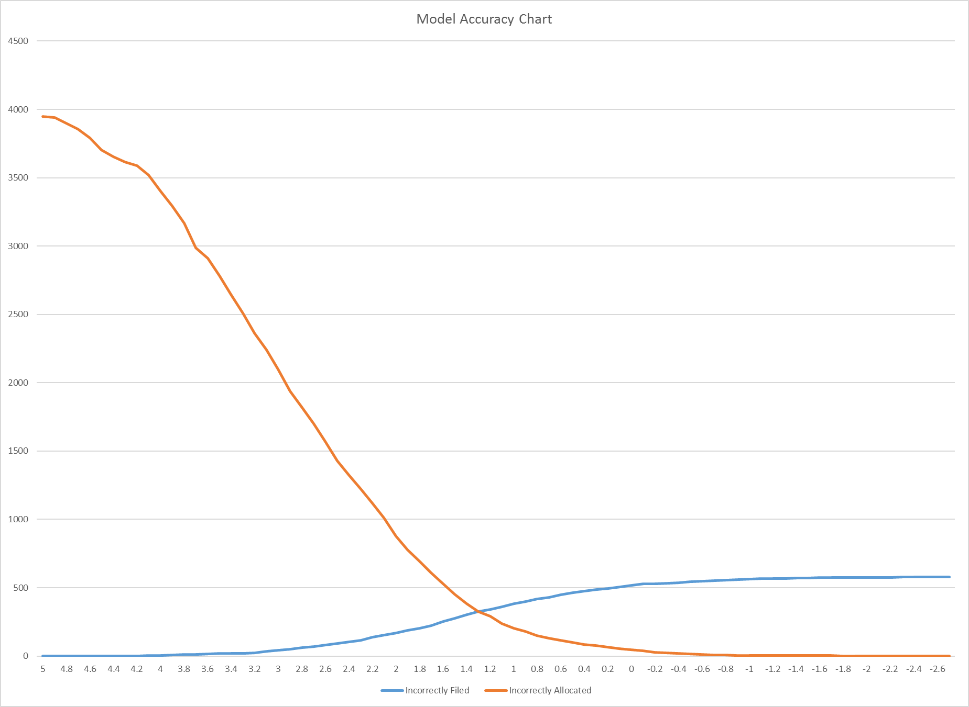
Cut-Off Point
Cut-Off Point:
The model works out the answer to a sum
Cases are allocated if their score is equal to, or lower than the chosen cut-off value
Cases are filed if their score is higher than the chosen cut-off value
This can be optimised for either resourcing purposes, or based on a balance of solved crimes vs wasted resources
The graph to the right shows the error rates in each direction at each cut-off value
Somewhere around 2.8 to 3.2 would maximise the case-filing potential of the model, whilst not losing many solved cases

Slide 15
Accuracy Comparisons
Cut Off 3.2 = 96% accurate in terms of solved cases correctly allocated
1586 cases correctly filed (40%)
Incredibly Low Risk Option
Cut Off 2.8 = 87% accurate in terms of solved cases correctly allocated
2041 cases correctly filed (52%)
Overall accuracy increased to 56.2% from 45.1% if all cases are investigated
Massive Reduction in workload of 42.2%
Important to remember though that some cases will have been solved due to additional information coming to light, this is something that the model cannot ‘see’ and therefore actual accuracy is hypothesised to be much higher
Cut Off 3.2
Cut Off 2.8

Slide 16
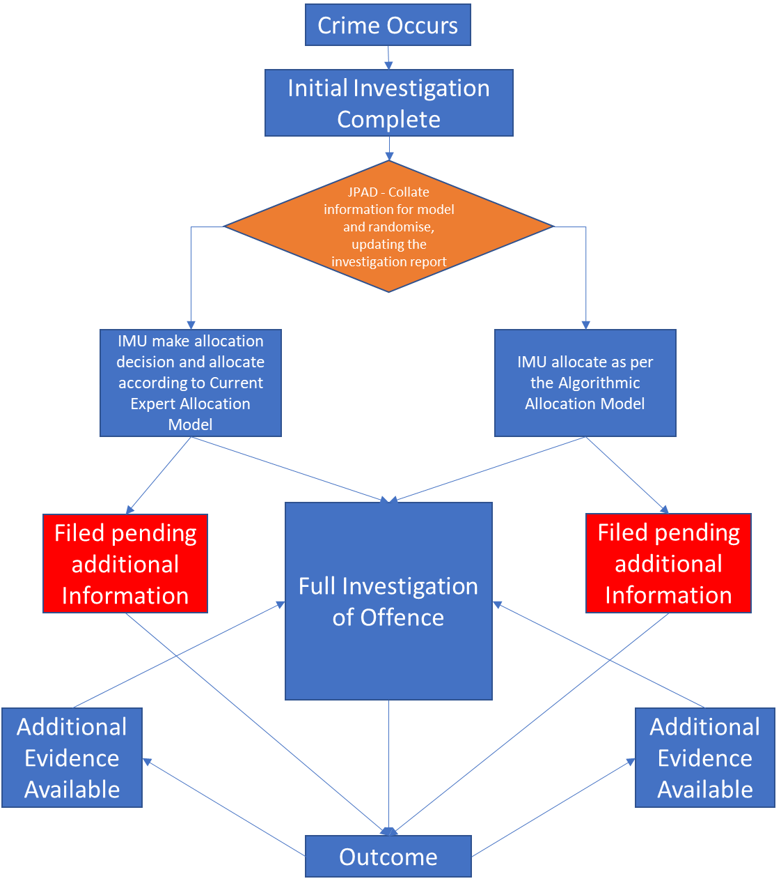
Running a Solvability RCT
Important Considerations
Solvability is well suited to running a randomised controlled trial, as power can be maximised by randomising each case as it is reported
Making it work for a trial can test whether larger system change would be beneficial later
Norfolk and Suffolk Constabularies have supported the experimental process thoroughly, providing a structure that it can be conducted in
Requires coding of variables as the crimes are reported, this is currently being achieved through hard work of analysts in Norfolk and Suffolk JPAD – Wouldn’t be possible without their commitment, buy in, and hard work

Slide 17
Conclusions
Possible to test in a force before changing systems to improve capability
Cut off points can be optimised to match priorities of the force using them
Even with 2.8 as cut off point, having no factors present would mean that the case is allocated
Predicting rare occurrences (burglary has lower clearance rate than some other crime types) is more difficult, but still possible
It is possible for a force to allocate their caseloads in an evidence based manner, and the impact of that will be known soon
Results of RCT are expected at the start of 2019
Massive thank you to staff and leaders in Norfolk and Suffolk Constabularies for making this work possible

Slide 18
Contact Details:
Tom Olphin, University of Cambridge & Better Policing Collaborative
tolphin@gmail.com
07921 808988
Work conducted in collaboration with:
Dr Siddhartha Bandyopadhyay and Prof Anindya Banerjee,
University of Birmingham & Better Policing Collaborative

