Slide 1
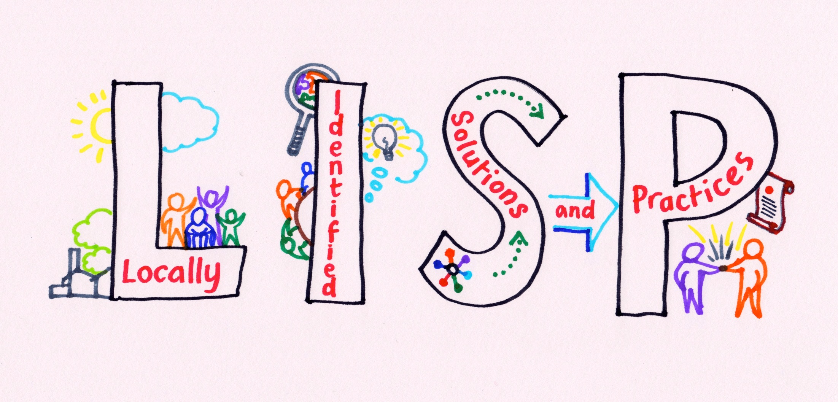

Slide 2
Creating ‘good enough’ evidence for action:
solution-focussed policing
Tim Curtis, The University of Northampton January 2018
Richard James www.intensiveengagement.com

Slide 3
The context
“engagement and consultation with their communities was predominately focused on public meetings, local priorities were based on the concerns of a small and unrepresentative part of the community, and some hard-to-reach groups in these areas reported that neighbourhood teams did not engage with them”
Myhill, A (2006/12) Community engagement in Policing; Lessons from the literature. National Policing Improvement Agency

Slide 4
The social innovation research question
How did I go about creating the toolkit? -antecedents
How was it implemented by PCSOs – case studies, soft systems analysis
What mechanisms (for social innovation) are at work in the toolkit? Critical realist analysis
Is it a reliable tool for designing socially innovative interventions?
How can the toolkit be improved?

Slide 5
What the investigation is not:
An evaluation study
A tool for measuring social impact
An investigation into social impacts of neighbourhood policing
  Impossible to create a counterfactual
  Long chains of causality and effect
Criminology
A review of police effectiveness or legitimacy

Slide 6
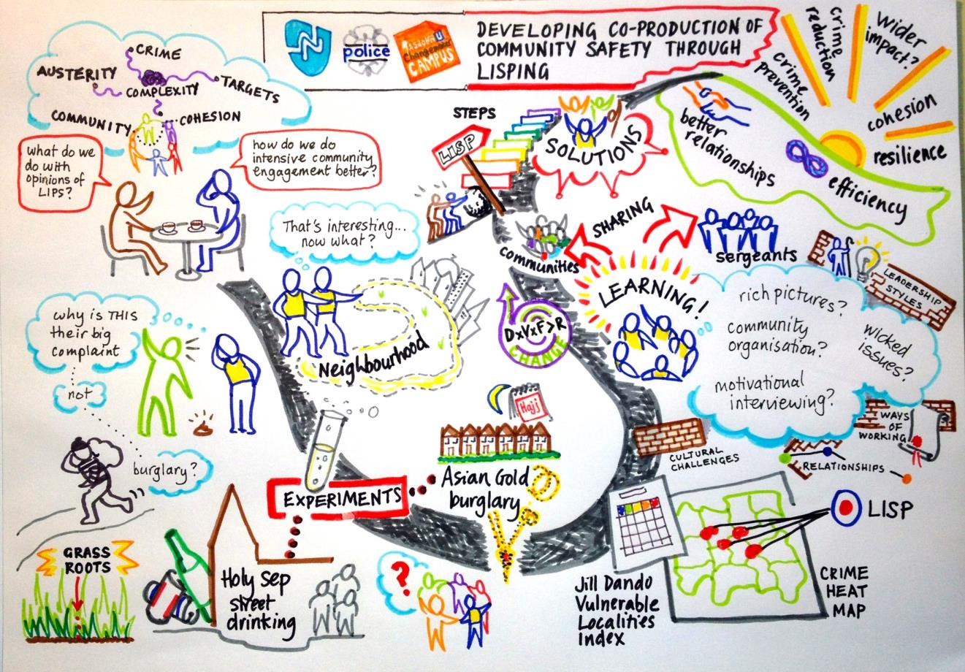
The story so far

Slide 7
First engagement Nov 2012
Discussing community profiling and rich picturing as a community engagement technique
NP seeking better ‘data’ from LIPS – hard data, closed question set.
How to ‘use’ the JDI Vulnerable Localities Index
What is ‘intensive community engagement’ and how does it differ from:
  Super cocooning: Inform – Reassure – Advise
  SARA/NDM
  Social media and community events

Slide 8
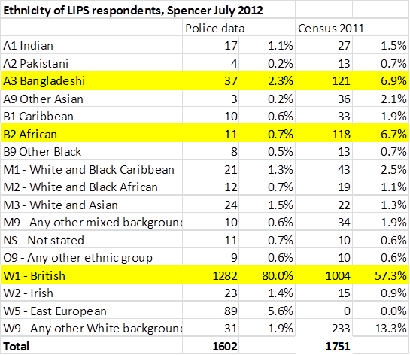
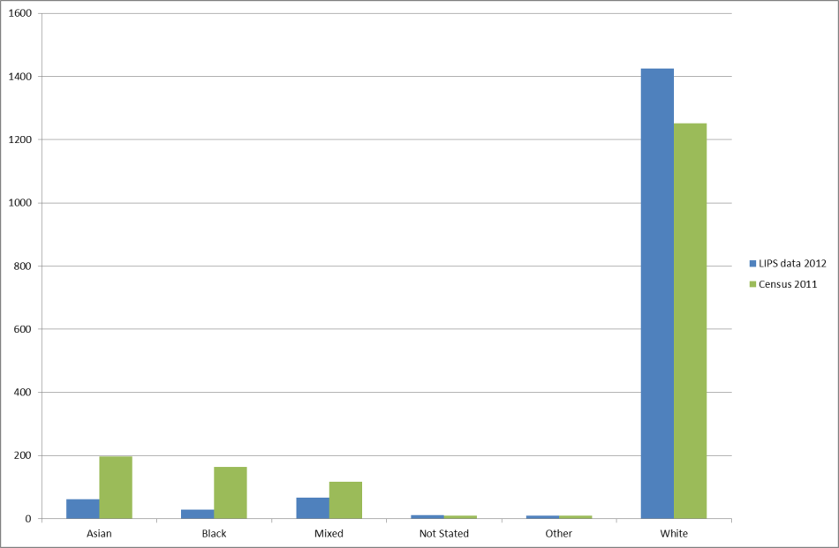
‘community’ data seriously flawed
The disparity between respondents to LIPS survey and census population

Slide 9
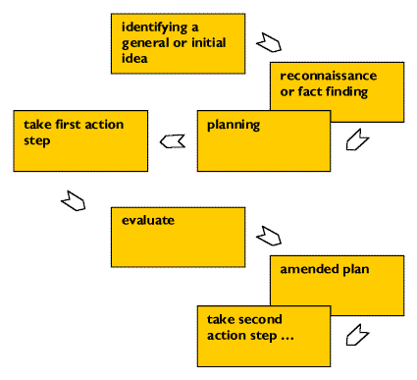
Methodology
Participatory Action Research
Rapid Appraisal
Insights & themes
Initial response
Effectuate
Review and Amend
PAR is collaborative, critical, participatory, and developmental.

Slide 10
Rapid Appraisal
Interviews in St James/Dallington team
Vertical sample through from Inspector through PC to PCSO and to residents
Use of Rich Picturing (RP) as exploratory tool
Engagements recorded film/audio
Seeking insights and themes
Verify insights through extending sample
Theoretical saturation

Slide 11
Insights and Themes
Significant change in discourse about communities between Police Officer and PCSO
PCSO actively solving problems
PSCO acting as a “boundary spanner” (Tushman 1977)
Intuitive rather than deliberate community engagement and problem solving
Frustrated by limited power and locus of control (being ‘abstracted’ to other tasks)
Tushman, Michael L (1977). "Special Boundary Roles in the Innovation Process". Administrative Science Quarterly 22 (4): 587–605.

Slide 12
Initial response
PCSOs operating in complex (messy) social environments
  Soft Systems Methodology specifically designed for this
Police being measured on performance where solutions owned by non-Police actors
  Community organising to get other working to deliver Police outcomes
Long tradition of expecting Police to solve everything
  Weekly ‘you said, we did’ closed loop cycle
  Required developing ‘self-efficacy’ in neighbourhoods

Slide 13
The 8 step process
Intensive Engagement- Locally Identified Solutions and Practices (LISP)- 8 step toolkit
LISP step 1 | Clarify the justification for commencing Intensive Engagement -scan what is known about the neighbourhood. What does crime and other data tell us? What are the issues identified? What is the evidence for this? Is there an evidence base for adopting as a location?
LISP step 2 | What community assets already exist in the location? What networks and associations are there? What are the vulnerabilities are in the area? (what makes this area already mostly successful?)
LISP step 3 | Who shares the problem? Stakeholders & networks Identify who are directly involved in this issue? (individuals, agencies, businesses, residents etc). How are all people/ agencies involved associated?
LISP step 4 | Develop Problem Rich Pictures – Engage with community members to establish how all stakeholders see the problem? Where do the issues arise? What parts of the neighbourhood are successful? Map the results
LISP step 5 | Form a working group made up of stakeholders who are engaged and able to make changes
LISP step 6 | Develop Solution Rich Pictures –Engage the working group to identify what the solutions look like from the stakeholders perspective? How can they be achieved? What would the neighbourhood look like if all the issues were solved?
LISP step 7 | Agree Interventions & Evaluation (Who is doing what, when, how, by when, what does success look like?)
LISP step 8 | Establish escalation processes with stakeholders, authorities and agencies- what will make the interventions fails? What are you going to do about it to prevent that happening? Who will you need to approach to unblock barriers to progress?

Slide 14
Beginning to seek Mechanisms
Community Policing Evidence | Features of LISP based Intensive Engagement
What works
In-depth understanding of people, place and problems | In-depth investigation of the police crime problem in the context of the other problems experienced in the locality
Full and consistent application of interventions | The training and subsequent evaluation of the quality of LISP work, and standard proforma
Sufficient ‘dose’ of intensive engagement with sufficient time | Success, i.e. depth of understanding of the problem and success of the interventions is determined by the working group rather than police timeframes
Proactive contact | Deliberate choices are made at the screening stage about the importance of the locality to policing outcomes. Process requires identification of all potential stakeholder groups, including hard to reach.
A group of residents | Where community organisations appropriate to the problems don’t exist, the LISP process creates the social capital and networks to allow this to happen
Joint problem solving | Co-production of the problem analysis and solving stages is central
What is promising
A consistent process | As above
Highly connected individuals | The LISP working group is made up of highly connected and highly capable people,
Support is won | Working group members elicit a clearly understood self-interest that underpins expected successes to secure and ‘win’ support
Attuned to community dynamics | The rich picturing processes develop a nuanced and empathetic understanding of the community and the issues and tensions within it.
Tacit skills | Training, with the aid of the publically available handbook, briefings to senior officers and a process of identifying the best implementations of LISP and mentoring of officers ensure that police skills are embedded and propgated across the force
Not reliant on multi-agency delivery | Where statutory partners are actively engaged, LISP provides a clear and discrete method for limited involvement. Where statutory agencies are not engaged, LISP provides a clear evidence base for Police and community to hold statutory agencies to account.
Curtis, T (2015) Why we think that Intensive Engagement using LISP works#1 1st May 2015

Slide 15
Soft Systems Methodology:
Making sense of complex contexts
Checkland, 1985

Slide 16
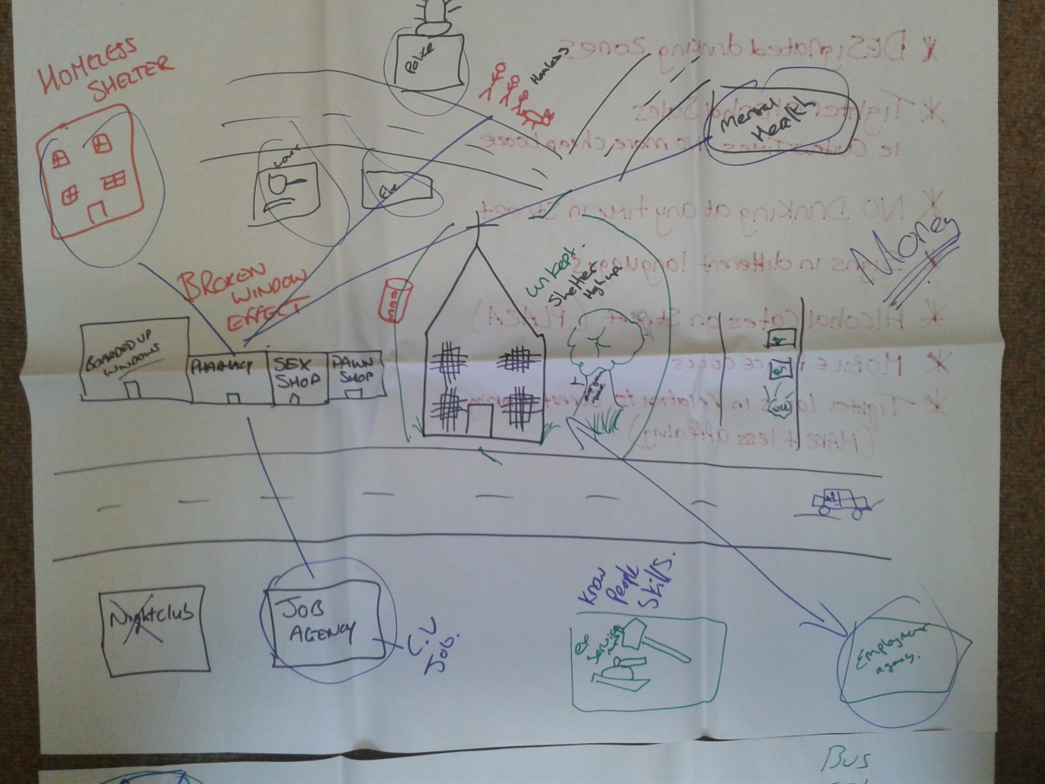
PCSO picturing

Slide 17
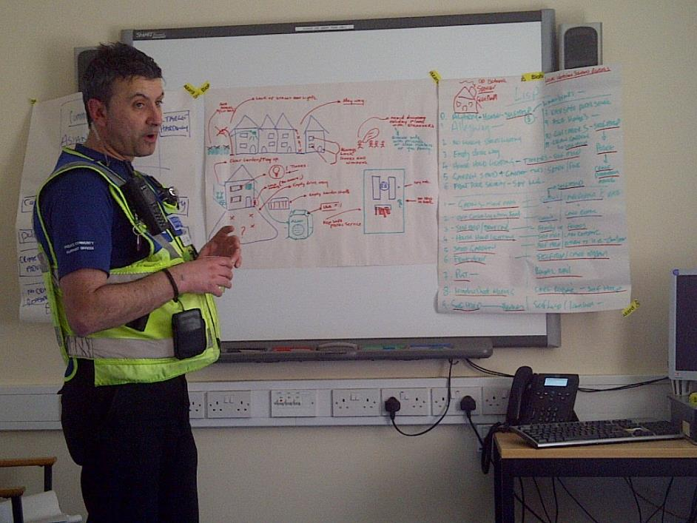
PCSO feedback and planning

Slide 18
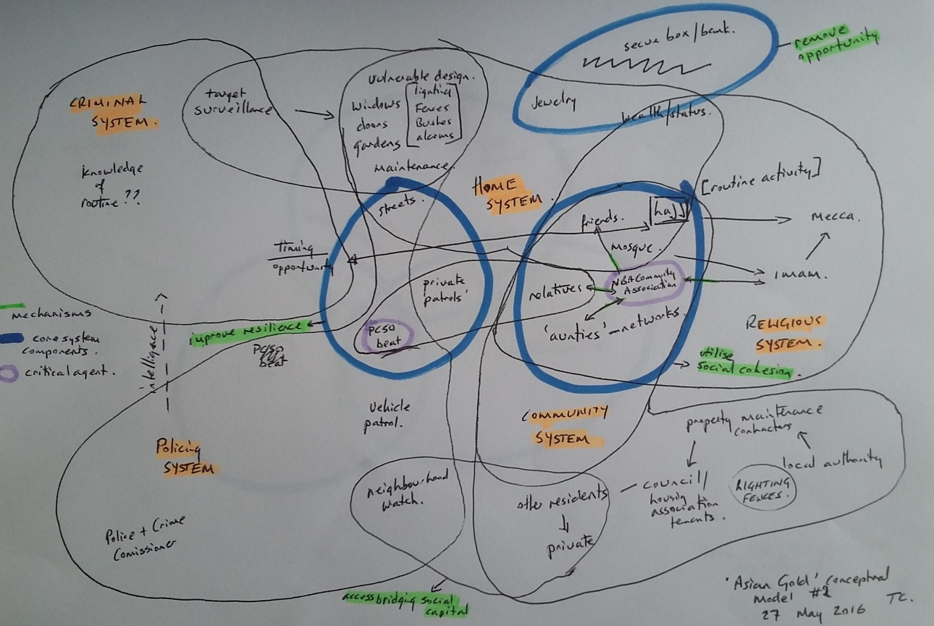
Conceptual modelling

Slide 19

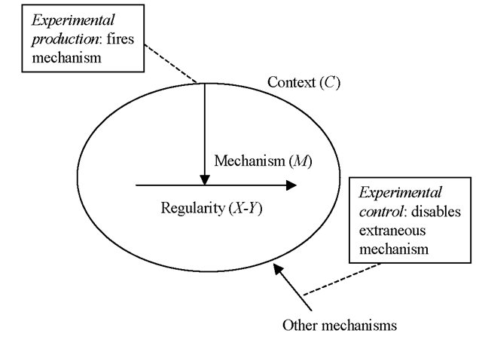
Archer 1995, Bhaskar, 2013 and Pawson 2013

Slide 20
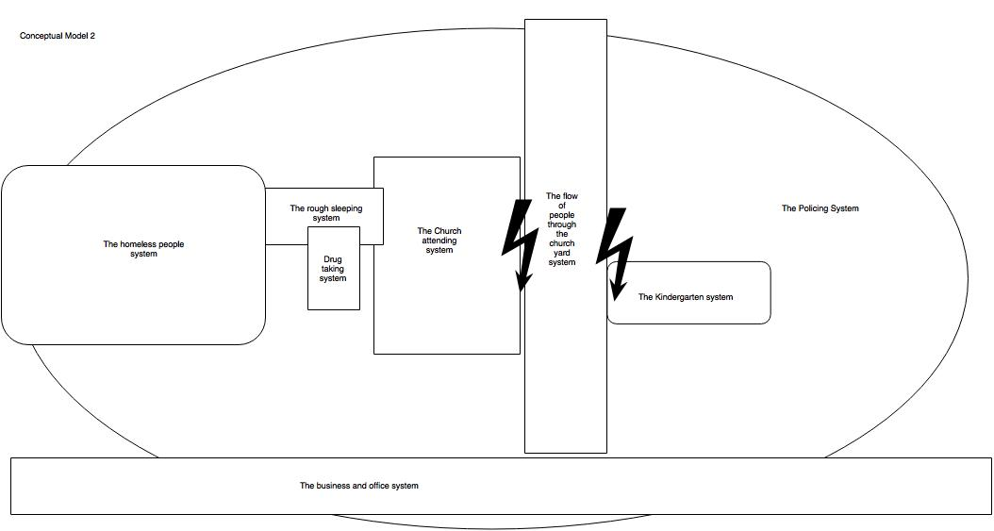
Developing a conceptual model
 | Neighbourhood Policing Evidence | Features of LISP based Intensive Engagement | Features of Holy Sepulchre LISP case
 | What works
 | In-depth understanding of people, place and problems | In-depth investigation of the police crime problem in the context of the other problems experienced in the locality | The LISP got a good start because the PCSOs had been working in this district for some time, but the analysis in the LISP documentation, and the choice of intervention was simplistic, indicating that the PCSOs and their senior officers had limited local knowledge
 | Full and consistent application of interventions | The training and subsequent evaluation of the quality of LISP work, and standard proforma | The intervention chosen, the community garden, was not seen through to full implementation.

Slide 21
Contexts
C1 | Vulnerable locality or area of significant multiple deprivation, and
C2 | Long-term chronic crime patterns
C3 | Complex, publicly contested crime types inc ASB, SAC

Slide 22
Mechanisms 1
No. | Proposed Mechanism | Features of LISP based Intensive Engagement
 | Neighbourhood Policing Evidence: What works
M 1 | In-depth understanding of people, place and problems | In-depth investigation of the police crime problem in the context of the other problems experienced in the locality
M2 | Full and consistent application of interventions | The training (and subsequent evaluation of the quality of LISP work), and standard proforma
M3 | Sufficient ‘dose’ of intensive engagement with sufficient time | Success, i.e. depth of understanding of the problem and success of the interventions is determined by the working group rather than police timeframes
M4 | Proactive contact | Deliberate choices are made at the screening stage about the importance of the locality to policing outcomes. Process requires identification of all potential stakeholder groups, including hard to reach.
M5 | A group of residents | Where community organisations appropriate to the problems don’t exist, the LISP process creates the social capital and networks to allow this to happen
M6 | Joint problem solving | Co-production of the problem analysis and solving stages is central

Slide 23
Mechanisms 2
 | What is promising
M7 | Highly connected individuals | The LISP working group is made up of ‘highly connected and highly capable people’
M8 | Support is won | Working group members elicit a clearly understood self-interest that underpins expected successes to secure and ‘win’ support
M9 | Attuned to community dynamics | The rich picturing processes develop a nuanced and empathetic understanding of the community and the issues and tensions within it.
M10 | Tacit skills | Training, with the aid of the publicly available handbook, briefings to senior officers and a process of identifying the best implementations of LISP and mentoring of officers ensure that police skills are embedded and propagated across the force
M11 | Not reliant on multi-agency delivery | Where statutory partners are actively engaged, LISP provides a clear and discrete method for limited involvement. Where statutory agencies are not engaged, LISP provides a clear evidence base for Police and community to hold statutory agencies to account.

Slide 24
Mechanisms 3
 | Pawson’s Public Policy ‘Hidden’ Mechanisms | Mechanism Ingredients in LISP Intensive Engagement
M13 | Recruit the stakeholders with care | Looking for the most highly connected, capable, and motivated: whose self-interest and motivation to contribute to public safety is understood
M14 | Create expectations of change | Intensive Engagement is oriented towards collaboratively deciding on what change is needed, to design Solutions & Practices
M15 | Demand effort from stakeholders | The LISP approach is designed to flip the Police response from ‘what can we do?’ to ‘What solutions have you got?’ for the Police.
M15 | Offer encouragement and feedback | The process is designed to recognise existing assets and capabilities that the community, with the help of the Police, that can be enhanced to support Police outcomes (Kretzmann and McKnight, 1993)
M17 | Build trust and resilience | Long-term, locally based relationships are key to developing mature LISP informed interventions
M18 | Make accommodations for set-backs | The embedding of the Motivational Interviewing ‘stages of change model’ (Prochaska and DiClemente, 1994; Rollnick and Miller, 1995; Miller and Rollnick, 2012) accounts for set-backs within the process of engagement
M19 | Explain the theory of change | The theory of change for LISP is described as “collaboratively designed solutions and co-produced practices are more robust than short-term projects and limited engagement”
M20 | Share execution and control of the intervention | The whole LISP model is built on recruiting capable and connected decision-makers and resources to the support of Police outcomes, and an attempt to ‘loosen the reins’ of Police controlled design and implementation
M21 | Ensure onward external continuation | The purpose of the community designing and delivering the interventions that are unique to a locality is to ensure that the Police have a ‘step-back and sustain’ (rather than an exit) strategy freeing resource up to tackle other localities and problems, leaving a self-sustaining legacy

Slide 25
Mechanisms 4
 | Additional insights from case study | Mechanism Ingredients in LISP Intensive Engagement
M22 | Stable team | Inspectors ought to be clear about the resource implications of choosing to undertake a LISP, in terms of long-term commitment (against a backdrop of ‘weeks of action’ and three month long ‘operations’). Outcomes based resource planning is required within LISPs rather than activity based. Sergeants need to decide with Inspectors on the justification to LISP. The decision was made by the PCSOs to undertake the LISP, but in this, the decision was aligned to the sergeants’ interests in managing the high profile performance issues. This was sustained through a change of sergeant, but only after significant progress had been made on the LISP process. The long-term stability of the PCSOs allowed significant connections to a marginalised and hard-to-reach community to be made within the attention span of the senior officers.
M23 | Responsibilisation | This LISP hinged around a form of responsibilisation, a quid pro quo where the attention of the police shifted from being visible through patrols to being the distributor of socially valuable goods- the smartwater etc. Rather than this being devalued though being given away, the LISP established a ‘transaction value’ – being required to complete the 6 points of action before receiving enhanced ‘attention’ through the distribution of freebies and receiving funding from the PCC.
M24 | A mix of ‘contingent’ interventions | The PCSO was clear that a number of different strategies, that could be introduced at different times, and with drawn if they don’t work, would strengthen the initiative. The six point action plan developed in the Asian Gold burglaries case is insufficient here, and over 20 different initiatives are used, including those that are existing successful practices
M25 | Perspective taking | A cognitive shift required to think of all the different stakeholders in a given problem situation, and systematically think through their interest and investment in the status quo in that context. The needs to be a deliberate attempt to this, at the point of evaluating the potential stakeholder group. The interests (and perhaps importantly, the self-interest) of the stakeholders need to be considered, as does the lived experience of those stakeholders (empathy).
M26 | Hidden community | Attention should be paid to the less obvious communities of interest. Whilst there was a strong sense in which the street drinking was being driven by transient workers and off-licenses exploiting the immediate situation, the more powerful communities of interest were the estate agents, landlords and employers, whose interests in the features of the problem situation were significant but invisible. When doing the scanning stage in the early part of the LISP process, there needs to be a more specific attention given to the owners or operators of buildings and consider them as a part of the community of interest
M27 | Connecting communities | The briefing in the LISP documentation regarding the stakeholders is to ask whether they can be connected to together. This is too oblique. This case indicates strongly that vulnerability localities suffer from low bonding social capital (especially when the residents are transient) and social cohesion is low. Bringing eastern European workers together may be a part of the solution, but also bringing together business interests (who might not understand their responsibility to a given neighbourhood) like landlord and employers of specific segments of the population (bridging social capital). This requires much harder work bringing together and motivating stakeholders who might consider their contribution to a neighbourhood to be even more minimal than the transient residents.

Slide 26
Outcomes
Code | For whom | Outcome
PO1 | Police | Performance. Reduced demand, lower crime rates, less enforcement activity
PO2 |  | Effectiveness/Efficiency Reduced activity per outcome. Greater focus on prevention than patrolling. Other statutory partners participating fully. Skills and assets levered from community to support crime reduction
PO3 |  | Improved legitimacy and/or confidence in policing

Slide 27
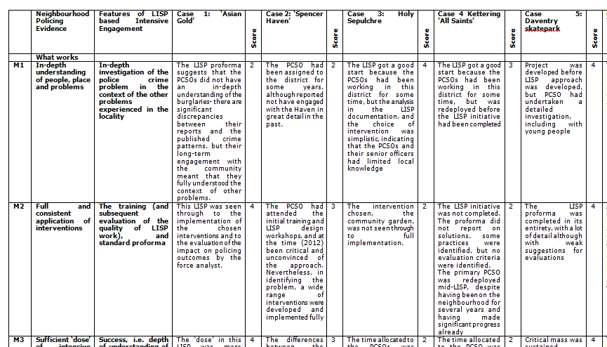
Connecting the mechanisms to the evidence

Slide 28
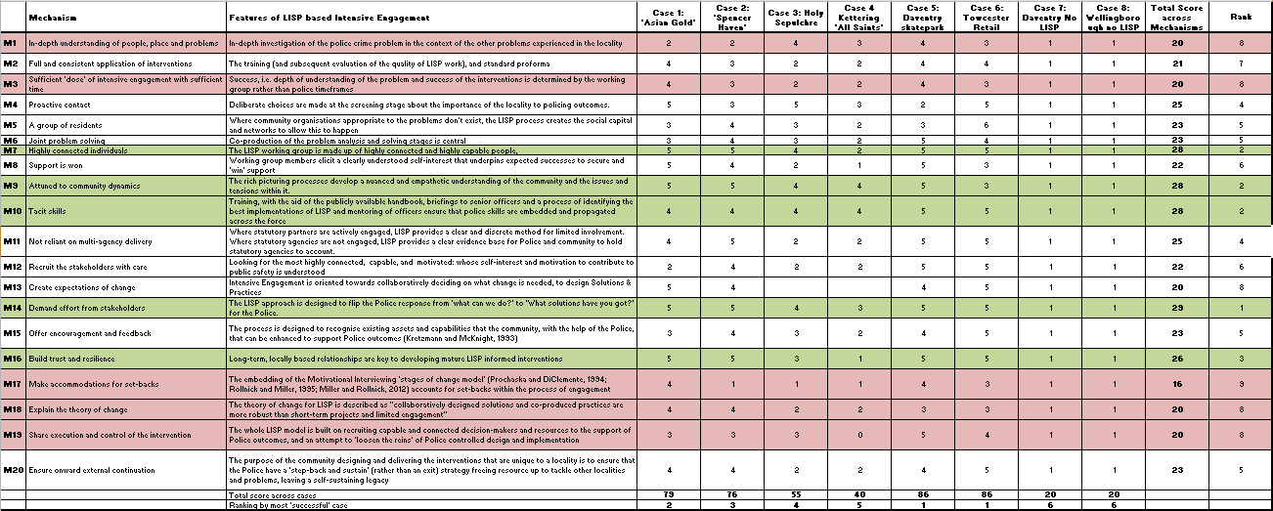
Nominal ranking of mechanisms

Slide 29
Most ‘active’ mechanisms
M7 | Highly connected individuals | The LISP working group is made up of highly connected and highly capable people,
M9 | Attuned to community dynamics | The rich picturing processes develop a nuanced and empathetic understanding of the community and the issues and tensions within it.
M10 | Tacit skills | Training, with the aid of the publicly available handbook, briefings to senior officers and a process of identifying the best implementations of LISP and mentoring of officers ensure that police skills are embedded and propagated across the force
M14 | Demand effort from stakeholders | The LISP approach is designed to flip the Police response from ‘what can we do?’ to ‘What solutions have you got?’ for the Police.
M16 | Build trust and resilience | Long-term, locally based relationships are key to developing mature LISP informed interventions

Slide 30
‘Least active’ mechanisms
M1 | In-depth understanding of people, place and problems | In-depth investigation of the police crime problem in the context of the other problems experienced in the locality
M3 | Sufficient ‘dose’ of intensive engagement with sufficient time | Success, i.e. depth of understanding of the problem and success of the interventions is determined by the working group rather than police timeframes
M17 | Make accommodations for set-backs | The embedding of the Motivational Interviewing ‘stages of change model’ (Prochaska and DiClemente, 1994; Rollnick and Miller, 1995; Miller and Rollnick, 2012) accounts for set-backs within the process of engagement
M18 | Explain the theory of change | The theory of change for LISP is described as “collaboratively designed solutions and co-produced practices are more robust than short-term projects and limited engagement”
M19 | Share execution and control of the intervention | The whole LISP model is built on recruiting capable and connected decision-makers and resources to the support of Police outcomes, and an attempt to ‘loosen the reins’ of Police controlled design and implementation
Ps, this does not mean that they are not relevant, just
more difficult to activate

Slide 31
Conclusions
“The above analysis demonstrates that within the four most active mechanisms operating in the LISP toolkit, strong CMO configurations can readily be constructed between the context of a ‘vulnerable locality’, and a complex problem situation.
This doesn’t mean that in all other types of areas (low deprivation/high crime or low deprivation/low crime or low deprivation/low crime) LISP doesn’t work, but, in the terms mentioned above, less ‘pressure’ would be necessary on different mechanisms.”

Slide 32
Conclusions
“This study has demonstrated that the 27 mechanisms satisfactorily map from the vulnerable locality contexts to the PEEL policing outcomes, therefore LISP is an effective new tool in the neighbourhood policing toolkit for engaging with high risk vulnerable neighbourhoods in an effective, legitimate and confidence building manner.”

Slide 33
Contribution to theory
Critical realism has not been utilised in social entrepreneurship or social innovation studies- mostly case studies, emerging critical theory literature.
Connecting critical realism to SSM as a methodology, only undertaken by Mingers.
The notion of ‘trigger pressure’ to activate mechanisms

Slide 34
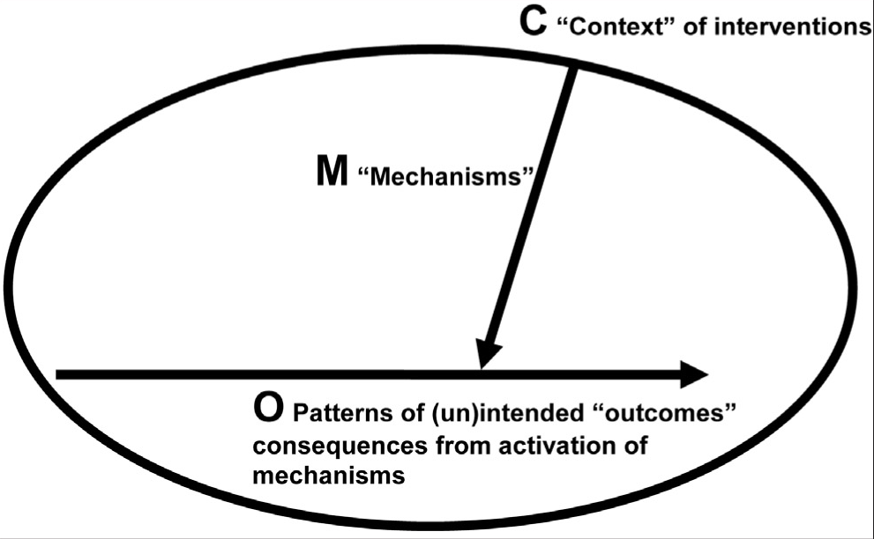
P: ‘pressure’ placed on mechanism to activate it

Slide 35
Contribution to practice
Neighbourhood Policing (NP) has lacked a theory of (sustained and sustainable) change
Developing a process (social innovation) whereby sustained, repeatable and measurable social change can be secured in NP

Slide 36
Change the way you police
Generate evidence for wicked problems in contexts
Devise unique packages of interventions in unique locations
Strategically segment different neighbourhoods based on vulnerability/harm
See interventions through to evaluation
Ensure that mechanisms that support success are triggered.

Slide 37
(partial literature)
Critical Realism
Archer, M (1988) Culture and Agency: The Place of Culture in Social Theory, Cambridge University Press, Cambridge.
Archer, M (1995) Realist Social Theory: The Morphogenetic Approach, Cambridge University Press, Cambridge.
Archer, M, R. Bhaskar, A. Collier, T. Lawson and A. Norrie (eds) (1998) Critical Realism: Essential Readings, Routledge, London.
Archer, M. S. (1995). Realist social theory: The morphogenetic approach. Cambridge university press.
Bhaskar, R. (2010). Reclaiming reality: A critical introduction to contemporary philosophy. Taylor & Francis.
Bhaskar, R. (2013). A realist theory of science. Routledge.
Bhaskar, R.A., 1986, Learning procedures in arithmetic: the principle of cognitive vigor. Yorktown Heights, N.Y.: International Business Machines Inc., Thomas J. Watson Research Center.
Bhaskar, R.A., 1989, Reclaiming Reality: A Critical Introduction to Contemporary Philosophy, London: Verso
Bhaskar, R.A., 1993, Dialectic: The Pulse of Freedom, London: Verso
Bhaskar, R.A., 1994, Plato, etc.: The Problems of Philosophy and Their Resolution, London: Verso
Bhaskar, R.A., 1997 [1975], A Realist Theory of Science, London: Verso
Bhaskar, R.A., 1998 [1979], The Possibility of Naturalism (3rd edition), London: Routledge.

Slide 38
Realist Research
Pawson, R. (2013). The science of evaluation: a realist manifesto. Sage.
Pawson, R., & Tilley, N. (1997). Realistic evaluation. Sage.
Pawson, R., & Tilley, N. (2001). Realistic evaluation bloodlines. The American Journal of Evaluation, 22(3), 317-324.

Slide 39
Soft Systems Methodology
Checkland, P. (1981). Systems thinking, systems practice. John Wiley & Sons Ltd.
Checkland, P. (1983). OR and the systems movement: mappings and conflicts. Journal of the Operational Research Society, 661-675.
Checkland, P. (1999). Soft Systems Methodology: a thirty year retrospective. In Systems Research and Behavioral Science.
Checkland, P., & Holwell, S. (1998). Action research: its nature and validity. Systemic Practice and Action Research, 11(1), 9-21.
Checkland, P., & Poulter, J. (2006). Learning for action: a short definitive account of soft systems methodology and its use for practitioner, teachers, and students (Vol. 26). Chichester: Wiley.
Checkland, P., & Scholes, J. (1990). Soft systems methodology in action. Chichester, England: John Wiley and Sons.

Slide 40
Connecting the two
Mingers, J. (1980). Towards an Appropriate Social Theory for Applied Systems Thinking: Critical Theory and Soft Systems Methodology. Journal of Applied Systems Analysis, 7, 41-50.
Mingers, J. (1992). Recent developments in critical management science. Journal of the Operational Research Society, 1-10.
Mingers, J. (2014). Systems Thinking, Critical Realism and Philosophy: A Confluence of Ideas. Routledge.
Mingers, J., & Brocklesby, J. (1997). Multimethodology: towards a framework for mixing methodologies. Omega, 25(5), 489-509.
Mingers, John (2014) Systems Thinking, Critical Realism and Philosophy: A Confluence of Ideas. Ontological Explorations . Routledge, London

