Slide 1


Alcohol and Crime: Supporting an evidence based approach to licensing
Manchester Metropolitan University Crime & Well-Being Big Data Centre
Mark Ellison
Professor Jon Bannister
Society of Evidence Based Policing
2nd March 2018

Slide 2
Motivation
Cost of alcohol harm to society / to policing (strategic - funding formula)
Under used licensing tools (operational - over provision and late night levy) – spatial and temporal sensitivity
Limited UK evidence base – deprivation / alcohol outlet density and crime (Glasgow)
RQ1: Does violent crime cluster (spatially and temporally)?
RQ2: What are the drivers of violent crime?
RQ3: Do the influence of these drivers vary over space?

Slide 3
Methodology and data
Regression / Geographically Weighted Regression: enables assessment of the associations between the dependent variable (violent crime) and the independent variables (neighbourhood characteristics) / whether the associations vary across space
Local Indicators of Spatial Association: enables assessment of whether areas with similar crime rates ‘cluster’
West Midlands Police (Coventry): Licensing data, violent crime data (2013-2015) census data – all modelled at Output Area level
We model crime counts not rates / do not use population counts

Slide 4
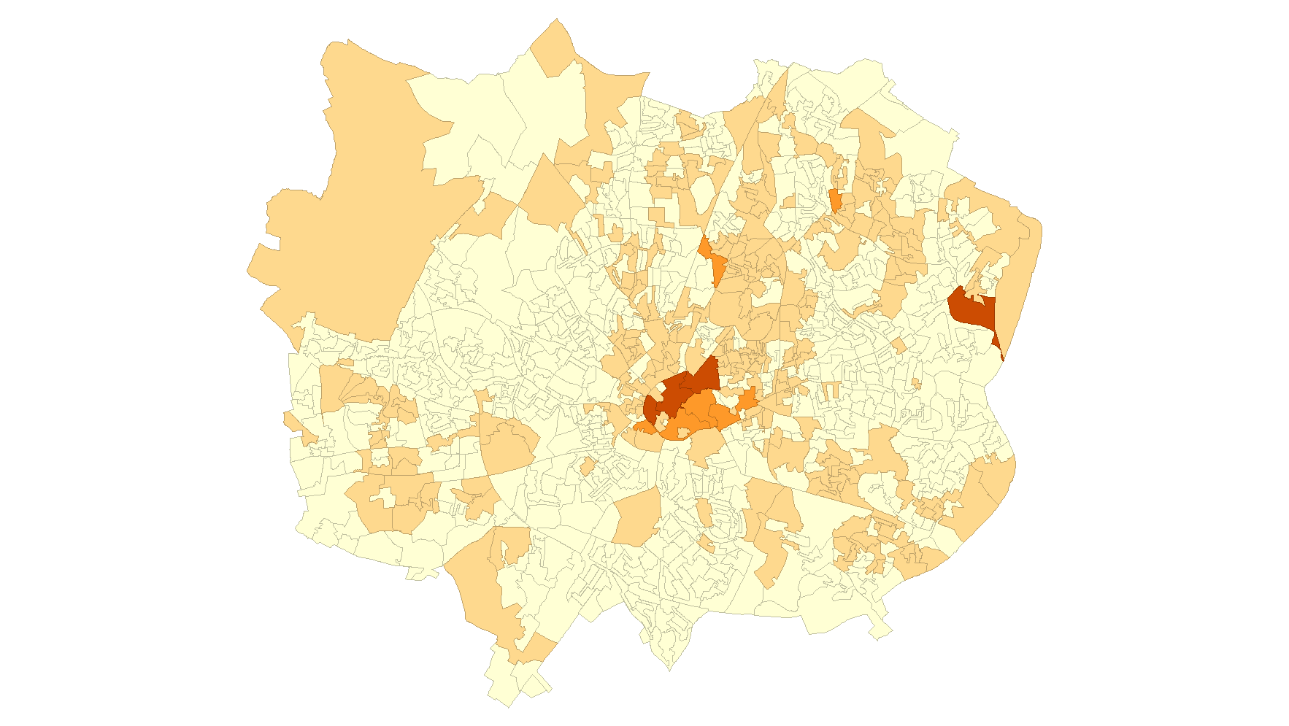
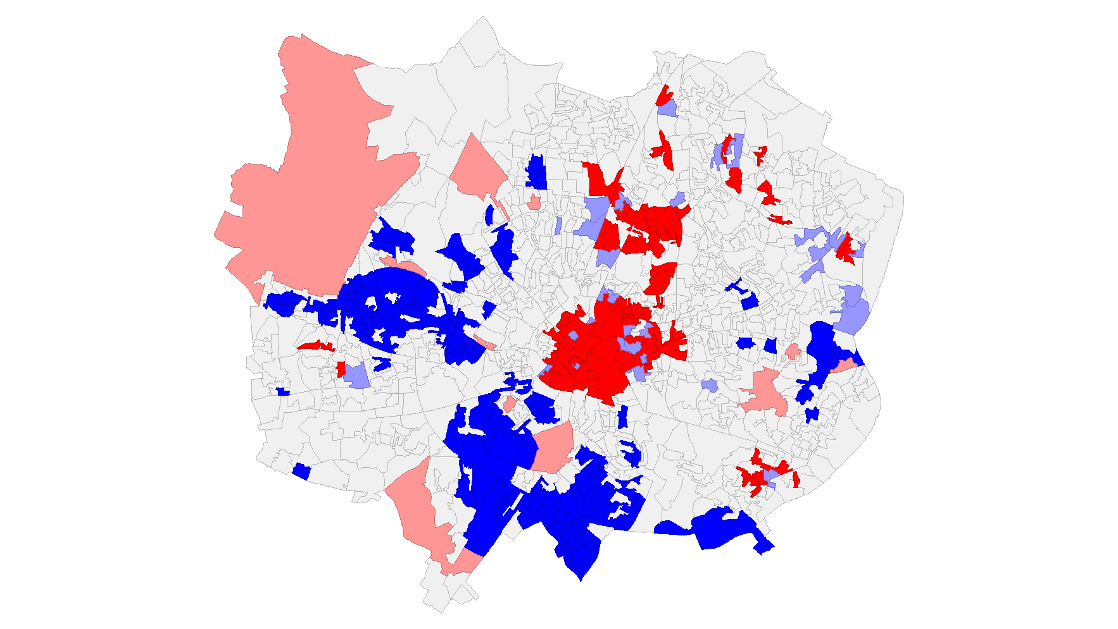
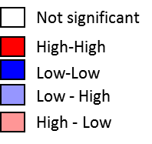

Spatial and temporal analysis of violent crime
Spatial (at Output Areas (OA), n=1,014)
(a) Counts
(b) Significant clustering
Temporal (using hour crime first committed)

Slide 5
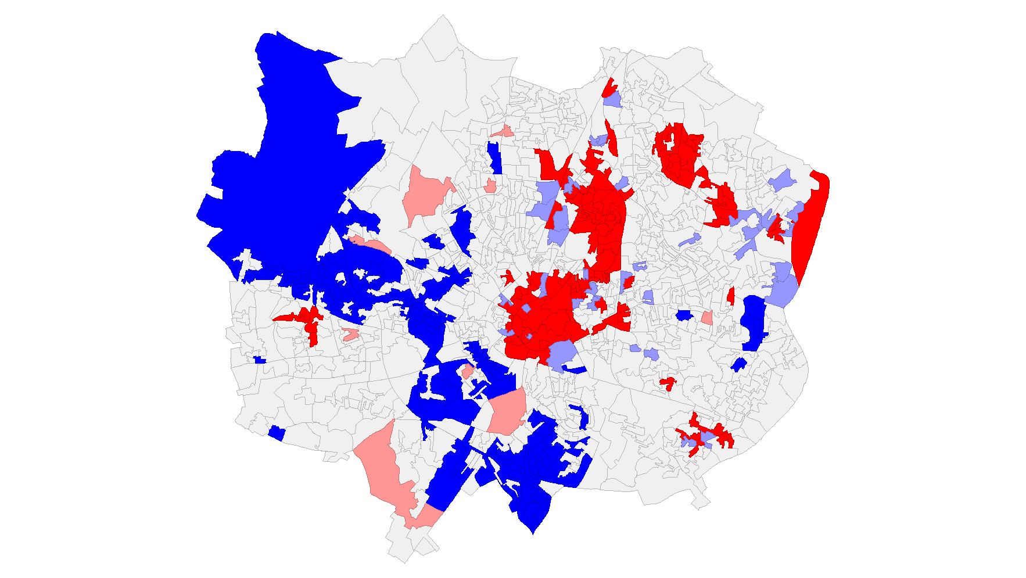
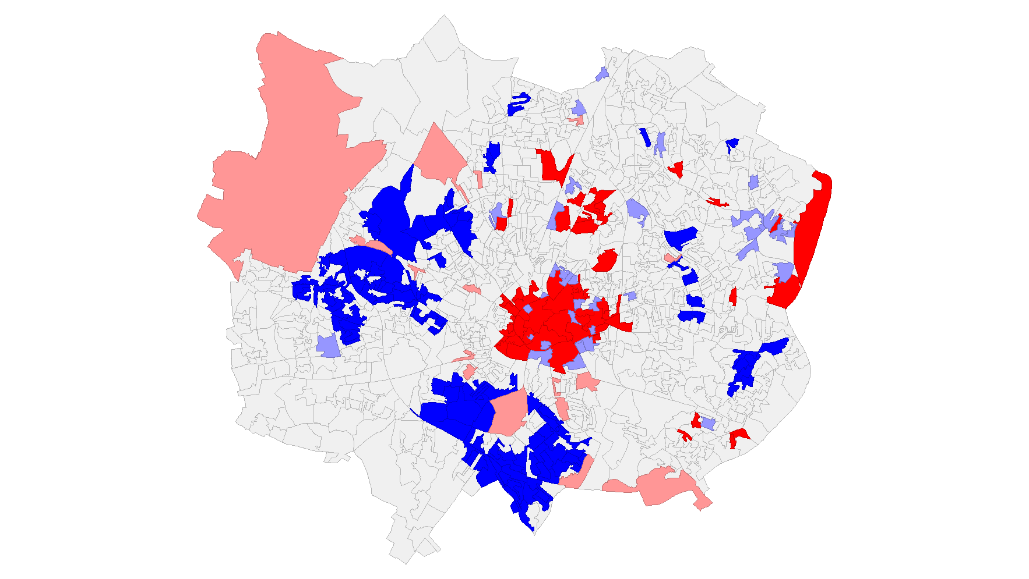
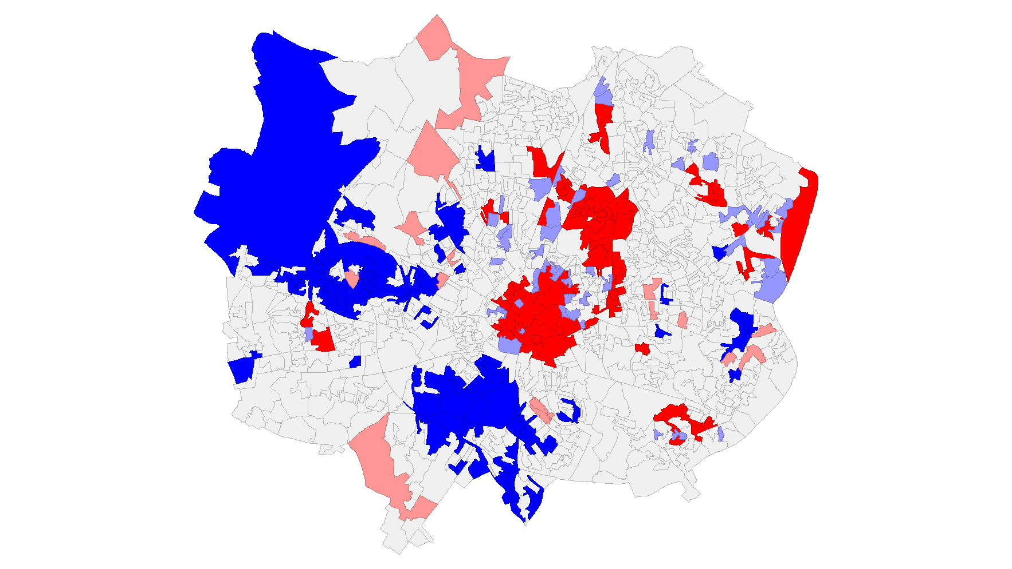
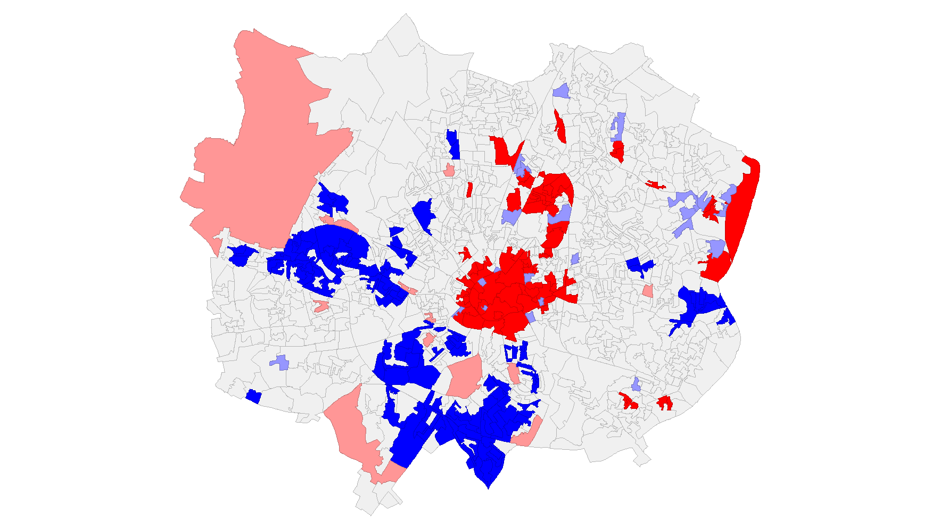
Clustering of violent crime (time / type)
(a) Daytime Violence
(b) Night-time Violence
(c) Violence Without Injury
(d) Violence With Injury

Slide 6
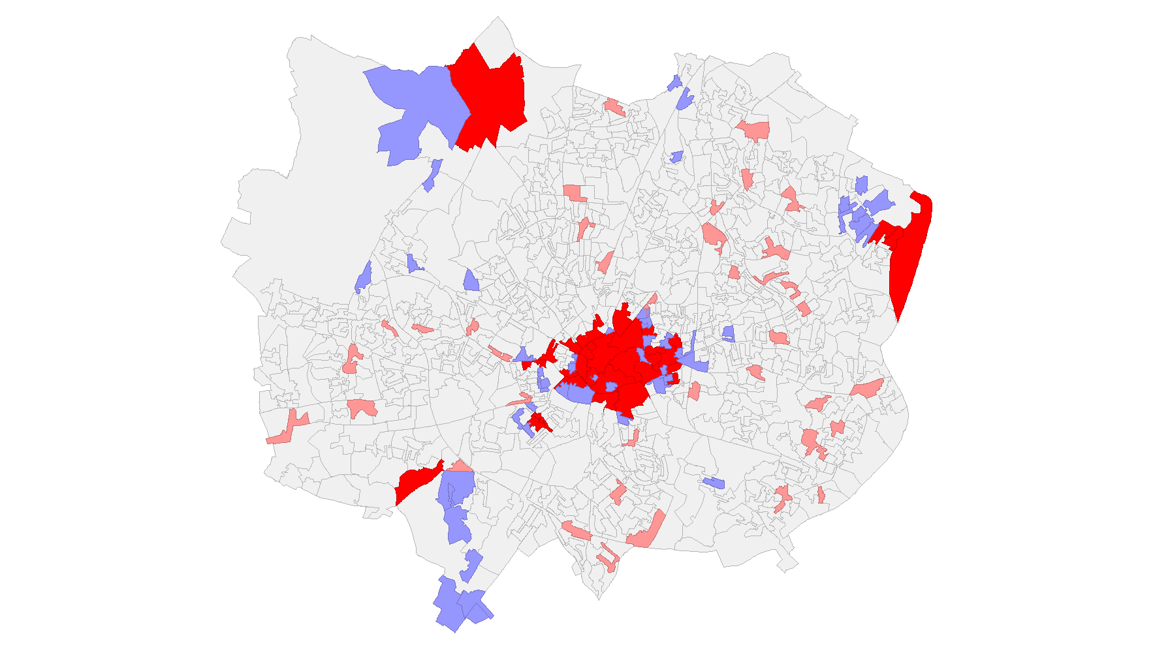
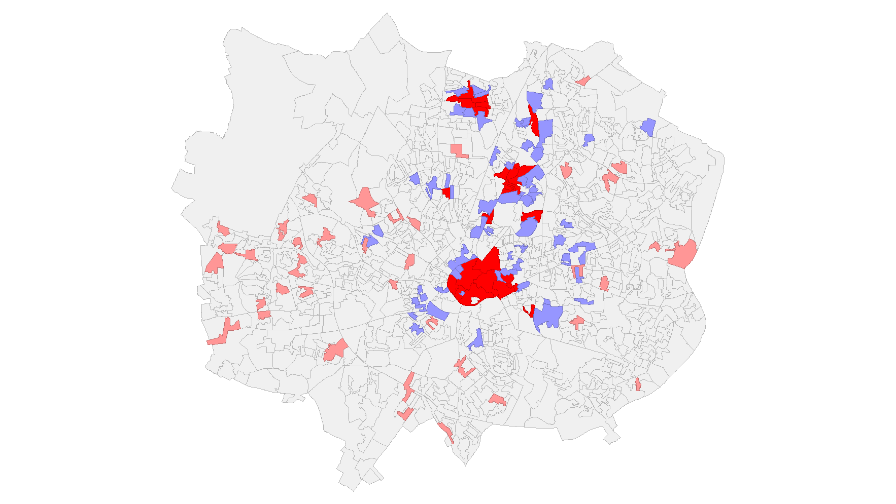
The spatial distribution of alcohol outlets
(a) Significant clusters (On-Sales)
(b) Significant clusters (Off-Sales)

Slide 7
The drivers of violent crime
  Across Coventry (regression analysis) – the variables most strongly associated with violent crime / account for the greatest variance in crime are:
    Alcohol outlets
    Degree of deprivation
    Proportion of Household Tenure owner occupied – negative association
    Proportion of the Population aged 35-44
  Police Scotland (2001-2008) – degree of deprivation more important than alcohol outlets, but growing influence of alcohol outlets

Slide 8
The drivers of violent crime
1 new alcohol outlet = 2.33 violent crimes per annum
Is this significant (strategic)? £1,030 - £25,500
The influence of alcohol outlets on violent crime varies across space
1 new alcohol outlet = 0.3 to 5.7 crimes per annum, £3,280 - £62,335
Spatial and temporal (operational) decision-making - overprovision and late night levy
Caution - policing benefit of density over dispersion
Notes:
Home Office
Option 1 presents range common assault to serious wounding
Option 2 presents variance IF serious wounding
Serious wounding £212,200 (£10,936 to police)
Other wounding £3,591 (£1,012 to police)
Common assault £881 (£441 to police)

Slide 9
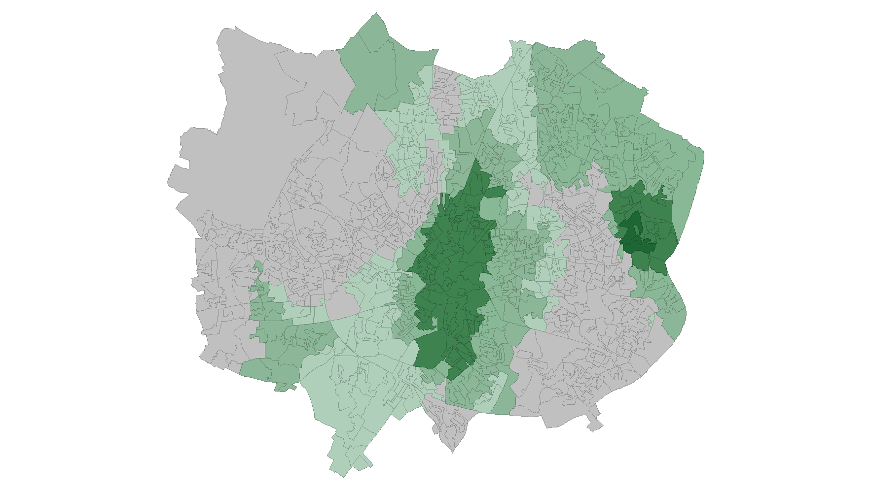

The drivers of violent crime – spatial variance
Not significant (grey areas)
1 alcohol outlet = 5.7+ violent crimes per annum
1 outlet = <1 violent crimes per annum
1 alcohol outlet = 3 violent crimes per annum

Slide 10
Policy Implications – overprovision and Late Night Levy
Night-time Violence (Counts)
Alcohol on-Sales
Spatial variance in the drivers of Violent Crime
Alcohol off-Sales
Notes:
Shortening text

Slide 11
Limitations and next steps
Changing patterns of alcohol consumption – changing location of violent crime
Capture all alcohol-related incidents (markers) - costs
Late night levy - time specific modelling of crime patterns / other licensing objectives
Extend / contrast geographies – availability (GMP, WMP and PS)
Counts and rates – population matters

Slide 12
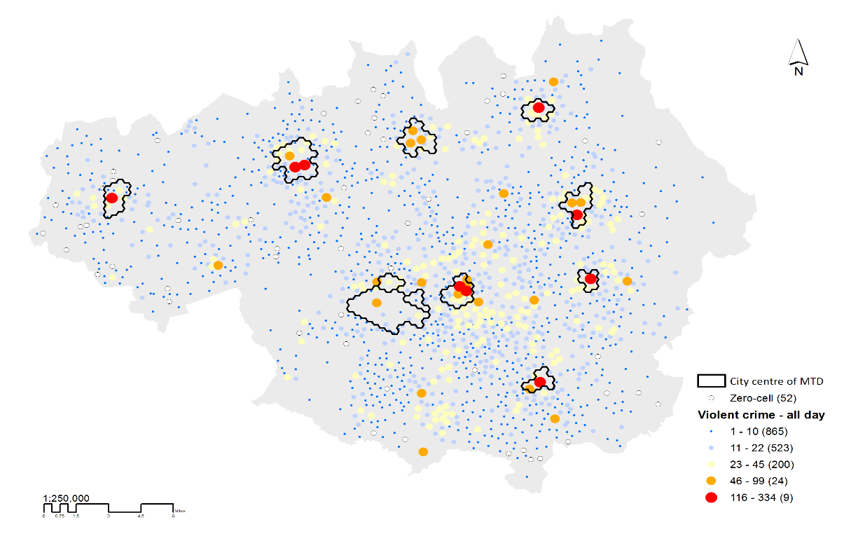
Populations at risk, violent crime and the NTE
Violent and sexual offences against the person
Population-at-risk = pool of potential victims and offenders / daily rhythms of the city
Population-at-risk - accurate identification of crime hot spots / proportionate policing responses / factors out with the model
Census Resident / Workplace and mobile phone data (ambient and exposed)

Slide 13
Populations at risk and the temporal patterning of violent crime
Time coverage
Workplace population
Resident population
Mobile users

Slide 14



Ambient population
  Amb_pop_T0 = Resid_pop + Inflows_T0 - Outflows_T0]
  Amb_pop_T1 = Amb_pop_T0 + Inflows_T1 - Outflows_T1] etc.
Visitors
Resident population
Inflows
Outflows

Slide 15
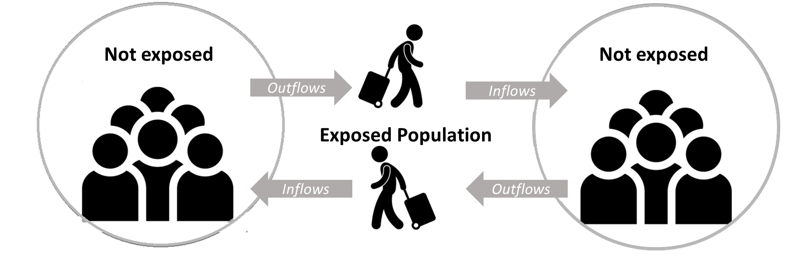
Exposed population
The on street / active population
Excludes the population that have reached their final destination (FD) or are commencing their trip (IO) in a particular time-bin.
Exp_pop_T0 = Inflows_T0 + Outflows_T0 – Inflows_T0_FD – Outflows_T0_IO

Slide 16
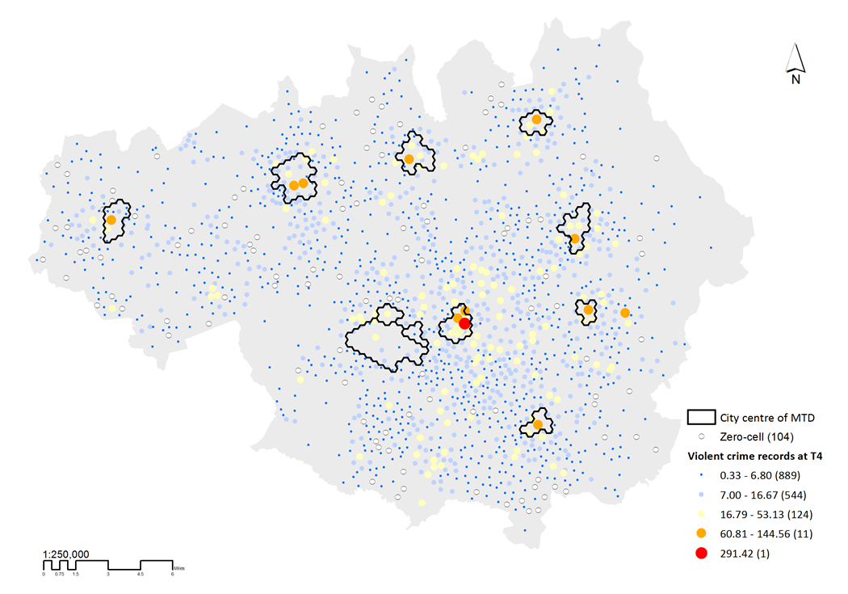
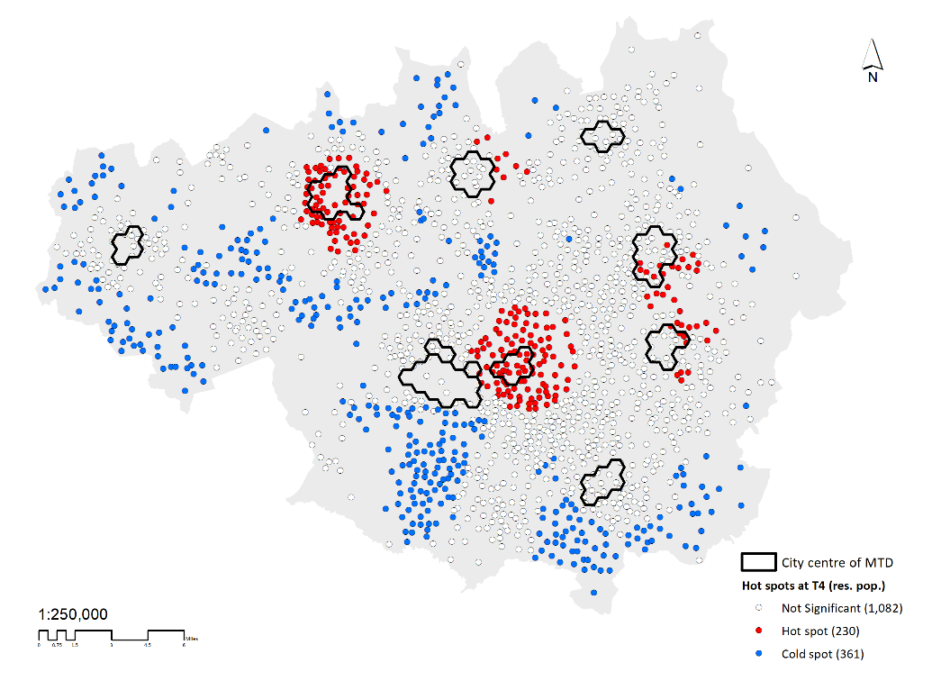
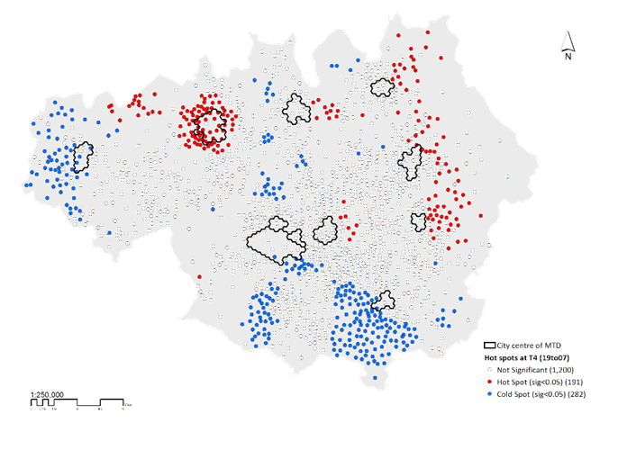
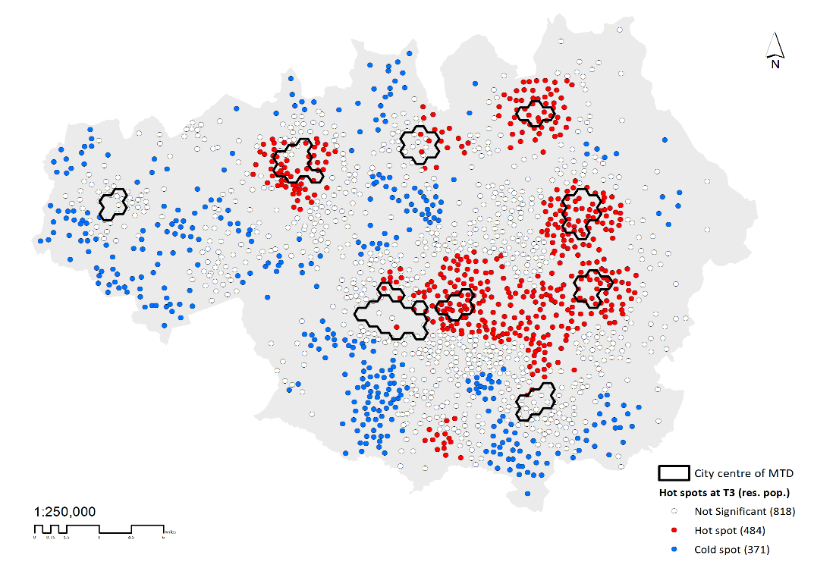
Hotspots - 7 pm to 7 am
Crime Counts
Residential Population
Ambient Population
Exposed Population
Notes:
Responding to counts - Yes, necessary but NOT sufficient
Identification of disproportionate (high – low) level of crime in relation to population sixe, i.e., hot and cold spots – effective design and efficient targeting (space-time) of policing intervention.

Slide 17
Alcohol and crime: Supporting an evidence based approach to licensing
Cost of policing alcohol related crime (strategic) / licensing (operational) tools
Clustering (spatial and temporal) of violent crime strongly associated with alcohol outlets and deprivation levels
The influence of alcohol outlets on violent crimes varies across space, 1 new alcohol outlet = 0.3 to 5.9 crimes per annum
A cost-benefit approach to decision-making?
Responding to counts – daily rhythms of the city
Rates – targeting, proportionality, the unmeasured
The importance of the population-at-risk measure

Slide 18
Questions?
Mark Ellison (M.Ellison@mmu.ac.uk)
Professor Jon Bannister (Jon.Bannister@mmu.ac.uk)
Manchester Metropolitan University Crime & Well-Being Big Data Centre

