Slide 1






Ten Evidence-Based Discoveries That Change the Way You Police
Annual Conference 2018
1st – 2nd March, The Open University
Sponsored by
#SEBP2018

Slide 2
Welcome and Introductions
#SEBP2018
T/Assistant Chief Constable Alex Murray
West Midlands Police and Chair, SEBP

Slide 3
Welcome
#SEBP2018
Vice Chancellor Peter Horrocks, The Open University

Slide 4
Welcome
#SEBP2018
Chief Constable Francis Habgood QPM
Thames Valley Police

Slide 5
Society of Evidence Based Policing (SEBP)
Chief Constable
Francis Habgood QPM

Slide 6
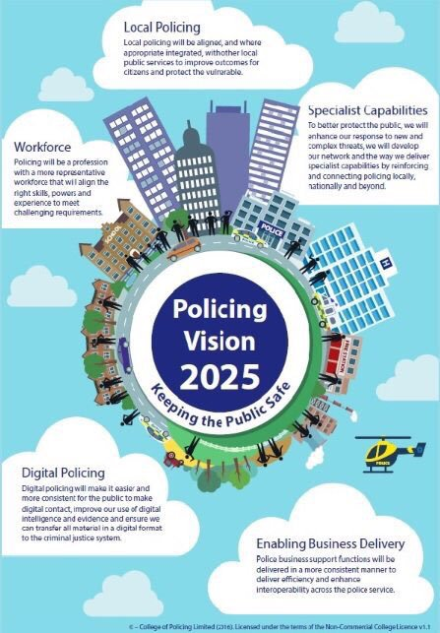
The case of evidence based practice…will be embedded and inform day to day policing practice
Establishing a methodology and framework which helps practitioners across policing contribute towards building knowledge and standards based on evidence

Slide 8
“ What works’ is a quietly radical agenda that is materially increasing the supply of evidence available to decision-makers. I am delighted to see that the public sector is embracing it. ”
Source: Sir Jeremy Haywood, Cabinet Secretary and Head of the Civil Service.

Slide 9

  Workforce

Slide 10

  Thames Valley Police
  Open University
  Cambridge University
  Oxford University
  Bucks New University
  Oxford Brookes University
  Warwick Business School
  Durham University Business School
  Study Sponsorship
  Consortium
  Advisory Board
  Partnership arrangements
  Research

Slide 11
How turn from
‘Quietly radical’
to
‘Business as usual’?

Slide 12
“Experimental.... Behavioural.... Digital….
The future of policing”
#SEBP2018
T/Assistant Chief Constable Alex Murray
West Midlands Police and Chair, SEBP

Slide 13

SEBP Winter Conference 2018
Experimental….Behavioural….Digital
The future of policing?
Alex MURRAY
@ACCMurray
@Society_ebp
Notes:
Triple T (not just RCT)
Behavioural Ecomics: How we must, but have not yet, taken notice
Digital – a huge enabler for EBP
In each area will talk about potential proposals

Slide 14
Prof David Lane (Business Informatics)
In coming decades success will not be just about intelligence and talent. They should never overshadow the significance of understanding what is going wrong and evolving. Organisations that foster the growth of knowledge will dominate”
Matthew Syed Black Box Thinking

Slide 15
Current policy
Test Policy

Slide 16
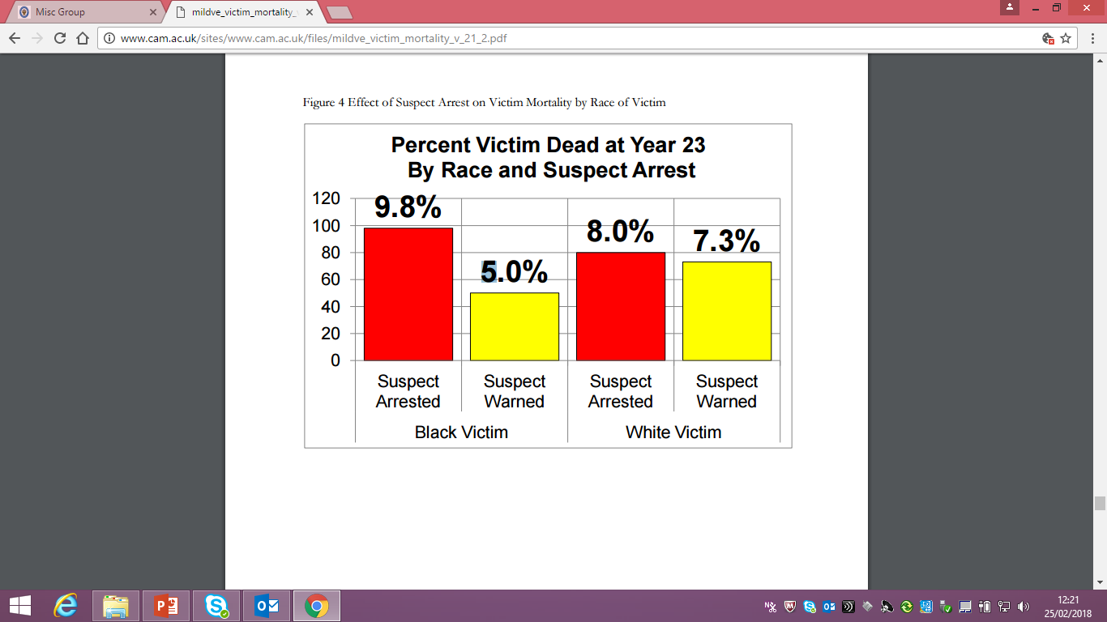
Notes:
Sherman and Heather HARRIS
Results: Victims were 64% more likely to have died of all causes if their partners were arrested and jailed than if warned and allowed to remain at home

Slide 17


Legitimacy in Schedule 7
Chief Superintendent Brandon Langley
Dr Barak Ariel
Notes:
Lorraine Mazerolle and Peter Martin QCET
Conversation with a man on the plane, forest gateaux, VW’s, the sign saying no whites after 6

Slide 18
All Sch7
(21 ports)
N=7,464 passengers
PJ Checklist
(33 teams)
(n=2,993)
Survey
BAU
(34 teams)
(n=4,471)
Survey (n=665)*
* As of 4 November 2016

Slide 19
To what extent do you disagree or agree with the following statements? | Standardized Score (out of 100) | Percent Change
The police officer gave me the opportunity to express my views | 80 | 16%
The police officer listened to me during the encounter | 81 | 24%
The police officer treated me with dignity and respect | 80 | 15%
I felt the police officer could be trusted | 75 | 35%
The police officer was polite when dealing with me | 84 | 21%
The police officer was honest with me | 77 | 21%
The police officer gave me the feeling he | 71 | 19%
The police officer clearly explained to me the way in which the encounter process would be carried out | 75 | 26%
The police officer answered my questions in a satisfactory manner | 76 | 20%
I felt the officer was biased against me | 41 | -12%
The treatment I received during the encounter was fair | 76 | 17%
I trust police officers to make decisions that are good for everyone when they are investigating and prosecuting terrorism | 76 | 19%
People’s rights are generally well protected by police officers when they are investigating and prosecuting terrorism | 74 | 19%
The police treated me the same way any other person would have been treated | 71 | 12%
I felt the police picked on me because of my background | 53 | -21%

Slide 20
To what extent do you disagree or agree with the following statements? | Standardized Score (out of 100) | Percent Change
The outcome of the encounter was not fair | 41 | 6%
It is right for the police to have the powers they have | 74 | 8%
I should accept the decisions made by police officers, even when I disagree with them | 69 | 14%
It is alright to go against the law, if you think the law is wrong | 38 | -9%
The police respect a citizen's individual rights | 76 | 19%
I believe I should do what the police ask me, even when I don’t agree with the reasons | 71 | 24%
I believe I should always obey the police even if I think they are wrong | 69 | 1%
I have confidence in the police | 77 | 20%
I have respect for the police | 83 | 20%
I often find myself objecting to the symbols of my country (e.g., the flag) | 39 | 5%
The police are doing a good job in fighting terrorism | 77 | 20%
I disagree with the values that my country represents | 43 | -2%
Sometimes I am opposed to what my country represents | 48 | -5%

Slide 21


Denley and Ariel 2017

Slide 24
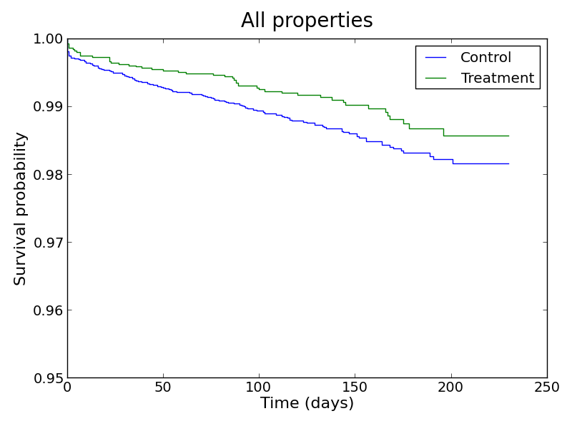


Slide 25
Reduced Crime Harm by 36%
Average, per offender, over 2 years after initial arrest
Notes:
Plus 45% reduction in costs

Slide 26
Notes:
So what are we going to do for crime filing. See tom olphin…

Slide 27


Slide 28
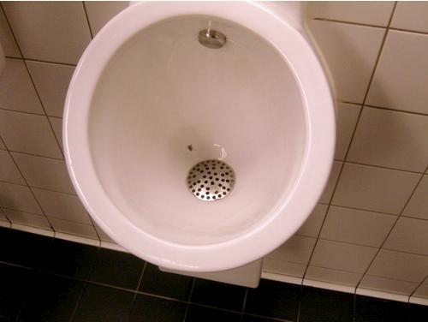
Notes:
Heuristic, cognitive shortcuts as opposed to rational choice theory
Schiphol Airport
Easy, Attractive, Social and Timely

Slide 29
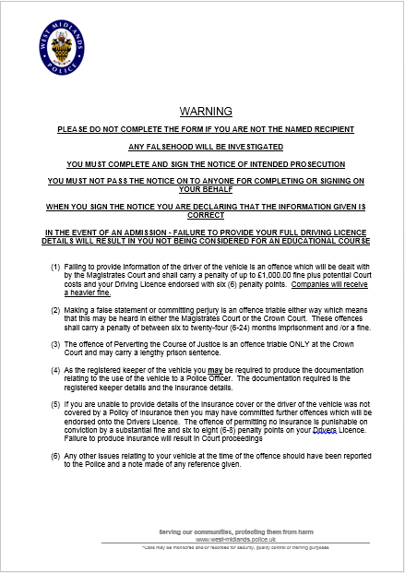
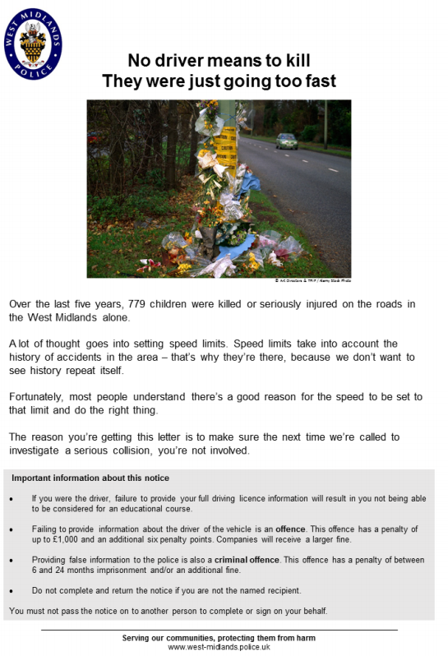

Slide 30
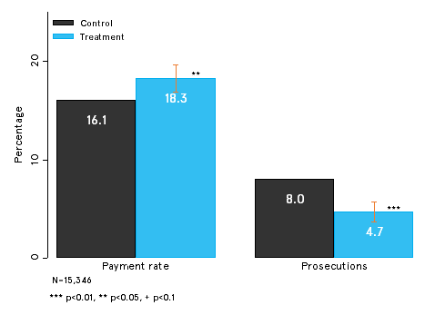

Slide 31
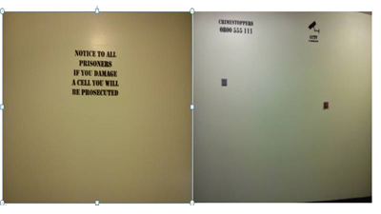
Notes:
Growth Mindset

Slide 32
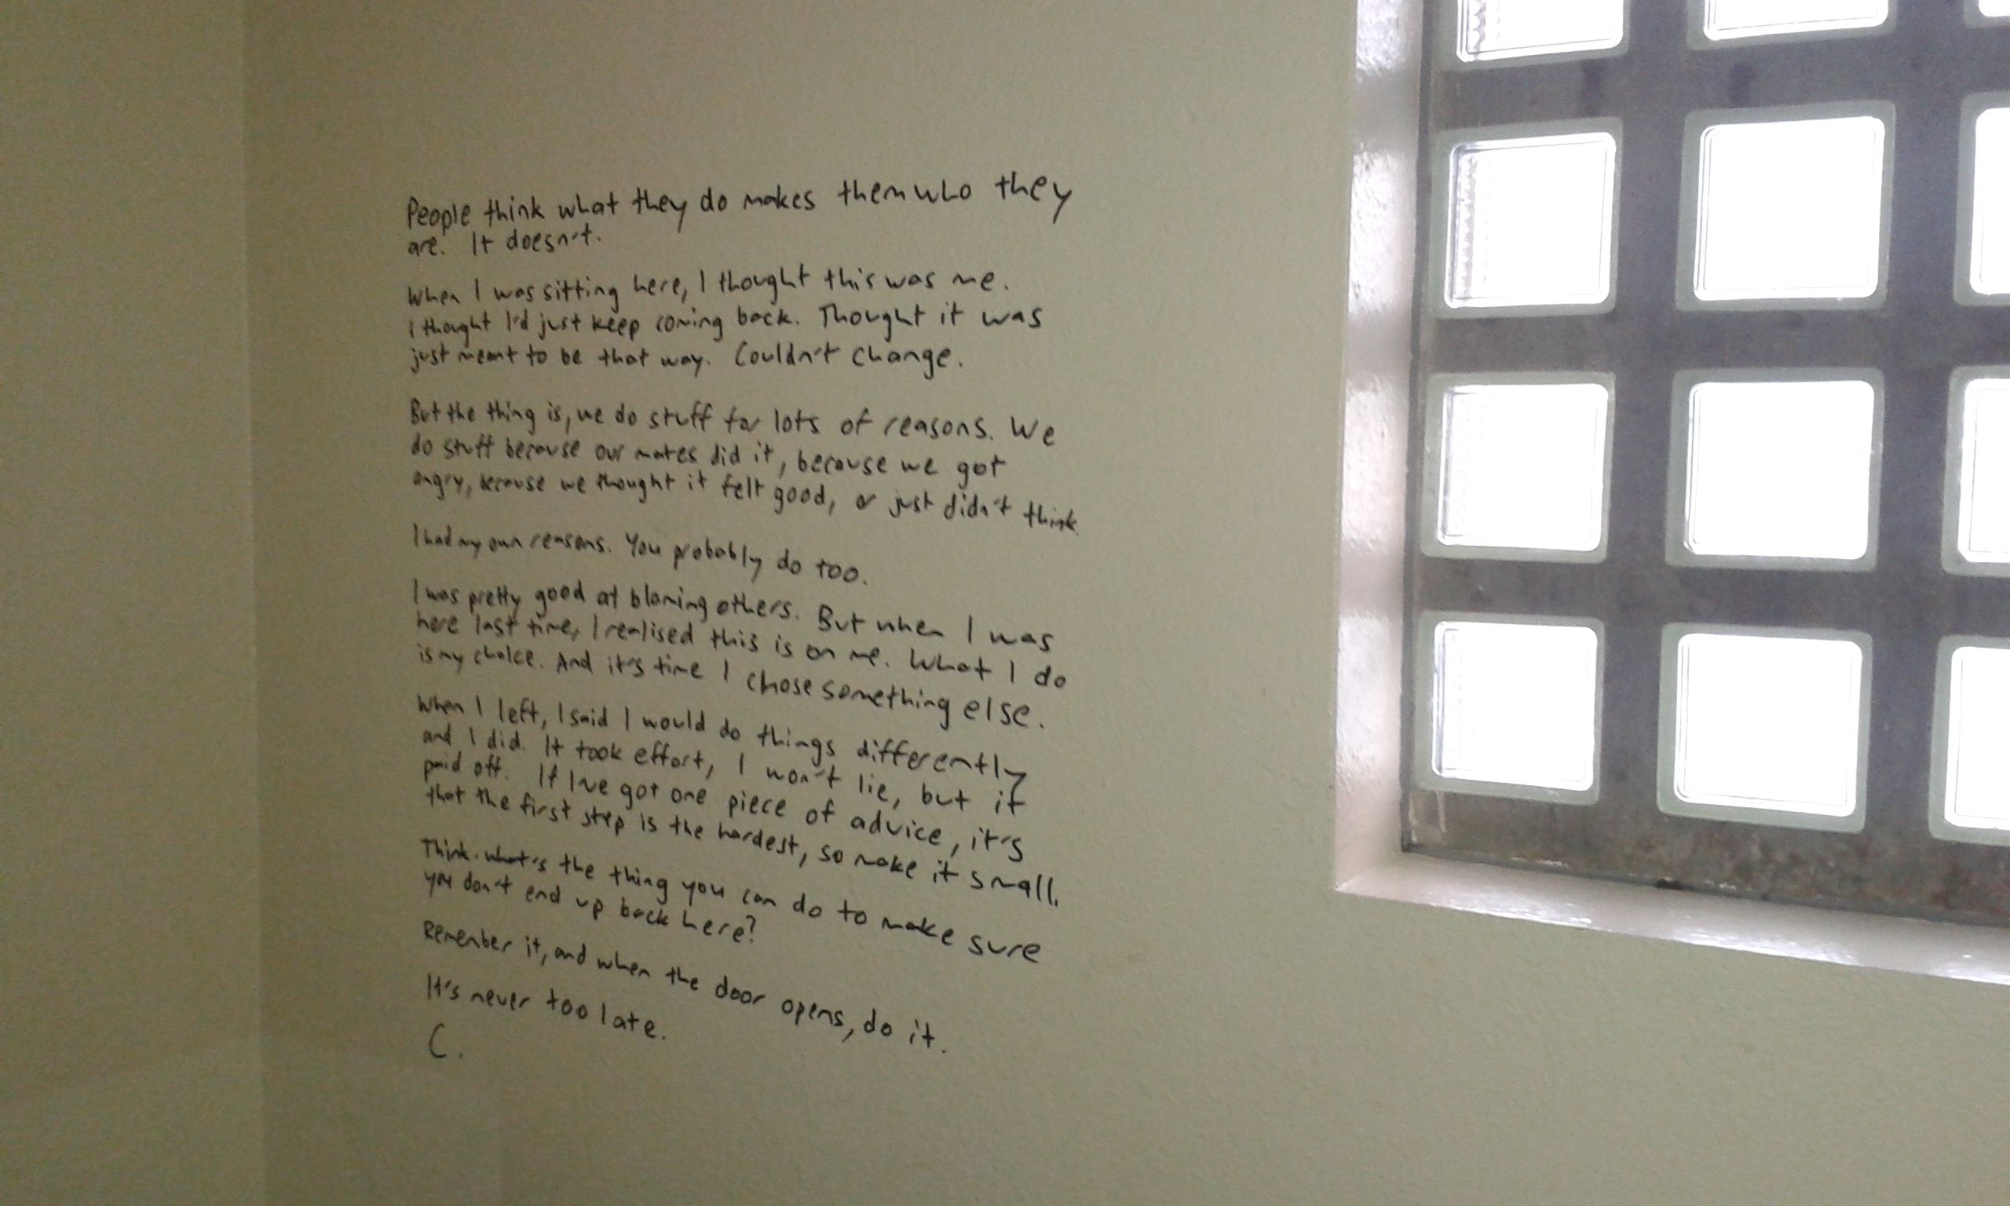
Notes:
Growth Mindset
MENTRAL CONTRASTING AND IMPLEMENTATION INTENTIONS MCII
Think about how you will feel when you are free from your habit of drinking too much beer (that belly replaced by a six pack; lynx advert – members of the opposite sex flock to you, you sleep well and jump out of bed etcc
Then Implementation Intentions…whats going to top you…someone is going to invite you to pint of science, make sure you are going for a bike ride instead. You want a reward after work – cold sparkling water…
Countering INDENTITY or LABELLING

Slide 33


Slide 34
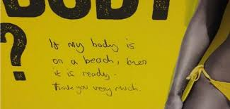

Slide 35
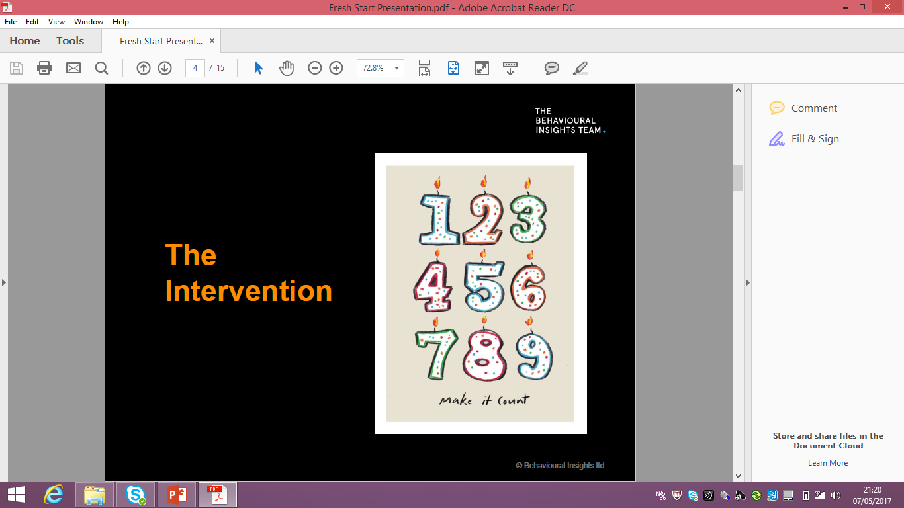

Slide 36
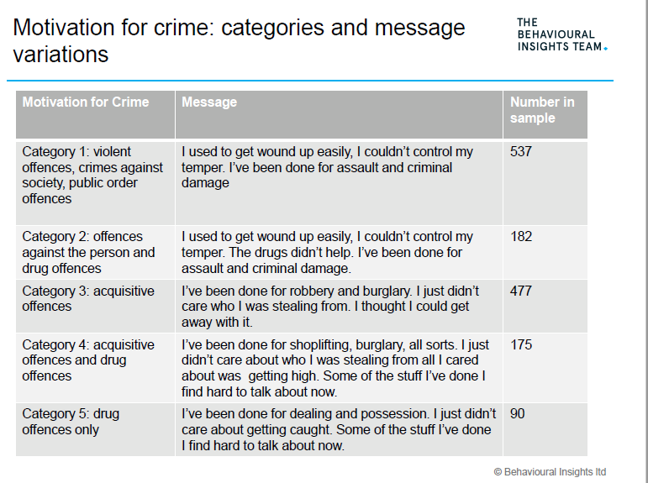

Slide 38
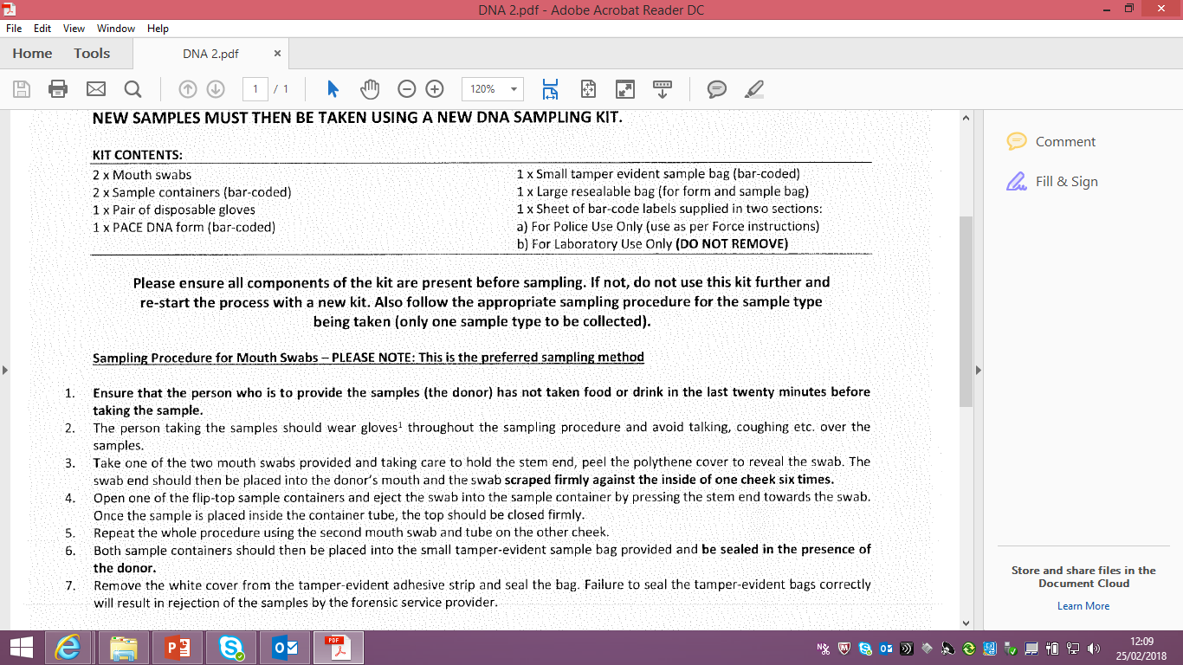
Notes:
1% increase in police numbers equates to a less than 1% increase in detection rates.
DNA though 3-4%
When law changed in Denmark meaning registration for DNA went from 5 to 40%
Biggest impact on violent crime
Anker et Al Denmark 2017

Slide 40
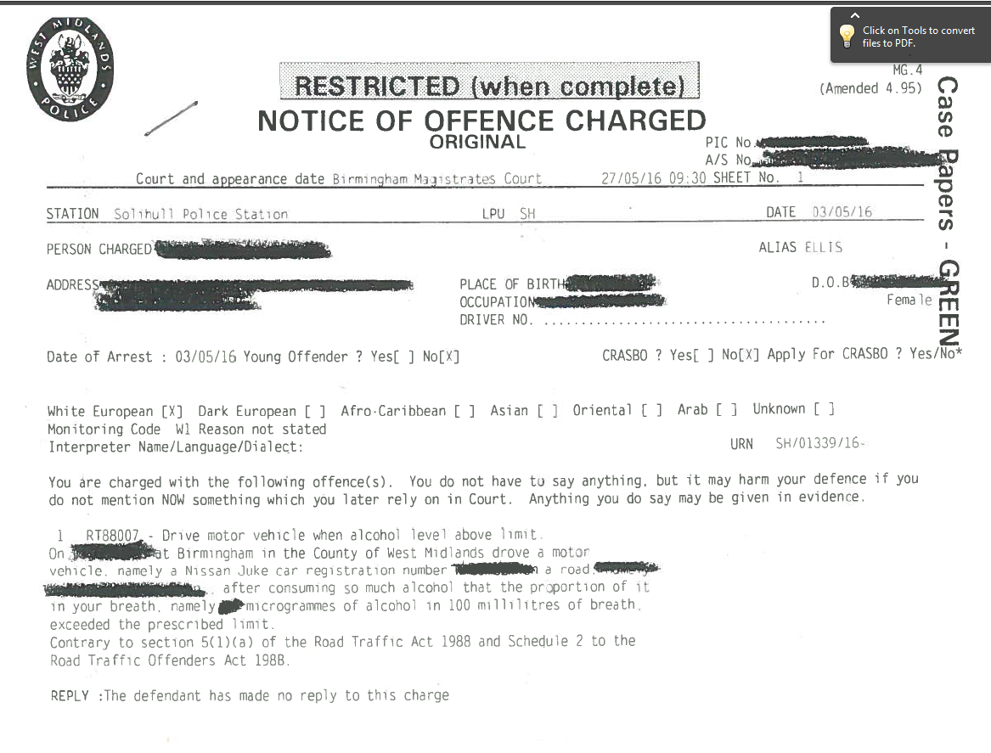

Slide 41
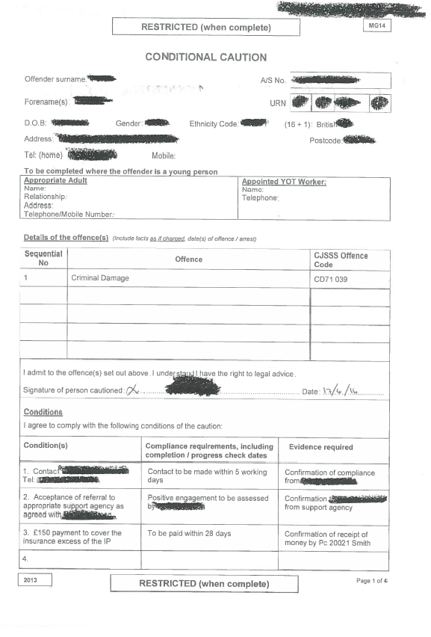
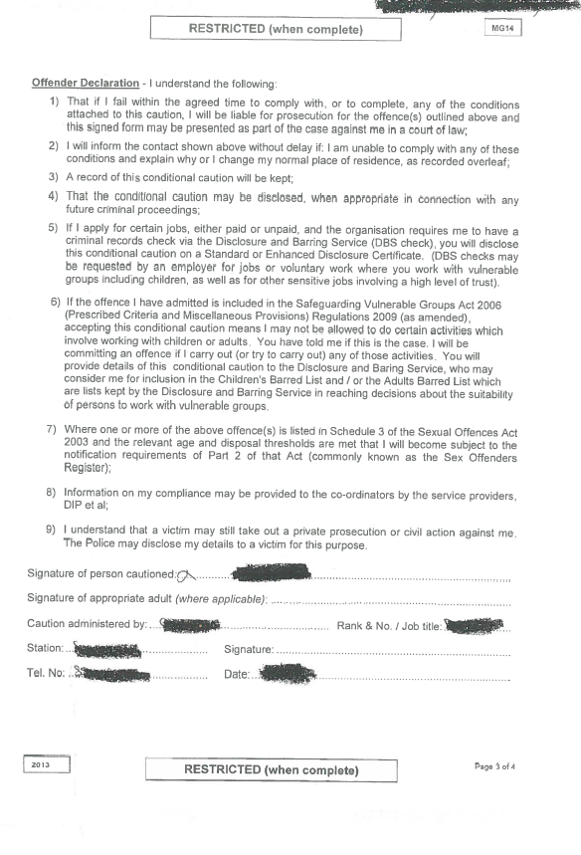

Slide 42
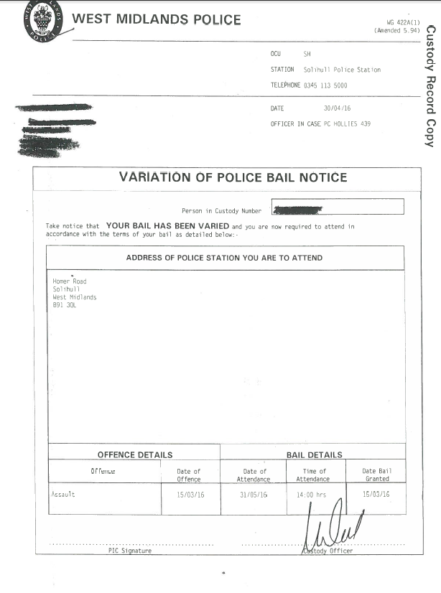

Slide 43


Slide 44




Sourced and integrated data from 9 core WMP data sources and text mining was performed on IMS logs
CRIMES
Stop
&
Search
PINS
PNC
IMS
Custody
Corvus
Compact
OCG
tracker
Over 1TB of data volume
437 Source tables
10, 908 Columns
Over 267m rows
~900k Intel log entries
text mined
Nominal table and interim data structure with:
over 10m nominal entries
~30m event entries
~14m associations for over 4m nominals
Nominal Analytical Record with over 1300 KPIs
Notes:
1. Shows that we can integrate structured data and make it available for manipulation
2. Demonstrated the ability to text mine across un-structured data from IMS. This is searching across the free text data within IMS logs. Use SCR/DHR example.
267 million rows of structured data
About 900k intel logs mined.
From that you get:
10 million nominals
30 million events
14 million associations
DDI is a complex solution that touches infrastructure, data integration (which includes things such as data matching, cleansing. Re-modelling, de-duplication etc) , analysis and analytics.
At a high level DDI will bring three core capabilities:
1. A big data compatible platform to host cutting edge technologies and a store for cleansed, de-duplicated and integrated data sources.
2. Modern tools to interrogate the data on the platform using intuitive user interfaces; enabling the efficient search, discovery and visualisation of information in modern consumable formats. 12k for ES…. 500 for advanced analytics… 15 for AL
3. An analytics laboratory to:
develop the practice of data science in policing
extract insight beyond the reach of traditional analysis
shape evidence based policy development,
develop and operationalise advanced risk models
evaluate existing and future interventions

Slide 45
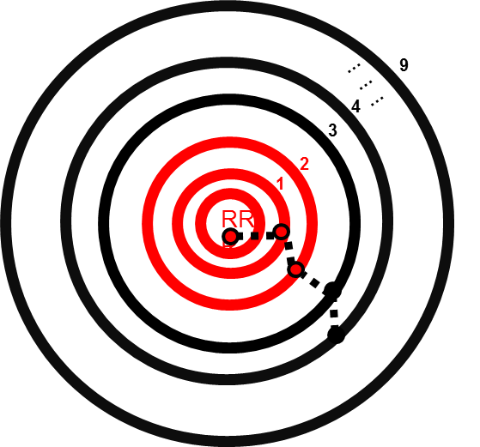
Interventions with soon-to-be influencers (proactive)
Comparison with Neighbourhood Policing or FCID at-risk nominals
Interventions with existing influencers (reactive)
Comparison with those nominals on IOM radar
Notes:
This will give us two lists to consider potential interventions:
Who are the existing influencers and prioritisation of those?
Who are those who we think will soon make the transition to becoming influencers.

Slide 46
Among the 1349 KPIs, 32 KPIs have been identified for their strong predictive power
The most important KPIs are related to the social network of the nominal
4 out of the top 10 KPIs are related to network.
Number of co-offending crimes
Crimes committed by the members of your network
Co-offending patterns - followed or before solo crime pattern (specific sequence)
! Social network KPIs are around 3 times more predictive compared to “age of nominal”
! More crimes are committed in your network more risky you are.
Nominals are most likely to turn influencers when they are between age 14.67 and 20.5. The risk of becoming influencer is still high up to age of 29 years. Past this age nominals more and more less likely to become influencers.
Some key KPIs are related to presence across systems (IMS logs and number of times) overtime
Notes:
32 KPIs have very strong predictive power.
Model suggests that KPIs in relation to networks are the most powerful in predicting future behaviours/influencers. 3 times more predictive than age of nominal.
Whereas, at the moment we tend to focus on the individual… IOM?

Slide 47

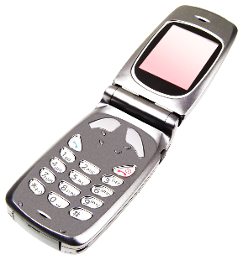
Insp Dave Hollies
Customer
1
3
2
Runner
Safe
House
Notes:
- Simple business model like Dominoes Pizza;
- Usually OCG driven;
- Demand seeks out supply by contacting a SPOC mobile phone;
- SPOC contacts runners – usually less senior members of the OCG;
- Runners deliver drugs to demand;
- OCG controls safe houses where drugs are stored;
- Risks – minimal – police seizure, rival robberies etc;
- Benefits – simple means to make large sums of money;
Identified by Europeans study as means by which over 50% of users obtain their supply – other were largely from friends or dwelling based enterprise

Slide 48
Clear drop off in trade post-trial start date
Individual lines
Collectively decrease shown in ability to contact demand
Collective Impact
Notes:
- Denial of service attack commenced on 29th February – by 4th March, 10 of the 15 lines were down
- Simply put delivery of a Denial of Service attack works – it prevents the lines from functioning;
- Drop off is clear to see both individually, and collectively – including Jonny does inflate this as they appear to be dealing cannabis from the line too which represents higher volume and lower value.
Reaction of suppliers
- Variety of different reactions – some engaged, some did not;
Technical response -Diversion of numbers to innocent members of the public;
Technical - Delivery of DDoS themselves of sorts;
Technical - Placing SIM card in Smart Phone to block numbers not known to the phone;
Appealing to policing - Offer of intelligence about competitors;
Threatening - Abusive;
Threatening – Threat to harm author;
Deflection – Innocent reason for receiving over 1000 contacts per day;
Legal - Questioning legality – questions raised and reference made to involvement;
Overall concerns surrounding engagement proved unfounded as many took the opportunity even if simply to voice their frustrations.
Denial of Service approach disrupts drug supply as anticipated;
Market will adapt and consideration will need to be given to how continuity is maintained;
Demand can be influenced remotely;
Law enforcement can impact drug supply at a market level as opposed to targeting of individual lines.

Slide 49

The microscope showed us there is more to a drop of pond water than we think we see. The telescope showed us there is more to the night sky than we think we see. And new digital data now show us there’s more to human society than we think we see.
Notes:
The search window is like a view into the mind – it often acts as a kind of confessional…ew do not search rationally, and on our search engine the social desirability bias I removed. Eg I hate my boss

Slide 50
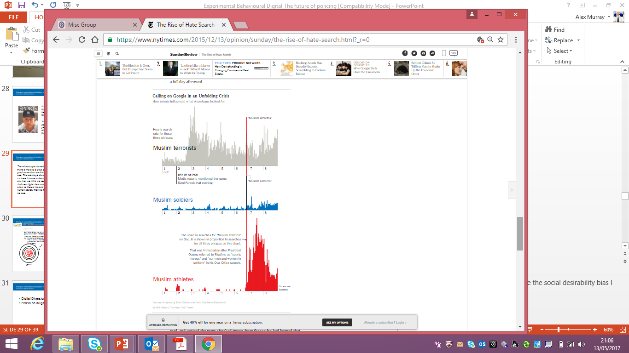

Slide 51
Society Of Evidence Based Policing
Aim One: Increased use of best available research evidence to solve policing problems
Aim Two: The production of new research evidence by police practitioners and researchers
Aim Three: Communication of research evidence to police practitioners and the public
WWW.SEBP.POLICE.UK
@society_ebp

Slide 52
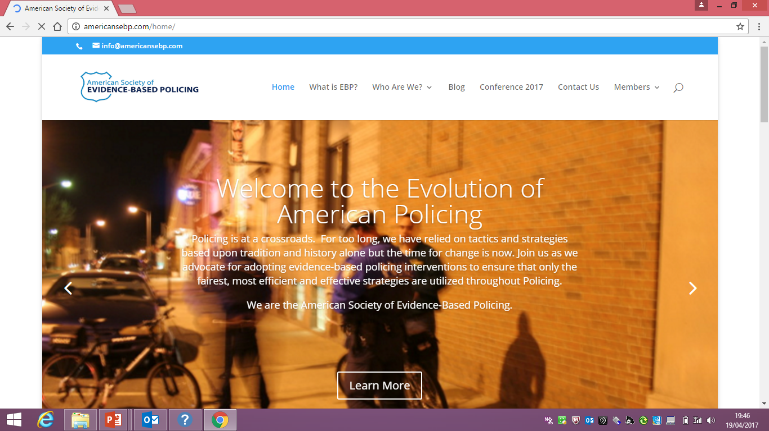
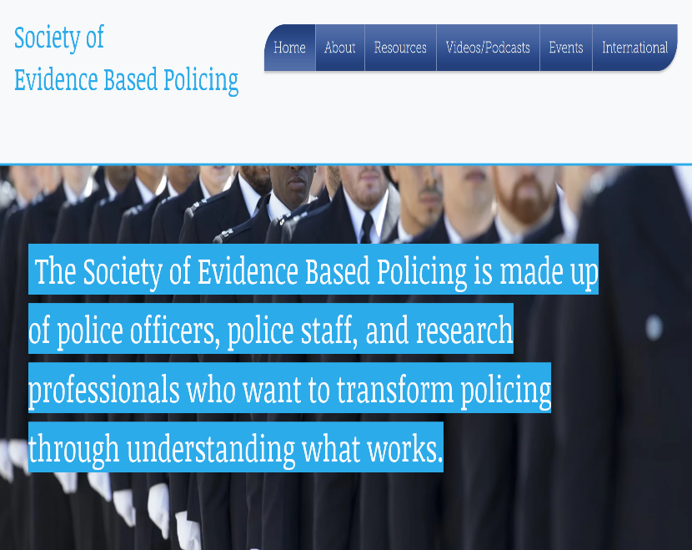
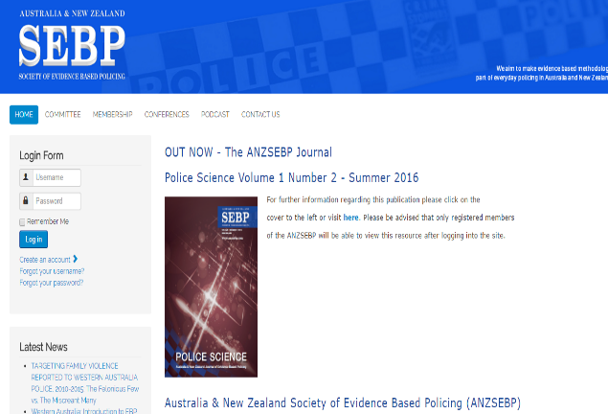
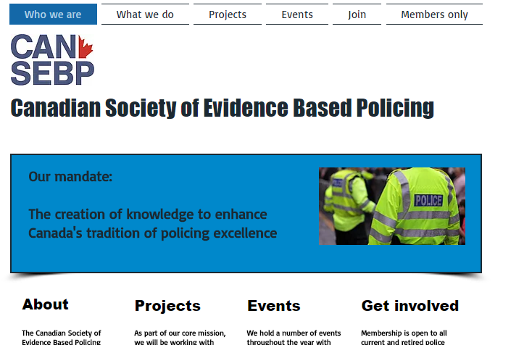

Slide 53

Notes:
So why do successful policing initiatives more often than not pass away? Consider the lion. A lion finds a lioness attractive. She already has cubs. He sees off her partner, the father of the cubs. He then kills the cubs. He’s not going to waste time and energy nurturing progeny which do not carry his genes.
Like the lion, the ambitious police officer, having achieved command, will be tempted, consciously or because of enthusiasm for his or her as yet unrealised ideas, to let the initiatives of his or her predecessor wither, however successful. the ideal career trajectory for the ambitious officer is to kill your predecessor’s promising cubs, make a song and dance about the birth of your own cubs, then get promoted (to head of the pride) before someone comes along to kill your cubs. Ken Pease

Slide 54
History as Evidence
Using the Past to Prevent Future Crimes
Martin Innes: Director of the Crime and Security Research Institute, and Universities’ Police Science Institute, Cardiff University
Shane Johnson: Director of the Dawes Centre for Future Crime at University College London
#SEBP2018

Slide 55


History as Evidence
Using the Past to Prevent Future Crimes
Martin Innes & Shane D Johnson

Slide 56
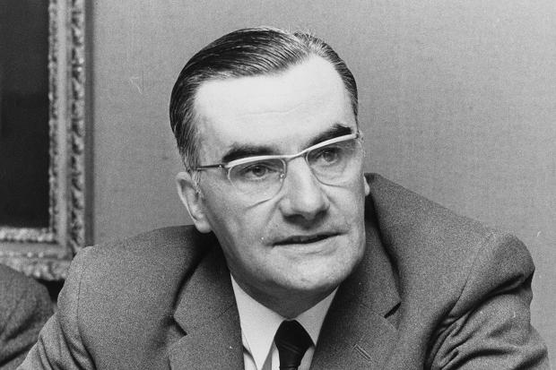
For the Super-recognisers

Slide 57
Policing a Perplexed Society
“We…are the anvil on which society beats out the problems and abrasions of social inequality, racial prejudice, weak laws and ineffective legislation...”
(Sir Robert Mark, 1977: 118 from a speech to National Police College 1975, pubd as ‘Policing a Perplexed Society’ )

Slide 58
3 Propositions
Policing has neglected learning systematically from its own history. Shift focus from ‘problems’ to ‘process patterns’ in responding to new risks and threats.
Current accent in EBP is upon evidence about ‘treatments’, rather than evidence based diagnostics. A pluralistic and wide-ranging acceptance of evidence is needed.
Digital technologies (socmed / IoT / smart cities) creating new criminogenic opportunity structures that will alter prevalence and distribution of future crimes.

Slide 59
4 Cases of ‘Eternal Recurrence’
Digital disclosure – long standing concerns (Innes, 2003);
Non-crime demand – the classic police ethnographies of the 1970s;
Technology’s ironies – phones + patrol cars increased social distance between police & policed; computerization process & store more information.
Child sexual abuse – HMIC 2016 reports flag issues that have been highlighted repeatedly over past 5 decades.

Slide 60
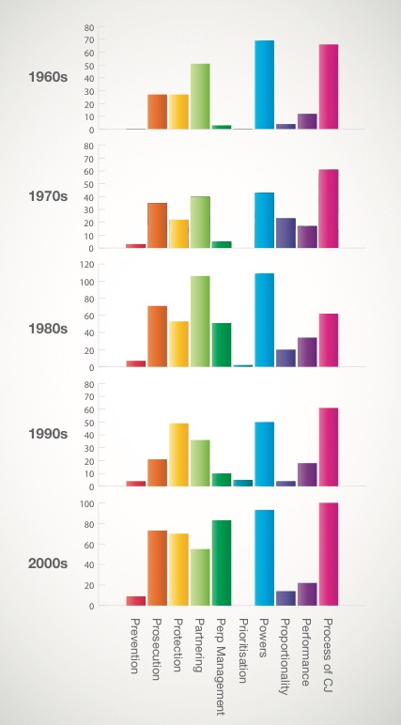
Dawes Centre for Future Crime at UCL
50 Year Analysis of CSA
Prevention – trying to limit the amount and harm of CSA. More recently, this dimension of police activity has focused upon the use of proactive high level surveillance capabilities.
Prosecution – police work to construct a case for the prosecution through their investigative activities.
Protection – work to support vulnerable individuals at risk of CSA, or who have experienced it.
Partnering – working with other agencies with child protection responsibilities. A key aim being to ensure police have access to relevant information possessed by other agencies, but also that others are aware of information and intelligence available to the police.
Perpetrator management – monitoring and supervision of known offenders, albeit other agencies (Probation Service / National Offender Management Service) are ‘on point’ for this work, police play an important role.
Powers – use and explanation of powers possessed by police and other agencies for managing the harms associated with CSA. An important consideration is that only police possess some of the powers routinely utilised.
Process of criminal justice – this category covers issues relating to the courts and other aspects of the criminal justice process as they relate to the police role.
Prioritisation – this concept is designed to capture how CSA was positioned in relation to other demands on the police at national and local level. This includes the local use of risk assessment tools to decide what issues and cases to work on, as well as how government edicts and strategies both explicitly and implicitly shaped police activity.
Proportionality – this focuses upon the balance between rights as a suspect vs rights of victims. This theme has come to the fore relatively recently in relation to a number of false allegations, but interestingly was also present in Home Office policy commentary about the issues associated with naming young people in press reports.
Performance – pertains to the activities associated with monitoring and identification of good and poor policing performance, as well as commentaries upon these.
Notes:
Innovation and change bring benefits but also new crime opportunities. Let’s consider the past..

Slide 61
2 Visions of EBP
‘Strong’ vision – privileges RCTs and systematic reviews;
‘Catholic’ vision – more pluralist in what counts as evidence - naturalism + experimentalism, problem-finding + problem-solving.
Neighbourhood Policing – based upon multiple forms of evidence including – quasi-experimental design; in-depth qualitative interviews; field observations; structured survey; co-production; signal crimes analysis – a focus on how as well as if it works.

Slide 62
Crime Prevention Comms
In terms of austerity ‘doing more with less’, or more properly ‘less with more’, what can we learn from 1980s.
Lots of work in 1980s on crime prevention, what lessons have been forgotten?
From contemporary perspective tells us much about ‘what doesn’t work’ – crime prevention communication experiments.

Slide 63
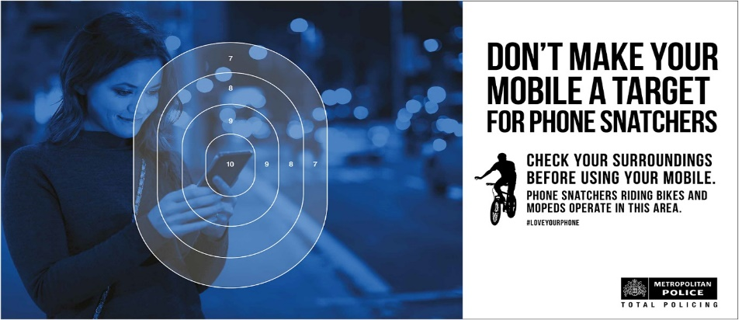
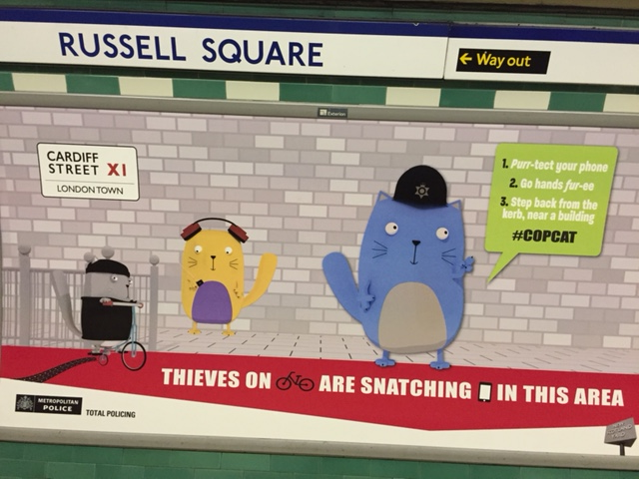
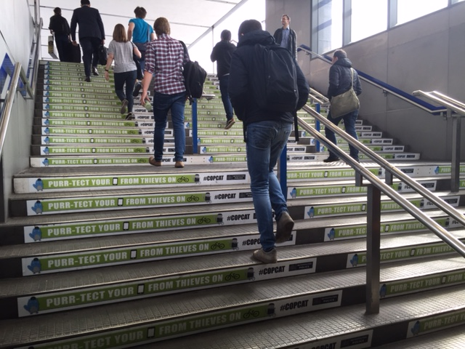
#Copcat MPS Trial
Field trial June 2016 – compare ‘Copcat’ campaign with standard MPS comms.
Empathetic messenger; humour; simple; no fear.
Social media assets; tube station; posters

Slide 64
Behavioural Crime Prevention
Design policy & practice to go with the grain of human behaviour
Messenger, message, mechanism – blend alters salience, receptivity & impact;
Avoid negative side effects – anger, fear;
Need to install responsibility + competence;
Paradox of choice - too much info induces inertia;
Showing not telling – model what you want people to do.
Complex problems blend nudges, tugs, teachable moments.

Slide 65

Technological Change
Dawes Centre for Future Crime at UCL
Notes:
Innovation and change bring benefits but also new crime opportunities. Let’s consider the past..

Slide 66
Car theft in England and Wales – A Crime Harvest?
Lessons in Prevention
Dawes Centre for Future Crime at UCL
Ownership
4M
8M
13M
19M
23M
28M
Notes:
Changes to recording practice (TWOC) in 70s.
Increase in availability led to a crime harvest that showed no signs of abating.
Vehicle manufacturers had the competency to act, and their changes could affect the masses. But were reluctant to do so. Car theft index…
https://www.gov.uk/government/uploads/system/uploads/attachment_data/file/8995/vehicles-summary.pdf
1992 first Car Theft Index, last 2006
Car theft peaked in 2003: 592,000 incidents
Last year, 2010-11, 99,000
The police loved it
The manufacturers took it on the chin
The insurance industry was supportive
The consumer groups were keen
The media picked up on it
It avoided legislation
It was very popular with the politicians

Slide 67
Lessons in Prevention
Horizon Scanning
  Tension between hard evidence versus stimulus
  Bottom-up (inductive) scanning for signals and issues
    clear search criteria
    Reach and possible impact
  Top-down (deductive) hypothesis testing
    Systematic realist synthesis
    Hierarchy of evidence
    Impartiality
    Weighting convergent sources
Notes:
Tension between evidence and stimulus value – RCTs tells us about interventions now but offer no insight into what’s next.
Hierarchy of evidence – High quality peer-reviewed studies with good samples; Ltd sample but robust method; single study or well cited review through to pure speculation.

Slide 68
Future Crimes Challenges
Internet of Things
Criminogenic Smart Cities: “The more we instrument the city and rely on those technologies clearly the more vulnerable they are to, to hacking and to, you know to collapse and so on.”

Slide 69
Conclusions
“We should recognize that anything that has happened in the past can happen again.” Becker, H. (2017) Evidence. P.10 – not ideographic history, but one that looks at ‘deep’ patterns in core processes.
Policing as a social institution was estd. as part of wider regulatory response to industrial revolution and urbanization, if ‘information revolution’ similarly profound, should accept changes to organization of social control similarly wide-ranging.

Slide 70
BREAK
Please join us for refreshments in the Hub Suite before returning to your seat
Don’t forget to visit the sponsors and poster displays
#SEBP2018

Slide 71
New Evidence from Queensland Police
Detective Inspector Mike Newman: Investigations and Intelligence Training Unit, Operational Policing and Leadership
People Capability Command, Queensland Police Service
#SEBP2018

Slide 72
10 RTCs that will change the way you think about policing
Barak Ariel: Lecturer in Experimental Criminology, Institute of Criminology at Cambridge University and Lecturer at the Faculty of Law at the Hebrew University of Jerusalem
#SEBP2018

Slide 73
LUNCH
Please collect your lunch from the Hub Suite, refreshments will be available in here. Please return to this room once you have collected lunch to allow others to get theirs
Don’t forget to visit the sponsors and poster displays
#SEBP2018

Slide 74
Lessons in Extremism: Behavioural Sciences
Simon Ruda: Director of Home Affairs and International Programmes. Behavioural Insights Team
Dr Antonio Silva: Home Affairs and International Programmes. Behavioural Insights Team
#SEBP2018

Slide 75
BREAKOUT SESSIONS
Breakout sessions are being held in a variety of rooms nearby, please refer to the agenda and choose a breakout session. Please note rooms are limited and seats will be allocated on a first come first served basis.
Rooms are signposted as you leave the theatre but if you are unsure, please ask a member of the organising team
#SEBP2018

Slide 76
Summary and Close
#SEBP2018
T/Assistant Chief Constable Alex Murray
West Midlands Police and Chair, SEBP

Slide 77
CONFERENCE DINNER
For those that have booked
Welcome drinks – 7.00pm
Dinner service – 7.30pm
Hilton Hotel, Kents Hill, MK7 6HL
Please make your own way there
#SEBP2018

