Slide 1
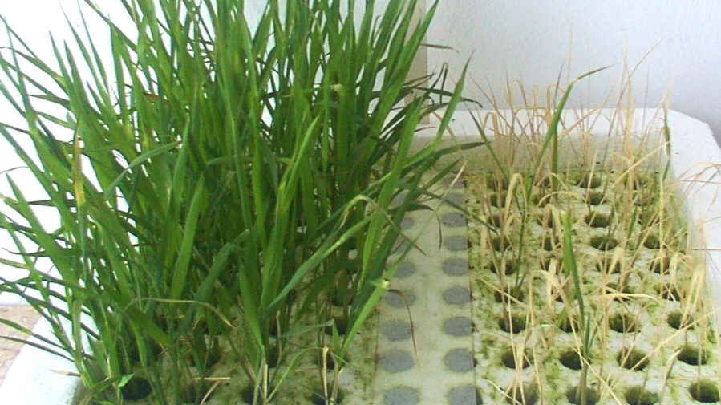

Slide 2
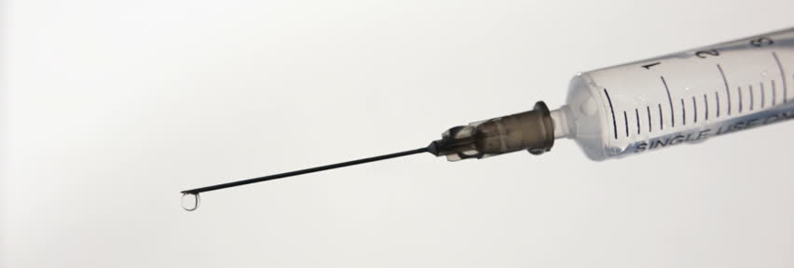
Enhancing evidence-based research within law-enforcement intelligence practice
A Call to Arms for Practitioners & the Pragmatic Intellectual Ecosystem Beyond
Dr Mils Hills

Slide 3
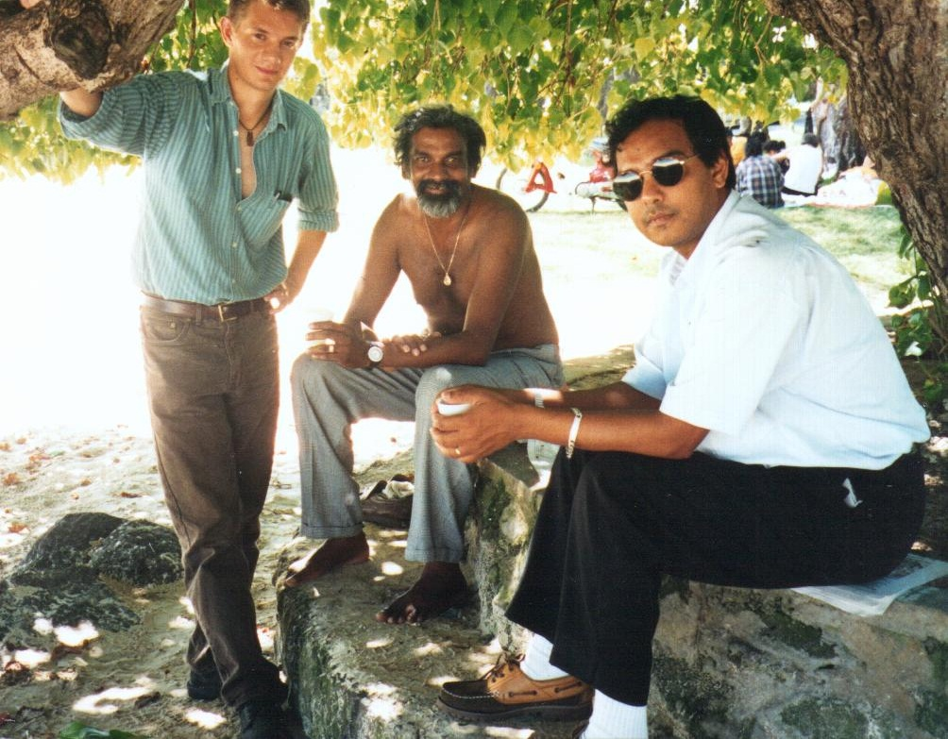
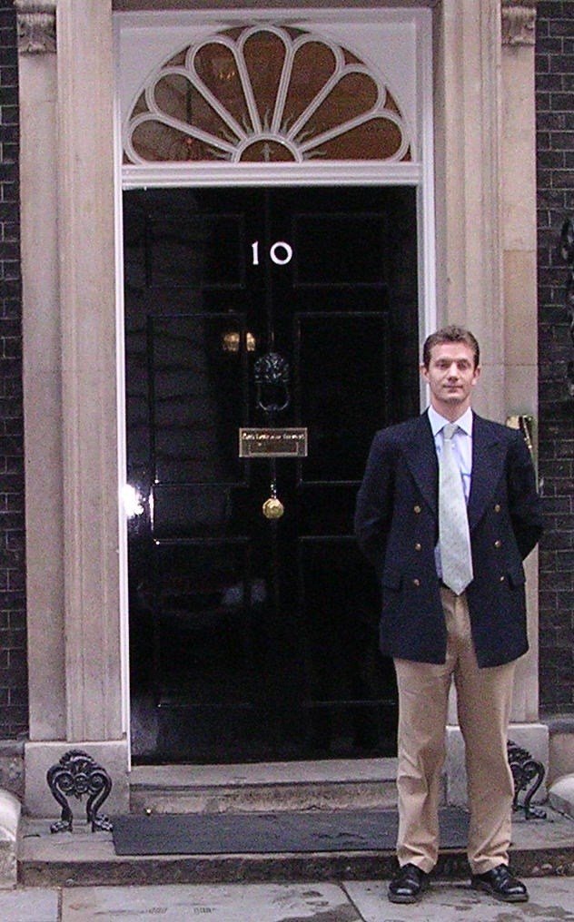
My Background
1998
First Social Anthropologist in HMG
Defence: Information Warfare / social network analysis
2001
Secondment to Cabinet Office
& National Capability Head for Human Factors of Info Ops [dstl]
2005
Analytic Red LLP consultancy
Contracted by OGDs, [dstl], Bank of England boards
2010
University life
Research & development
Support to elite military units
Tremendous PhD student from Met Police – Dr Paul MacFarlane.

Slide 5
Risk of Erosion of Public Trust + Political Capital

Slide 6
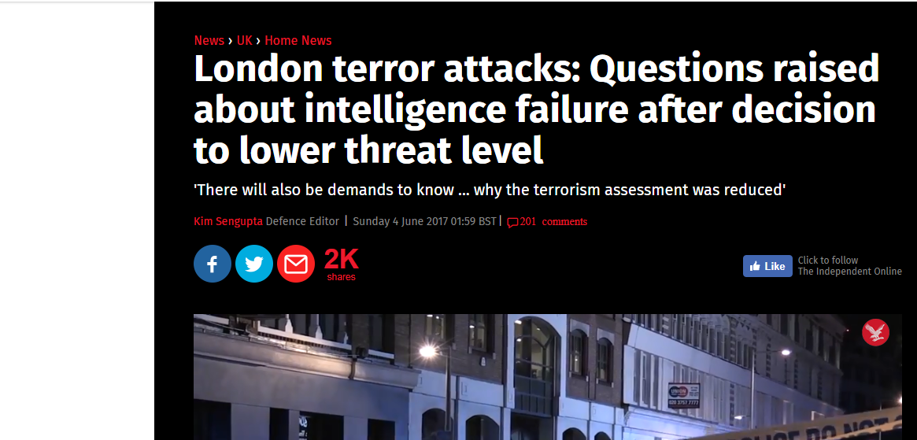

Slide 9
If things were easy to fix …. they would have been
Organisational culture within law enforcement needs to be open to sharing / drawing on insights, changing practice
Asking for support at the right time
Knowing where (critical) friends are

Slide 10
Practitioners’ Reasonable Expectations of Academics

Slide 11
Accessing academics is difficult… but there are models to follow

Slide 12
Adding Value through:
Empathy for Constraints
Practical Creativity
Disruptive Innovation

Slide 13
Empathy with the Practitioner
Legal + operational constraints
Pressing timescales (which could shift with no warning)
Security classifications & sensitivities
Willingness to transcend disciplinary boundaries

Slide 14
Achieving Evolutionary Leaps
Guarded Openness from law enforcement
Willing to take a chance on new approaches for potentially massive benefit
Locate ‘Pracademics’ or, at the very least ‘pragmatademics’
Beyond usual sources (criminologists, sociologists of deviance, policing experts)
Package problems in a way that eliminates classification concerns
Identify clearable problem-solvers for issues that cannot be de-contextualised
Collateral from ‘unrelated-to-law-enforcement’ resources:
77 Brigade / SF etc.: reachback from theatre to deep expertise (non-military)
Transport Systems Catapult: 150 experts, most with no background in transport
Urgent Operational Requirements (UOR) for MoD, etc. into [dstl]
CPNI - Information Exchanges ….. Professional ‘Devil’s Advocates’
Secondment / embedding outsiders

Slide 15
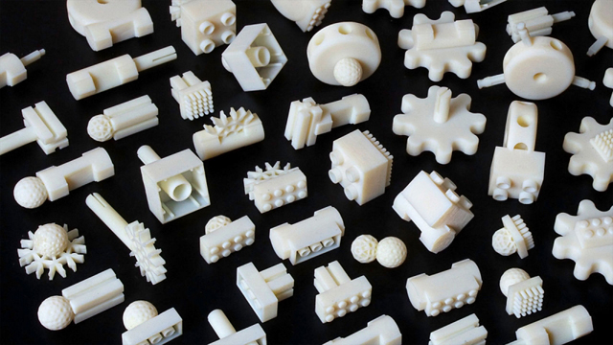
Catalytic Effects
Decrease lag between identifying problem & trialing solution
Rapid prototyping – aka 3d printing of novel parts to solve unique problems
New techniques to build cohesion across multiple law enforcement / intelligence stakeholders

Slide 16
Thank You
Mils.hills@Northampton.ac.uk

