Slide 1
Recurrent problems with investigative interviews; Can a Structured Interview Protocol help?
Fiona Gabbert¹ & Laura Hynes²
¹ Professor of Psychology at Goldsmiths University of London
² Detective and Interview Advisor at Greater Manchester Police
Notes:
30 mins total

Slide 2
Background & Context for Research
Investigative interviewing is a complex task requiring;
Interpersonal skills
Knowledge of memory
Cognitive resources (attention,monitoring, decision making, strategy)
Professional knowledge, expertise, and competence.
It is not intuitive. It is not easily learned on the job.
It evolves via scientific enquiry and the systematic evaluation of methods, leading to evidence-based advances in effective investigative interview training, policy, and procedure
This knowledge/expertise does not always translate into practice – WHY?
Notes:
Advanced knowledge/expertise does not always translate into practice, in particular the delivery of interview training has not kept pace with research.
Laura, do we want to focus on frontline officers?
Least training
Most interviewing
Increasingly wearing Body-Worn Video Cameras, so their conduct is recorded.
Advanced knowledge/expertise does not always translate into practice, in particular the delivery of interview training has not kept pace with research.

Slide 3
Background & Context for Research
Recurrent problems with frontline interviews include;
Inappropriate questioning techniques (including use of leading q’s)
Inappropriate structuring of interviews (topic-hopping)
Minimal rapport-building
Unconscious incompetence
Evidenced by –
Surveys of police officers re. interview techniques used (and skills needed).
Analyses of real-life interview data from frontline officers identifying common challenges and training needs.
Focus group work with frontline officers.
Notes:
…on that note I’ll hand over to you.

Slide 4
Response officers’ views on interview skills
Research involved over 82 response officers working on an inner city sub division of GMP.
Responsibility for initial attendance at a varying range of incidents.
Actions inform immediate and long term investigative response.
Refresher training conducted around witness and suspect interviews.
Training commenced with a workshop in which participation was encouraged within groups regarding points they considered relevant and important.
Recurring themes, topic areas and specific quotes recorded contemporaneously (as well as misconceptions!)

Slide 5
Topics addressed
Topics
1 | When and in what circumstances did you last/have you ever received any form of investigative interview training? What format did this take?
2 | How often do you feel you carry out an investigative interview in your current role?
3 | What is the current model of Investigative Interviewing used by UK Police services? Explain your understanding and use of this in your role.
4 | What note taking methods do you use when undertaking an investigative interview?
5 | Describe any operational issues you are experiencing, in relation to conducting Investigative interviews.

Slide 6
Results
Average length of service – 9 years.
All participants except five stated only training was on initial training, prior to operational deployment and contextualisation.
All could not recall the detail in the training, and had developed their own methods since as result of time constraints, apathy, peer pressure & forgetting.
There was a generalised view that RPT officers were not prioritised, if considered at all for any further development, training or assessment once confirmed in their substantive role.
Those who were content to remain deployed in a frontline uniformed role believed they were unlikely to receive any further formal or informal training in relation to interviewing skills, despite an eagerness to undertake the same. This point of view was clearly linked to issues of morale and confidence.

Slide 7
Results
The training and usage of Specially Trained Officers (STO’s) in sexual offences, was identified as a particular cause for concern, with claims that this does not involve any real interview training, rather just forensic instruction.
All reported daily “statement taking activities” but generalised lack of link to an Investigative Interview.
Many officers failed to recognise the importance of their immediate role in the wider context of investigation and interviewing, including that of developing rapport, and setting the tone for furtherance of enquiries. The clear picture was that of the RPT role being viewed as “crime recorders not investigators” to directly quote one participant.

Slide 8
Results
High numbers of participants were unable to name, define or explain the PEACE model of interviewing. Very few were able to provide an insight into what they considered to be good interview structure.
No officers were able to give an overview of anything approaching the correct legislation or guidance intended to categorise and enable appropriate management of Vulnerable or Intimidated witnesses, they were vastly unaware of other categorisations as detailed in Achieving Best Evidence (ABE) despite this being a core function of their role.

Slide 9
Results
All Officers involved stated that they did not make any notes of any kind, regarding their decision making, strategic choices, or reasoning in relation to investigative interview related issues (or indeed any other areas of their work) When probed this was attributed to lack of time, and a clear lack of comprehension how to do this, or what the purpose for doing it might be.
Generally Officers stated their main reason for lack of proper note taking, and proceeding straight to writing a statement, was due to lack of time and “pressure to get to the next job.” Few had any insight as to the fact that this has a tendency to produce poor quality, low detailed evidential statements
Many participants stated they were “not investigators” and rejected notions that to the contrary they were vital components of the wider investigation.
All participants expressed a desire to receive constructive developmental, feedback, mentoring and assessment of their interviewing performance.

Slide 10
Results
There were concerns raised as to the allocation of BWV and the fact that this is now exposing the actions these officers take at the scenes of incidents. A common call was given for further support and training to protect them.
Even very recently trained participants admitted to an almost immediate alteration of practise due to the pressures placed upon them in the workplace, by managers and the wider system. There was an apparent difficulty in the application of accepted best practise, into everyday operations.
This research did not uncover a series of disenchanted or wrathful individuals, rather a large group of Professional Police Officers who wanted to perform to the best of their ability, and felt a number of preventative frustrations.
PROFESSIONAL CONFIDENCE?

Slide 11
Crisp box head.
Gangland shooting (call handler – officer safety).
Vulnerable persons – Op Bran CSE (rapport build) OP Span Girl A.
Interfamilial sexual abuse – BWV.
Live kidnapping/aggravated burglary – safety interview.
Key Points?
Early accuracy of info. is VITAL.
Frontline officers (Uniform & CID) are VITAL investigators – should they not therefore receive good quality training and CPD?
Confidence and morale are intrinsically linked.
Case study (IES!)

Slide 12
Background & Context for Research
Implications of poor interview practice at an early stage?
Sub-standard evidence
Poor investigative use of frontline interviews further down the line
Officer/Force accountability
Conduct captured on video (BWV, recorded interviews)
The Supreme Court has ruled that people can sue the police for failures in investigations, after two victims of black cab rapist John Worboys brought a case against the force.
Notes:
I have given it some thought, and i also feel that in support of frontline staff and the accounts that they take, we should also mention the poor usage of good frontline interviews, and poor investigative use of these further down the line (i can give examples jut need to put my mind to them) and mention the gold dust that these early accounts are for an investigation especially considering the advent of technology and awareness of offenders (if that makes sense?) often the early accounts hold some compelling unguarded responses from both victims and suspects and we fail to tap into these - this links to investigative knowledge and strategy as a whole and not just interviewing as a discipline.
I think the message to those who don't value and cherish interviewing as we do, has to continue to be that it is an area that influences the usefulness of all other investigative tools (phones, forensic for example)
now that we have a rough plan we can gather some supporting material and start to compile a really engaging session (i hope!) i think it will work well with you presenting the research and outcomes and me contextualising it? but happy to do whatever you think…

Slide 13
Background & Context for Research
What works to translate knowledge into practice?
Introduce/reinforce evidence-based interview tools and techniques via effective training resources to enhance learning and reduce skill fade
Focus not only on how to use tools and techniques, but why they work
Use of structured protocol approaches
Use of aide-memoirs
Joint practitioner/academic delivery of training where possible
Refresher training
Establish mechanisms to provide feedback on the quality of interviews

Slide 14
Developing and testing a Structured Interview Protocol: Evidence-based and PEACE compliant
Research Objectives
Examine real-life interview data from frontline officers to identify common challenges and training needs (baseline performance).
Work with our practitioner collaborators to develop an evidence-based Structured Interview Protocol & related training, for use by frontline officers and PIP level one interviewers.
Test the Structured Interview Protocol under controlled conditions to examine the amount of training required to produce effective results.
Test the Structured Interview Protocol training in the field.
Notes:
“PIP level one interviewers” includes call handlers IAs and detectives when we talk about it?

Slide 15
Objective 1: Examining baseline performance
Total N = 94, from four participating UK-based police forces.
Common deviations from best practice and PEACE guidelines –
Engage & Explain phase
Absence of any rapport building attempts (87 / 94)
No attempt to explain expectations of the witness (78 / 94)
Account phase
Poor interview structure; ‘topic-hopping’ was the norm.
Poor use of hierarchical questioning (open – closed q’s)
Over-reliance on closed and 5 wh- questions
Interviewer led

Slide 16
Objective 2: Develop a Structured Interview Protocol
Taking the form of a generic PEACE interview template, ensuring -
Evidence-based techniques to facilitate ‘Engage’ (rapid rapport techniques, use of empathy, etc.) and ‘Explain’ (setting expectations and threshold of reporting, source-monitoring, allowing uncertainty, etc.)
Evidence-based techniques to facilitate retrieval (appropriate use of questions; interviewee-led interviewing; use of retrieval techniques, etc.)
Effective training techniqes to facilitate retention of learning (psychology of learning, protocol format, use of aide memoirs, etc.)

Slide 17
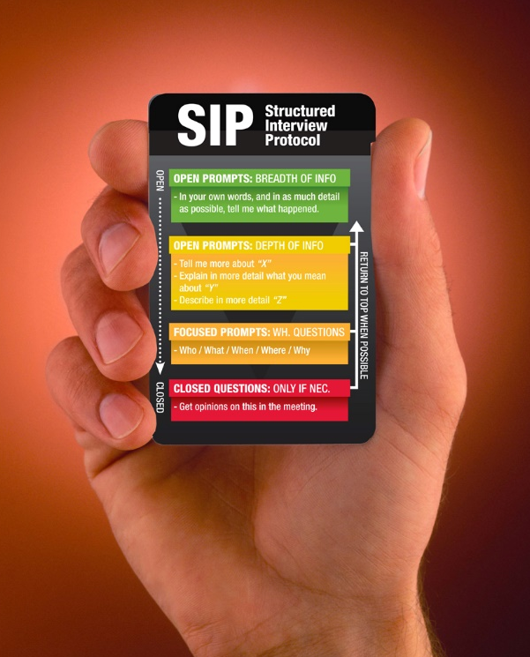
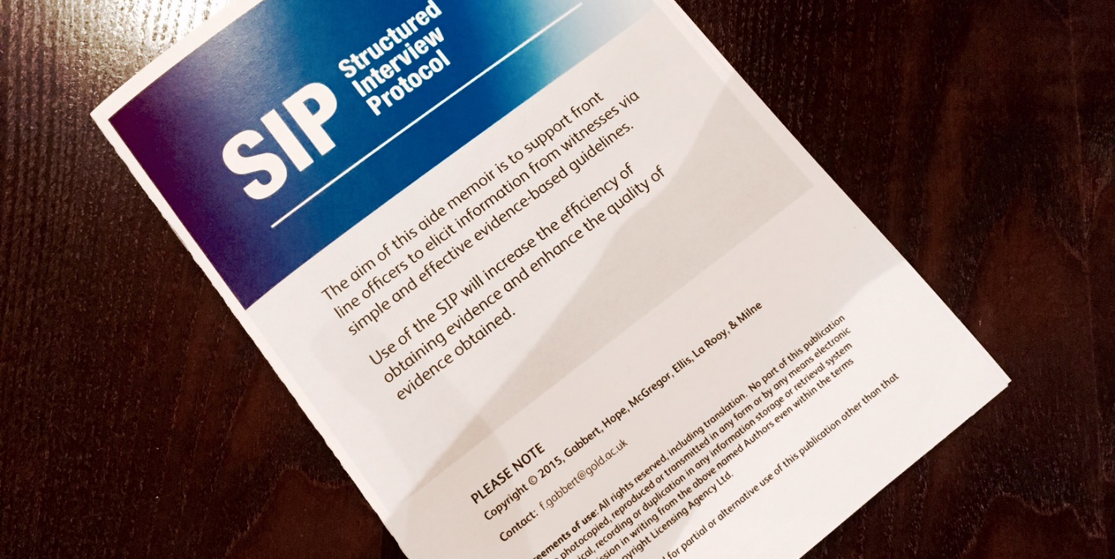

Slide 18
Objective 3: Field trial
Mock-witness study (N = 65 response officers from 2 forces)
Pre-SIP training interview with a mock witness.
SIP training (max. 1 day)
Post-SIP training interview with a mock witness.
Real-witness field study (N = 216 response officers from 4 forces)
BWV footage of interviews sourced from officers who (a) later received SIP training, or (b) did not receive SIP training.
BWV footage of SIP-trained vs. non trained officers approx. 1-2 months following the training sessions.
Notes:
GMP – experience 9 years (last training 7.5 years)
TVP – experience 4 years (last training 4 years)
Mock witness – lab members trained to be witnesses; know everything about a couple of crimes; respond appropriately to questions to reinforce learning

Slide 19
Results: mock witness study, engage & explain
Mean no. of advanced E&E techniques used

Slide 20
Results: mock witness study, use of questions
Mean % of question types used

Slide 21
Results: mock witness study, appropriate structure
Notes:
Appropriate use of topics? Interviewee-led questioning?

Slide 22
Feedback
Would you do anything different post SIP training? YES 77%
 | Strongly Disagree | Disagree | Neutral | Agree | Strongly agree
SIP booklet useful | 1 | 0 | 5 | 43 | 38
SIP aide memoir useful | 1 | 4 | 2 | 41 | 38
Feel more confident | 1 | 3 | 13 | 48 | 22

Slide 23
Results: field interviews
Engage & Explain % of Open Qs used
% of Closed & Probing Qs used % of Inappropriate Qs used
SIP training Controls (no SIP training)

Slide 24
Summary and concluding comments
The PEACE-compliant SIP package promotes high quality interview performance
Increased use of rapid rapport techniques, enhanced ‘engage & explain’ skills, and an increase in appropriate question types, used in a structured manner.
Vital skills; the initial work of response officers often lays the foundations for successful major investigations.
In addition
All content is evidence-based; It addresses needs; It is cost-effective
It is the product of an academic/practitioner collaboration.
All resources are freely available.
Notes:
But what could be added is that the sip fits in with the later models of interviewing taught at pip 2 and pip 2 specialist and response interviewers should be adhering g to same standards Why would we do it one way at initial action and another at Abe? Best practise is best practise.... maybe a revisit to the confidence issue- these officers are the foundations of a successful major investigation? Any major investigation you can think of will prob have started with a response officer .....
Potential for additional effective techniques to be added in so that it remains current (modular based)
Acknowledge that budget cuts mean less training - and refresher training – opportunities
Embed as initial training for all new officers (easier than re-training)?
Creates strong base for advanced training

Slide 25
Thank you. Questions welcome.
f.gabbert@gold.ac.uk laura.hynes@gmp.police.uk
Acknowledgments:
Research funding from the Economic & Social Research Council (ESRC grant no ES/M006395/1)
Participating Police Forces
Volunteer Research Assistants at Goldsmiths University

