Slide 1
Combined Performance Management System (CPMS)
Technology as a Tool for Evidence-based Policing
Society of Evidence-based Policing
Open University, 01 March 2018
Confidential BriefingCopyright© Lightfoot Solutions 2016

Slide 2
Evidence-based Policing
How do you know?
Combined Performance Management System (CPMS)
Confidential BriefingCopyright© Lightfoot Solutions 2016

Slide 3
Evidence-based Policing
How do you know?
Combined Performance Management System (CPMS)
RCT?
Careful preparation of target group and control group
Some element of overhead / cost
Length of time of trial
At what point should trial start / end
Needs to be statistically valid
Sample sizes
Rigour
Stats analysis
Confidential BriefingCopyright© Lightfoot Solutions 2016

Slide 4
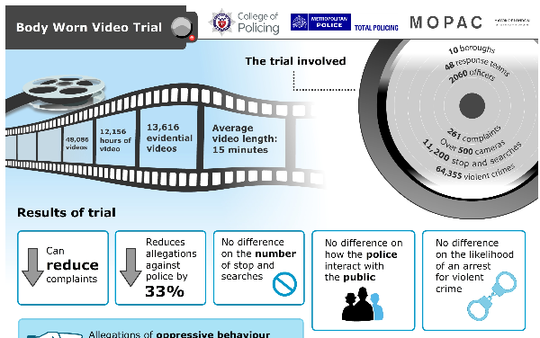
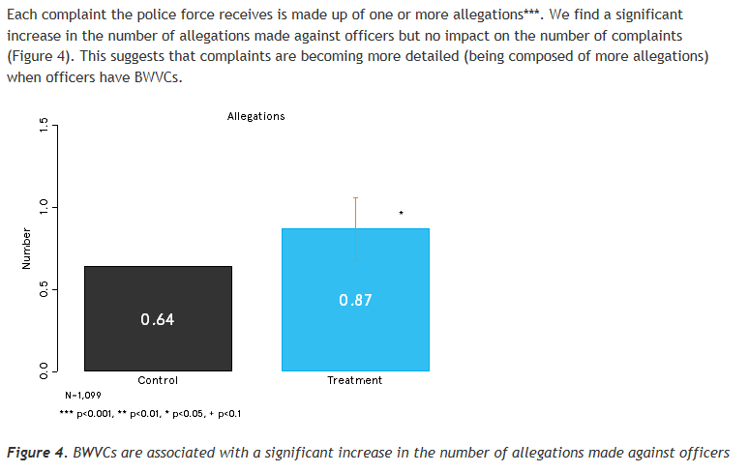
Evidence-based Policing
How do you know?
Combined Performance Management System (CPMS)
For example, Body Worn Video Trials
College of Policing, 05 December, 2017
College of Policing, 16 May, 2016
Confidential BriefingCopyright© Lightfoot Solutions 2016

Slide 5
Evidence-based Policing
How do you know?
Combined Performance Management System (CPMS)
Longitudinal Trial?
Time consuming and demanding for researcher and participants - may affect results
Sample Attrition – people / teams change or drop out over time
Environment, expectations, issues and concepts may change over time it takes to do research
Confidential BriefingCopyright© Lightfoot Solutions 2016

Slide 6
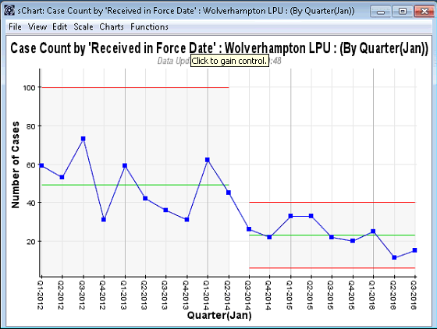
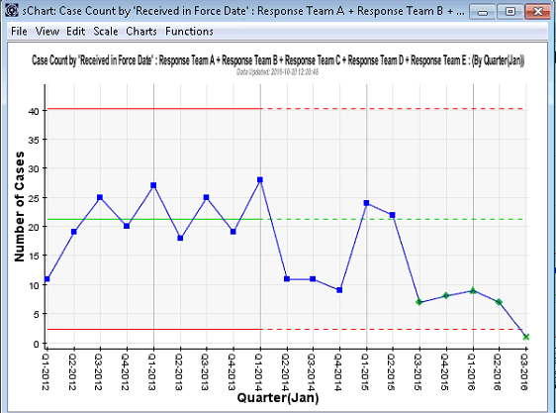
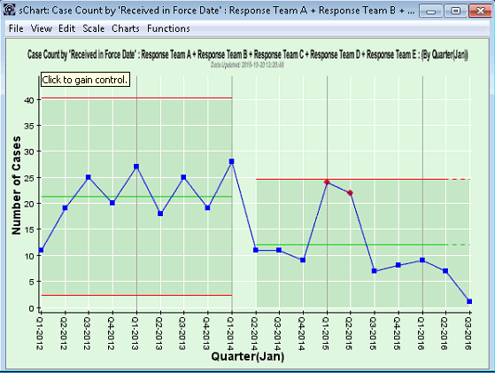
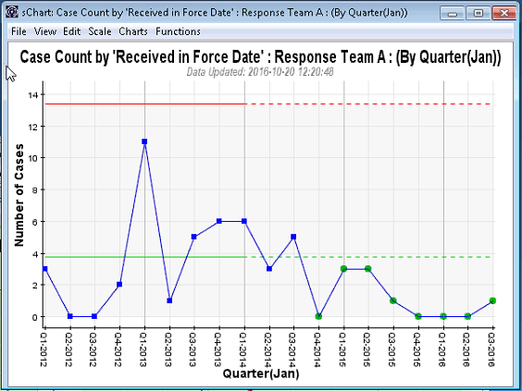
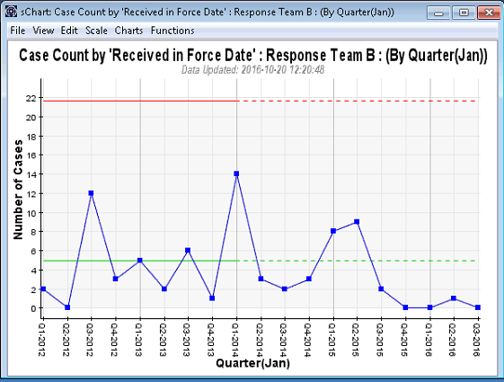
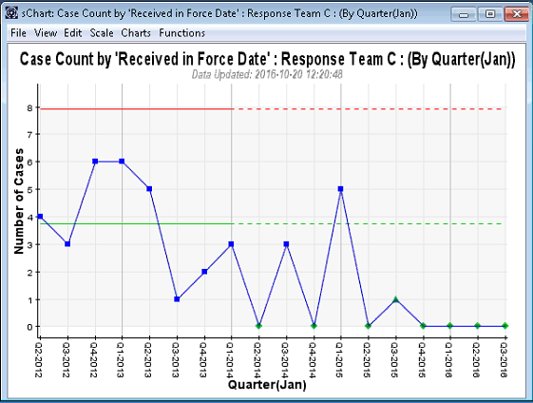
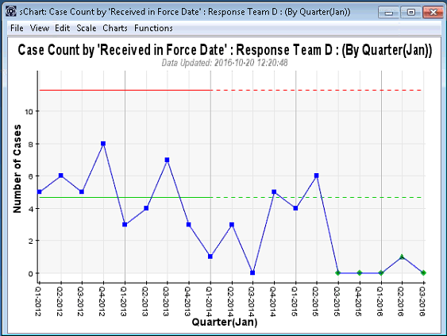
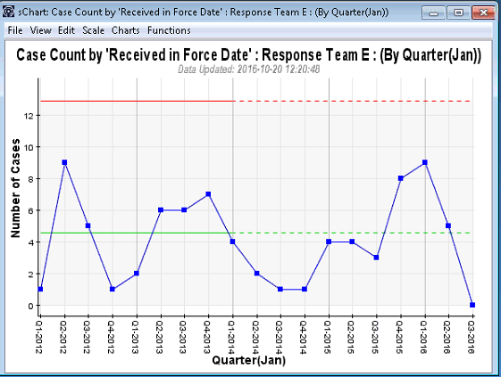
Evidence-based Policing
How do you know?
Combined Performance Management System (CPMS)
For example, Body Worn Video Trials
Wolverhampton Trial (Dec 2013 – Sep 2015)
Trial Results: Complaints reduced by 46%
Wolverhampton Data:
Background & Context Overall:
Q3 2014: Greater than 3σ shift down
Much greater predictability
Response Teams wearing BWV:
Q3 2014: 1.5 σ shift down (Q1, Q2 2015?)
Team A: Reduction signal
Team B: Potential Reduction signal (except for (Q1, Q2 2015))
Team C: Potential Reduction signal
Team D: Potential Reduction signal
Team E: No reduction signal
Confidential BriefingCopyright© Lightfoot Solutions 2016

Slide 7
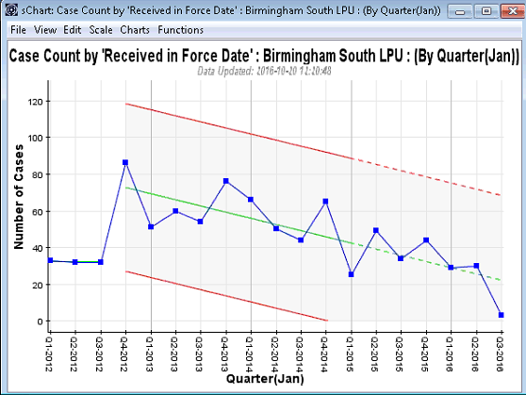
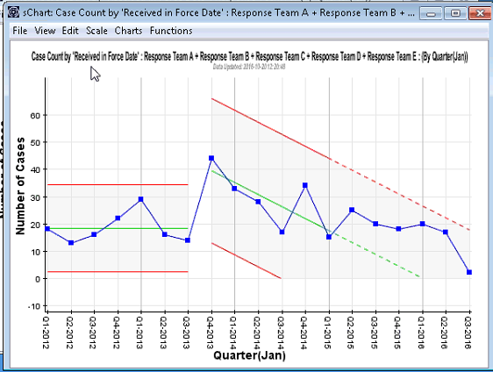
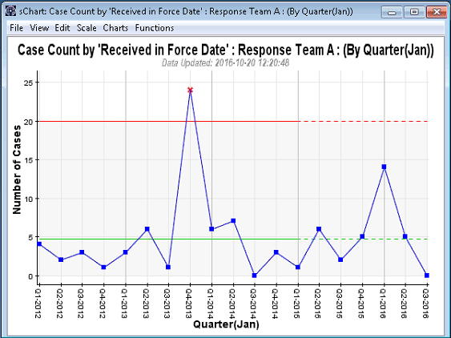
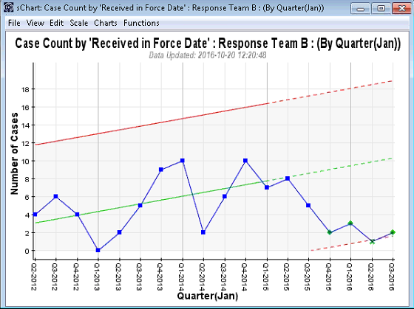
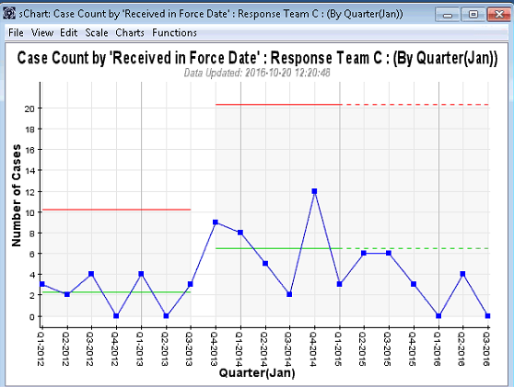
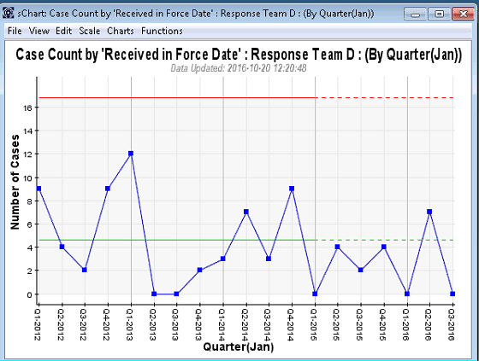
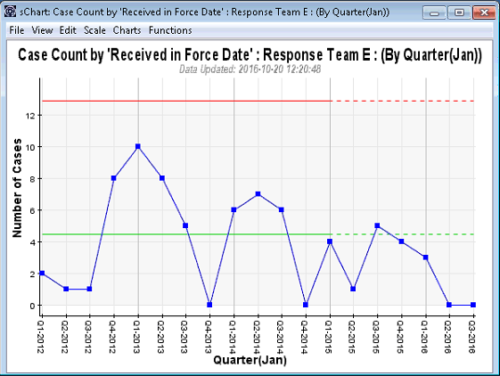
Evidence-based Policing
How do you know?
Combined Performance Management System (CPMS)
For example, Body Worn Video Trials
Birmingham South Trial (Mar – Sep 2015)
Complaints reduced by 100%
Birmingham South Data:
Background & Context Overall:
Q4 2012: Trend downwards @ 20/year
Response Teams wearing BWV:
Q4 2013: Trend downwards @ 15/year
Team A: No Reduction signal
Team B: Potential Reduction signal Q4 2015 onwards
Team C: Potential Reduction signal Q1 2015 onwards
Team D: No Reduction signal
Team E: No reduction signal
Confidential BriefingCopyright© Lightfoot Solutions 2016

Slide 8
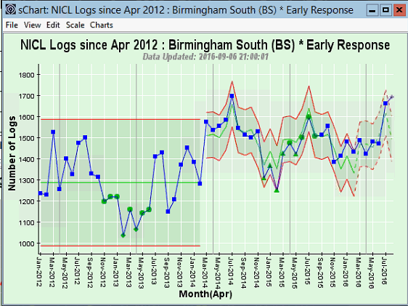
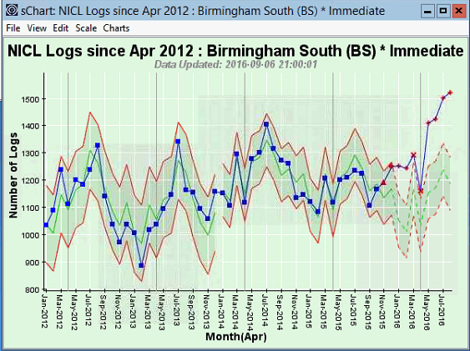
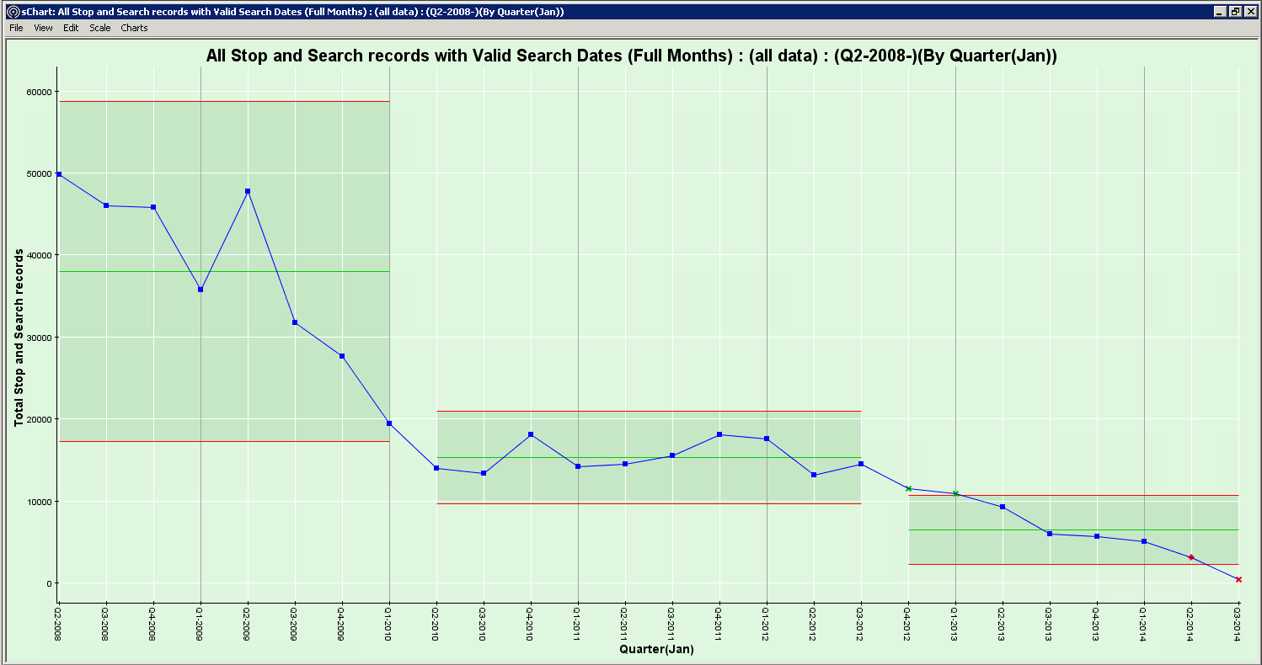
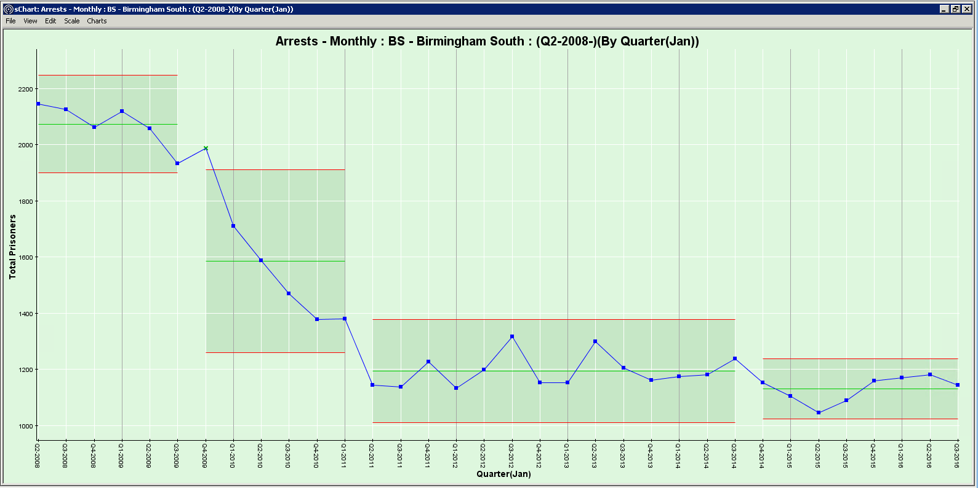
Evidence-based Policing
How do you know?
Combined Performance Management System (CPMS)
For example, Body Worn Video Trials
Birmingham South Trial (Mar – Sep 2015)
Complaints reduced by 100%
Birmingham South Data:
Background & Context Overall:
Q4 2012: Trend downwards @ 20/year
Immediate & Early Response Incident Volume
No correlation
Stop & Search
Arrests
Confidential BriefingCopyright© Lightfoot Solutions 2016

Slide 9
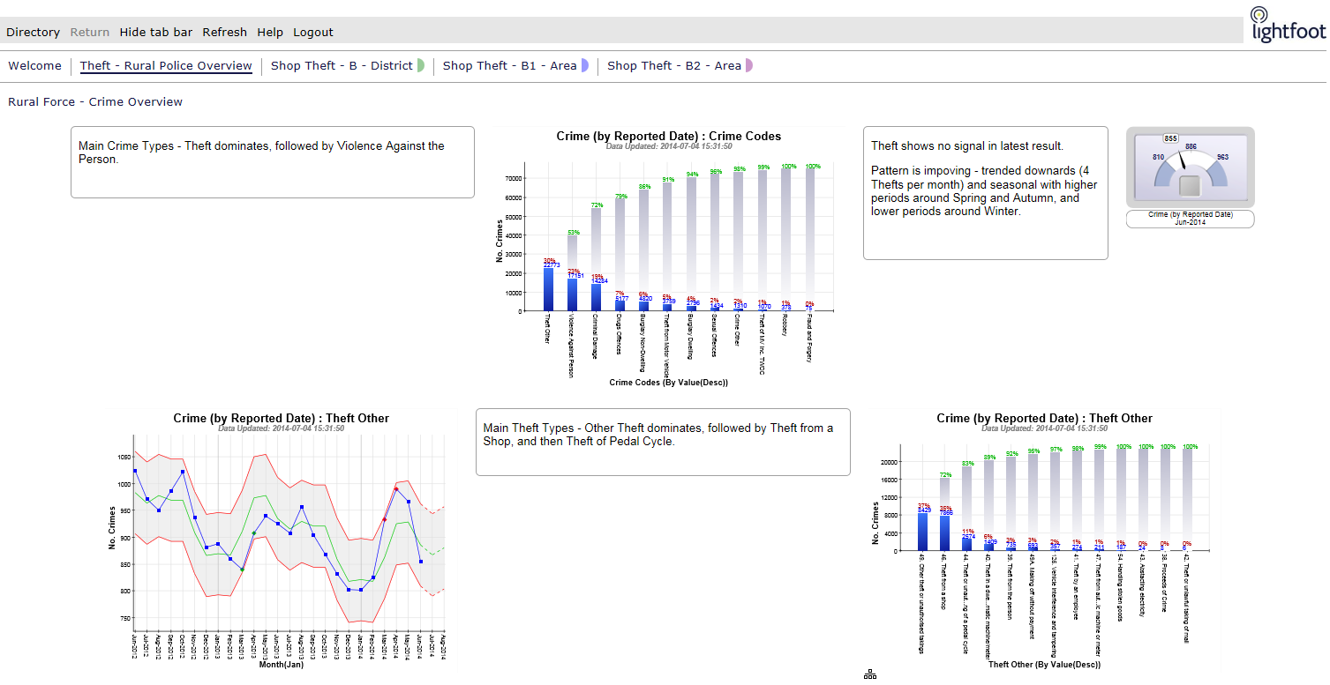
Evidence-based Policing
How do you know?
Combined Performance Management System (CPMS)
For example, Police Operations / Initiatives (properly monitored)
Norfolk Police
Operation Mistletoe
Norfolk Police Data:
Background & Context Overall:
Theft dominates volume
Theft seasonally trending down
Confidential BriefingCopyright© Lightfoot Solutions 2016

Slide 10
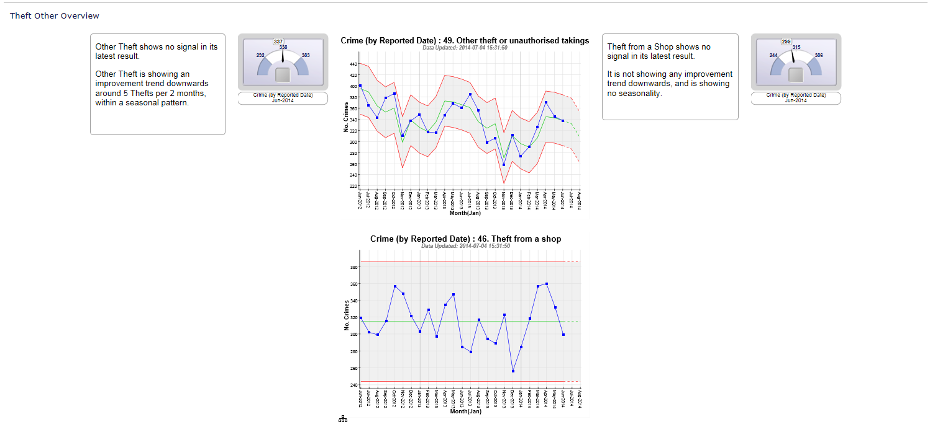
Evidence-based Policing
How do you know?
Combined Performance Management System (CPMS)
For example, Police Operations / Initiatives (properly monitored)
Norfolk Police
Operation Mistletoe
Norfolk Police Data:
Background & Context Overall:
Theft dominates volume
Theft seasonally trending down
Other Theft seasonally trending down
Shoplifting is not improving
ACTION: Make intervention on Shoplifting
Confidential BriefingCopyright© Lightfoot Solutions 2016

Slide 11
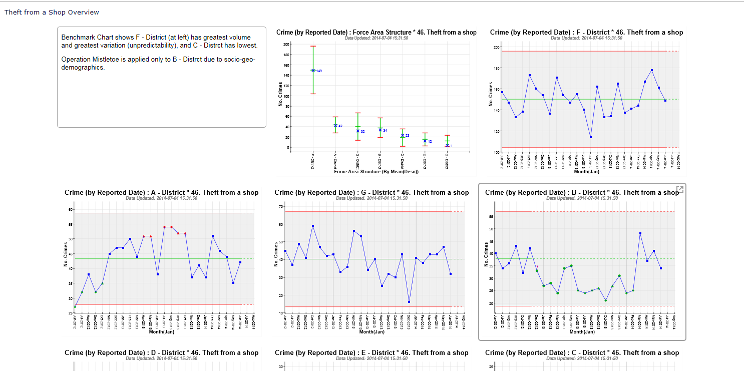
Evidence-based Policing
How do you know?
Combined Performance Management System (CPMS)
For example, Police Operations / Initiatives (properly monitored)
Norfolk Police
Operation Mistletoe
Norfolk Police Data:
Background & Context Overall:
Theft dominates volume
Theft seasonally trending down
Other Theft seasonally trending down
Shoplifting is not improving
ACTION: Make intervention on Shoplifting
WHERE: B District
Confidential BriefingCopyright© Lightfoot Solutions 2016

Slide 12
Evidence-based Policing
How do you know?
Combined Performance Management System (CPMS)
For example, Police Operations / Initiatives (properly monitored)
Norfolk Police
Operation Mistletoe
Norfolk Police Data:
Background & Context Overall:
Theft dominates volume
Theft seasonally trending down
Other Theft seasonally trending down
Shoplifting is not improving
ACTION: Make intervention on Shoplifting
WHERE: B District
IMPACT: Sustained reduction
Confidential BriefingCopyright© Lightfoot Solutions 2016

Slide 13
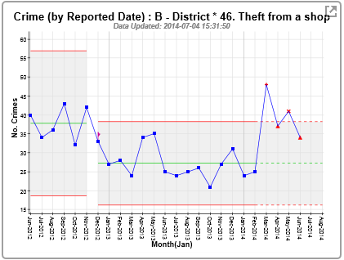
Evidence-based Policing
How do you know?
Combined Performance Management System (CPMS)
For example, Police Operations / Initiatives (properly monitored)
Norfolk Police
Operation Mistletoe
Norfolk Police Data:
Background & Context Overall:
Theft dominates volume
Theft seasonally trending down
Other Theft seasonally trending down
Shoplifting is not improving
ACTION: Make intervention on Shoplifting
WHERE: B District
IMPACT: Sustained reduction
Confidential BriefingCopyright© Lightfoot Solutions 2016

Slide 14
Evidence-based Policing
How do you know?
Combined Performance Management System (CPMS)
For example, Police Operations / Initiatives (properly monitored)
Norfolk Police
Operation Mistletoe
Norfolk Police Data:
Background & Context Overall:
Theft dominates volume
Theft seasonally trending down
Other Theft seasonally trending down
Shoplifting is not improving
ACTION: Make intervention on Shoplifting
WHERE: B District
IMPACT: Sustained reduction
PERFORMANCE LEVEL: Reset Performance Guidelines
Confidential BriefingCopyright© Lightfoot Solutions 2016

Slide 15
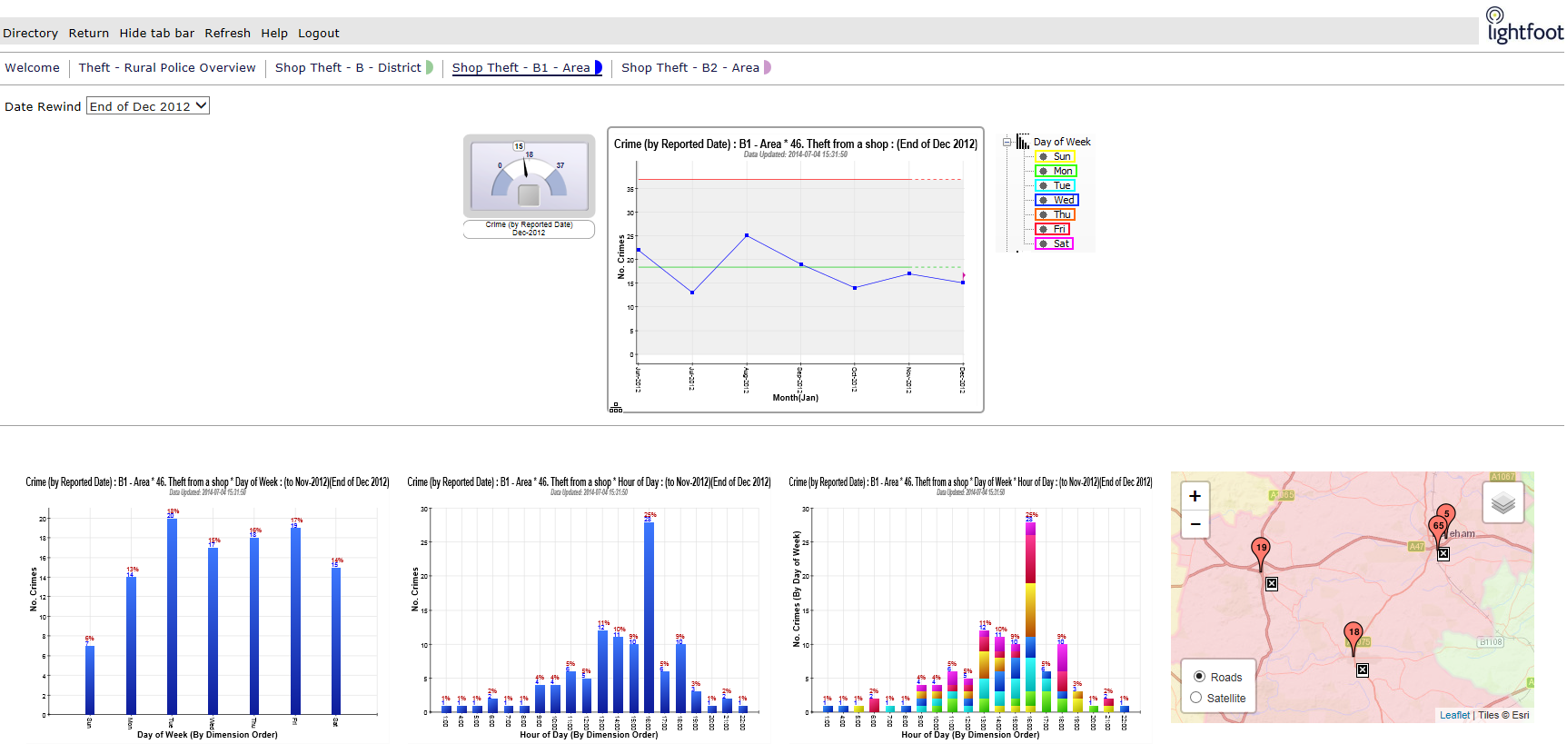
Evidence-based Policing
How do you know?
Combined Performance Management System (CPMS)
For example, Police Operations / Initiatives (properly monitored)
Norfolk Police
Operation Mistletoe
Norfolk Police Data:
B1 December 2012:
Operation Mistletoe begun
Schools
Shopping complexes
Confidential BriefingCopyright© Lightfoot Solutions 2016

Slide 16
Evidence-based Policing
How do you know?
Combined Performance Management System (CPMS)
For example, Police Operations / Initiatives (properly monitored)
Norfolk Police
Operation Mistletoe
Norfolk Police Data:
B1 December 2012:
Operation Mistletoe begun
Schools
Shopping complexes
IMPACT: Run of 8 = sustained reduction
Confidential BriefingCopyright© Lightfoot Solutions 2016

Slide 17
Evidence-based Policing
How do you know?
Combined Performance Management System (CPMS)
For example, Police Operations / Initiatives (properly monitored)
Norfolk Police
Operation Mistletoe
Norfolk Police Data:
B1 December 2012:
Operation Mistletoe begun
Schools
Shopping complexes
IMPACT: Run of 8 = sustained reduction
CONSEQUENCES: Shoplifters adjusted behaviour!
Confidential BriefingCopyright© Lightfoot Solutions 2016

