Slide 1
How should police cope with demand?
Centre for Policing Research and Learning
Paul Walley, Anna Jennison-Phillips

Slide 2
Introduction
Purpose
This presentation reports the findings of a study to identify ways of reducing demand for police services from “known” sources of non-urgent demand.
Motivation
Gloucestershire Police have previously identified the need to reduce demand by 30% if they can achieve a demand/capacity balance within existing resource constraints.
Method
The work is based on an in-depth stratified study of 535 non-urgent incidents of demand that occurred over a two-week period in February 2017.
Perspective
We take a systems approach to the problem, drawing on concepts such as “failure demand” [tested widely in healthcare].

Slide 3
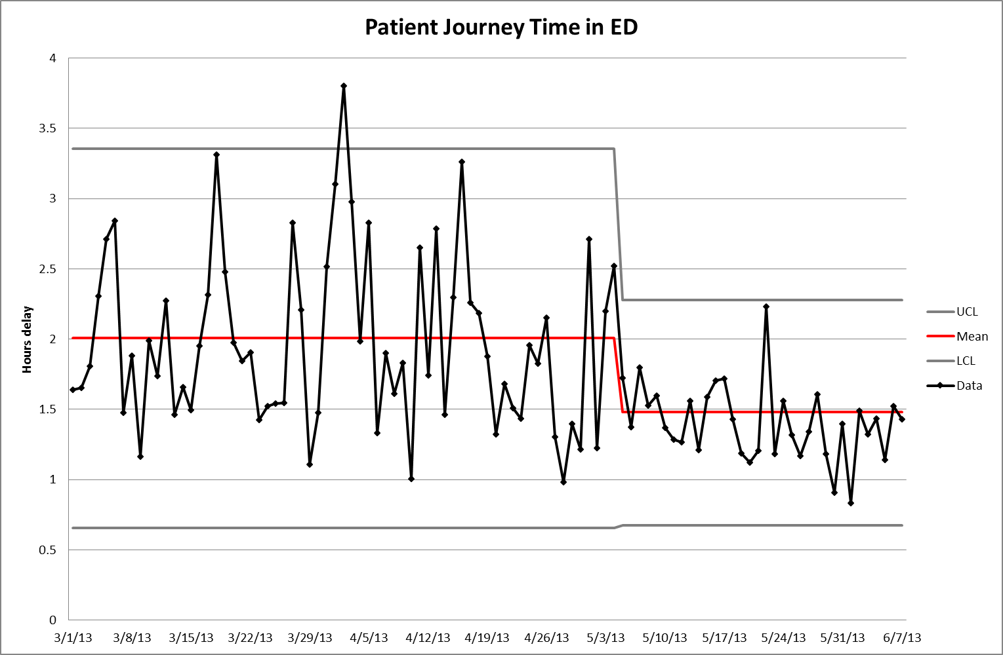
Context
Background in improving access to healthcare
Significant reductions in journey time and access block achieved by:
Eliminating/reducing prioritisation
Eliminating/reducing ring-fencing
Focusing on customer journeys
Dealing with simple work straight away
Eliminating MAUs/SAUs
Project Start
Comparisons:
Does prioritisation increase delays in police services?
Can prioritisation be reduced?
Can streaming of non-urgent work help reduce resource requirements?
Is there a comparison between MAUs and Incident Assessment Units?

Slide 4
Dealing with Police Demand
Is risk the only factor to consider?
Safety
Ensuring that risks are considered
Service
Sustain-ability
Ensuring the service is designed to meet needs
Ensuring that the service is feasible and affordable

Slide 5
Public sector failure demand
Failure demand can be defined as:
“demand caused by a failure to do something or do something right for the customer” (Seddon, 2003)
“In service organisations…failure demand often represents the greatest lever for performance improvement. In financial services it can account for anything from 20 to 60 per cent of all customer demand…in local authorities and police forces as much as 80-90% are avoidable and unnecessary” [Seddon (2009), p33]

Slide 6
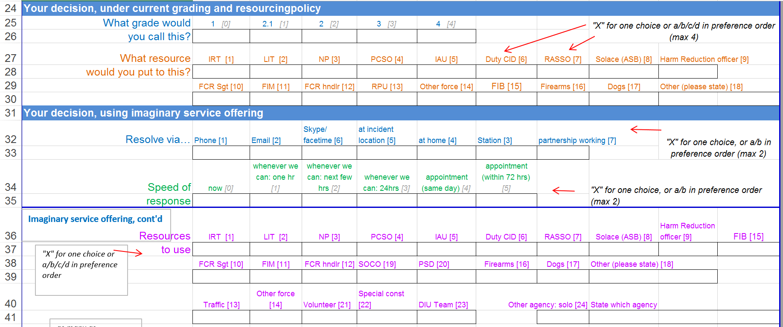
Research method
Survey of 535 non-urgent incidents coming into the control centre
Demand from early February
Each incident re-assessed by
Listening to the original call
Looking at the incident contemporary notes
Using THRIVE+ to categorise risk
Looking at the follow-up notes
80+ items of information recorded for each incident in the following categories
Incident call assessment
Assessor decision about risk and grading
Imaginary ideal service offering
What did happen? (Resolved? Resources? Failure demand?)

Slide 7
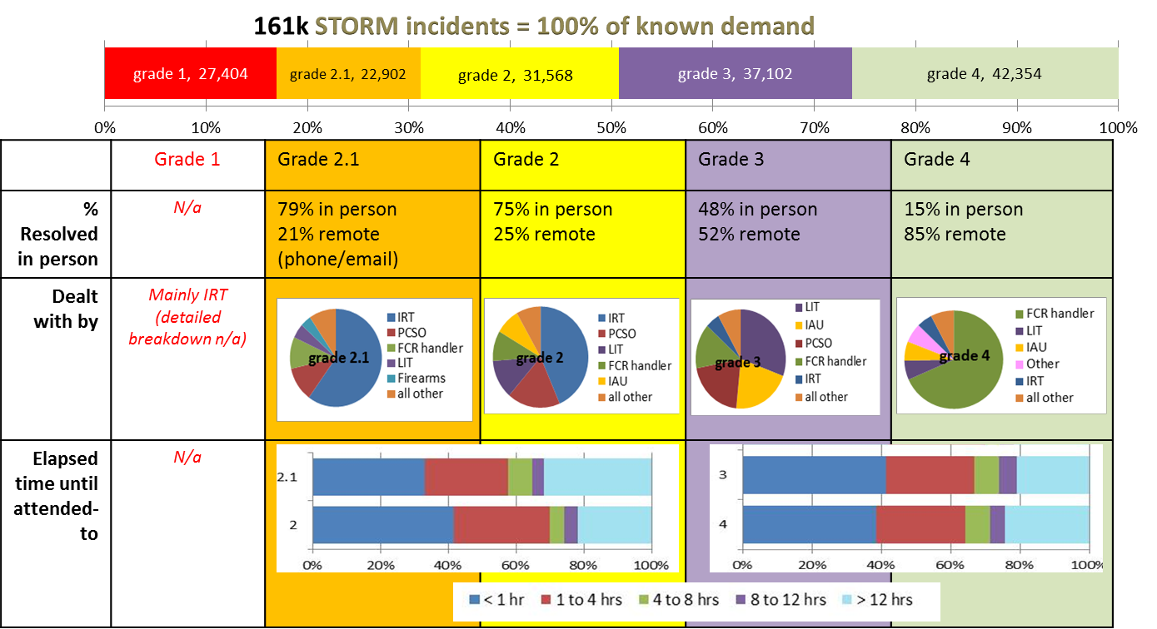
Results: Basic Stats

Slide 8
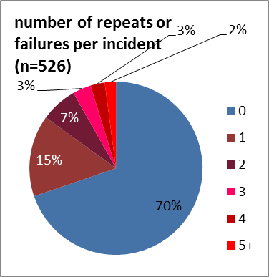
Findings
Prevalence of Failure Demand
Example:
Failure to collect evidence from retail store resulted in 2 attempts by shoplifters to reclaim property. Four contacts with the police by victim.
Incident not resolved after 11 days despite knowing who was involved, where they lived and considerable evidence to convict.

Slide 9
Findings
Preventable demand
% mentioned | Description | For instance
11% | Police processes done better or earlier | better use of intel, going to an earlier job to prevent recurrence
11% | Crime prevention/resolution measures - personal/private | Person should engage with NHW, Rural Watch, get better locks
11% | Crime prevention/resolution measures - commercial/business | Company should take action to protect itself or IP - Taxi companies, Facebook, garages
2% | Other law intervention | Action Fraud, other police area
17% | Mental Health intervention | Crisis Team
9% | Housing Agency intervention | incl. shared housing (flats), council housing
9% | Childrens Services intervention | Children's Social Work, children's homes
8% | Domestic Abuse intervention | DA specialist support
6% | Council intervention | Env Health, dangerous dogs, bins
6% | Highways/Traffic Agency intervention | Road signs, street lights
4% | Health intervention | Alcohol, A&E
3% | Multi-agency intervention | Complex needs, e.g. ASB diversion, partnership solutions, cause of demand unclear
3% | Supported residential / Adult social care intervention | Homeless shelters, general Social Work
2% | Schools intervention | victim/IP's school

Slide 10
Reassessing how to deal with demand
Deal Now
Deal Soon
In person
Remote
Other

Slide 11
Reassessing how to deal with demand
Deal Now
Deal Soon
In person
Emergency:
e.g. threat to life,
crime in progress etc.
… Or simple – quick answer
Does not need to be stabilised or
More complex
Remote
Deal with in order of arrival to FCR
Simple (or urgent but remote)
First contact resolution
Deal with in order of arrival in queue (FCFS)
Needs specialist or local resource or preliminary research.
Other
Not a police matter – other agency
Hand over to them to take over and manage

Slide 12
Reassessing how to deal with demand
Deal Now
Deal Soon
In person
Emergency:
e.g. threat to life,
crime in progress etc.
… Or simple – quick answer
Does not need to be stabilised or
More complex
21% to 18%
42% to 24%
Remote
Deal with in order of arrival to FCR
Simple (or urgent but remote)
First contact resolution
Deal with in order of arrival in queue (FCFS)
Needs specialist or local resource or preliminary research.
18% to 45%
19% to 10%
Other
Not a police matter – other agency
Hand over to them to take over and manage
0.2% to 3%

Slide 13
Final points
Existing methods to assess incidents almost entirely on risk create extra work and often cause the system to fail to meet callers’ needs.
There is much failure demand created by postponing service – but we suspect our study has not uncovered all failure demand.
The framework shown divides urgency into just two categories – urgent & soon. “One-touch” resolution (especially remote) is the ideal to reduce failure demand.

