Slide 1


History as Evidence
Using the Past to Prevent Future Crimes
Martin Innes & Shane D Johnson

Slide 2
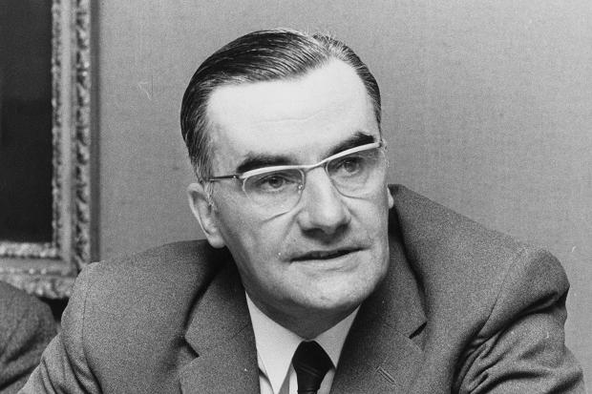
For the Super-recognisers

Slide 3
Policing a Perplexed Society
“We…are the anvil on which society beats out the problems and abrasions of social inequality, racial prejudice, weak laws and ineffective legislation...”
(Sir Robert Mark, 1977: 118 from a speech to National Police College 1975, pubd as ‘Policing a Perplexed Society’ )

Slide 4
3 Propositions
Policing has neglected learning systematically from its own history. Shift focus from ‘problems’ to ‘process patterns’ in responding to new risks and threats.
Current accent in EBP is upon evidence about ‘treatments’, rather than evidence based diagnostics. A pluralistic and wide-ranging acceptance of evidence is needed.
Digital technologies (socmed / IoT / smart cities) creating new criminogenic opportunity structures that will alter prevalence and distribution of future crimes.

Slide 5
4 Cases of ‘Eternal Recurrence’
Digital disclosure – long standing concerns (Innes, 2003);
Non-crime demand – the classic police ethnographies of the 1970s;
Technology’s ironies – phones + patrol cars increased social distance between police & policed; computerization process & store more information.
Child sexual abuse – HMIC 2016 reports flag issues that have been highlighted repeatedly over past 5 decades.

Slide 6
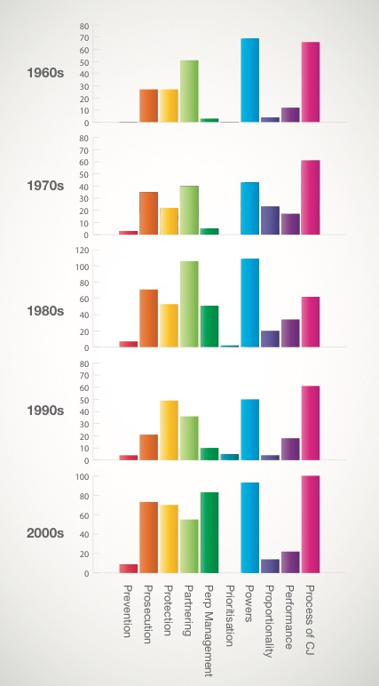
Dawes Centre for Future Crime at UCL
50 Year Analysis of CSA
Prevention – trying to limit the amount and harm of CSA. More recently, this dimension of police activity has focused upon the use of proactive high level surveillance capabilities.
Prosecution – police work to construct a case for the prosecution through their investigative activities.
Protection – work to support vulnerable individuals at risk of CSA, or who have experienced it.
Partnering – working with other agencies with child protection responsibilities. A key aim being to ensure police have access to relevant information possessed by other agencies, but also that others are aware of information and intelligence available to the police.
Perpetrator management – monitoring and supervision of known offenders, albeit other agencies (Probation Service / National Offender Management Service) are ‘on point’ for this work, police play an important role.
Powers – use and explanation of powers possessed by police and other agencies for managing the harms associated with CSA. An important consideration is that only police possess some of the powers routinely utilised.
Process of criminal justice – this category covers issues relating to the courts and other aspects of the criminal justice process as they relate to the police role.
Prioritisation – this concept is designed to capture how CSA was positioned in relation to other demands on the police at national and local level. This includes the local use of risk assessment tools to decide what issues and cases to work on, as well as how government edicts and strategies both explicitly and implicitly shaped police activity.
Proportionality – this focuses upon the balance between rights as a suspect vs rights of victims. This theme has come to the fore relatively recently in relation to a number of false allegations, but interestingly was also present in Home Office policy commentary about the issues associated with naming young people in press reports.
Performance – pertains to the activities associated with monitoring and identification of good and poor policing performance, as well as commentaries upon these.
Notes:
Innovation and change bring benefits but also new crime opportunities. Let’s consider the past..

Slide 7
2 Visions of EBP
‘Strong’ vision – privileges RCTs and systematic reviews;
‘Catholic’ vision – more pluralist in what counts as evidence - naturalism + experimentalism, problem-finding + problem-solving.
Neighbourhood Policing – based upon multiple forms of evidence including – quasi-experimental design; in-depth qualitative interviews; field observations; structured survey; co-production; signal crimes analysis – a focus on how as well as if it works.

Slide 8
Crime Prevention Comms
In terms of austerity ‘doing more with less’, or more properly ‘less with more’, what can we learn from 1980s.
Lots of work in 1980s on crime prevention, what lessons have been forgotten?
From contemporary perspective tells us much about ‘what doesn’t work’ – crime prevention communication experiments.

Slide 9
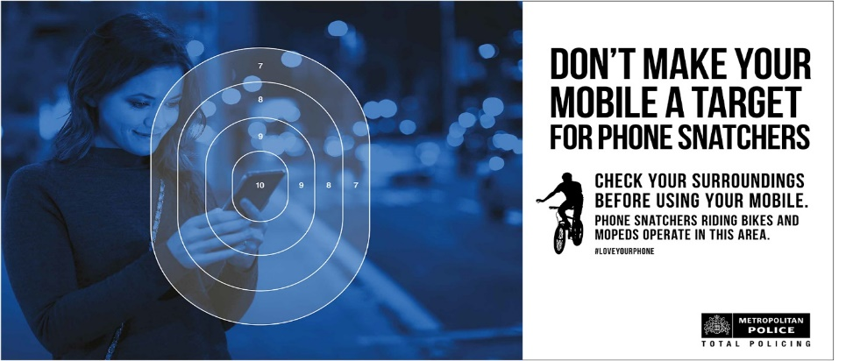
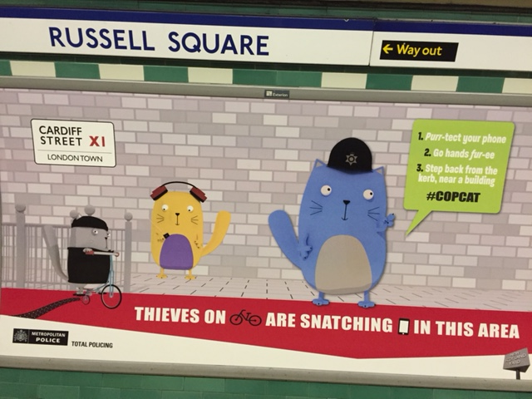
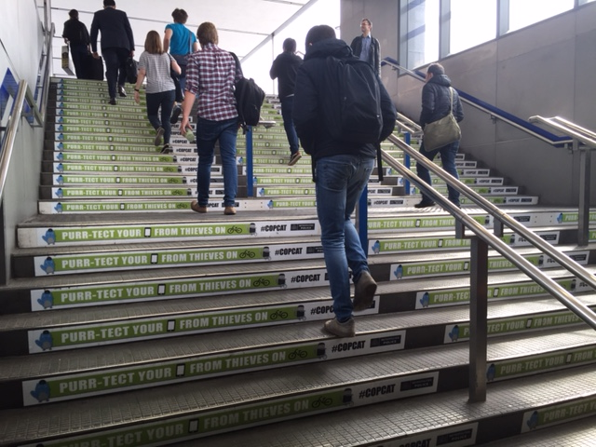
#Copcat MPS Trial
Field trial June 2016 – compare ‘Copcat’ campaign with standard MPS comms.
Empathetic messenger; humour; simple; no fear.
Social media assets; tube station; posters

Slide 10
Behavioural Crime Prevention
Design policy & practice to go with the grain of human behaviour
Messenger, message, mechanism – blend alters salience, receptivity & impact;
Avoid negative side effects – anger, fear;
Need to install responsibility + competence;
Paradox of choice - too much info induces inertia;
Showing not telling – model what you want people to do.
Complex problems blend nudges, tugs, teachable moments.

Slide 11

Technological Change
Dawes Centre for Future Crime at UCL
Notes:
Innovation and change bring benefits but also new crime opportunities. Let’s consider the past..

Slide 12
Car theft in England and Wales – A Crime Harvest?
Lessons in Prevention
Dawes Centre for Future Crime at UCL
Ownership
4M
8M
13M
19M
23M
28M
Notes:
Changes to recording practice (TWOC) in 70s.
Increase in availability led to a crime harvest that showed no signs of abating.
Vehicle manufacturers had the competency to act, and their changes could affect the masses. But were reluctant to do so. Car theft index…
https://www.gov.uk/government/uploads/system/uploads/attachment_data/file/8995/vehicles-summary.pdf
1992 first Car Theft Index, last 2006
Car theft peaked in 2003: 592,000 incidents
Last year, 2010-11, 99,000
The police loved it
The manufacturers took it on the chin
The insurance industry was supportive
The consumer groups were keen
The media picked up on it
It avoided legislation
It was very popular with the politicians

Slide 13
Lessons in Prevention
Horizon Scanning
  Tension between hard evidence versus stimulus
  Bottom-up (inductive) scanning for signals and issues
    clear search criteria
    Reach and possible impact
  Top-down (deductive) hypothesis testing
    Systematic realist synthesis
    Hierarchy of evidence
    Impartiality
    Weighting convergent sources
Notes:
Tension between evidence and stimulus value – RCTs tells us about interventions now but offer no insight into what’s next.
Hierarchy of evidence – High quality peer-reviewed studies with good samples; Ltd sample but robust method; single study or well cited review through to pure speculation.

Slide 14
Future Crimes Challenges
Internet of Things
Criminogenic Smart Cities: “The more we instrument the city and rely on those technologies clearly the more vulnerable they are to, to hacking and to, you know to collapse and so on.”

Slide 15
Conclusions
“We should recognize that anything that has happened in the past can happen again.” Becker, H. (2017) Evidence. P.10 – not ideographic history, but one that looks at ‘deep’ patterns in core processes.
Policing as a social institution was estd. as part of wider regulatory response to industrial revolution and urbanization, if ‘information revolution’ similarly profound, should accept changes to organization of social control similarly wide-ranging.

