Slide 1











WIFI Code: saints_conferencing
Password: TheS41nt753
Conference 2017
Creating a Culture of Curiosity: Why Failure is a Good Thing
In association with:

Slide 2

Conference 2017
Creating a Culture of Curiosity: Why Failure is a Good Thing
Welcome and Introductions
T/ACC Alex Murray
West Midlands Police & Vice-Chair SEBP
#SEBP2017
WIFI Code: saints_conferencing
Password: TheS41nt753

Slide 3
Conference 2017
Creating a Culture of Curiosity: Why Failure is a Good Thing
In association with:

Slide 4
Conference 2017
Creating a Culture of Curiosity: Why Failure is a Good Thing
Evidence and Partnerships
Assistant Chief Constable Phil Kay (Leicestershire Police)
and Superintendent Dave Hill (IPSCJ)

Slide 5













East Midlands Policing Academic Collaboration
ACC Phil Kay
Superintendent Dave Hill

Slide 6

What is EMPAC?
The East Midlands Policing Academic Collaboration (EMPAC) will combine the best of academic expertise and a ‘what works’ evidence base to create a dynamic and exciting multilateral partnership that has a tangible impact on policing in the East Midlands and beyond.

Slide 7
What do we want to do?
Embed or accelerate understanding of crime and policing issues, and evidence based problem-solving approaches; and
Demonstrate innovation in building the research evidence base and applying it through knowledge exchange and translation across all levels of policing
Inform changes in professional policing policy and practice through the creation and application of a research-driven evidence base.

Slide 8
East Midlands Police Academic Collaboration PKF project
Operational Group
Local and Community Policing
Serious and Organised Crime
Organisational Transformation
Victim and witness Public Protection
Operational Policing
Fellowships
Research
Research
Research
Research
Research
Research
Research
Research
Research
Research
Research
Research
Research
Research
Programme of Events and CPD
Knowledge Hub
Improved Service Delivery and Social Impact

Slide 9




What we have achieved
Professional development of policing
Post graduate and undergraduate fellowship provision
Developing the evidence-base
  Evaluating online police-community engagement;
  Exploring the relationship between ASB and crime victimisation;
  Effectiveness of video relay services;
  Understanding post-Brexit hate crime
  Competency profile of EM Special Constabulary
  Intelligence sharing between police and NGOs
An evaluation of the use of digital evidence in crime investigations.
Presence and visibility
Relationship and collaboration with Scottish
Institute of Police Research (SIPR)
Work with forces to assist in creating Evidenced
Based Policing Networks
Events
Strategic approach to innovation
  Officer’s use of body worn video;
  The development of a Fellowship programme to influence occupational culture;
  The effectiveness of coaching in improving policing performance;
  Development of understanding of extremism and free speech on campuses;
The development of research as a strategic tool to combat organised crime.
Relationships
Dialogue
Collaboration
Change

Slide 10
The Approach
Inclusivity – through active dialogue
Relationships – Finding the “win-win-win”
Clarity – through translation
Decisiveness – through focus on purpose
Delivery – through all of the above

Slide 11

The Future

Slide 12
ACC Phil Kay
Strategic Lead, EMPAC
Superintendent Dave Hill
Programme Director, EMPAC
david.hill@northampton.ac.uk
www.empac.org.uk
Twitter @EMPACorg

Slide 13
Conference 2017
Creating a Culture of Curiosity: Why Failure is a Good Thing
In association with:

Slide 14
Conference 2017
Creating a Culture of Curiosity: Why Failure is a Good Thing
It’s not whether you have the tools,
it’s how you use them
Justin Ready
Griffith University

Slide 15
Society of Evidence Based Policing
Annual Conference
Northampton, England
Why Randomized Experiments Matter in
Assessing the Impact of On-officer Video Technology
Justin T. Ready, Ph.D.
Griffith University, AU
Police Foundation, US
Jacob T.N. Young, Ph.D.
Arizona State University

Slide 16
In the field of observation, chance favors the prepared mind.
Louis Pasteur

Slide 17
Why Experiments Matter
1. With experimental designs, size doesn’t matter as much. Bigger isn’t always better. What’s more important than sample size is the amount of control over experimental conditions and the assignment of participants to treatment and control groups.
2. It is the unanticipated findings that are most interesting – but these findings are seldom apparent or uncovered when the research design is haphazard and retrospective.
3. Things that researchers don’t want to happen often benefit the police, and things police don’t want to happen benefit the research. Although these things are hard to reconcile, in the long run everyone benefits.

Slide 18
Background
The nature of police work creates an environment that places officers in dangerous situations where the use of coercive force is sometimes necessary.
This unique aspect of police work opens the door for high levels of public scrutiny about how individual police officers do their job (Archbold & Maguire, 2002).
Police operate in an environment where allegations of misconduct have an immediate impact on the officer and the agency, which threatens to erode community trust.
In 2010, the CATO Institute tracked 925 civil lawsuits for police misconduct reported in the media. The median award for this litigation was $225,000 (Packman, 2011).

Slide 19
Overview
In November 2012, the Mesa Police Department initiated a 12 month evaluation of the Axon Flex on-officer video camera system.
This policy evaluation focused on the video cameras’ potential to increase officer accountability, reduce citizen complaints, and enhance prosecution.
We were also interested in how the technology affected police-citizen interactions and officer perceptions of the technology.

Slide 20
This presentation focuses on three simple research questions…
Question 1:
Will the officers use the technology, and what are the conditions that will impact their willingness to turn on the camera?
Question 2:
How does the adoption of body-worn cameras affect their attitudes about police work and the technology?
Question 3:
How does wearing the technology impact police-citizen contacts and coercive actions taken by the police?

Slide 21
Research Design
50 officers were assigned to wear the cameras (treatment group) and 50 officers were assigned to the comparison group and did not wear cameras.
Half of the officers in the treatment group volunteered to wear the cameras in response to an internal solicitation and the other half were assigned.
Treatment officers were matched to comparison officers based four key characteristics: age, race, gender, and citizen complaints.

Slide 22
Police Officer Characteristics:
Treatment vs. Comparison Group
Police Officer Characteristics | Treatment Group (n=50) | Comparison Group (n=50)
Experience in years | 9.9 | 10.8
Age (in years) | 35.9 | 37.5
Race (non-white) | 24.0% | 26.0%
Rank (officer) | 98.0% | 100.0%
Citizen Complaints | 0.60 | 0.50
Education (4-year degree) | 32.0% | 36.0%
Gender (female) | 8.0% | 10.0%
Total citizen complaints | 30.0 | 25.0

Slide 23
Data Collection
  Field contact reports
    Field contact reports were completed on randomly selected days every time an officer had contact with a citizen.
    The report contained questions about why the contact was initiated, citizens’ demeanor and behavior, police actions and use of force, presence of victims and bystanders, and demographics.
    A total of 3,702 field contact reports were completed by 100 officers over the study period.
  Officer perception surveys
    Quarterly surveys track officers’ perceptions of the technology over the course of the evaluation period.
    Measured: administrative burden, citizen reactions, officer behavior, comfort of use and general perceptions.

Slide 24
Question 1:
Will the officers use the technology, and what are the conditions that will impact their willingness to turn on the camera?

Slide 25
Department Policy on the Use of
On-officer Video Cameras
Mandatory Activation: From November through April (5 months) Axon officers were directed: “When practical, officers will make every effort to activate the on-officer body camera when responding to a call or have any contact with the public.”
Discretionary Activation: From May through September (5 months) Axon officers were given the latitude to: “exercise discretion and activate the on-officer body camera when they deem it appropriate.”

Slide 26
The Effect of Policy Change on Camera Activation
During the mandatory activation period, camera officers averaged 2,327 videos per month. During the discretionary period they averaged 1,353 videos per month. There was a 42% decline in camera use under the discretionary policy.
During the discretionary period, volunteer officers produced 71 videos per month compared to compulsory assigned officers who averaged 28 video files per month. Officers who volunteer to wear the technology were 60.5% more likely to use the camera than their assigned counterparts.

Slide 27
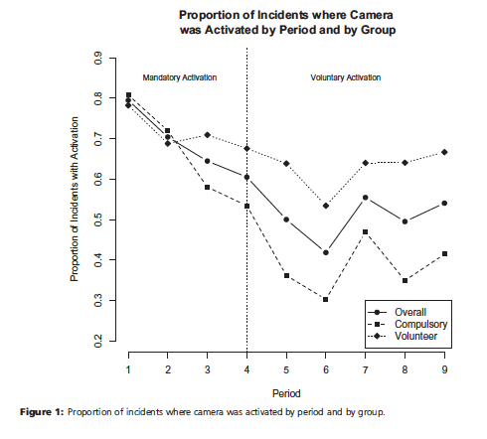

Slide 28
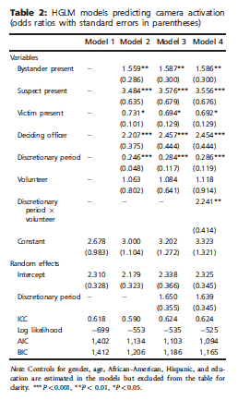

Slide 29
Question 2:
How does the adoption of body-worn cameras affect their attitudes about police work and the technology?

Slide 30
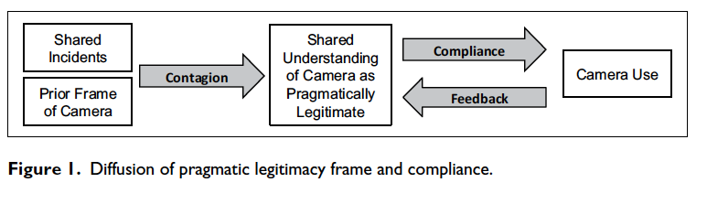
Are cynical or favorable attitudes toward the new technology more likely to diffuse through the organization?

Slide 31
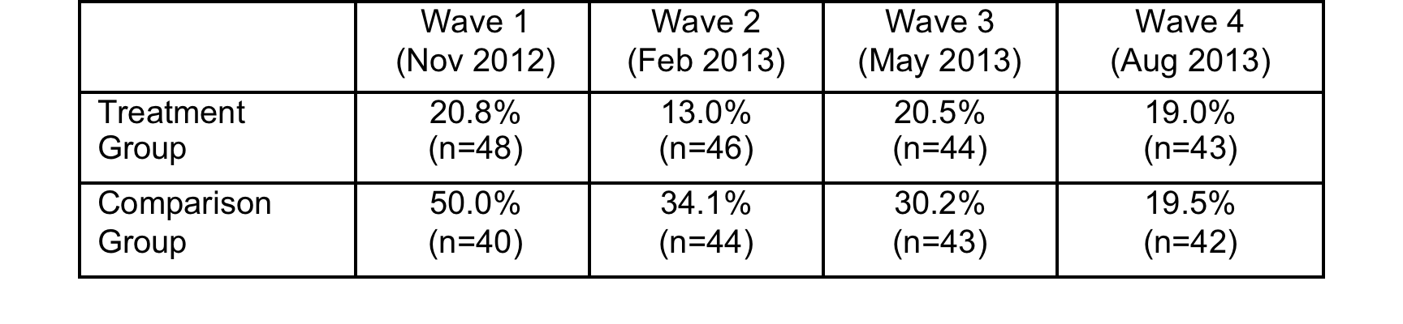
When wearing on-officer video cameras, police have less
discretion to give warnings to citizens.

Slide 32
Discussion of Patrol Officer Survey
Two thirds of officers believe that cameras will improve the quality of evidence and produce more accurate information.
Over 75% of officers believed that video evidence would help prosecute cases when the victim was not willing to testify.
But only one-third of officers believed that the on-officer video cameras would increase officer safety.

Slide 33
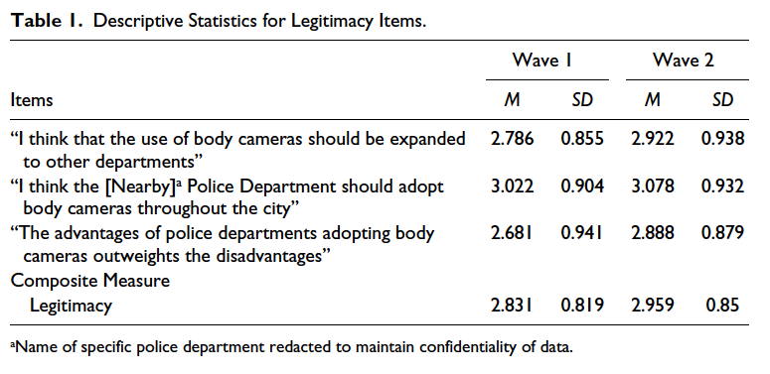

Slide 34
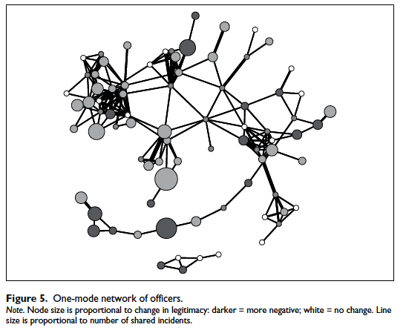

Slide 35
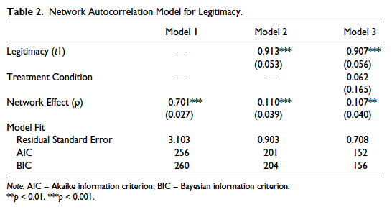

Slide 36
Question 3:
How does wearing the technology impact police-citizen contacts and coercive actions taken by the police?

Slide 37
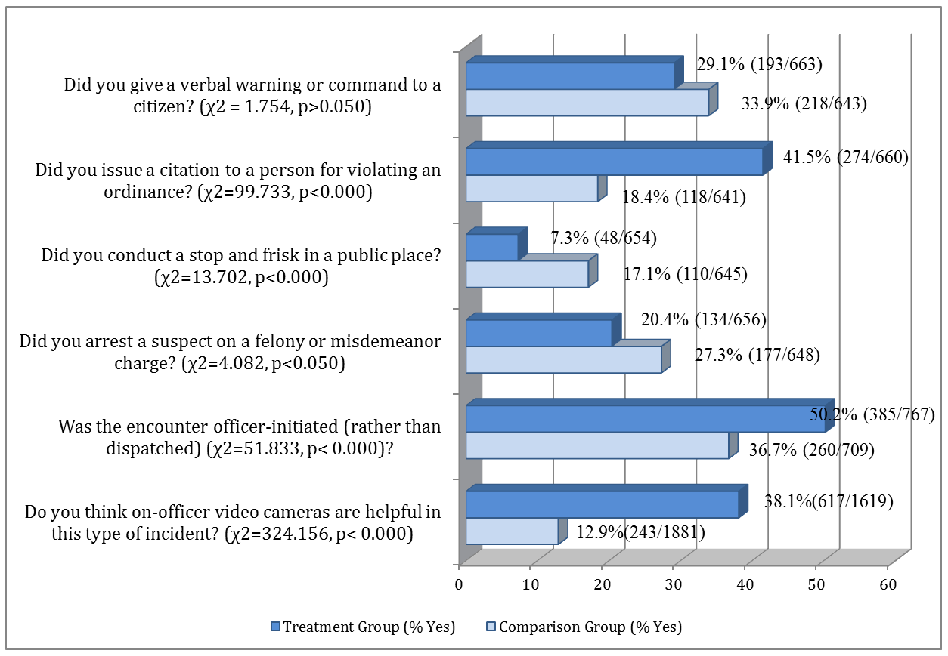
Figure 1. Officer Behavior and Perceptions of Camera Technology:
Treatment vs. Comparison Officers

Slide 38
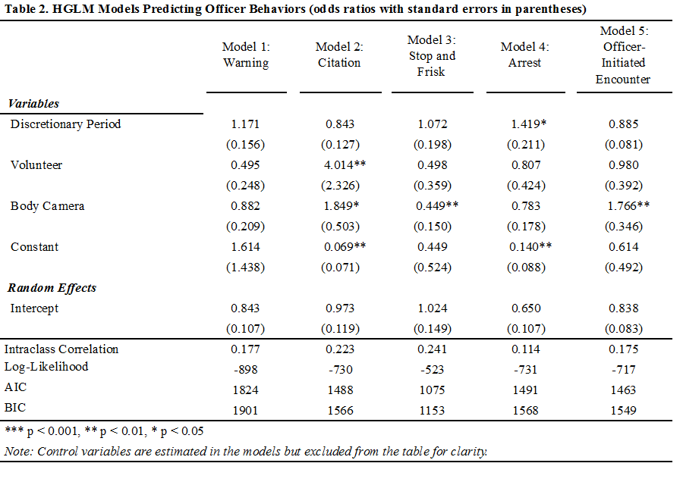

Slide 39
Discussion of Police-Citizen Contacts
Our analysis reveals that officers assigned to wear a camera were less likely to perform stop and frisks and make arrests, but were more likely to give citations and initiate encounters.
In addition, officers were more likely to report OVCs as being helpful if they wore a camera, and in situations where they issued a warning or citation, performed a stop and frisk, or made an arrest.
Our findings suggest that officers are more proactive with this technology without increasing their use of invasive strategies that threaten the legitimacy of the organization.

Slide 40
Overview of Citizen Complaints
During the 12 month evaluation period, Axon users were the subject of 48% fewer complaints relating to abuse of authority and 75% fewer complaints for excessive force. The control officers experienced no significant reduction in citizen complaints.

Slide 41
Why Experiments Matter
1. With experimental designs, size doesn’t matter as much. Bigger isn’t always better. What’s more important than sample size is the amount of control over experimental conditions and the assignment of participants to treatment and control groups.
2. It is the unanticipated findings that are often most interesting – but these findings are seldom apparent and able to be uncovered when the research design is haphazard and retrospective.
3. Initially, what researchers don’t want to happen often benefits the police, and what police don’t want to happen often benefits the research. But in the long run, everyone benefits.

Slide 42
Thank you for attending my talk at the Society for Evidence Based Policing Conference.
Questions?

