Slide 1











Conference 2017
Creating a Culture of Curiosity: Why Failure is a Good Thing
In association with:

Slide 2

Conference 2017
Creating a Culture of Curiosity: Why Failure is a Good Thing
How do criminals ask themselves
to be policed
Dr. Jason Roach
University of Huddersfield

Slide 3
How do criminals ask themselves to be policed?
Dr Jason Roach
Associate Director, Applied Criminology Centre
University of Huddersfield

Slide 4
How do criminals ask themselves to be policed?
Differently to other people?
Predictably?
Fairly?
But why should we let them decide?

Slide 5
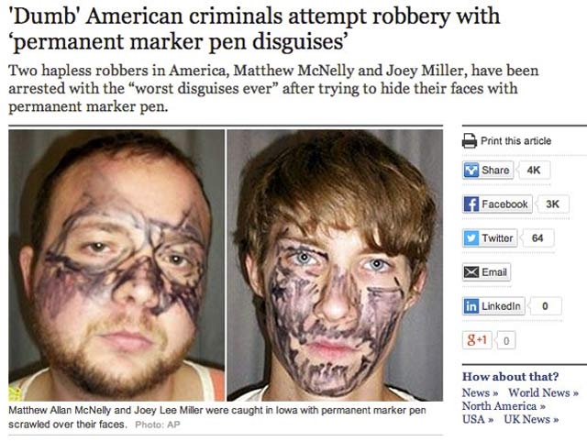
1. “Please police me, let me go”
Police wanted to keep law and order (don’t want to be victims) but not to target them.
Cheats and freeloaders theory
Cheats do prosper as long as there are less of them than us goodies.

Slide 6



2. Predictable policing example 1?

Slide 7
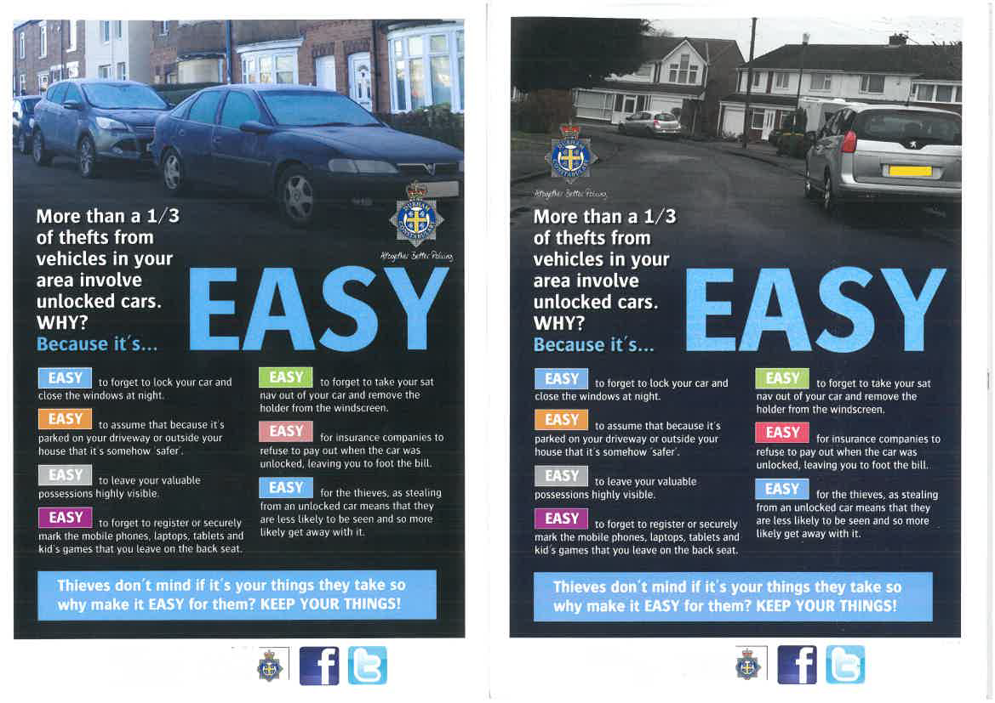
Nudging down TfMV in Durham
(Roach et al., 2016)

Slide 8
Thefts from all motor vehicles and the percentage from insecure motor vehicles for the period 01/09/2012 to 31/08/2015, for the four nudge pilot areas
.
LSOA NAME | All TFMV | Insecure TFMV | Insecure Index | % Tot TFMV
Durham TREATMENT | 43 | 18 | 337 | 41.9%
Chester-le-Street CONTROL | 45 | 27 | 506 | 60.0%
Wear Valley TREATMENT | 87 | 28 | 524 | 32.2%
Wear Valley CONTROL | 26 | 18 | 337 | 69.2%

Slide 9
Thefts from all motor vehicles and the percentage from insecure motor vehicles for the pilot period 01/10/2015 to 31/01/2016
.
LSOA NAME | All TFMV | Insecure TFMV | Insecure Index | % Tot TFMV
Durham TREATMENT | 3 | 1 | 36 | 33.0%
Chester-le-Street CONTROL | 19 | 8 | 286 | 42.0%
Wear Valley TREATMENT | 16 | 4 | 143 | 25.0%
Wear Valley CONTROL | 13 | 9 | 321 | 69.0%
(t=2.80, df=6, p=0.03) with a standard error of difference = 13.42.

Slide 10


Predicatability example 2 - What do most people think about criminal careers?
Generally, people over-estimate offence homogeneity (i.e. they over-estimate offence specialisation).
Common perception where robbers only rob, flashers are going to graduate to more serious commit sexual offences.

Slide 11
Police predictions for further offending (Roach and Pease, 2013)
Police estimates of re-offence type by first offence type compared with 2009 proven reoffending type
First Offence Responses lower | Responses lower than official rate | Responses higher than official rate | Proven reoffending by type i.e same type (adult 2009)
Burglary*** | 2 | 40 | 18
Theft** | 11 | 31 | 5
Drugs supply*** | 5 | 37 | 3
Violence to person*** | 6 | 36 | 2
Robbery*** | 0 | 42 | 4
Public Order** | 12 | 30 | 3
Sexual** | 11 | 31 | 4
Motoring offences* | 14 | 28 | 34
Fraud*** | 7 | 35 | 18
Drink driving*** | 2 | 40 | 6
* p<.05 **p<.01 ***p<.001

Slide 12
Disqualified Driver Study
(Roach, 2017)
Sample of DD’s convicted between 2010-2015.
94% male drivers
Average age when convicted of driving while disqualified was 30.72 years (range 18-62 years, SD= 9.73 years), in
In total 704 recorded convictions were found with an average of 14 recorded offences per disqualified driver (range= 0-84 offences, SD = 17.63 offences).
14% (n=7) were found to have had no other criminal convictions, with 86% (n=43) having convictions for offences other than the index offence of driving while disqualified (which had flagged them for this study.

Slide 13
Disqualified Drivers (Roach, 2017).

Slide 14
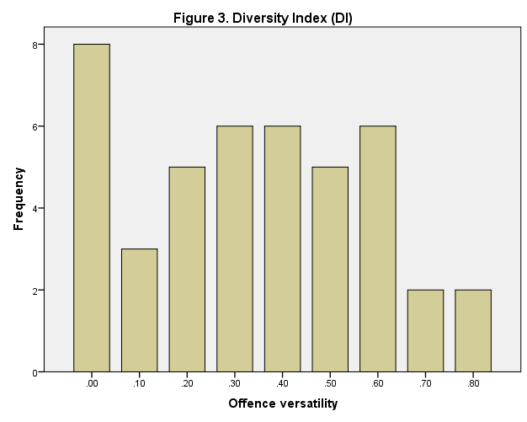
Disqualified Drivers (Roach, 2017).

Slide 15
Do criminals and police think the same thing?
Criminals?
Police?
The police are mainly interested in serious crimes
The police will not make the link between a minor offence and serious further criminality.
Their major disrespect for the law will go unrecognised unless a serious crime.
Serious offenders tend to specialise
Minor offences are solely the remit of minor offenders
Priority is on serious crime less focus on minor crime (e.g. Flanagan, 2008).
So why is this important?

Slide 16

Predicting and the science of mindreading
Rene ‘I think therefore I am’ Descartes (1637) figured that he must exist.
Most of us go further – we think that others think.
We humans have a Theory of Mind (Premack and Woodruff, 1978)

Slide 17
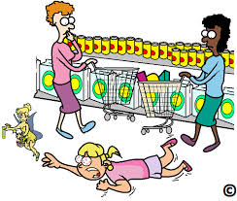
ToM -Mind-reading at different levels
ToM is a testable belief (theory) about the content of another person’s mind and that this can be different to our own and from the objectivity of the situation (Barrett et al., 2.002, p. 296).
I believe
I believe that you believe.
I believe that you believe that I believe.
I believe that you believe that I believe that you believe.
I believe….

Slide 18
QUESTION: So what has this got to do with criminals asking themselves to be policed predictably?
ANSWER: Everything (if we don’t want them to get how they ask to be policed).
We let them think that they are being policed like everybody else

Slide 19

Self-Selection Policing
(Roach and Pease, 2016)
Those who do big bad things also do little bad things (Roach,2007)
They ‘self-select’ themselves for police attention.
Minor offences are often much more easily detectable than the more isolated, infrequent and well concealed ones
The difficulty is in separating ‘trigger offences’ from all minor offences (later)
Chenery, Henshaw and Pease (1999). Illegal parking in disabled bays,

Slide 20
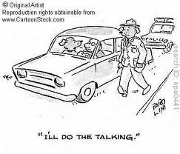
HO/RT1 (Roach 2007)
129 issued (PNC June 2006) 39% no-shows
PNC – shows (20%) no-shows (58%)
Strong correlation between non-compliance and PNC marker
Strong correlation between non-compliance and serious criminality
Regression analysis - frequency and length of career as main predictor variables.

Slide 21
Criminals asking to be policed predictably.
1. Disqualified Drivers (Roach, 2017).
28 with convictions prior to driving while disqualified also had convictions for offences after disqualification (56% of the overall sample had been convicted of offences both before and after they were caught driving while disqualified. Of these
19 were on record for offending less than 1 year after the date of driving whilst disqualified
8 were on record for offending more than 2 years after but less than 3 years after the date of driving whilst disqualified
0 were on record for offending more than 3 years after but less than 4 years after the date of driving whilst disqualified
1 was on record for offending more than 4 years after but less than 5 years after the date of driving whilst disqualified.

Slide 22
Disqualified Drivers (Roach, 2017).
Seen through a self-selection policing lens, 68% (19/28) of those who went on to commit other offences after their conviction for driving whilst disqualified, did so less than 12 months later.
DD as a SSP trigger offence, disqualified driving is useful for police in identifying likely active, concurrent criminality.
Does your force have a record of DD?
Durham are currently cross-tabulating a list of DD with those with convictions for burglary.

Slide 23
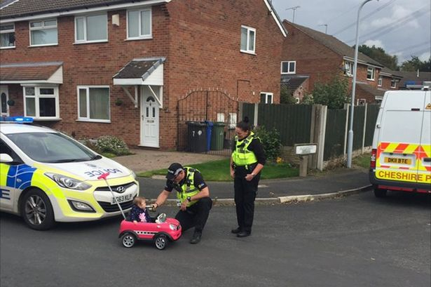
Criminals asking to be policed predictably
2. SSP Pilot - Solihull LPU WMP
(Roach and Hatton, 2017)
2 Response teams selected for 2 full working sets for 12 days (24/04/16 – 12/05/16 )
Told to target traffic offences including manner of driving, condition of vehicle & parking offences
Officers to record VRM of vehicle(s) stopped and occupants to determine any criminality
Officers to record on running log or direct to PS Hatton

Slide 24
SSP Pilot (Solihull)
36 Vehicles stopped in total

Slide 25
SSP Pilot (Solihull)
Previous convictions of drivers

Slide 26
SSP Pilot (Solihull)
Notable stops and arrests
2 of the vehicles stopped had OCG nominals with firearms markers
8 Stop and searches were generated as a result of the traffic stops
6 vehicles seized as a result of the traffic stops
5 persons arrested resulting from the stops
Arrests

Slide 27
Pragmatism begins at home
POSITIVES
Encouraged officers to become more focused on actual traffic offences as apposed to person driving vehicle.
Easier to justify a stop with a traffic offence. Reduced bias.
Up - scaled officers knowledge on traffic law and stop search process
Townsley and Pease estimate that SSP minor driving offences 5-6 times greater hit-rate than random stops.
CONSIDERATIONS
Not RCT design
Recent firearms recruitment impacted on team resourcing, failed to provide full use of officers time
Pilot running along side identified priority zones so difficult to compare against normal day to day operations.

Slide 28

Self-Selection Policing
(Roach and Pease, 2016)
Offence criteria
Is it an actual offence? (e.g. illegal parking)
Does it justify enforcement in its own right (e.g. driving without a seat-belt)?
Is it evident by observation rather than detection? (i.e. can someone committing it be easily seen doing it?).
Will it take additional resources and if so what and how much? (i.e. does it require more police time, money etc?)
Is it unobtrusive to the public? (e.g. will those found committing the offence be blissfully unaware of further background checks being done?)
Will those identified committing it be investigated? (i.e. can you insure that those committing the offence will be scrutinised by police colleagues?)
Can the offence also be identified by non-police agencies? (i.e. can traffic wardens, parking attendants, and security guards also notice those committing the offence?)
Is there a firm plan to evaluate this trial or study? If so, how?
If found to be a successful SSP trigger, will its wider implication be met with resistance? If so, where? (e.g. will a change in thinking or police culture be needed?)
Do you plan to disseminate your findings widely and if so how? (e.g. articles, conference papers, police professional etc.).
Notes:
The key issue is the choice of trigger, which optimally has a high hit rate and a low irritation potential for the basically decent who get inconvenienced.
Identifying such triggers is the purpose of my research

Slide 29

Self-Selection Book 2 (edited).
Successful case studies
All SSP ideas welcome.
We will hep you trial them
We will help you evaluate them.
We will include your work in the next SSP book

Slide 30
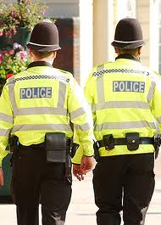
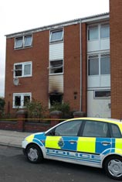
Book 4
Practical psychology for police

Slide 31

Lying liars
1. Addresses and postcodes.
96% gave what they thought was a bona fide false postcode
However, 55% gave the same PC as their real on, or a false postcode from the same postal area.
Almost 70% of false postcodes did not to exist (but only 10% of the real ones given).

Slide 32

Lying liars.
2. Date of birth
65% said they could identify where false DOB had come from – only 35% said random
47% gave a zodiac sign which did not match their false DOB (age and gender t-tests not stat significant).
Those who got it correct said they knew it was the correct sign for the false DOB given (e.g. was brother’s DoB and sign).

Slide 33

How do criminals ask themselves to be policed?
3. FAIRLY!
I believe that you believe that I believe.
OR PUT ANOTHER WAY Police believe that criminals believe that police believe.
Ripe for manipulation?

Slide 34

The dark side of the nudge?
To disrupt drugs markets?
In counter-terrorism?
To deter and prevent cyber-enabled crime?
EVIDENCE-BASE?

Slide 35
So how do criminals ask themselves to be policed and what can we do about it?
More research needed on how criminals ask to be policed
We should use how criminals think police think against them (e.g. Self-Selection Policing).
SEBP should include trials using deception and misinformation to develop EB practice.
The use of nudge psychology needs to be extended to offenders (e.g. police cells study in Durham) as well as psychological ‘shoves’.
Don’t be afraid to try ideas as failure is often as important. Not all pilot studies have to be RCT’s with 70,000 offenders
Research is done with not to police!

Slide 36
Thank you for listening.
Please do contact me with any ideas and comments
j.roach@hud.ac.uk
Twitter: @jrro47

Slide 37
Conference 2017
Creating a Culture of Curiosity: Why Failure is a Good Thing
In association with:

Slide 38
Conference 2017
Creating a Culture of Curiosity: Why Failure is a Good Thing
What works in Violence Prevention
Chair: Rachel Tuffin
Speakers: Dr. Amanda Robinson (Cardiff University),
Dr. Hannah Farrimond and
Dr. Dreolin Fleischer (both University of Exeter, #RU2Drunk?)

Slide 39


What works in violence prevention?
Dr Amanda Robinson
Cardiff University
Society of Evidence Based Policing conference
3rd March 2017

Slide 40



Key questions
What are the inherent challenges in answering the question ‘what works’?
Given these challenges, what seems to ‘work’ to reduce domestic violence and abuse (DVA)?
What part does a ‘risk-led’ approach play in current efforts to better comprehend and respond to DVA?

Slide 41
Understanding ‘what works’:
Challenge #1
The problem of DVA is prevalent, multi-faceted
and complex.
In every society, a substantial proportion of people is affected, often multiply, at different points in the life course, in various contexts, with numerous consequences.
DVA overlaps with, contributes to, and is reinforced by other crime and social problems.
Under these circumstances, comprehension and systematic identification of the problem itself are significant challenges.

Slide 42
Understanding ‘what works’:
Challenge #2
The risk of DVA for both victims and offenders
reduces over the lifespan.
This occurs ‘naturally’ even without formal intervention.
Therefore we must identify whether interventions significantly accelerate this natural desistance.
The evidence that can best distinguish between natural and accelerated desistance is hard to come by (RCTs).
Notes:
What we know fairly well is that the risk of IPV declines over time for both offenders and for victims, for men and women. For all types of violence not just IPV.
This is seen to be a natural process that – in relation to offending – has come to be known as natural desistance. Many IPV studies document a desistance rate from violence that is larger than the recidivism rate even without formal intervention .
The fact that violence decreases with time regardless of the presence or absence of an intervention means that to fairly test whether an intervention reduces violence one must have an equivalent control group to distinguish between natural and accelerated desistance.
RCTs are necessary for distinguishing between natural desistance and those accelerated significantly by an effective intervention.

Slide 43
Understanding ‘what works’:
Challenge #3
A diverse toolkit of interventions
has developed over time.
These may target the offender, with the aim of reducing their recidivism.
These may focus on the victim, with the aim of reducing their re-victimisation.
These may be located within multiple domains (e.g. NGOs, Criminal Justice, Health).
Additionally, these are often located across multiple domains, in the form of partnerships (e.g., CCRs, MARACs).
Notes:
During the past two decades in particular, a broad platform of interventions has emerged that can be described as two parallel streams of intervention efforts: one focused on reducing IPV by targeting the offender and changing or controlling their behaviour; the other focused on providing victims with resources that may reduce their risk of experiencing further victimization.
In some instances, these interventions emerged organically whereas in other cases they resulted from systematic implementation efforts. Accordingly, combining the research evidence is not straightforward primarily because victims and offenders are not mirror opposites where interventions designed for one group always produce a known, consistent impact on the other. In other words, there might be success in terms of re-victimization but not recidivism, or vice versa. For example, a victim may be re-abused but the (original) offender does not cause this – the re-abuse is from a different offender (i.e., new partner), or victim is not re-abused but the (original) offender re-offends (i.e., his recidivism is with a new partner).
Producing a clear statement of the impact of IPV interventions on IPV is further complicated by the fact that there are now many interventions in place. These are located in different domains, including those delivered by non-governmental organizations [NGO] in the voluntary sector, those delivered through the criminal justice system, or by healthcare providers.
Each one of these systems will have dozens, if not hundreds of interventions that have been designed and implemented in various ways across time and place. Then there are efforts to combine interventions (i.e., to deliver services to victims and/or offenders in multi-agency partnerships) which might produce outcomes that also vary across time and place.

Slide 44
Research highlights
Widespread proliferation of interventions as well as research to test their effectiveness
  Advocacy: Moderate evidence from 10 studies that advocacy services may improve safety and reduce re-victimisation.
  Police: Pooled analyses of US field experiments showed arrest produced less re-victimisation on average.
  Prosecution and Conviction: A review of 32 studies found no statistically significant difference in the rates of recidivism.
  Group interventions for abusers: Inconsistent evidence from 10 studies that short duration (<16 weeks) group interventions reduce recidivism.
  Partnerships: Moderate evidence from 11 studies that partnerships were effective at supporting victims and reducing further violence.
Notes:
Given the challenges of a variegated, complex and perhaps even morphing problem, the challenge of developing interventions to respond to that problem that are effective and then subject to rigorous research which is able to demonstrate the extent to which they are effective and/or cost-effective is difficult, to say the least.
Nevertheless, we do have evidence suggesting the effectiveness of different single and multi-agency interventions to respond to DVA.
Notably, interventions located outside of the CJS (e.g. advocacy) and/or in partnership with CJS, have the most evidence demonstrating their effectiveness.
However it’s important to note that important insights into the nature of DVA as a problem, and ways of responding to it that seem to have value (to the victims, offenders, or practitioners involved), to ‘work’, have also emerged from three or more decades of scholarship.
For example, evidence-based insights revealing:
The multi-faceted nature of DVA – including a range of behaviours and criminal offences – not all of which involve physical violence
The factors influencing police decision-making at DVA calls
The many hurdles facing victims seeking help and how to better assist them
Such insights can sometimes be forgotten when it comes to systematic reviews of evidence (e.g. NICE 2014).
It’s within this context that I’d like to proceed to discussing recent research into risk-led policing of DVA in the UK – a strategy encompassing many interventions crossing agency boundaries

Slide 45
Overview of
a risk-led approach to DVA
Developing risk tools (e.g. DASH) based on a particular analysis of the problem
Structuring professional judgment
Linking tools to interventions (e.g. IDVAs, MARACs)
Facilitating partnership work amongst key agencies
Classification as domestic abuse
Identification of risk factors
Assessment of risk level
Management of risk
Notes:
‘risk-led policing’ involves 4 distinct stages:
Briefly, these are:
Classification – first, police have to recognise a particular incident as ‘domestic abuse’ – obviously an important starting point to get right
Identification – the second stage is to use a tool such as DASH to identify whether certain risk factors are present
Assessment – translating these risk factors into a risk level or grade (standard, medium or high risk). This stage can be further divided into an initial (frontline) stage where the initial risk grade is given, and then a secondary stage where it is reviewed, and possibly changed.
Management – the stage involving the actions taken to try and reduce a victim’s risk, to prevent further violence and abuse

Slide 46
DASH research
National mapping exercise
Analysis of 43 forces to describe their approach
Fieldwork in 3 forces
61 interviews with police and partners
Aimed to identify different approaches or models of risk-led policing
Three forces representing three different models chosen for fieldwork
120 hours of observations
Analysis of 2000 domestic abuse incidents
1296 online survey responses
Notes:
The first stage of our research was to take a look at the national picture. What forces were using DASH, how were they using it, how did risk inform the police response, and how was it all working?
The national mapping exercise allowed us to identify 3 different models of risk led-policing, and then the fieldwork allowed us to describe how these were working ‘on the ground’ in three force areas.
The fieldwork took place during the autumn of 2016 and spring of 2016.
The data are also extensive, as we collected four different types of data in the fieldwork sites, to provide an in-depth and comprehensive look at how risk-led policing takes place.
Risk-led policing… what does this term mean?

Slide 47


Classification as domestic abuse
Uneven recognition of incidents as domestic abuse
When mixed with other vulnerabilities
When familial
When non-violent
‘Cuffing’ of incidents
www.youtube.com/watch?v=jdKmykYSqRg
https://www.youtube.com/watch?v=w2uJDiaLbh0
Notes:
Consistent with other studies, our research showed that not all domestic abuse is recognised as such by frontline officers.
For example, we observed incidents that involved domestic abuse, but were not seen as such, because for example there were also mental health issues.
We also found ‘cuffing’ or downgrading of incidents (through recording a less serious offence, or recording only one of many offences, or concluding that no offence took place at all, when it actually did) in our research, reinforcing what has been found in other studies: that coercive controlling behaviour can go ‘under the radar’ - it constitutes a pattern of often subtle behaviours than is inherently more difficult to recognise than say, a physical assault.
Taken together, these findings reinforce a need for ‘going back to basics’ – because we are still seeing basic misunderstandings and failings at the frontline.

Slide 48
Identification of risk factors
Uneven application of DASH
Certain types of situations (“NCDV” and “verbal only”)
Certain types of people
Utility of DASH questions for frontline interactions with victims
Blurred distinction between risk identification and risk assessment
DASH
Notes:
Once identified as ‘domestic abuse’, force policy should kick in and officers should use the DASH risk tool to gather information from the victim (27 questions with yes/no answers, for those of you who don’t know)
Our research found very uneven application and delivery of DASH.
We saw (through observations) and heard about (through interviews) domestic abuse incidents where a DASH was not completed.
This was reinforced through the case file analysis, where for example in one force 14% of incidents did not have a DASH form attached (and a DASH was less likely to have been completed if there was not a criminal offence).
When DASH was completed, it might be completed in a variety of ways, with a variety of consequences (both good and bad). Many of the officers observed were professional, sympathetic, thorough and displayed interest in the victim’s responses during completion of the DASH.
But others were not.
Some officers went through the questions one-by-one, directly asking the victim each one and recording her answers on the form there and then. Other officers felt this type of approach was ‘robotic’ and instead worked the questions more casually into a conversation, sometimes making notes in their pocket notebook (right there and then), or sometimes not (just trying to remember it all), and then recording the answers back at the station sometime later.
We can’t just simply attribute these different approaches to officers being sloppy or lazy – they must be seen as officers attempting to make the DASH model ‘work’ in a variety of circumstances, often to the best of their abilities.
Yet the uneven application of DASH, combined with its uneven delivery, means we really have to question the completeness and quality of the information that is being collected through this process.
We need the information collected to be robust and complete because – crucially – it informs risk assessment – the next stage of the process.
As set out in the NPIA guidance of 2008 and the original DASH model of 2009, risk identification is meant to be a separate stage to risk assessment. They are different types of activities, to be undertaken by those occupying different roles, at different stages of the process.
Yet in practice these stages are blurred. We know from the national mapping that most forces expect a response officer, at the initial incident, to not only collect the risk information but to also decide on the risk grade.
The ‘how’ of risk assessment – how it’s done – is one of the key findings from the current study (next slide).

Slide 49
Assessment of risk level
Problematically, risk assessment is largely a frontline activity
DASH plays a relatively small part in a ‘true’ risk assessment
Understanding of risk largely dictated by the violence model
Worrisome backlogs for the secondary review stage
STANDARD
MEDIUM
HIGH
Notes:
So, we found that in most forces, the initial risk assessment is usually decided by response officers, as a result of their interaction with the victim at the incident.
What does this mean, and what are the implications? There are 2 main implications. Both are problematic.
First, it means that what information a response officer gets at an incident will primarily determine a victim’s risk grade (standard/medium/high) in most areas of England and Wales
But research shows that response officers might not always have a deep level of understanding of domestic abuse, especially compared to specialists
And regardless of the individual officer’s level of understanding or competence, there are situational constraints (e.g. the victim may be injured and/or upset, there may be children present, it may be late at night, etc.) and these are going to limit the accuracy of the risk assessments that are made.
Also, even if those situational constraints are not present, the level of disclosure by victims is often less than it would be at a different time or setting (e.g. a couple of days after the incident, in conversation with an IDVA)
Second, due to high volumes, frontline risk assessments are not always reviewed in a timely way, and the reviews tend to focus on the medium/high risk cases.
Whether this is an accurate assessment or not will not be known for some days or weeks (if there is a backlog, which is a problem we observed in all of our fieldwork sites) until a specialist officer or risk assessor has a chance to review the DASH, look at the history of the victim and perp, and consider whether for example the ‘standard’ label is actually true.
A risk assessment grade follows the victim for some time, and determines whether and what services she gets. Errors at this stage are not just paperwork errors, they create meaningful, perhaps life-threatening consequences for victims.
It’s important to say that, even when the initial risk assessment does not take place at the frontline, it is not always clear that a ‘specialist’ (someone with a designated role or expertise) will decide the risk grade. Or be able to decide it in a timely manner.
Police and partners we interviewed were clear that both the current incident and history need to be considered when deciding upon risk gradings – therefore a ‘true’ risk assessment involves some time and effort. They said that DASH plays a part, but is only one part, of this process.
The main implication from all of this is that the risk assessment stage is really important and needs to be done in a way that minimizes errors: by specialists who have the time and expertise to make a holistic judgment. Risk assessments have to be reviewed quickly, and we know that they aren’t always, due to high demand.

Slide 50
Police survey about DASH | DASH police data
Items rated most important (highest percentages first): | Significant predictors of ‘high risk’ classification (strongest first):
Hurt children/ dependents Physical injury in current incident Threaten children/dependents Victim fear Strangulation/ choking | Physical injury in current incident Breach of bail/injunction Sexual assault Strangulation/ choking Threats to kill
Notes:
The survey shows that serious physical violence is what is at the forefront of their minds when they think about high risk domestic abuse: injury, threats to kill, strangle/choke, weapons.
Also important are those relating to children’s risk (hurting children, threats of violence or against children, other dependants in the home and pregnancy).
The victim’s level of fear also seems highly relevant to frontline risk identification (very frightened and afraid).
A violence and offences focus was also apparent from the DASH data in police records. Logistic regression analysis was performed on data from cases files in one of the forces, the dependent variable being whether the case was graded as high risk. Reinforcing the survey findings, factors that were associated with a statistically significant increase in the odds of a case being graded as high risk were all concerned with physical violence or criminal offences.

Slide 51
Management of risk
“Doing something” based on risk, but few options for victims not considered high risk
Process-driven
Challenges of joint working
MARACs struggling with demand
POSITIVE ACTION
SAFETY PLANNING
MARACs
Notes:
The last stage of risk-led process: risk management.
We have an infrastructure set up now (DASH, IDVAs and specialist police, and MARACs) which makes improved outcomes for those affected by domestic abuse a greater possibility, and many times a reality.
But we also have an infrastructure that is trembling under the weight of demand, with activities and tasks sometimes being performed without an understanding of how and what the process is meant to achieve.
A risk tool – such as DASH – is only going to ‘work’ if it is embedded within a bigger process that also ‘works’. Therefore, we have to be careful not to ‘blame DASH’ when it is just one part of the risk-led approach. Getting the DASH form ‘right’ is actually the easy part, if you ask me.

Slide 52
Insights from the
DASH research
Police responses to DVA remain highly discretionary
Police responses to DVA remain influenced by extra-legal factors
Police still tend to better recognise and respond to DVA when it manifests as physical violence
But widespread support for taking a risk-led approach was also apparent, as was increased recognition of DVA as a prevalent, multi-faceted and complex problem.

Slide 53
Concluding thoughts
We now have a great deal of evidence (of varying quality) that some of the many interventions available may be effective and/or cost-effective to some degree.
We also have a number of important operational insights about the nature of the problem of DVA with implications for the refinement of current approaches.
Going forward, research needs to (continue to) focus on diagnosing the problem as well as testing interventions in order to determine ‘what works’.

Slide 54
Are we there yet?
Knowledge-driven model: Policies emerge from the fruits of basic research
Problem-solving model: Research provides evidence to solve a policy problem
Interactive model: Researchers collaborate to identify policy responses
Political model: Research used as ammunition
Tactical model: Research as a tactic for delaying action
Enlightenment model: Research redefines the policy agenda
“The imagery is that of social science… coming to shape the way in which people think about social issues.”
C. H. Weiss (1979) The many meanings of research utilization.

Slide 55
  Thank you for listening!
  RobinsonA@Cardiff.ac.uk

Slide 56
Further resources
Robinson, A. L., Myhill, A., Wire, J., Roberts, J. and Tilley, N. (2016). Risk-led policing of domestic abuse and the DASH risk model. London: College of Policing. http://www.college.police.uk/News/College-news/Pages/Police-support-victims-of-coercive-control.aspx
NICE (2014). Domestic violence and abuse: how health services, social care and the organisations they work with can respond effectively. https://www.nice.org.uk/guidance/ph50
Maxwell & Robinson (2013). Can Interventions Reduce Recidivism and Re-victimization Following Adult Intimate Partner Violence Incidents? http://iom.edu/Reports/2013/The-Evidence-for-Violence-Prevention-Across-the-Lifespan-and-Around-the-World.aspx

Slide 57
#RU2Drunk:
Assessing effectiveness & acceptability of a breathalyser scheme in the night-time economy
Dr Boyd & Dr Farrimond
Sociology, Philosophy and Anthropology, University of Exeter
DR Fleischer
Research Fellow, University of Exeter

Slide 58
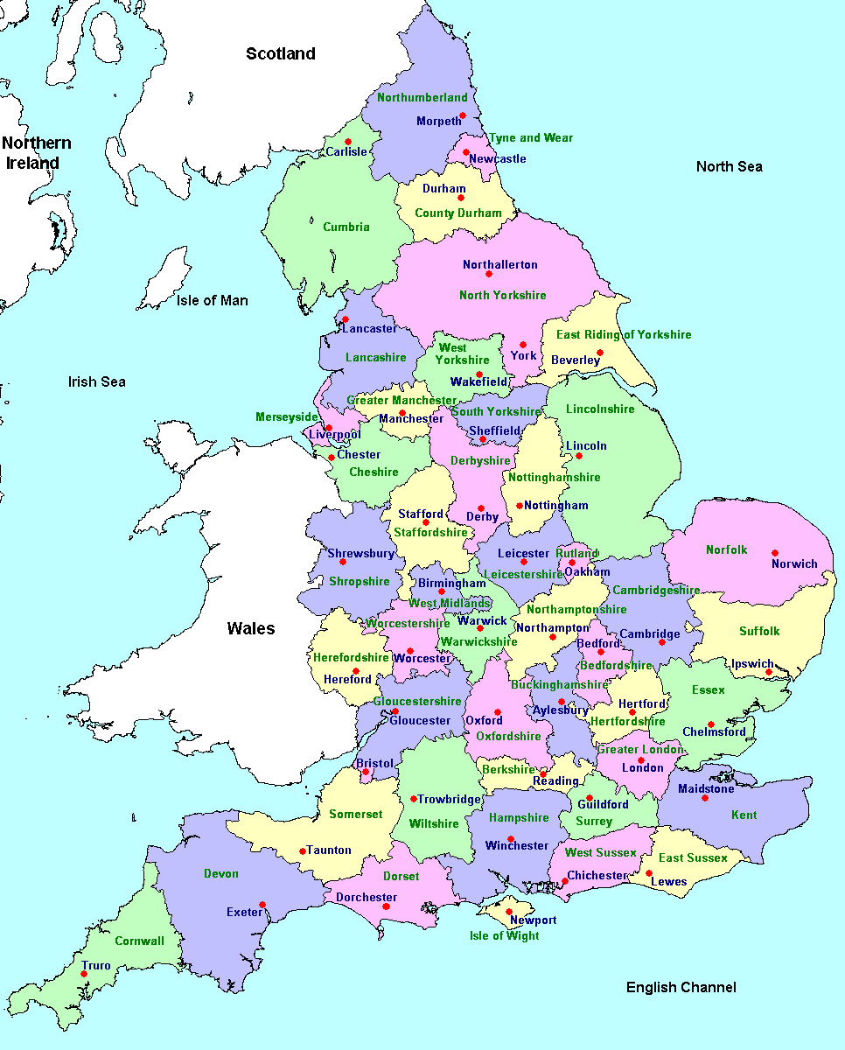
Drinking in UK
‘Binge and brawl’ culture, with the attendant harms to health and public order, has emerged in the UK in the wake of the liberalization of licencing laws in the mid-2000’s (Measham & Brain, 2005).
Binging dropping, 18% in 2005 to 15% in 2013 (ONS, 2015)
  Drop greatest in younger groups
Least abstinence in the South-West (ONS, 2015)

Slide 59
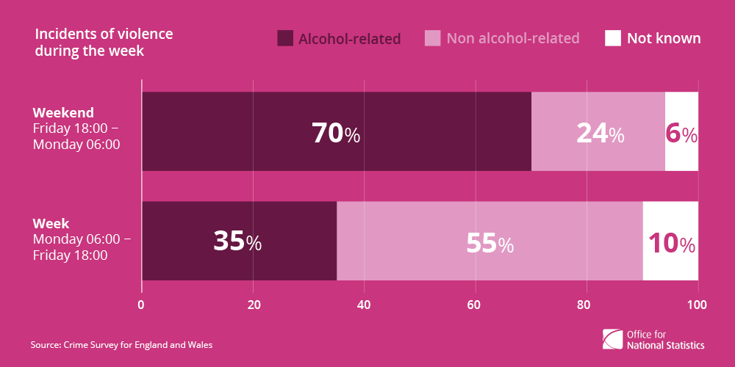
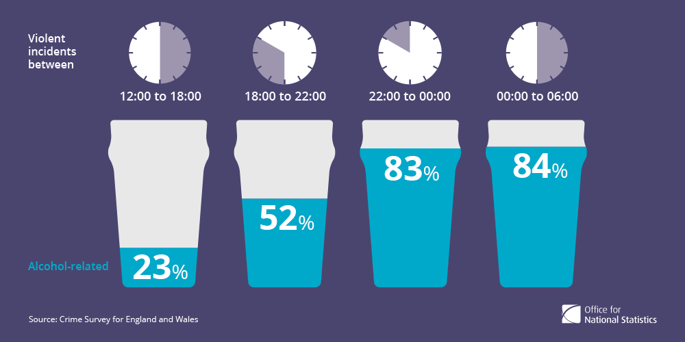
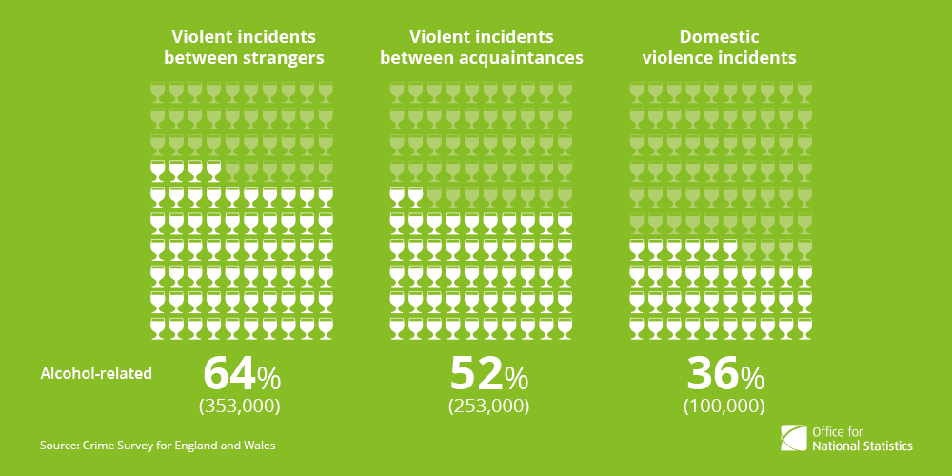
Alcohol and Crime
It’s estimated that 1,000 people in a community of 100,000 will be a victim of alcohol-related violent crime.
Crime Survey for England and Wales, 2013/2014
53% of violent incidents between adults involved alcohol
Alcohol-related incidents more often involved male victims
Relationships between individuals in alcohol-related incidents were most frequently strangers (then acquaintances, and DV)
Crime Survey for England and Wales, 2013/14
ONS, Feb. 2015, “5 facts about alcohol-related violence”

Slide 60
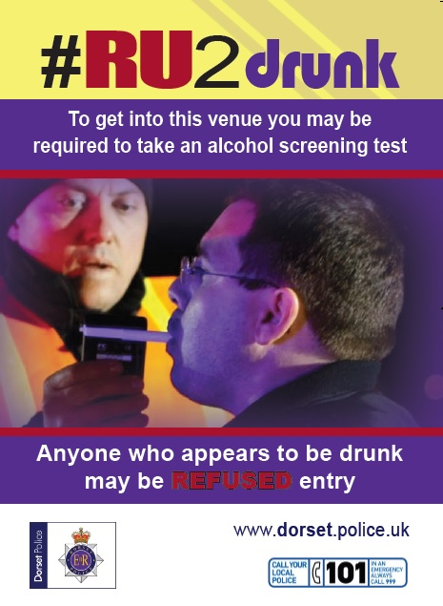

Breathalysers to door staff at pubs and clubs
Saturation of breathalysers to prevent crime displacement
Media campaign: publicising the use of breathalysers
Inspired by Norfolk Police DeepBreath initiative in Norwich in 2013

Slide 61
#RU2Drunk Program Logic
Breathalysers used in licensed premises within ENTE
Decrease in ‘preloading’ by patrons of the ENTE
People know they will be turned away from venues if intoxicated
Decrease in alcohol-related violence
in the ENTE
Decrease in excessive drinking while out in ENTE
Media campaign: publicising the use of breathalysers

Slide 62
#RU2Drunk Evaluation
Research question:
Is the breathalyser initiative effective at reducing violence and is it acceptable?
Effectiveness
Acceptability

Slide 63
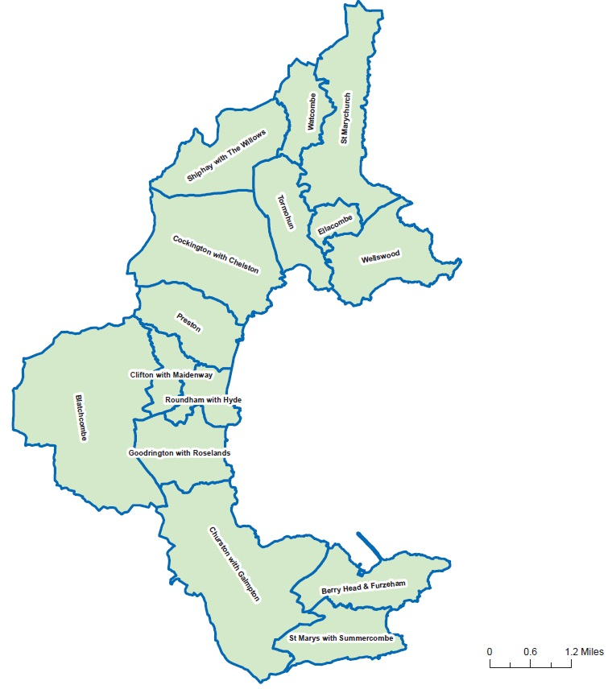
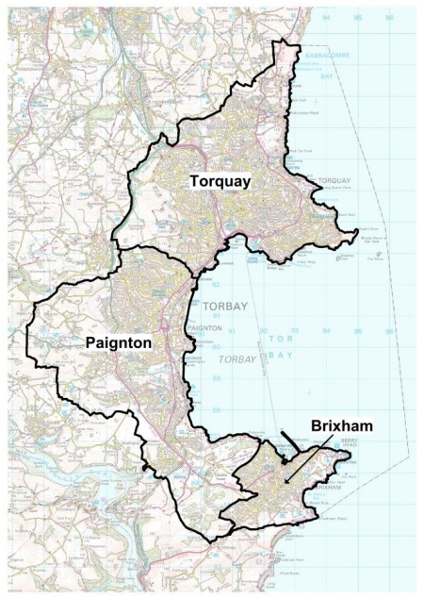
Torquay Pilot Study: Dec. 2014
Quasi-Experimental Design with intervention (Torquay) and control town (Paignton)
22 pubs/clubs within the Torquay Night Time Economy are highlighted on the map
Comparison of crime rates between Torquay and Paignton
Led by DCI Neil Ralph, South Devon Police, working with local stakeholders
Training in how to use breathalysers, limit of 70-80 suggested (drink drive 35 mg per 100 millilitres of breath).

Slide 64
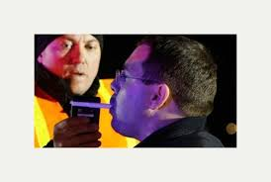
Breathalyser Use
819 breathalysed, 298 refused entry (32% female; 68% male)
  Most popular club had 10,000 footfall over Christmas/New Year
  33 people who refused to be breathalyzed
Notes:
33 refused to be breathalysed

Slide 65
Crime Statistics –Pilot Study
Comparison across years of recorded VATP (excluding DA)
 | December 2012 | December 2013 | December 2014 | 2012/2013 % Change | 2013/2014 % Change
Torquay ENTE Ward | 20 | 23 | 14 | +15% | -39.13%
Paignton ENTE Ward | 24 | 10 | 22 | -58.33% | +120%
Notes:
Note that the numbers are not large and do differ between locations
The low base rate indicates further testing is needed to determine if these findings are not due to chance or confounding factors

Slide 66
Crime Statistics –Pilot Study
Comparison of recorded VATP (excluding DA) over 24 months

Slide 67
Acceptability Evaluation
Public attitudes survey on SurveyMonkey for 1 month of initiative (n=301)
Door staff survey (post-initiative) (n=14)
Interviews with members of door staff, licensees/owners, bar staff, security company (n= 18)
Observations of night-time economy

Slide 68
Acceptability Results
More than 77% of survey respondents reported they support the use of the scheme more widely across Devon and Cornwall
Door staff and management reported using the breathalyser reconfigured the encounter from an interpersonal challenge to one between the drinker and the machine
  It ‘depersonalized’ the potentially violent encounter.
Breathalyser results were perceived by door staff as ‘neutral’ and non-negotiable, putting the judgement of being ‘too drunk’ ‘in black and white’

Slide 69
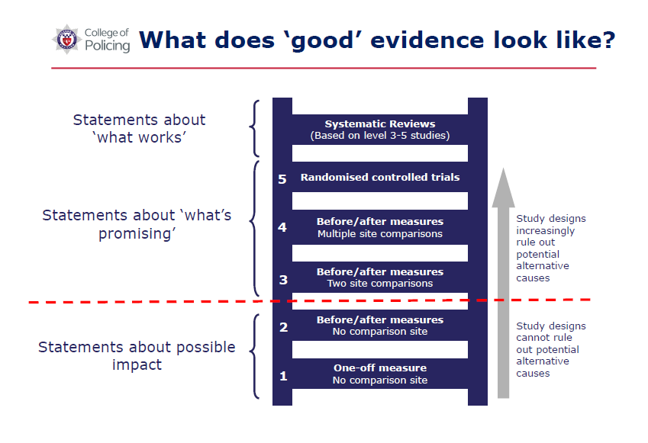
Qualitative Results
More than 75% of survey respondents reported they support the use of the scheme more widely across Devon and Cornwall
Door staff and management reported using the breathalyzer reconfigured the encounter from an interpersonal challenge to one between the drinker and the machine
  It ‘depersonalized’ the potentially violent encounter.
Breathalyzer results were perceived by door staff as ‘neutral’ and non-negotiable, putting the judgement of being ‘too drunk’ ‘in black and white’
Source: ‘What Works for Crime Reduction: Linking Research to Policing ’ presentation, by Dr. Nicky Miller, College of Policing

Slide 70
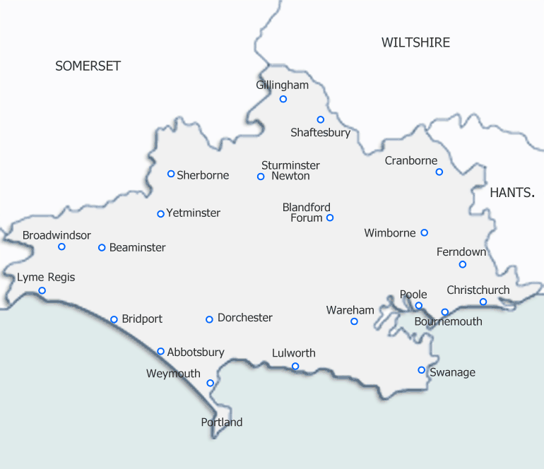
Weymouth: Autumn 2016
29 pubs/clubs within the Night Time Economy (NTE) joined the scheme in Weymouth; Sept. 16th - Dec. 16th
Quasi-Experimental Design:
  Treatment: Weymouth
  Comparison: Bournemouth
Funding for evaluation

Slide 71
Mixed-Methods
Primary Data Collection:
  Public attitudes online survey
  Online survey of staff at participating licenced premises
  Telephone interviews with stakeholders
  Telephone interviews with licensees/owners/managers
  Observations with in-situ interviews within the ENT
  Focus group with door staff & paper-and-pencil survey
Secondary Data Analysis:
  Breathalyser records
  Crime data

Slide 72
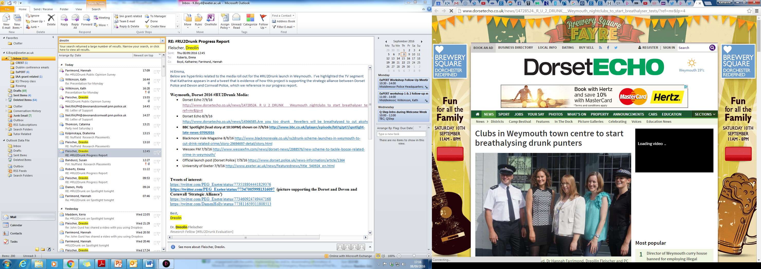
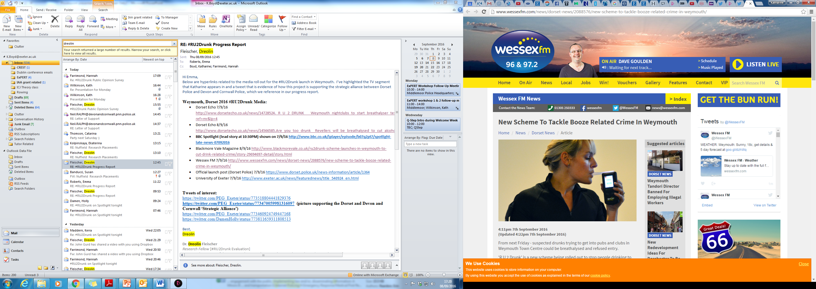
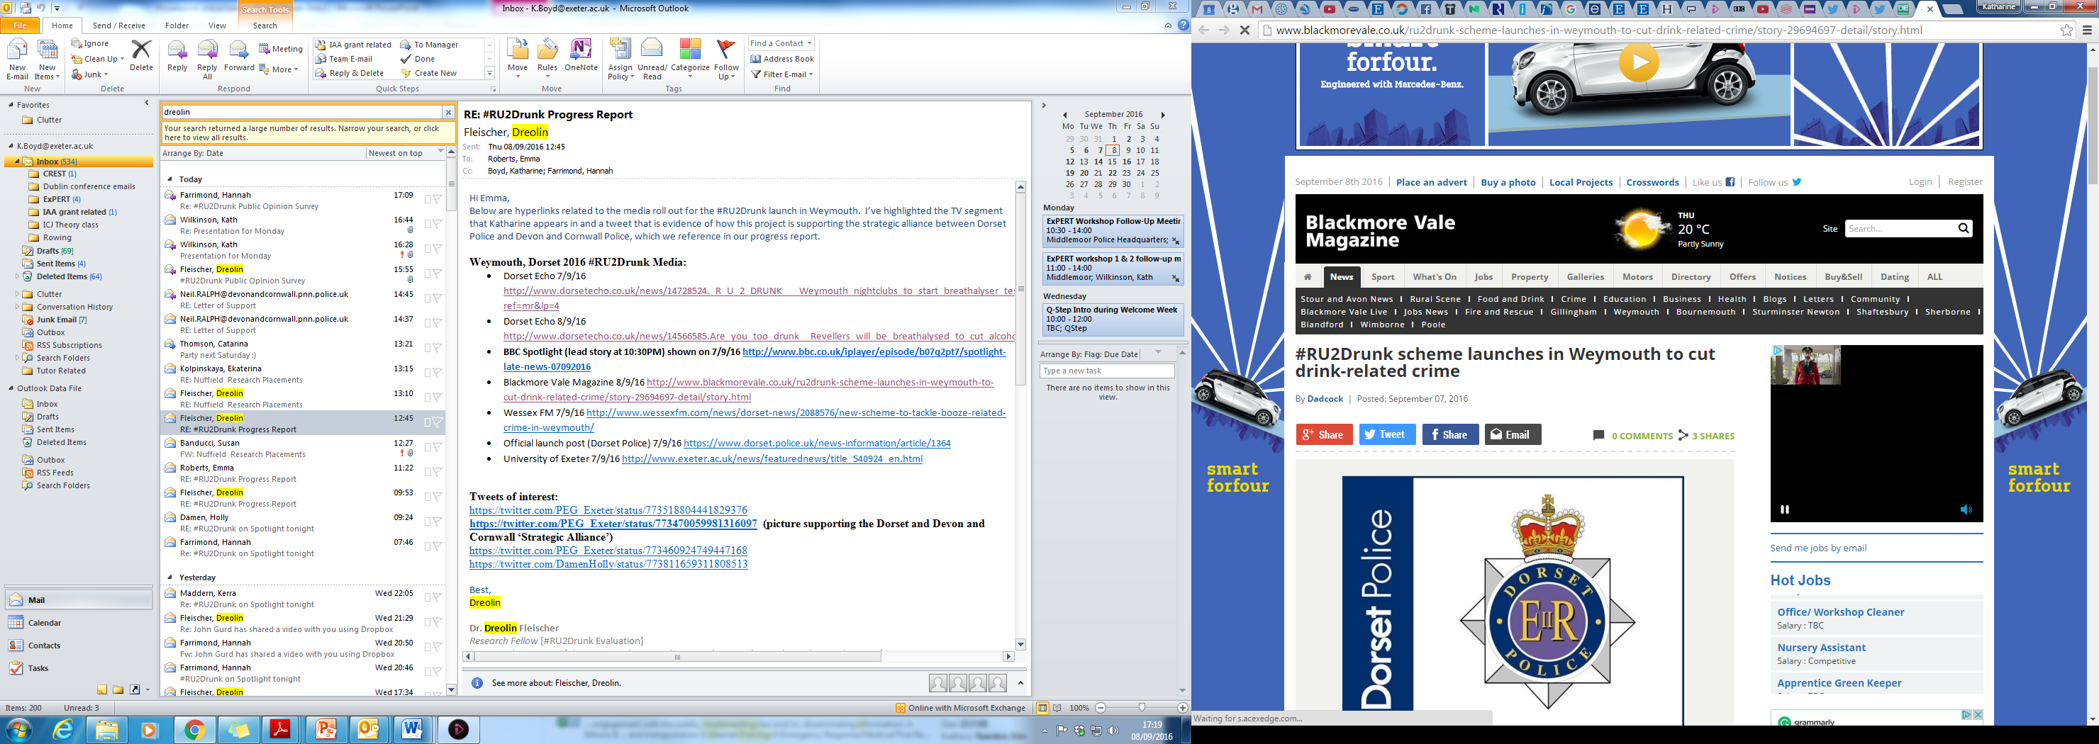
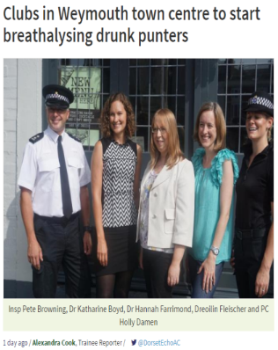
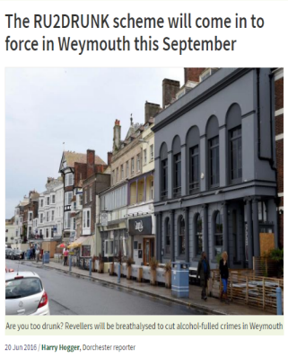
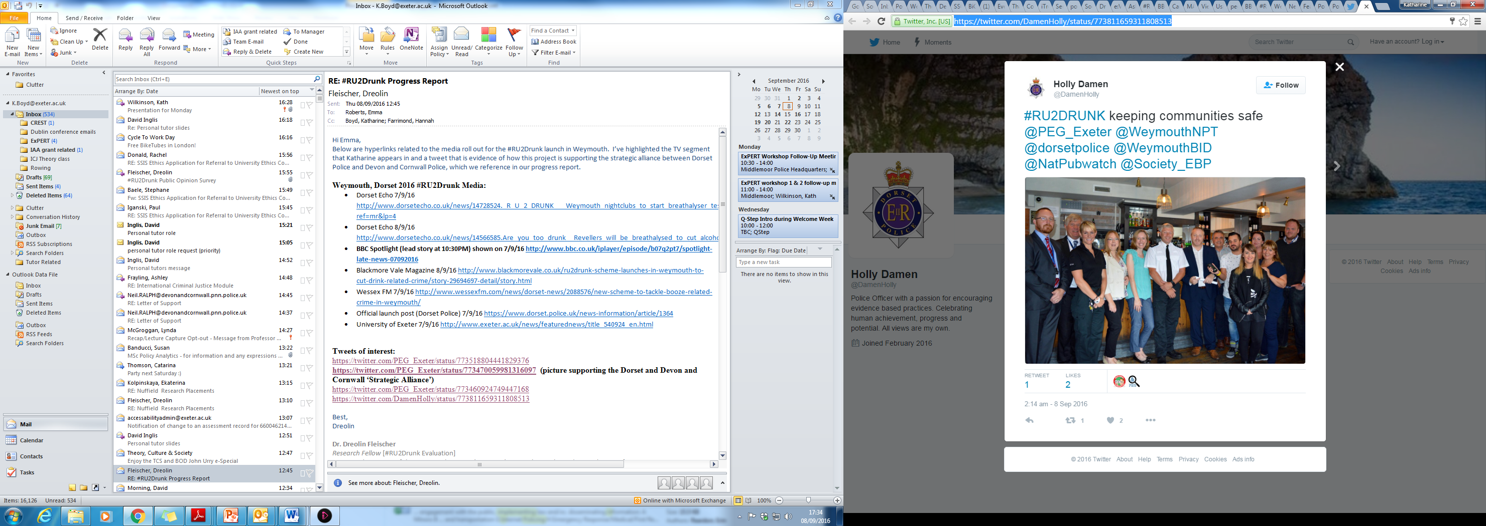
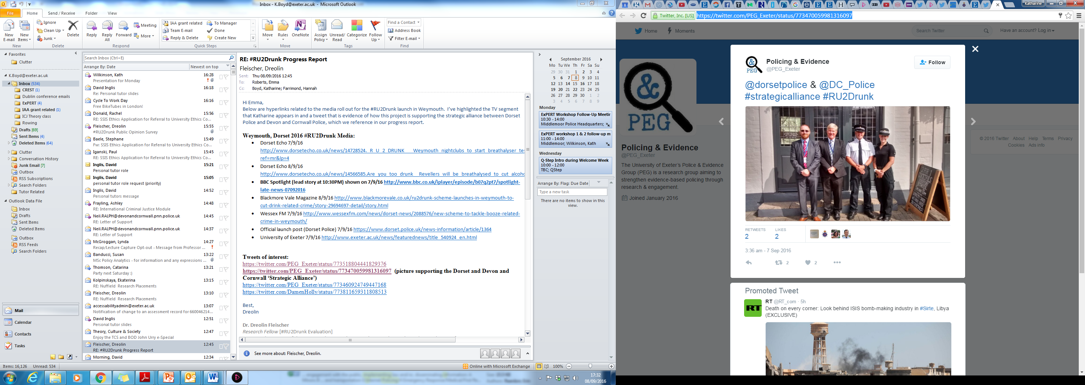
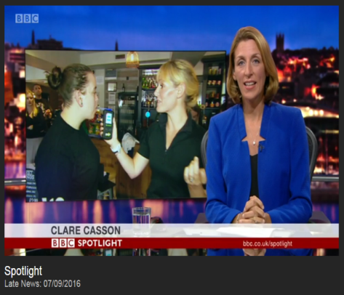
Media Coverage

Slide 73
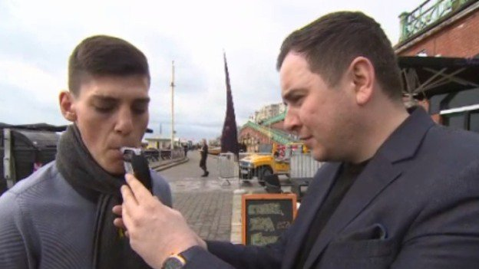
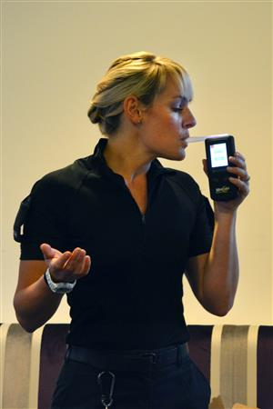
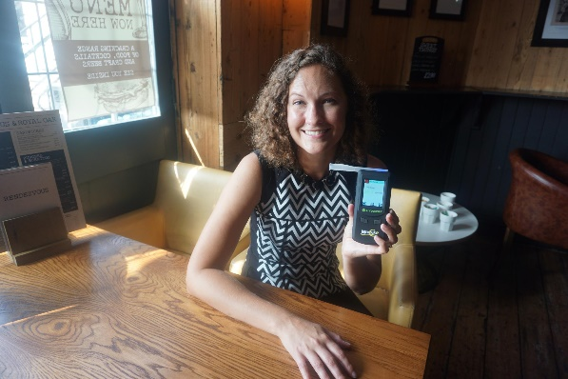
Implementation
  Low-level implementation:
  Received breathalyser records from six participating premises
  133 recorded uses of the breathalyser across the six premises
  Interviews, focus group and observations indicated there was resistance by staff (of all levels) to using the breathalyser
  Affects ‘saturation’
  However…
  Usage was likely greater than that reported in received breathalyser forms

Slide 74
Acceptability
  Participating premises were divided in the extent of their support for the scheme
  Momentum was lost early on in the trial
    National chains were forced to stop participation by head offices
    Some door staff offended they were not approached directly about the scheme
  Public opinion divided (Weymouth & surrounding areas; N=594)
    36% ‘somewhat’ to ‘strongly supported’ the scheme
    31% ‘neutral’ about the scheme
    33% ‘somewhat’ to ‘strongly opposed’ the scheme

Slide 75

Public Opinion
Efficacy:
  38% thought #RU2Drunk would have ‘some effect’ to a ‘major effect’ on pre-drinking in Weymouth (N=594).
  Vast majority of respondents to public opinion survey reported not changing their drinking behaviour during the trial, but of those who did:
    ‘I personally have because I realise how much being turned away from specific premises will effect my night. I’ve been more careful with how much I’ve drunk and how quickly I consume certain drinks. I must say I haven’t been involved in any breathalysing incidents, nor have I seen any and neither have any of my friends. I do not think that this scheme has had an impact that it was hoping for.’

Slide 76
Crime Data
Melcombe Regis (Weymouth): Non-DA VATP crime in the NTE hours during the trial months compared across years

Slide 77
‘What Works’
  ‘What works’ often addresses policy questions relevant to policymakers rather than front-line workers (Thatcher, 2008).
  There are benefits to evaluation that goes beyond answering the question of what works…
    Learnt more about the licensing climate in Weymouth
    The need to work with security companies from the outset
    Influenced Weymouth successfully bidding for the HO local alcohol action area (LAAA) phase 2
    Strengthened partnerships between police & academics
  Even ‘simple’ interventions like #RU2Drunk are complex to evaluate.
    However, we should not shy away from evaluating real world schemes but should be prepared for evaluation results to be nuanced.

Slide 78
Questions?
H.R.Farrimond@exeter.ac.uk or D.Fleischer@exeter.ac.uk
With thanks to our funders:
  ESRC IAA Impact Award
  Police Knowledge Fund (HEFCE, CoP, and the Home Office)
And collaborators:
  Neil Ralph, Devon & Cornwall Police
  Alexis Poole, Devon & Cornwall Police
  Peter Browning, Dorset Police
  Holly Damen, Dorset Police
Web presence:
  http://socialsciences.exeter.ac.uk/sociology/research/projects/policingandevidencegroup/
  https://expert-study.com/
  Twitter: @PEG_Exeter

Slide 79
Conference 2017
Creating a Culture of Curiosity: Why Failure is a Good Thing
In association with:

Slide 80
Conference 2017
Creating a Culture of Curiosity: Why Failure is a Good Thing
Lightning Talks
Turning Point – Two Years On
Inspector Jamie Hobday (West Midlands Police)
and Molly Slothower (University of Maryland)

Slide 81



The Turning Point Project

Slide 82
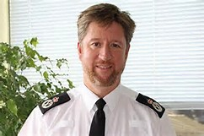
Do not jail all paedophiles, says police chief
BBC, 28 Feb 2017

Slide 83

The Turning Point Experiment
Sample of 414 first and second offenders whom the police have decided to prosecute
Random assignment=414
Prosecution = 208
Turning Point =206

Slide 84
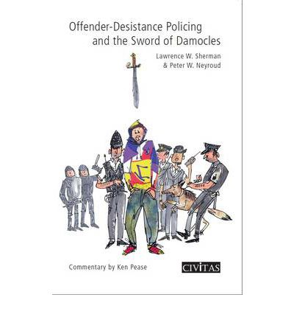

Slide 85
‘Treatment’
Deferred prosecution and completion of a plan of activity:
  ‘Sword of Damocles’
  Restorative Justice
  No more offending
  Offence/offender specific

Slide 86

DILEMNA

Slide 87
Crime Types – Turning Point
Of the 414 cases:
48% involve a violent offence
48% involve a property offence
15% include a drugs offence

Slide 88
Results…

Slide 89
Results
"Big reductions in Cambridge Harm Index for deferral vs. prosecution

Slide 90
Results
"Big reductions in Cambridge Harm Index for deferral vs. prosecution
"Big reductions in costs as well"

Slide 91
Results
"Big reductions in Cambridge Harm Index for deferral vs. prosecution
"Big reductions in costs as well"
"Substantial increases in holding offenders accountable by NOT prosecuting"

Slide 92
Results
"Big reductions in Cambridge Harm Index for deferral vs. prosecution
"Big reductions in costs as well"
"Substantial increases in holding offenders accountable by NOT prosecuting"
“No increase in re-arrest rates"

Slide 93
Results
"Big reductions in Cambridge Harm Index for deferral vs. prosecution
"Big reductions in costs as well"
"Substantial increases in holding offenders accountable by NOT prosecuting"
“No increase in re-arrest rates"
Victims strongly prefer TP to prosecution when purpose is explained to them

Slide 94
The Big Difference in Victim Satisfaction….?
Turning Point sample was more likely to think what happened in their case is going to stop the offender from doing it again.
…effect was not likely without attention to communication

Slide 95
Prosecution Outcomes

Slide 96
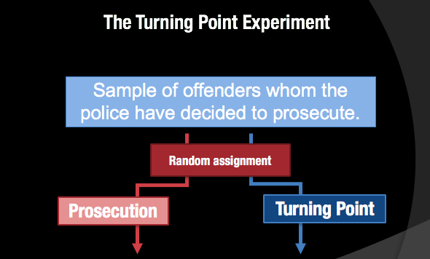


The Evidence base is building..

Slide 97
A New Framework?
Simplified – for officers and the public
Deferred prosecution –
    no criminal record, but a police record
    Police decision making
Demanding, but proportionate
Proven Programmes
Tracking, tracking…. and a little more tracking!
Oversight and monitoring

Slide 98
But a word of warning…
Inappropriate police decision making
Loose handover procedures
Poor assessment of offender need
‘Gut-feeling’ programming
Ineffective programmes
Disappointing victim communication
No ‘outside voice’ or oversight
Lack of understanding

Slide 99

Questions?

Slide 100
Conference 2017
Creating a Culture of Curiosity: Why Failure is a Good Thing
In association with:

Slide 101
Conference 2017
Creating a Culture of Curiosity: Why Failure is a Good Thing
Lightning Talks
Changing Attitudes towards
Evidence Based Policing
Helen Selby
Office of the Police and Crime
Commissioner for Merseyside

Slide 102

Receptivity to Evidence Based Practice (EBP); Implications, Challenges & Opportunities
Helen Selby-Fell
Head of Commissioning, Policy & Research, Office of the Police & Crime Commissioner for Merseyside.
Practitioner Fellow,
Liverpool John Moores University.
PhD Candidate,
Applied Criminology Centre,
University of Huddersfield.

Slide 103

EBP Research- Merseyside
Online survey Interviews
502 responses- Chief Constable
spread of roles/ranks PCC & Chief Exec
(open to all officers and staff) DCC
ACCs
Focus Groups Senior Responsible Officers
Ops Supts. Head of Corporate Support
Analysts (Strategic, Intel & Area) Head of Operational Analysis
Inspection & Audit Head of Intelligence Analysis
Operations Planning D/ Chief Inspector
Neighbourhood Team Chief Inspector Ops
Detectives Head of Training
LJMU (cohort and staff)
Community Safety Partnerships
Notes:
Victims’ Services and Restorative Justice - £1.5m. Awarded to:
Anthony Walker Foundation for a hate crime advocacy service
Catch 22 for a child sexual exploitation service
Light for Life for a hate crime service
Listening Ear to support children within DV environments
RASA/RASASC for a sexual offences service
Victim Support for a vulnerable victims service
Merseyside Police for referral and Neighbourhood support model

Slide 104
EBP Research- Initial Findings
Online Survey-
There was significant engagement with the survey, in particular, detailed responses were provided regarding how research could be made more accessible and useful and how the force can assist officers and staff in adopting an EBP approach.
Only 5% said that academic knowledge is ‘not at all transferable’ to policing.
However, nearly one third of respondents had never heard the term ‘Evidence Based Policing’.
When asked to define EBP there were a wide range of definitions/ interpretations of EBP cited.
38% seek out research evidence to inform decision making
32% stated that they sometimes or often use research to inform decision making (less than a third agreed that research evidence has changed or influenced their decision making/working practices).
30% felt that academics are producing research that is relevant in practice.
57% felt research findings were often presented in a way that is unclear.
Notes:
Victims’ Services and Restorative Justice - £1.5m. Awarded to:
Anthony Walker Foundation for a hate crime advocacy service
Catch 22 for a child sexual exploitation service
Light for Life for a hate crime service
Listening Ear to support children within DV environments
RASA/RASASC for a sexual offences service
Victim Support for a vulnerable victims service
Merseyside Police for referral and Neighbourhood support model

Slide 105
EBP Research- Initial Findings
…Online Survey-
50% of respondents stated that they lack the time to engage in EBP.
75% felt that decisions often have to be made too quickly to consider research evidence.
88% stated that they have had no training relating to EBP.
Less than 10% said that they are made aware of the research evidence that supports new policies and procedures.
78% felt that the organisation does not provide sufficient support and resources for them to implement evidence based practice.
50% thought that there was no ‘organisational emphasis’ on EBP.
50% said that they do not feel that they ‘have a voice’ should they have an idea to implement a ‘new’ tactic (based upon research evidence).
75% use previous experience, professional judgement (78%) and/or colleagues advice (76%) prior to responding to a crime problem.
There was a lack of understanding or agreement regarding how to evaluate whether an operation/ initiative had been successful.
Notes:
Victims’ Services and Restorative Justice - £1.5m. Awarded to:
Anthony Walker Foundation for a hate crime advocacy service
Catch 22 for a child sexual exploitation service
Light for Life for a hate crime service
Listening Ear to support children within DV environments
RASA/RASASC for a sexual offences service
Victim Support for a vulnerable victims service
Merseyside Police for referral and Neighbourhood support model

Slide 106
EBP Research- Initial Findings
Focus Groups and Interviews-
Genuine appetite/ interest/ enthusiasm to take EBP forward at all levels of the organisation.
EBP perceived as a threat to professional judgement/ experience by some officers/ staff (in particular lower ranks).
Lack of understand regarding the forces’ expectations on staff with regard to EBP.
Leadership & Culture- values swift response and ‘success’. Emphasis on being seen to act quickly.
Lack of willingness to accept ‘failure’ at (esp. at middle and senior management) and ‘Sunk Cost’ effect.
Very limited emphasis on evaluation/assessment in force.
Lack of organisational learning/ reflection.
Lack of awareness of sources of research.
Lack central expertise/guidance in the force.
Notes:
Victims’ Services and Restorative Justice - £1.5m. Awarded to:
Anthony Walker Foundation for a hate crime advocacy service
Catch 22 for a child sexual exploitation service
Light for Life for a hate crime service
Listening Ear to support children within DV environments
RASA/RASASC for a sexual offences service
Victim Support for a vulnerable victims service
Merseyside Police for referral and Neighbourhood support model

Slide 107
EBP Research- Initial Findings
….Focus Groups and Interviews-
- Significant gaps in the evidence base.
- EBP process sometimes too slow in practice.
- Risk of EBP being perceived as ‘another fad’.
- Officers and staff need to play integral role (i.e rather than academic v practitioner)
- Consolidation of other officers projects ‘carries less kudos’ than innovation (i.e temptation to reinvent the wheel).
- Role of Analysts as central to EBP
- Significant potential for Analysts to engage/ play key role in EBP.
- Number of organisational constraints identified (esp. by Analysts).
- Randomised Control Trials (RCTs) very resource intensive.
Notes:
Victims’ Services and Restorative Justice - £1.5m. Awarded to:
Anthony Walker Foundation for a hate crime advocacy service
Catch 22 for a child sexual exploitation service
Light for Life for a hate crime service
Listening Ear to support children within DV environments
RASA/RASASC for a sexual offences service
Victim Support for a vulnerable victims service
Merseyside Police for referral and Neighbourhood support model

Slide 108
EBP Research- Initial Findings
Focus Groups:
Analysts/Researchers- mixed capabilities (some frustrated, some require training), desire to be involved in research projects from outset of the work, have the capability/potential to contribute significantly to the formulation of the Response and the Assessment (as well as the Scan and Analysis- i.e SARA).
Neighbourhood Team- no one in team saw EBP as ‘their’ role, despite the team focusing on local problems where research evidence does exist.
Operations Planning- some cynicism regarding the relevance of research evidence to their role, despite research underpinning many of the policies that direct their activity (lack of awareness of such), evaluations limited.
Notes:
Victims’ Services and Restorative Justice - £1.5m. Awarded to:
Anthony Walker Foundation for a hate crime advocacy service
Catch 22 for a child sexual exploitation service
Light for Life for a hate crime service
Listening Ear to support children within DV environments
RASA/RASASC for a sexual offences service
Victim Support for a vulnerable victims service
Merseyside Police for referral and Neighbourhood support model

Slide 109
EBP Research- Initial Findings
EBP Simple Delivery Principles;
Take personal responsibility to seek out research and information to help inform decision making (e.g. new operations/ strategies).
Design and implement operations/strategies with evaluation in mind (i.e. set out the desired outcomes at the outset. and be explicit regarding how they will be assessed
Have the confidence to challenge the status quo and harness the learning from within the force and elsewhere, in turn building our local evidence base.
Notes:
Victims’ Services and Restorative Justice - £1.5m. Awarded to:
Anthony Walker Foundation for a hate crime advocacy service
Catch 22 for a child sexual exploitation service
Light for Life for a hate crime service
Listening Ear to support children within DV environments
RASA/RASASC for a sexual offences service
Victim Support for a vulnerable victims service
Merseyside Police for referral and Neighbourhood support model

Slide 110
Merseyside EBP Development Plan
1. Communication
2. Knowledge Hub
3. Repository of Information
4. Building Capability
5. Academic Partnerships
6. Organisational Enablers
7. Governance
Notes:
Victims’ Services and Restorative Justice - £1.5m. Awarded to:
Anthony Walker Foundation for a hate crime advocacy service
Catch 22 for a child sexual exploitation service
Light for Life for a hate crime service
Listening Ear to support children within DV environments
RASA/RASASC for a sexual offences service
Victim Support for a vulnerable victims service
Merseyside Police for referral and Neighbourhood support model

Slide 111
Force EBP Development Plan
1. Communication
. - Provide an agreed force definition & principles of EBP with linked expectations for officers and staff (in terms of delivery).
- Circulate ‘In Touch’ to all members of staff
- Video blog
2. Knowledge Hub
- Put into place a central team to provide, advice and assistance across the force- to include the interpretation of research, evaluation of operations etc.
- Provide methodology/ techniques for the evaluation of operations;
-Importance of defining desired outcomes at the outset.
- Principles and techniques for how to design operations that can be reliably evaluated.
Notes:
Victims’ Services and Restorative Justice - £1.5m. Awarded to:
Anthony Walker Foundation for a hate crime advocacy service
Catch 22 for a child sexual exploitation service
Light for Life for a hate crime service
Listening Ear to support children within DV environments
RASA/RASASC for a sexual offences service
Victim Support for a vulnerable victims service
Merseyside Police for referral and Neighbourhood support model

Slide 112
Force EBP Development Plan
3. Repository of Information
- Improve the accessibility of research evidence (to include published research, research from other forces and the local evidence base).
- Develop a central repository of research (against force priorities)
- Processes for continually updating and building the evidence base from both external and internal learning
- Data base of staff research projects
- Disseminate the learning from staff research projects
4. Building Capability
- ‘Masterclasses’
- Training Needs Assessment
- CPD
- Opportunities for academic study/ experience
- Utilisation of officers and staff who have EBP skills
Notes:
Victims’ Services and Restorative Justice - £1.5m. Awarded to:
Anthony Walker Foundation for a hate crime advocacy service
Catch 22 for a child sexual exploitation service
Light for Life for a hate crime service
Listening Ear to support children within DV environments
RASA/RASASC for a sexual offences service
Victim Support for a vulnerable victims service
Merseyside Police for referral and Neighbourhood support model

Slide 113
Force EBP Development Plan
5. Academic Partnerships
- Co-ordinated approach to academic partnerships
- Maximise benefits of collaborations (e.g N8, OU etc.)
- Establish new relationships
- Explore external funding sources
- Co-ordinated approach to officers/staff funded study
- Maximise benefits of officers and staff who have been provided with study opportunities (e.g. consider role of ‘EBP Champions’)
6. Organisational Enablers
- Culture
- Leadership
- Capacity
- Capability
- Structures & Roles
- Systems (including IT)
- Processes
7. Governance
- EBP Steering Group
- EBP Tactical Group
- Inspection regime
- Change Programme
Notes:
Victims’ Services and Restorative Justice - £1.5m. Awarded to:
Anthony Walker Foundation for a hate crime advocacy service
Catch 22 for a child sexual exploitation service
Light for Life for a hate crime service
Listening Ear to support children within DV environments
RASA/RASASC for a sexual offences service
Victim Support for a vulnerable victims service
Merseyside Police for referral and Neighbourhood support model

Slide 114
EBP Research- Initial Findings
Key Enablers
Provide an understanding of the concept and the expectations upon officers and staff- Simplify!
Explain why and how EBP provides benefits and supports day to day delivery (i.e. the evidence for EBP!)
Provide officers/staff with the necessary resources (e.g. research source/s, capability (including training) capacity, IT, systems etc.
Promote a culture in which innovation/ respectful challenge of the status quo is encouraged.
Promote a culture and strategy in which EBP is considered fundamental to day to day business, rather than something ‘additional’ to do.
Notes:
Victims’ Services and Restorative Justice - £1.5m. Awarded to:
Anthony Walker Foundation for a hate crime advocacy service
Catch 22 for a child sexual exploitation service
Light for Life for a hate crime service
Listening Ear to support children within DV environments
RASA/RASASC for a sexual offences service
Victim Support for a vulnerable victims service
Merseyside Police for referral and Neighbourhood support model

Slide 115
Going Forward
Organisational Enablers
The role of professional experience ( and how to capture the learning and disseminate).
Role of force Analysts & Researchers as central to EBP
Measures of success for EBP
Collaborations (forces/ OPCCs)
Partners (Community Safety Partnerships, Local Authorities etc.)
Notes:
Victims’ Services and Restorative Justice - £1.5m. Awarded to:
Anthony Walker Foundation for a hate crime advocacy service
Catch 22 for a child sexual exploitation service
Light for Life for a hate crime service
Listening Ear to support children within DV environments
RASA/RASASC for a sexual offences service
Victim Support for a vulnerable victims service
Merseyside Police for referral and Neighbourhood support model

Slide 116
EBP Research- Initial Findings
The 3 T’s. (Sherman 2013).
1. Targeting
(identify ‘power few’- people and places
2. Tracking
(track officer activity)
3. Testing
(test impact of activity, e.g. RCT)
SARA process.
Scan (identify a significant problem on which to focus attention AND consider desired outcome)
Analysis (detailed analysis- who/what/where/when/why)
Response (formulate response based upon consideration of research evidence)
Analysis again! (collect tracking information/data to assist with assessment).
Assessment (evaluate impact of response)
Notes:
Victims’ Services and Restorative Justice - £1.5m. Awarded to:
Anthony Walker Foundation for a hate crime advocacy service
Catch 22 for a child sexual exploitation service
Light for Life for a hate crime service
Listening Ear to support children within DV environments
RASA/RASASC for a sexual offences service
Victim Support for a vulnerable victims service
Merseyside Police for referral and Neighbourhood support model

Slide 117
Conference 2017
Creating a Culture of Curiosity: Why Failure is a Good Thing
In association with:

Slide 118
Conference 2017
Creating a Culture of Curiosity: Why Failure is a Good Thing
Recent Discoveries in Evidence-
Based Policing:
A Global Round-Up
Professor Lawrence Sherman
Professor of Criminology, University of Cambridge
and Honorary President, SEBP

Slide 119
Conference 2017
Creating a Culture of Curiosity: Why Failure is a Good Thing
In association with:

Slide 120
Conference 2017
Creating a Culture of Curiosity: Why Failure is a Good Thing
Measuring the things that matter
Paul Dawson
Mayor’s Office for Policing And Crime (MOPAC)

Slide 121
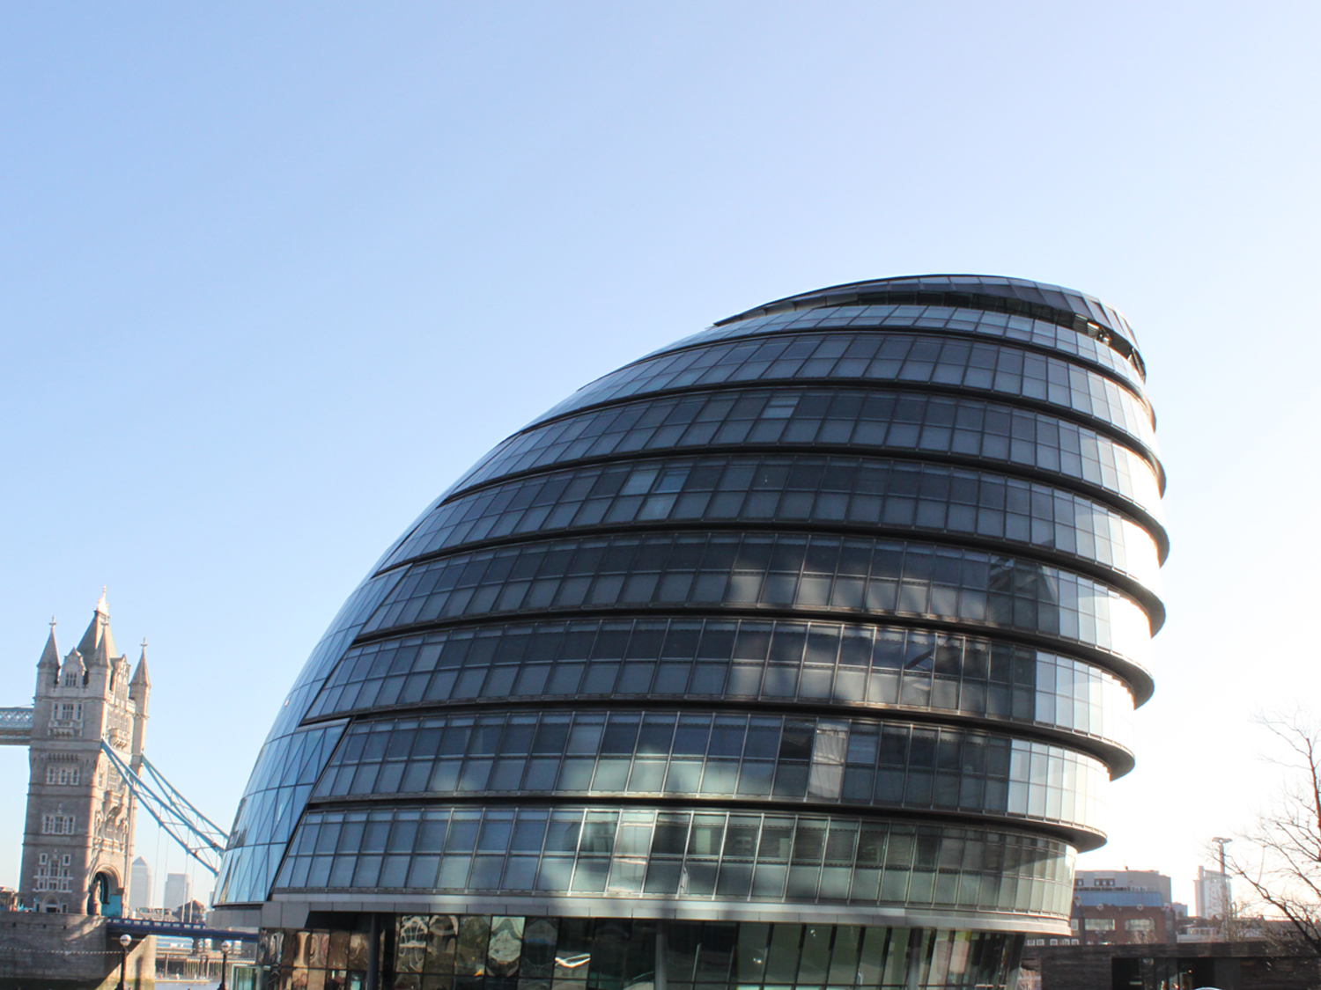

Measuring the things that matter: how far a researchers’ influence...
Dr. Paul Dawson CPsychol AFBPsS
Evidence & Insight
Mayor’s Office for Policing And Crime, London.
Paul.dawson2@met.police.uk
paul.dawson@mopac.london.gov.uk

Slide 122
Who are MOPAC Evidence & Insight...
E&I is the largest dedicated civilian research unit in UK policing or PCC in the country. Approximately (22) specialist staff, such as criminologists & psychologists.
Based within the MPS for many years, moved to MOPAC with wider scope April 2014.
Working to drive change and improvements that benefit London (within policing, crime and justice…) from the inside (A unique and privileged position).
E&I four main areas of expertise:
1) Performance analytics and data visualisation (performance dashboards, interactive tools – linked heavily to oversight and transparency)
2) Survey design and conduction (oversee 2 large scale pan-London surveys)
3) Social research/evaluation (15+ evaluations – ranging from experimental to smaller scale)
4) Liaison with academic organisations
Full access to MPS systems and data. A goldmine of data is captured within the MPS that should be promoted and used more by academics... (you don’t need to be interested in policing to want to use police data).
Aim is to embed this rich evidence into the core of the organisation… see it used.

Slide 123
Love the breadth of work – don't want to concentrate on this aspect...
Range of analytics exploring inequalities in London (i.e., vulnerable areas = more victims of higher harm, examining day-time London population and how this changes demand)
Exploring perceptions of Londoners towards firearms officers (i.e., approachability, feeling of safety)
Impact evaluation around a pan-London Restorative justice programme (process, impact and economic)
Research into Police Misconduct: that shows that BAME officers are x2 times more likely to go through internal misconduct – not difference re allegation, length of service, age of officer, on vs off duty, public complaints…
Longitudinal tracking of a number of graduate police cohorts (i.e., Police Now) (published today!)
Innovative Randomised Control trial of Police Mental Health Training (MAST) (published today!)
Evaluation around tagging alcohol offenders (process, impact and economic).
Range of accessible 'data dashboards' on core MOPAC topics available to all.
These are embedded into MOPAC working (Boards) and Oversight of the MPS (i..e, public meeting driven by evidence between DMPC and Commissioner).
https://www.london.gov.uk/what-we-do/mayors-office-policing-and-crime-mopac/data-and-research

Slide 124
Police Now – lessons from the first cohort
The first cohort of Police Now participants highly satisfied with the level and quality of training they received as part of the Summer Academy
The majority of participants reported job satisfaction (74%) and 76% reported being motivated at work. Both job satisfaction and motivation have declined over time.
What worked? The syndicate structure emerged as an important feature, along with the positive learning environment and the quality of the visiting fellows and guest lecturers
What could be improved? Participants thought the training could have had a larger focus on the practical aspects of the job and longer shifts on field training.
32% of participants feel they are rewarded fairly for the work they do
40% feel there is a positive atmosphere among the people they work with
Only 43% of the cohort thought the Summer Academy equipped them with the necessary skills to embark on their career as a police officer and only 36% felt they had the necessary confidence.
Only 18% reported having access to the resources and equipment needed to do their job (decline from 37% in TS2)
There was a decline in some attitudes since participants began their roles as police officers. E.g., fewer officers were confident of receiving a good service if contacting the MPS as a member of the public
Significantly fewer female participants were satisfied with their job and significantly fewer felt confident beginning their roles as police officers compared to male participants
Question | TS 1 (n=69) | Tracker Survey 2 (n=45) | Tracker Survey 3 (n=38) | % change
Being concerned about customer service should not be a big part of a police officer’s job | 7.2% | 17.7% | 21.0% | 13.8%
Officers should treat everyone with the same level of respect regardless of how they behave towards police | 94.2% | 86.6% | 73.7% | -20.5%
If I contact the MPS as a member of the public, I would be confident of receiving a good service | 75.4% | 64.5% | 50.0% | -25.4%
It is important that the MPS workforce ‘looks and feels’ like the diverse communities that it serves | 88.4% | 77.7% | 76.1% | -12.3%
Good police-community relations has no effect on the crime rate | 2.9% | 4.4% | 10.5% | 7.6%
Some victims of crime are more deserving of a good service than others | 2.9% | 2.2% | 7.9% | 5.0%
I have confidence in the leadership provided by senior leaders in the MPS | - | 73.9% | 36.8% | -37.1%
Senior managers are out of touch with what is happening on the front line | - | 23.9% | 47.4% | 23.5%
53% reported feeling a stigma attached to being part of Police Now and only 40% reported feeling comfortable disclosing being part of the programme when meeting new colleagues
64% of the cohort thought scientific knowledge and professional expertise should make an equal contribution to day to day decision making
The Police Now cohort was more receptive to implementing evidence based policing compared to officers who joined the force through other routes; however, more work needs to be done to enable them to practically embed such work.
82% would encourage other graduates to join the scheme and 76% talk positively about Police Now when speaking to others
Note: figures represent % strongly agree/agree
Notes:
124

Slide 125
Am really here to talk about measuring the things that matter…
MOPAC currently developing a 'Policing and Crime Plan' – due to be launched March 2017 - itself an evidence based document.
Mayors vision as to how the Police and partner agencies will work together to make London safer and reduce crime.
A key aspect in this a new performance framework to establish what success looks like for London over the next 4 years.
Measuring the Mayor’s priorities for London.
My role – thinking about how the Mayor should hold the MPS and Commissioner to account... and what success can look like…
Huge impact upon the ground.
I entered into the process with an aim to bring about more sophisticated conversations.
To begin with = what did London MOPAC and MPS have previously …?

Slide 126
Previously MOPAC set clear Crime Targets
Targets! Targets! Targets! Targets! Targets! Targets!
Previously used my many forces and Government departments.
Setting a particular level of performance that is to be met or aimed for.
Previously MOPAC had – six blanket numerical targets – these were the ‘measure’ of MPS in view of the Mayor. i.e.,:
- 20% reduction in key volume crime types (MOPAC 7) (no vulnerability / high harm and even if you didn’t present problem in the areas)
- 20% increase in 'public confidence in police' (was this evidence based/achievable?)
Potential negative impacts of numerical target setting.
Chasing figures? Gaming of system? Impacted heavily by any recording changes.
What gets measured gets done? Performance cultures? Quality of recording?
Perverse incentives? Cause for concern and anxiety for staff? Harm a learning culture?
Certain crimes reducing by a set percentage doesn’t mean overall the service is 'good'!

Slide 127
Thoughts at the beginning – redefining success for MOPAC/MPS….
Can we:
Move away from blunt pan London measures, volumes and targets to a more sophisticated conversation.
Wanted high harm offences.
Move beyond purely 'crime'.
Consider issues around tackling inequality and vulnerability.
Ensure victim voices are core.
Incorporate Londoners experiences and perceptions into defining success.
Have a process supported by evidence and scrutiny.
Move away from 'blame cultures' to learning cultures.
Focus on problem solving.
Talk about the three core areas to measuring success…
Hope to stimulate conversations...
Underpinning this – lots unsaid around need to develop learning culture and the sheer strength of influence we can have.
127

Slide 128
Topic 1 : A Safer London – balance high harm and volume
No more numerical targets (appreciate that losing targets doesn’t solve everything).
A mandatory focus on High Harm priorities (i.e., Sexual offences, CSE, Domestic Abuse, Weapon based, knife and gun, Hate crime). Area was missing previously.
- Measuring but beyond numbers – some high harms should go up (better reporting).
Focus to be on reducing repeat victimisation within higher harm victims.
Commitment to tackle ASB (volume wise- no1).
Volume crime priorities - local decision making based upon evidence.
Local policing - local priorities - Local decision making - local problem solving
Refreshed annually - aiming for year on year reductions.
Link in with local assessments and profiles.
Maintain oversight of all recorded crime and drive actions where appropriate.
Transparency in reporting and scrutiny (i.e., new suite of dashboards)

Slide 129
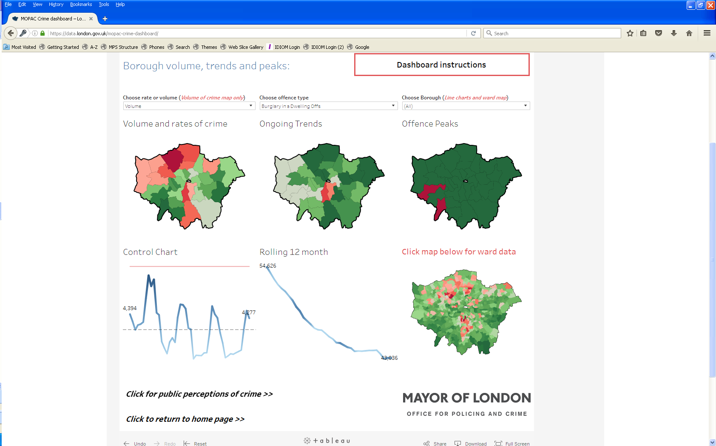
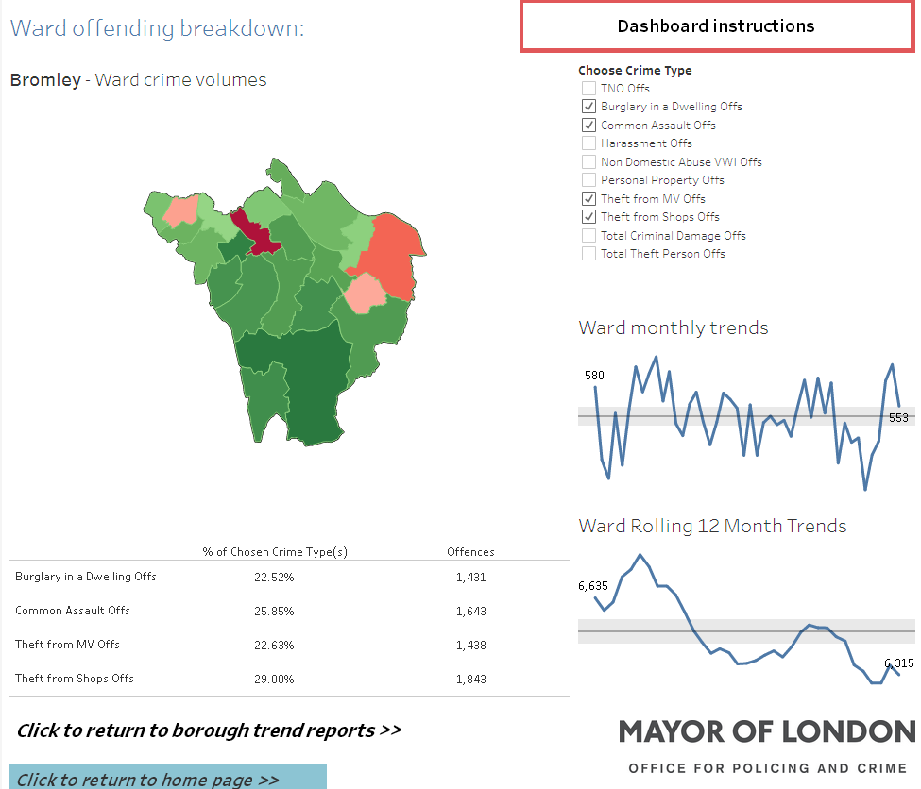
A Safer London local decision making - our analytic offer
Local priorities to be locally decided based upon evidence – are there local analysts?
To shape conversations – MOPAC analysis and tools – focussing upon 60% of all TNO (i.e., no drug crime = police generated). E&I developed a new 'crime dashboard'.
Priorities over time, ranks, volume: short and long term trends, rate per population, … down to a ward level.
DMPC and AC Martin Hewitt met every borough (Chief Exec) to agree the local priorities. Clear Support.
We report on overall crime and the locally selected priorities.

Slide 130
Topic 2: A better police service for Londoners
Ensuring public views are core to understanding success…
Placing victim satisfaction with police at the front..
Moving beyond previous narrative around 'confidence' (aka. Good job local).
'Good job local' / confidence - previously limited - strategic grip, understanding, actionable. We had a statistical model - broad concepts… unconvinced it ever landed well.
A new focus on the core actionable behaviours we want to see improve (fair treatment; dealing with the things that matter; are informed about what police are doing …) as opposed to wider concepts.
Seek to drive more representative workforce (BAME / Female recruitment).
Use MPS own staff survey – track and seek improvements within …'being treated with fairness and respect by collegues'.

Slide 131
An extension of our evidence base – focussing upon core behaviours
A focus on seven core questions that underpin the behaviours of Neighbourhood policing:
Are based upon the evidence base (key influencers within the MPS confidence model) and P&CP ambitions.
Are all simple, measurable and actionable. No conceptual discussions, terms or statistical models.
All questions within MOPAC's Public Attitude Survey – the most robust survey of it’s type in the country.
(each ward in London now has a ward officer dedicated to tackling) … Do you know how to contact your Local Ward Officer?
[police in this area] listen to the concerns of local people
[police in this area] are dealing with the things that matter to people in this community
How well informed do you feel about what the police in THIS AREA have been doing
[police in this area] can be relied on to be there when you need them
[police in this area] treat everyone fairly regardless of who they are?
…How good a job do you think the police in this area are doing?
SIMPLE
MEASURABLE
ACTIONABLE
No set targets – but look for year on year improvements

Slide 132
Tackling inequalities within public perceptions
Typically a 5-10 percentage point gap between certain demographic groupings having lower perceptions of policing.
BAME victims of crime in London report lower satisfaction with the service they receive from the police, compared to White victims (4.5 percentage points – consistent for years, widest gap is for burglary victims (8-9 percentage points).
Young BAME Londoners have lower perceptions – i.e.,
63% compared to 74% (police do a good job in your local area) (11pp)
Just 59% of 16-24 year olds, who are male and of black ethnicity think the police treat people fairly…compared to 73% of white 16-24 year olds (14 pp difference).
BME Londoners confidence increases with age, for white Londoners confidence remains broadly stable.
Self declared disabled individuals 7 percentage points less satisfied (73% vs. 80%).
Those living in deprived areas present less positive opinions towards the police.
UK-born BAME respondents hold significantly less favorable views towards the police than non-UK born BAME respondents.
Can we seek to narrow these gaps?
132

Slide 133
Topic 3: A better CJS for London
Can we move the Criminal Justice System to a Criminal Justice Service.
There is no routine capture of victim satisfaction through the CJS…
The high cost of repeat offenders – small number of offenders committing a disproportionate amount of crime (i.e., 4000 most prolific offenders – avg of 57 arrests, 36 convictions).
Overall cost of London reoffending each year estimated at 2.2 billion pounds. But does 'proven reoffending' take too long to measure (12+6m).
High victim attrition especially within some Higher Harm offences.
Lack of direct grip – CJ devolution discussions. Partnership key.

Slide 134
Taken together – an innovative performance framework
Action plans & problem solving
Trajectory and monitoring
Some volume may go up
Repeat victimisation decrease
Mandatory
High Harm
priorities
A Safer London
A focus on volume and high harm priorities
(MOPAC in consultation with MPS and Local Authorities)
Sexual offences, Domestic Abuse, Hate Crime, Child Sexual Exploitation, Weapon based (Knife & Gun)
Provision of tools (borough & ward: rank, trends, peaks)
Problem solving action plans (locally driven, geographically focused (i.e., vulnerable areas).
Annually refreshed
Year on year reductions
Local priority may be evidenced by:
Theft (from MV, shops, person), Non DA VWI, Common Assault, Harassment, Burglary dwelling, Criminal Damage, Robbery person
ASB plus
Two volume
Priorities
Active monitoring & reporting – looking for improvements within:
Victim Satisfaction with police service (MOPAC's User Satisfaction Survey)
Improve public perceptions towards the police (MOPAC's Public Attitude Survey)
Challenge the inequalities in Satisfaction & public perceptions (i.e., BAME present lower perceptions)
More representative Police workforce (More BAME/ More female recruitment)
Police officers/staff treated with fairness and respect by colleagues (MPS Staff Survey)
A Better Police Service for London
(MPS)
A Better CJS for London
(CJS / MPS)
Active monitoring & reporting – looking for improvements within:
Reduce offending behaviours of targeted cohorts (i.e., offending, frequency, severity)
Better service for victims (i.e., VCOP compliance – victims kept informed and referred to services)
Improve victim satisfaction with the service they receive through the courts (new survey for London)
MOPAC will continue to routinely monitor all recorded crime & ensure action

Slide 135
Measuring the things that matter - A deeper look at the High Harms - London priorities
Keeping children and young people safe
Active monitoring & reporting – looking for improvements within:
Reduce the number of young victims of crime
Reduce the number of first-time entrants to the criminal justice service
Reduce the number of knife crimes – by volume and numbers of repeat victimisation
Reduce the number of gun crimes (including discharges)
Encourage more victims of Child Sexual Exploitation to come forward and report
Active monitoring & reporting – looking for improvements within:
More domestic abuse victims to come forward / reduction in repeat victimisation
More victims of sexual violence to report / reduction in repeat victimisation
Work with the CJS to reduce the rates of attrition in cases of violence against women and girls as they progress through the criminal justice process
Encourage more victims of harmful practices such as female genital mutilation (FGM), ‘honour’- based violence and forced marriage to come forward and report
Tackling Violence Against Women and Girls
Active monitoring & reporting – looking for improvements within:
Encourage more victims of hate crime to come forward and report
Reduce the level of repeat victimisation
Reducing the rates of attrition in hate crime as they progress through the criminal justice process
Improve the level of satisfaction of victims of hate crime with the service they receive from the police and criminal justice service
Standing together against extremism, hatred and intolerance

Slide 136
An offer supported by evidence & scrutiny
MOPAC active monitoring and analysis – an offer to the MPS - i.e. diagnostics / focused analysis, enhancing the evidence base around what works. MOPAC attendance at Crime fighters & appropriate MPS boards to embed evidence & analysis.
Regular meetings between DMPC / Commissioner/Deputy Commissioner.
Regular meetings between E&I and relevant MPS staff.
Monthly MOPAC performance top-line result briefs.
A new suite of Public Data Dashboards & transparency in reporting.
Internal (and partnership) MOPAC boards.
Search for champions to help embed stories of evidence ....
Public Scrutiny sessions (i.e., Policing or Justice matters) – DMPC draw upon MPS and wider partners to explore performance and problem solve.
Provision of tools to support...
Live from Q1 17/18.

Slide 137
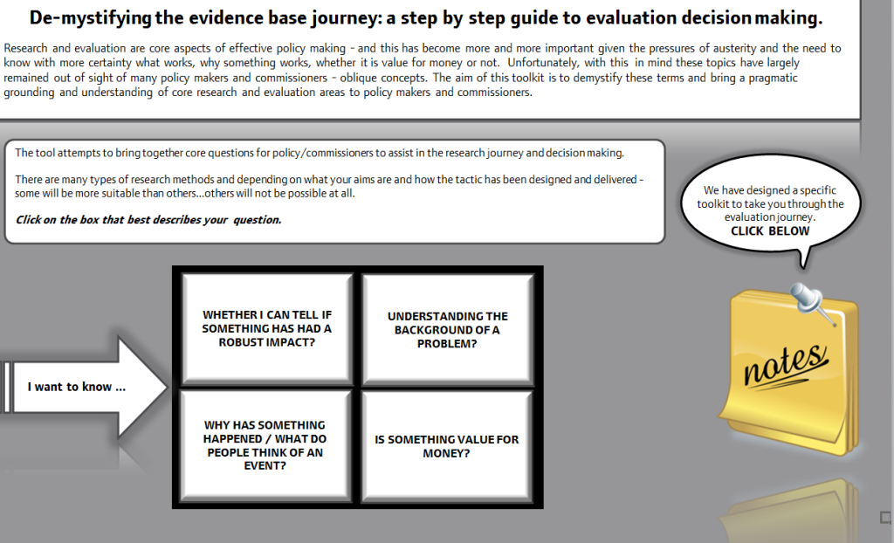
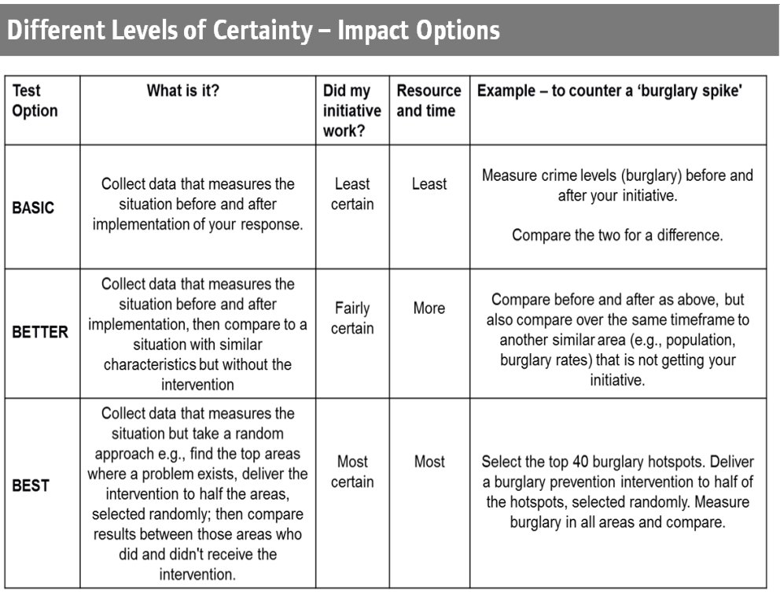
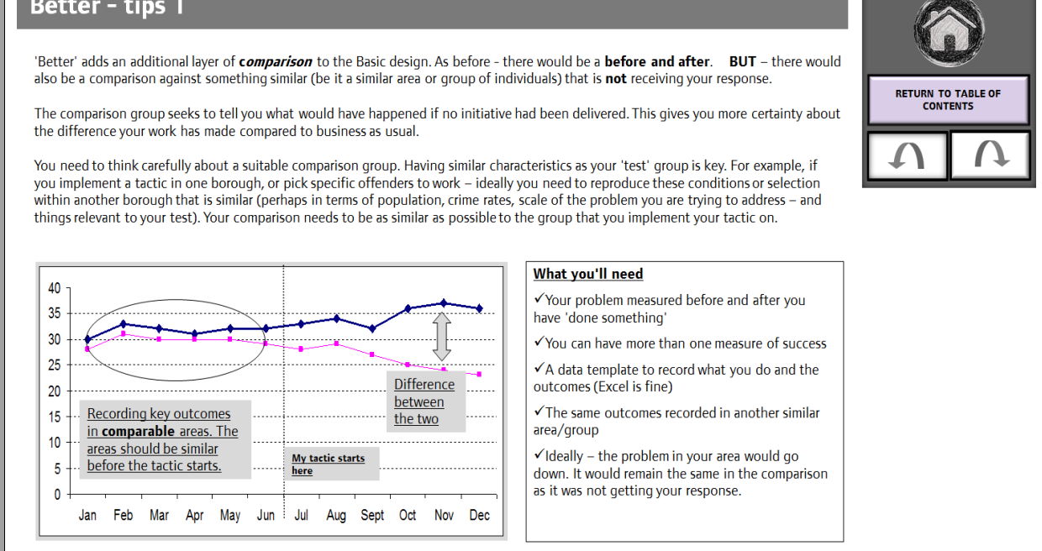
Provision of tools to support…
Research, evaluation (formal and informal), problem solving....
137
Notes:
The development of IOM can be tracked back to such initiatives as the Street Crime Initiative, Persistent Offender Programme, Prolific and other Priority Offender programme, Drug Intervention Programme all of which were supported by a variety of research findings.
Police & Crime Plan
See Dawson & Stanko (2013) on the importance of 'implementation' within offender management. http://policing.oxfordjournals.org/cgi/reprint/pat015?&ijkey=H8Ir9jVeV4ZTpL7&keytype=ref
paper?

Slide 138
Wider reflections on influence… in the past
Wider reflections on role – previously six years within the MPS.
We had a wide ranging programme of research.
To be blunt – work mixed to little influence.
Many quality research pieces – little organisational landing.
Quality not always the main factor on research landing...
Tried to embed centrally - usually working with motivated minority groups.
Worked with those who got it....
Vs. receptivity to research, performance cultures, pressures to succeed, can-do attitudes, information flows, risks of research, traditional craft of policing, poor programme integrity and implementation; etc…
Often attempting to plant seeds from the inside ... Take a long time.
Rewarding, some success, some challenges – not transformational.

Slide 139
And in the present / future...
Not perfect - but at MOPAC - working with a motivated majority.
Direct links into policy & programme design.
Able to embed evidence around organisational narrative / driven from the centre (working closely with Directors and Deputy Mayor). Not just individual projects.
Evidence based Policing and Crime Plan.
Am developing a Research Strategy – 4 year forward look key research.
Links with MOPAC DARA – can evidence base be brought into Audit? (hopefully YES – i.e., audit of Diamond or Gold groups –what evidence is used here, how is learning shared...!)
Able to have genuine influence – see performance framework. Beyond anything able to do whilst we were in the MPS.
Personal learning.
Role of wider PCCs – can these be your evidence allies?

Slide 140

Good Luck
Our experience (in the MPS) captured in print
http://www.amazon.co.uk/Police-Research-Evidence-Recommendations-SpringerBriefs/dp/3319206478

Slide 141
Conference 2017
Creating a Culture of Curiosity: Why Failure is a Good Thing
In association with:

Slide 142
Conference 2017
Creating a Culture of Curiosity: Why Failure is a Good Thing
Closing address
T/Assistant Chief Constable Alex Murray
West Midlands Police Force and Vice Chair, SEBP

Slide 143
Conference 2017
Creating a Culture of Curiosity: Why Failure is a Good Thing
In association with:

