Slide 1











Conference 2017
Creating a Culture of Curiosity: Why Failure is a Good Thing
In association with:

Slide 2

Conference 2017
Creating a Culture of Curiosity: Why Failure is a Good Thing
How evidence drives change
Chief Constable Dave Thompson
West Midlands Police and Honorary President, SEBP

Slide 3
Conference 2017
Creating a Culture of Curiosity: Why Failure is a Good Thing
In association with:

Slide 4
Conference 2017
Creating a Culture of Curiosity: Why Failure is a Good Thing
So what about Evidence Based
Management?
Professor Rob Briner
University of Bath, School of Management

Slide 5



SO WHAT ABOUT
EVIDENCE-BASED MANAGEMENT?
www.cebma.org
Rob B Briner
Society of Evidence-Based Policing Winter Conference – Northampton – 02.03.17

Slide 6

Most stuff available www.cebma.org

Slide 7
Some things that get in the way of evidence-based practice in policing (etc)
Inadequate training and development
Not provided with resources to properly diagnose or understand nature of problems in context
Limited access to information and evidence that might help understand problems and possible solutions
Incentivized to focus on areas and take actions to please higher-ups rather than deal with important problems effectively
Jobs and roles and processes designed in ways that make EBP difficult
Performance management focuses on superficial targets rather than process
Assigned too many tasks that not aligned to organization’s purpose
Zero or low tolerance of mistakes

Slide 8
What creates and can help
remove these barriers?

Slide 9
The whole argument…
Evidence-based policing slowly becoming established as the way policing should be done
The extent to which professions and organizations can operate in an evidence-based way depends on many factors
One important factor is the way in which those professionals and those organizations are managed
Therefore a necessary but not sufficienct condition for evidence-based practice is evidence-based practice in management
Few disagree with the principles of EBMgt but it doesn’t seem to happen much so what are the barriers?
How can leaders and managers be more evidence-based?

Slide 10
Does management matter?
“No job is more vital to our society than that of a manager. It is the manager who determines whether our social institutions serve us well or whether they squander our talents and resources.” Henry Mintzberg
If this is true, we need to take managing organizations and management as a profession and practice much more seriously

Slide 11
Why evidence-based practice? The elevator pitch
Decisions about problems and solutions should be based on the best available evidence
Evidence = relevant information and data = scientific findings, organizational/context data, personal experience, stakeholder perceptions
All practitioners base their decisions on evidence but
  Limited attention to quality (and relevance) of evidence
  Limited sources and types of evidence

Slide 12
Where did the idea of evidence-based practice come from?
1991/2 British Medical Journal editorials
  Only 15–20% of medical interventions were supported by solid medical evidence
  Many practices do more harm than good
  Started an evidence-based practice ‘movement’ in medicine
Evidence-based medicine and policing and management just examples of application of evidence-based practice

Slide 13
Evidence-Based Practice in other fields
1998 Education
1998 Probation service
1998 Policing
1999 Housing policy
1999 Social care
1999 Regeneration policy and practice
2000 Nursing
2000 Criminal justice
2005 Management?

Slide 14


Slide 15
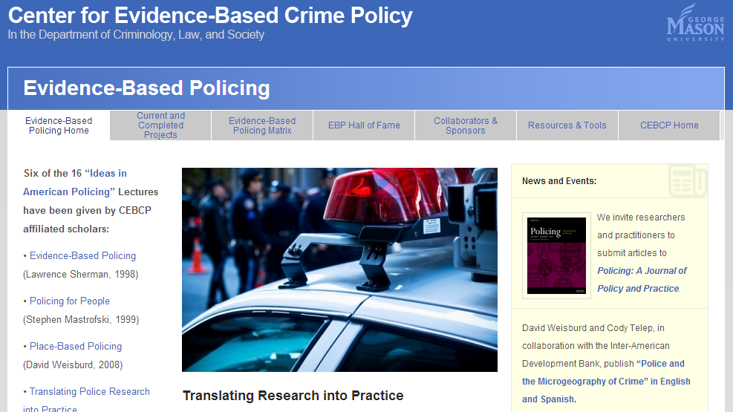

Slide 16


Slide 17


Slide 18


Slide 19


Slide 20


Slide 21
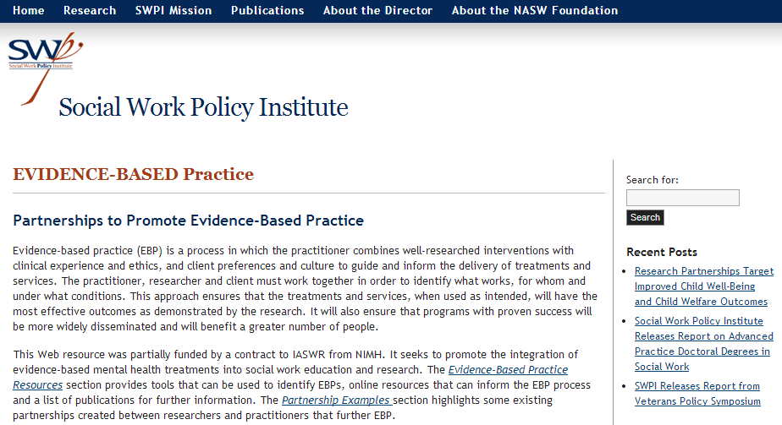

Slide 23
What is evidence-based practice?
The conscientious (effort), explicit (clarity) and judicious (critical of quality) use of evidence from multiple sources to increase the likelihood of a favourable outcome
It’s about the process
It’s not about certainties (this will work)
It’s is about probabilities and likelihoods
It is about reducing uncertainty (given our context this is more likely to lead to the outcome we want than doing something else or doing nothing)

Slide 24
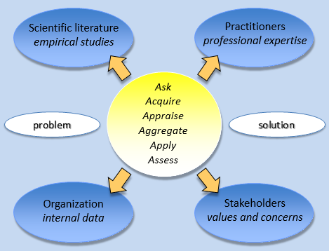
Six step process for identifying likely problem/opportunity and solution

Slide 25
Example of evidence-based absence management
Suppose you have a hunch or some data suggesting that absence may be ‘too high’ (whatever that means)
How would you approach from an evidence-based practice approach?

Slide 26
Element 1: Practitioners’ professional expertise
Identifying the problem
  Have I/we seen absence problems before? What happened?
  Based on our experience, is the level of absence here a problem?
  What do I/we believe about causes of absence?
Identifying solution (only if absence is a problem)
  Have I/we seen absence interventions before? What happened?
  What do I/we believe about absence interventions?
  Based on our experience, is the level of absence here a problem? What are costs & benefits of intervening?
How relevant and applicable and trustworthy is my/our expertise?

Slide 27
Element 2: Organizational data
Identifying the problem
  What actually is the absence rate?
  What type of absences and where?
  Are there patterns or trends in absence?
  Do data show how absence is a problem?
Identifying solution (only if absence is a problem)
  What absence management is currently in place and is it working?
  What else is happening that might be affecting absence?
  Are there relationships between absence and other data? Employee type? Shift? Department?
How relevant and applicable and trustworthy are our organizational data?

Slide 28
Element 3: Scientific literature
Identifying the problem
  What are the average rates of absence in my sector and location – is the absence rate here ‘high’?
  What does systematically reviewed research evidence suggest are the problems with absence
Identifying solution (only if absence is a problem)
  What does research evidence from systematic reviews suggest are major causes of absence?
  What does research evidence from systematic reviews suggest as effective absence interventions?
How relevant and applicable and trustworthy are the scientific findings?

Slide 29
Element 4: Stakeholders values and concerns
Identifying the problem
  How do employees feel about and view the absence ‘problem’?
  Do they see negative consequences?
  What do managers think about the problem?
  Do customers or clients or service users have a view?
Identifying solution (only if absence is a problem)
  How do employees feel about and view the solutions?
  What do managers think about the solutions?
  What alternative explanations and proposed solutions do others have?
How relevant and applicable and trustworthy are stakeholder concerns evidence?

Slide 30
What gets in the way of evidence-based practice in management (and generally)?
Misconceptions of EBP
Strong and wrong beliefs
Individual and group cognitive biases
Fads, fashions & (some) consultancies
Organizational politics/power
Poor logic models/theories of change
Over-claiming about the quality and quantity of evidence (critical appraisal essential)
Politics and career incentives
Pre-enlightenment views
Not necessarily a lack of or poor evidence – it’s about the best available evidence and a process
A lack of focus on a specific and well-identified problem (or opportunity)
Contexts in which practitioners’ practice is not evaluated (it doesn’t matter what they do)
Good intentions (road to hell paved with)
Erroneous belief that we already are evidence-based (or evidence-based enough)
Access to only some sources/types of evidence
The perceived need for speed
Crude benchmarking
Lack of attention to problem and solutioneering

Slide 31
Misconceptions of evidence-based practice (in management)
Practitioners can’t use their experience - it’s mostly about scientific/academic evidence
It’s about the truth and proving things
It’s about making perfectly-informed decisions using all the necessary information
Gathering the evidence will give you The Answer
It’s about new ‘cutting edge’ ideas and studies
Experts/academics know all about the evidence so you just need to ask them
It’s an academic versus practitioner thing

Slide 32
Strong and wrong beliefs
It ain't what you don't know that gets you into trouble. It's what you know for sure that just ain't so. (Mark Twain)
The greatest enemy of knowledge is not ignorance, it is the illusion of knowledge (Stephen Hawking)
Ignorance is fine – false beliefs not so

Slide 33
Some examples…
What’s happened to average job tenure in the past 10 years? Up? Down? Stayed same?
Job satisfaction in past 15 years? Up? Down? Stayed same?
Generational differences in work attitudes? Large? Small? None?

Slide 34
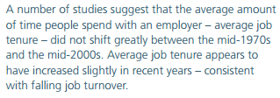
Job tenure UK

Slide 35
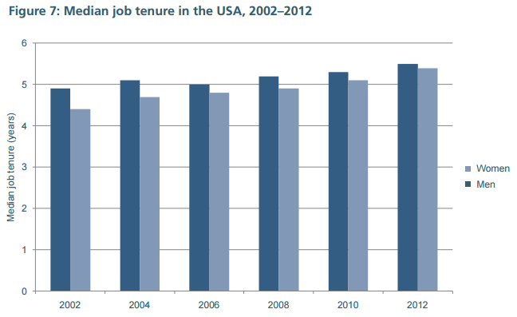
Job tenure USA

Slide 36
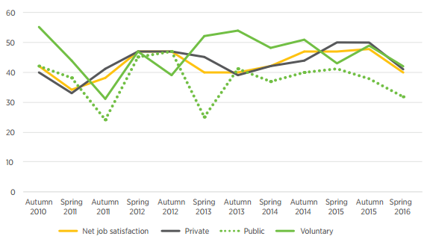
Job satisfaction UK

Slide 37
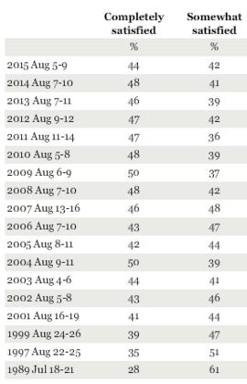
USA

Slide 38
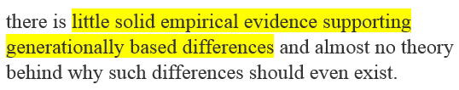

Generational differences in work attitudes?

Slide 39
So what? What’s wrong with strong and wrong beliefs?
How might such beliefs affect the decisions a manager makes in relation to (for example)
  Recruitment practices?
  Retention practices?
  Improving job satisfaction?
  The speed with which decisions need to be made?

Slide 40
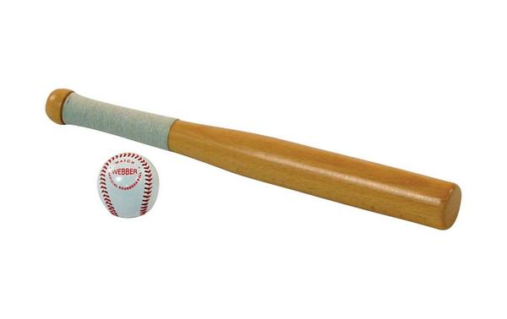
Error and biases in problem-solving and decision-making
A bat and ball cost one pound and ten pence. The bat costs a pound more than the ball. How much does the ball cost?

Slide 41
Error and biases in problem-solving and decision-making – some examples
Confirmation bias: Tendency to interpret and search for information consistent with one’s prior beliefs
Availability heuristic: Tendency to overestimate likelihood of events with greater availability in memory – “if you can think of it, it must be important”
Hindsight bias: Tendency to see past events as being more predictable than they were before the event occurred
Anchoring effect: Tendency to rely too heavily or over-emphasize one piece of information (e.g., wine price lists, large reductions in price)
Framing effect: Drawing different conclusions from exactly the same information presented in different ways (e.g., a ready meal that’s “85% fat free” or “only 15% fat”)
Meta-cognitive bias: The belief we are immune from such biases

Slide 42
Fads and fashions
Business process re-engineering
Total quality management
Quality circles
Talent management
Lean
Outsourcing
Employee Stock Ownership

Slide 43


Slide 44


Slide 45
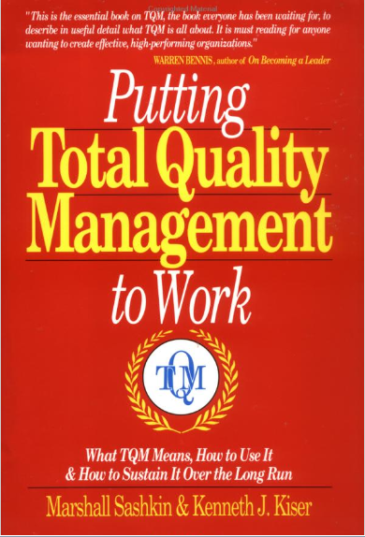

Slide 46


Slide 47


Slide 48


Slide 49
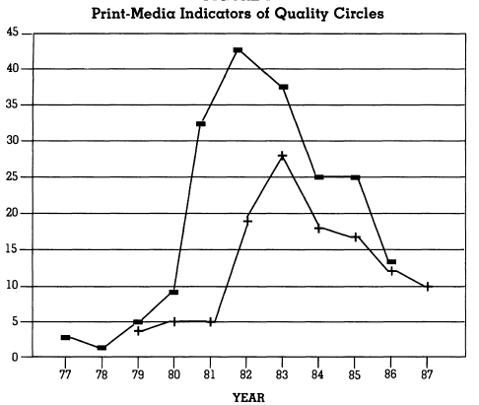
ABRAHAMSON (1996)

Slide 50
Article titles: Miller et al (2004)
Stage 1 - Ascendancy: Total Quality: Wave of the Future, Reengineering: It’s Totally Radical, Welcome to the Revolution, The Promise of Reengineering, How to Work Wonders, Completely.
Stage 2 – Maturity: Reengineering: The Hot New Managing Tool, The Reengineering Rage, Warning: This Good Idea May Become a Fad, Reengineering: Beyond the Buzzword.
Stage 3 – Decline: Ten Reasons Why TQM Doesn't Work, TQM: The Mystique, the Mistakes, The Hocus-Pocus of Reengineering, Why TQM Fails and What to Do About It.

Slide 51
How are fads a problem? (Donaldson & Hilmer, 1998)
“The main problem…is their lack of any solid intellectual foundation. Implicit in each fad is a cause effect statement that is rarely made explicit and never properly supported.”
“…management needs to evolve a sound body of knowledge and clear language that will assist members of the profession to reason cogently. Faddism is the enemy of this professionalism.”

Slide 52
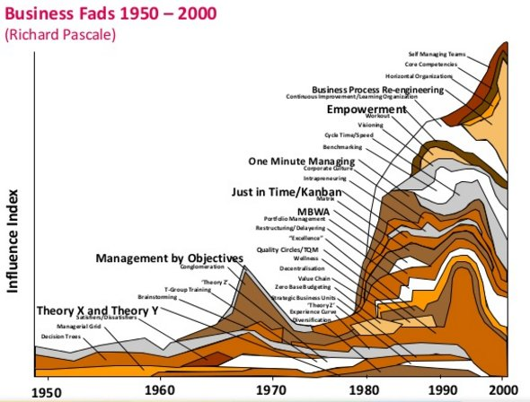

Slide 53
Policing fads and fashions
Can you name some?
What are the benefits and costs of policing fads and fashions?
Who are the fashion-setters? In policing (and public sector contexts) can be politicians

Slide 54
Following fads and fashions seems like a human urge
In retrospect can we identify fads?
Why did we follow them?
  Dangers of solutioneering
  Dangers of best practice
  Dangers of benchmarking practices
What happened to them?
The kitchen equipment analogy…

Slide 55
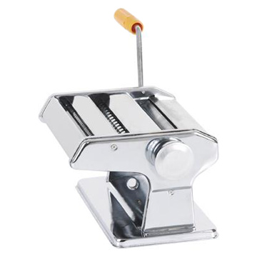


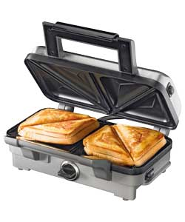
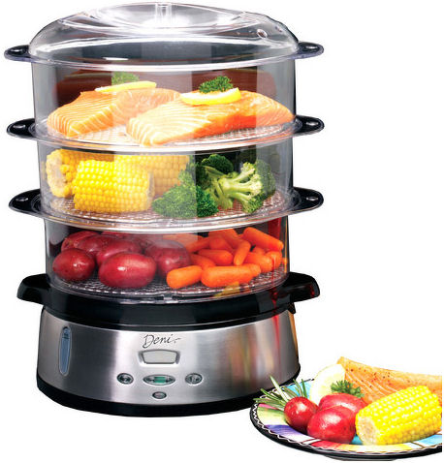
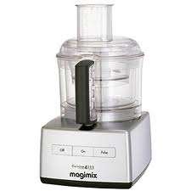


Slide 56
Career incentives
What are managers/higher ups rewarded for?
  Doing what works? But very few evaluations
  Getting things done?
  Making things happen?
  Not rocking the boat?
  Working hard?
  Obeying orders?
  Solving problems?
  Meeting targets and goals? But who sets and why?
  Making their bosses look good?
Do very senior people/higher ups people get there by being evidence-based practitioner and professionals?
In police/public sector context also influence of politicians

Slide 57
Espoused and more implicit goals of managers
ESPOUSED GOALS
To do what works (but few evaluations)
To help organization fulfil its mission
To identify and solve important problems
To do what matters
Treating everyone equally
Speak truth to power(?)
IMPLICIT GOALS
To get things done
To further career
To avoid trouble
To fix political or presenting problems
To meet targets
To do what gets measured
Favour those who help advance personal goals
Say what higher-ups want to hear

Slide 58
So is evidence-based practice happening much in management?
Almost no managers even heard of EBP
Apparently no management training or management development around EBP
Still very few systematic reviews in management
Business schools generally regarded as part of the problem – more interested in academic careers and student fees than practice
Teaching in management and business schools very rarely evidence-based (a tiny percentage teach EBP courses)
May vary across domains of management and sectors

Slide 59
So is evidence-based practice happening much in policing?

Slide 60

Evidence-based policing

Slide 61
Sherman (1998)
Of all the ideas in policing, one stands out as the most powerful force for change: police practices should be based on scientiﬁc evidence about what works best.
More complete evidence on the linkage between research and practice suggests a new paradigm for police improvement and for public safety in general: evidence-based crime prevention.

Slide 62
Sherman (1984)
Any police officer committed to the goal of crime control through specific deterrence would find it unconscionable to fail to follow consistent research findings. One may argue about the number of experiments in different settings needed to make the evidence persuasive, but once the evidence becomes persuasive, police should no sooner disregard it than they should help inmates escape from prison.

Slide 63
Definition from the College of Policing
What happens when we use the best available evidence to inform a policing decision. We don’t assume what we’ve always done is necessarily the right thing to do – we ask why. Evidence here means knowledge from recording, observing or experimenting in line with clear and explicit standards.

Slide 64
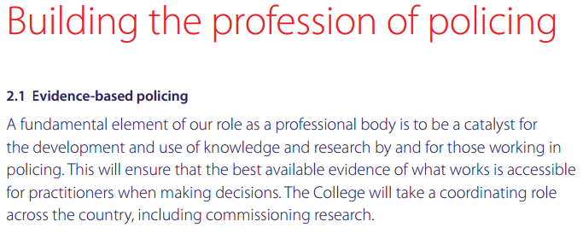

Slide 65


Slide 66
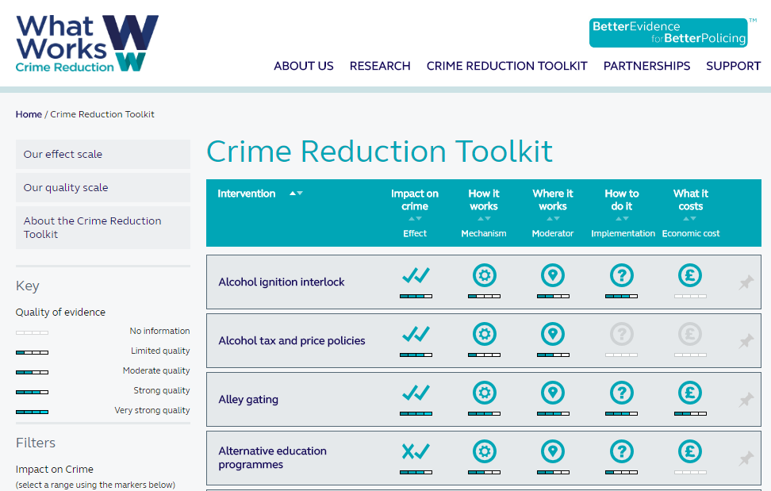

Slide 67


Slide 68
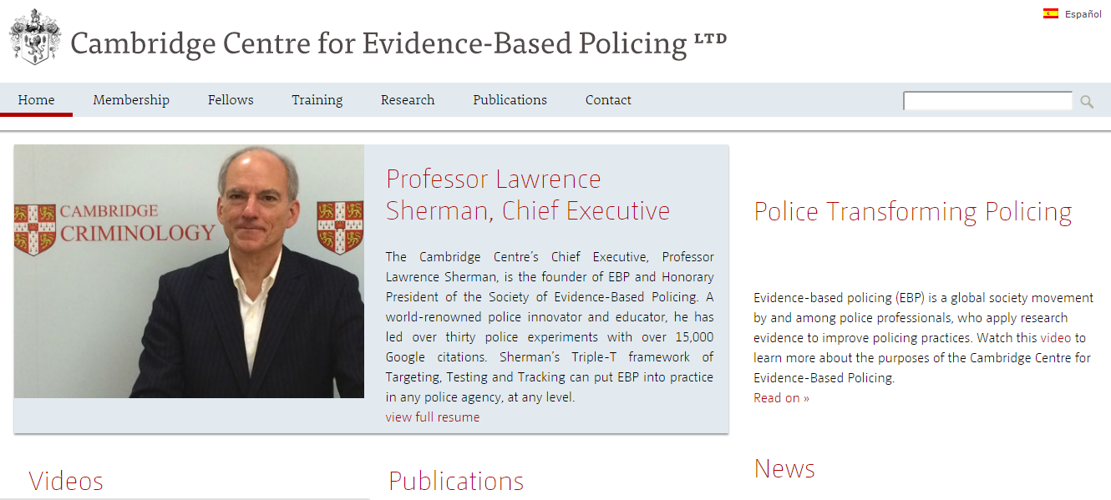

Slide 69


Slide 70


Slide 71


Slide 72


Slide 73
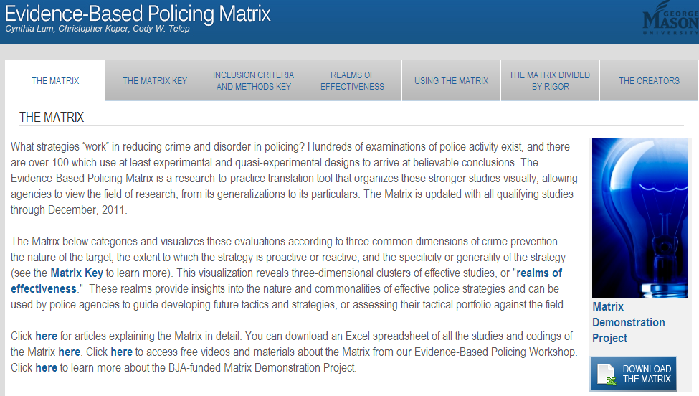

Slide 74
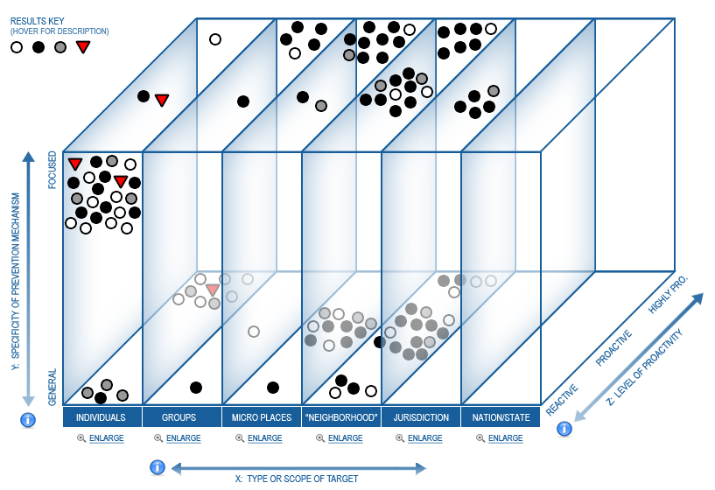

Slide 75
How evidence-based is policing? Seven evaluation criteria for any profession
The term “evidence-based” is well-known and used
The latest research findings and systematic research summaries are accessible to practitioners
Articles reporting primary research and traditional literature reviews are accessible to practitioners

Slide 76
How evidence-based is policing? Some evaluation criteria for any profession
‘Cutting-edge’ practices, panaceas and fashionable new ideas are treated with healthy scepticism
There is a demand for evidence-based practice from the practitioners’ clients and ‘customers’ (in this case includes politicians)
Practice decisions are integrative and draw on the four sources of information and evidence described in the definition of evidence-based practice
Initial training and continuing professional development adopt evidence-based approaches

Slide 77
Misconception endorsement (Chaplin & Shaw, 2016)
Psycho-legal beliefs questionnaire 50 items (five subscales) of counter-empirical (‘false’) statements
44 were law enforcement professionals and 56 not
Compared % true endorsements between two groups (all are sort of empirically ‘false’)

Slide 78
Five subscales example items
Police interrogations and procedures: “police can tell when a suspect is lying”, “people only confess when they have actually committed the crime they are being charged with”
Courts/Service provision: “most judges and jurors fully understand court instructions”, “eye-witnesses are always the most reliable source of case-related information”
Mental illness: “most mentally ill individuals are violent”, “all psychopaths are criminals”
Memory and cognition: “all memory is better for exciting events”, “if you are the victim of a violent crime, your memory for the perpetrators face will be perfect”
Tough on crime: “we need to be ‘tough on crime’ by giving convicted felons harsher punishments”, “capital punishment is an effective way to deter criminal activity”

Slide 79
Law enforcement vs layperson % agreement with ‘false’ statements
Law Lay
Police interrogations/procedures 47.5% 49.3%
Courts/Service Provision 48.6% 56.5%
Mental illness 20.7% 24.7%
Memory and cognition 33.9% 33.3%
Tough on crime 46.9% 46.1%

Slide 80
How can police leadership and management facilitate evidence-based policing?
A (large?) part of effective police management is to ensure that evidence-based policing happens
What leaders do and fail to do can play a fundamental role in the extent to which individual officers and the police service as a whole can practice evidence-based policing
Traditional ‘command and control’ leadership or leadership based on charisma, authority, hierarchy not so good for evidence-based policing (but good for some emergency situations)
Management decisions (as well as policing decisions) need to be evidence-based

Slide 81
What leader/manager behaviours are likely to help? [1]
Asking a lot of questions of themselves and others (Why are we doing this? How do we know it will work?)
Focus on understanding problem first – minimize solutioneering
Encouraging the routine collection of data and information and make it accessible to all
Not making “because I say so” or “because I’m in charge” decisions (stop JFDI and HiPPO)
Constantly explaining decision processes and decision outcomes to ensure transparency
Providing clear explanation of all the sources of evidence used to make decisions and critical appraisal of that evidence and how it was weighted (“on balance”)

Slide 82
What leader/manager behaviours are likely to help? [2]
Making explicit statements about accountability – what are leaders and others responsible for? What can’t they control?
Developing infrastructure and processes that support evidence-based policing
Rewarding and modelling evidence-based policing
Treating the organization as a prototype – assess effects of actions, experiment, collect information and evidence
Being open and relaxed about activities and initiatives not working – ‘celebrate’ failure as not doing or stopping doing things essential
Encouraging and supporting research
Not bring afraid as a leader to say the three hardest words…

Slide 83
Some alternatives to evidence-based management (inspired by Isaacs & Fitzgerald, 1999)
Vehemence-based management (loud, brow-beating)
Eloquence-based management (sharp-suited, sliver-tongued)
Obedience-based management (because I say so, just freakin’ do it)
Resemblance-based management (doing what others do)
Defence-based management (the safest option)
Indolence-based management (whatever takes least effort)
Haste-based management (whatever is fastest)
Indulgence-based management (the coolest most fun thing)
Reverence-based management (doing what is the most truly awesome)

Slide 84
Conclusions
The notion of evidence-based practice is well-established in policing…
…Though policing does not yet have all the characteristics of an evidence-based profession – though more so than management
Evidence-based management is a pre-requisite for evidence-based professional practice in any field
Evidence-based management is much less-well developed but police leaders and managers can do much to manage in a more evidence-based way and enable evidence-based policing

Slide 85
Questions? Criticisms? Thoughts?
www.cebma.org
Rob B Briner
r.briner@qmul.ac.uk

Slide 86
Conference 2017
Creating a Culture of Curiosity: Why Failure is a Good Thing
In association with:

Slide 87
Conference 2017
Creating a Culture of Curiosity: Why Failure is a Good Thing
Big Data providing Real Direction
Detective Chief Inspector Richard Evans
West Midlands Police

Slide 88
Big Data providing Real Direction
Notes:
Speak about the opportunities that Big data offers to policing.
At this point in the development not big data in terms of volume velocity but more about the application of analytical techniques used in data science.

Slide 89
What this offers
We all have the opportunity to exploit an already available pool of information/intelligence.
To derive scientifically reliable insight from it.
To use it to drive policy and decision making.
We already know more than we think
Notes:
I am part of a team at West Midlands Police working on a project named Data driven insight.
Two elements to the project.
First, is around the consolidation our data so that we can optimise the conventional insight that we would gain from it. Ding this by developing visualisation to commercially available tools.
Secondly, the establishment of an Analytics lab. The lab has been used to scientifically investigate using data science techniques a policing problem.
I hope to show over the next 30 minutes that.

Slide 90
Who are the influencers and who is at risk of becoming an influencer in co-offending?
The Analytics Lab focused on the development of a risk model that assessed the likelihood and risk of a particular nominal becoming influential in co-offending.
Co-offending is one pathway into crime, vulnerability and harm
Experienced based hypothesis that when people first engage with crime they often do so with someone else
Reduce demand on conventional crime by identifying opportunities for early intervention
£75m estimated cost to West Midlands society over 5 years associated to active influencers & co-offending
Rich and unexplored data on nominals, networks and co-offending
Initial segmentation of 600,000 highlighted a large number of nominals who had co-offended multiple times and with multiple people
Notes:
Why is this important. Wanted to identify question that touched on harm, vulnerability and demand.
We selected this partly based upon a need for insight and partly because we anticipated being able to get the correct data in.
Cost is based upon Home Office crime harm values index. This is accurate for the crimes committed but incomplete for cost as some of the HOCR codes have changed and HO haven’t got an up to date list. This makes this quite a conservative number. Later in the deck I have extrapolated these numbers out to give an indication of what the total costs could be.

Slide 91




Structured and Unstructured data from key WMP and national systems has been analysed
Sourced and integrated data from 9 core WMP data sources and text mining was performed on IMS logs
CRIMES
Stop
&
Search
PINS
PNC
IMS
Custody
Corvus
Compact
OCG
tracker
Over 1TB of data volume
437 Source tables
10, 908 Columns
Over 267m rows
~900k Intel log entries
text mined
Nominal table and interim data structure with:
over 10m nominal entries
~30m event entries
~14m associations for over 4m nominals
Nominal Analytical Record with over 1300 KPIs
Notes:
To achieve this we needed to buy in resource with data science skills.
1. Shows that we can integrate structured data and make it available for manipulation
2. Demonstrated the ability to text mine across un-structured data from IMS. This is searching across the free text data within IMS logs. Use SCR/DHR example.
267 million rows of structured data
About 900k intel logs mined.
From that you get:
10 million nominals
30 million events
14 million associations

Slide 92

The DDI algorithm achieved 99% matching accuracy
The matching process addressed 230m candidate pairs and produced 5.27 millions of resolved identities
10.4m nominals entries
Simple matching
After matching algorithm
7.1m unique identities
1.46 Entries (number of events) per identities
5.2m unique identities
1.98 Entries (number of events) per identities
Ca. 15 fuzzy matching rules applied
!
In one case the algorithm matched 108 nominal entries containing 27 different combinations of first name, surname CRO Number and PNC ID.
Notes:
DDI achieves 99% data matching accuracy… bringing together records into one unique identify
32% more accurate than FLINTS
39% more accurate than CORVUS
e.g. if a nominal had 100 records that related to them… DDI would bring 99 of them back in a single view of the nominal
FLINTS would bring back 68
CORVUS would bring back 61

Slide 93
Benefits of visualisation
Creating user specific visualisation
.The Organised Crime Group Dashboard.
By bringing specific data sets together and developing reporting dashboards in line with specific business requirements we have been able to improve the speed at which insight is available
Incorporated our own data sets with the NCA OCG tracker data. This has given us the capability to:
Automatically filter all information from source systems about members of an OCG and visualise it.
Auto-mated the process of network chart and time line generation.
Developed at prototype level s visualisation where you see people who are linked to a nominal at various level of separation. Believe strong operational used in high risk missing episodes and firearms incidents.

Slide 94



A data driven process has been adopted to produce the risk model
The journey to the risk model outputs has been based on the insight provided by the data validated with WMP SMEs
Understanding and Integration of Data
- 9 systems
- Sessions with SMEs and business experts
Nominal Matching
- Single view of each nominal
- Fuzzy matching rules
Interim nominal tables
- timeline of a nominals criminal career
- All events for the nominals
Risk Model - Risk scoring the nominals
- Most predictive KPIs
Nominal Base Table
- Key data and metrics combined
- KPIs identified for the model
Core group of influencers identified based on behaviors and associations (RRR)
Number of associations separating a nominal from the Core group (SNA)
Target variable created (i.e. those who transition to become an “influencer” in co-offending) to drive KPIs and development of the model
Notes:
Process was data driven….. The lab did the maths then sense checked it with the business….. Not the other way around which risks adding in bias to the model/approach.
Understanding Data Integration: Integrate 9 systems
Nominal Matching: Having a single view of everything we know about a nominal and removing duplicates. This work then used to build the Qlik dashboards.
Interim nominal tables: Allowed us to plot a nominals history over time and creates an index of all events for all nominals
Nominal Base Table: Key data and metrics, develop KPIs using univariate analysis.
Risk Model: Risk scoring the nominals and identifying the KPIS with the greatest predictive power.

Slide 95

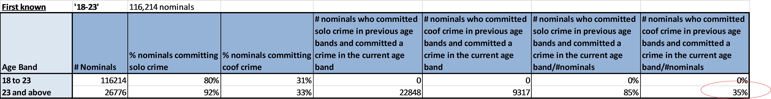
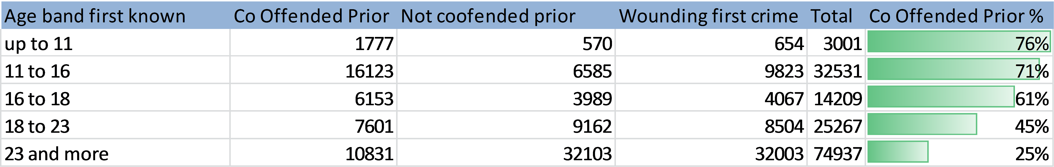
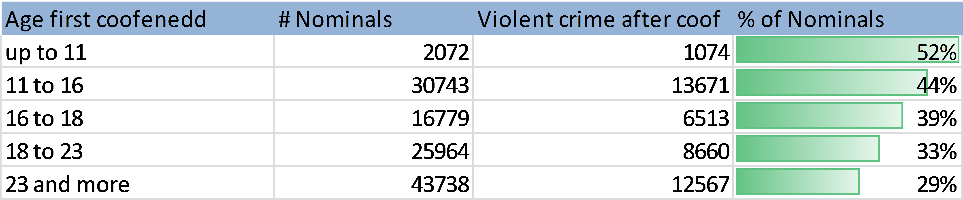
Insight from the data can be gained at each step of the analysis…..
The initial phases to understand and segment the data have provided some insight on the co-offending demographic
The younger you are when you commit a co-offending offence the more likely for you to go ahead to commit other crimes. Only 35% of people who first co-offend at age 23 or above go on to commit another crime
Where a person is known to us (in any role) before they are 11 and their first solo offence is classified as wounding or above, 76% will have co-offended prior to the wounding offence.
52% of those who have committed a co-offending crime before the age 11 go on and commit a violent crime 20 and above The percentage drops to 29% if the age is 23 or more
Notes:
Iterative Insight: As part of the process the data scientists discover and highlight little snippets that may or may not be useful to the business.
Early co-offending is a good indicator of future solo serious assaults… not small numbers
How does this influence our policymaking.

Slide 96
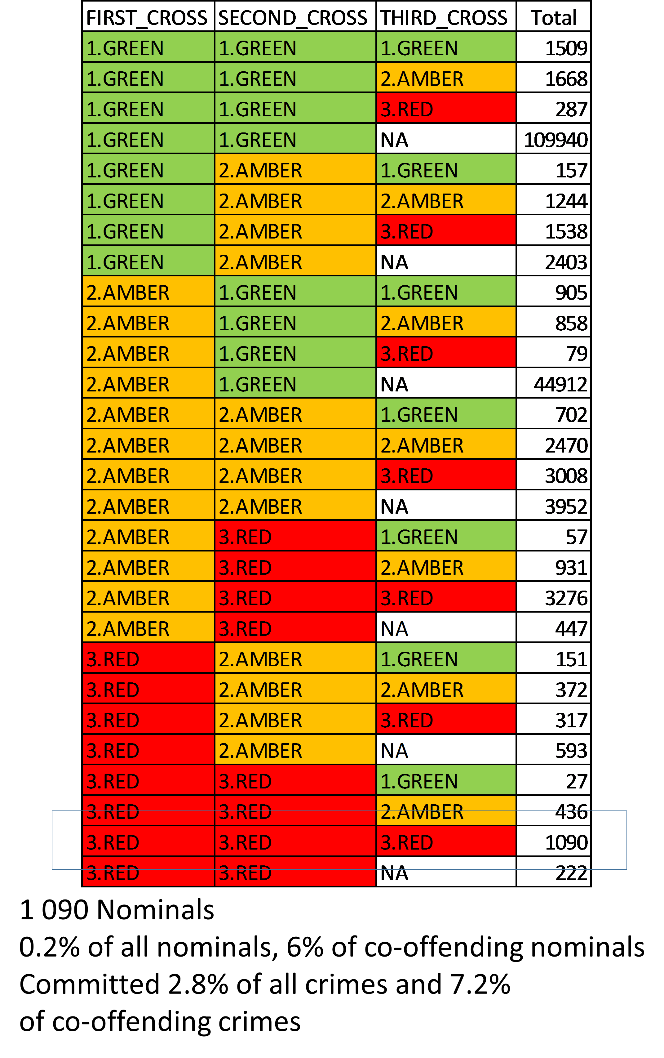
Identifying the influencers starting from the
Core Group
Influential Nominals are those nominals who are in the Core Group or associated with the Core group with co-offending crime association either directly or through another nominal.
The Core Group tend to be 3 years or older and had committed 2 or more plus crimes than their associates
They co-offended with a wider network
On average they committed 42 crimes and 10 co-offending crimes
Their associates committed 10% of all crimes ever
60% of the have been active within last 3 years
Average years 36 years
Notes:
The Lab began by carrying out segmentation on over 600,000 nominals from CRIMES data using the Self-Organising Maps Clustering Algorithm . The segmentation highlighted a large number of nominals who had co-offended multiple times and with multiple people (i.e. had a large network ).
1 Red = Older than (3 years)
2 Red = More crime than the person than they have influence.
3 Red = Bigger criminal network
Go through the key stats.
This process has identified out target group.

Slide 97
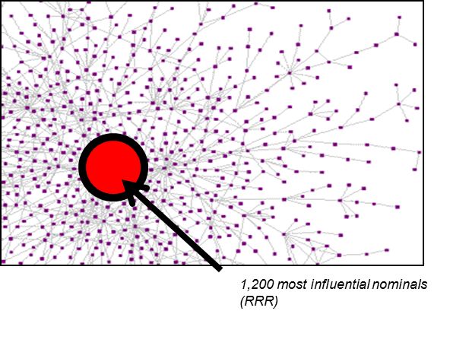
Who are the Influencers?
Influential Nominals are those nominals who are in the Core Group and/or associated with the Core group via co-offending crime association either directly or through another nominal (associate of associate)
5% of nominals who committed crimes (ca. 30,000)
~40% of co-offending crimes
~23% solo crimes
……
……
9
9
4
Infinity
4
Infinity
3
3
2
2
1
1
RRR
RRR
14/02/2011
22/02/2016
Notes:
5% of overall offenders: 30,000: 600000K total offending population
Influencers committed 40% of co-offending crimes committed by overall co-offending population
23% of all solo crimes from overall population.
The red identifies core who are already influences.
The right identifies the different journeys that people can take.
To put this into context the influence only represent 5 percent of offending population but responsible for 40 percent of all co offending crime and 23 percent of total recorded solo crime.

Slide 98
Comparison with IOM
A comparison with IOM RAG and interventions highlights discrepancies with the Foundation Phase Analytics Lab analysis
Distance from core |  | TOTAL number of WMP nominals per grouping | Appear on IOM RAG |  |  | Do not appear on IOM RAG
 |  |  | Proportion of TOTAL | Have undergone/ are undergoing IOM intervention | Have never undergone IOM intervention | Proportion of TOTAL
0,1,2 |  | 29,637 | 6,878 (23.2%) | 4,270 (14.4%) | 2,608 (8.8%) Of these 1,970 committed a crime within the previous three years | 22,759 (76.8%)
3,4,5,6 |  | 44,111 | 4,186 (9.5%) | 2,098 (4.8%) | 2,088 (4.7%) | 39,925 (90.5%)
7,8,9 |  | 2,134 | 107 (5%) | 53 (2.5%) | 54 (2.5%) | 2,027 (95.0%)
7
8
9
5
6
4
2
3
1
0
7
8
9
5
6
4
2
3
1
0
7
8
9
5
6
4
2
3
1
0
Notes:
29,637 core influencers…. Only 6878 in IOM (23% of 29,637).. This means 22,759 core influencers aren’t in IOM.
Of the 6878 in IOM, 4270 have had some intervention….. 2608 haven’t had any IOM intervention
Of the 44,111 at the mid-point towards becoming an influencer…. 4186 are in IOM… 2098 of those have intervention
39,925 of those at the mid-points towards becoming an influencer not in IOM.

Slide 99
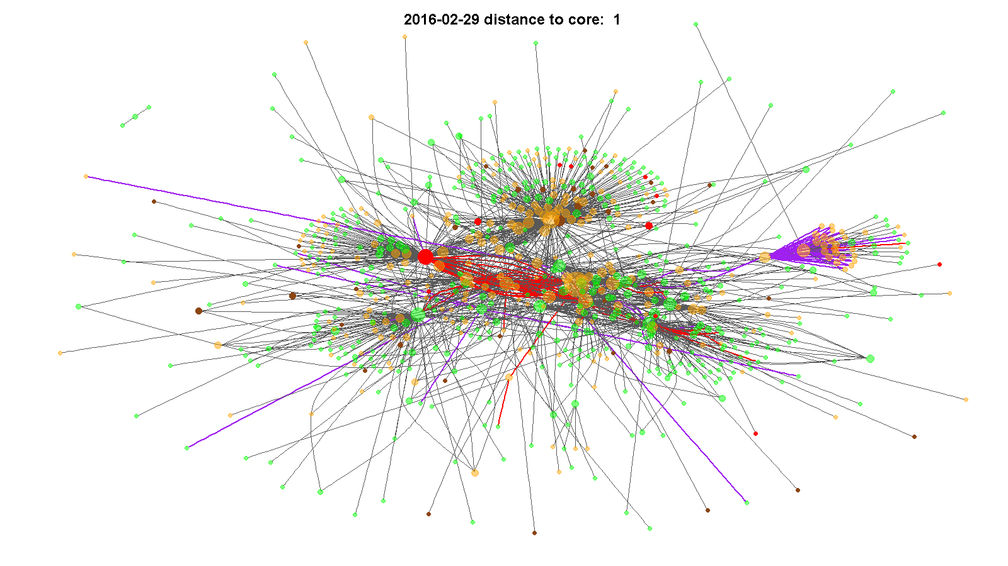
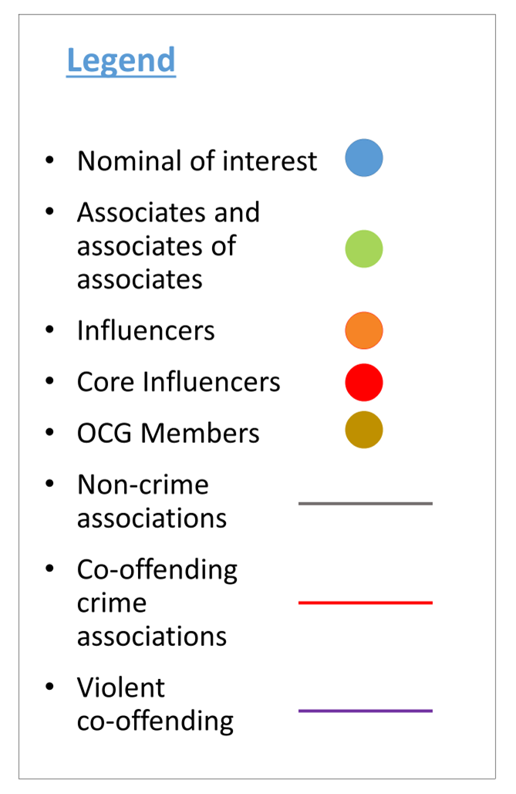
The network of a nominal is critical in his journey to influencer
Via an analysis of the events and the journey of a nominal we can identify the steps in the journey and critical transition events
Notes:
Show the video.
Highlight the violent co-offending as an interesting feature.
This picture started with one person who began their journey to becoming an influencer. They became an influencer and this picture demonstrates the scale of the connected networks that flow from one person.

Slide 100
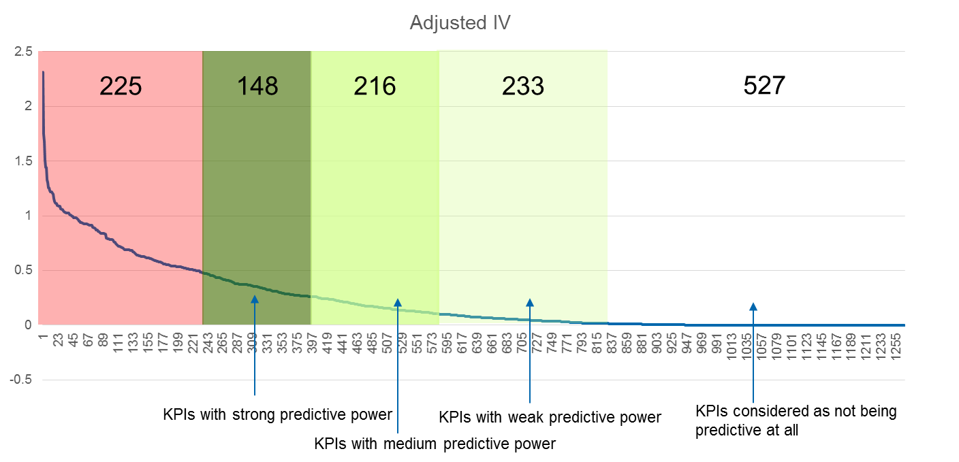
Based on the target group, 1349 KPIs have been identified
The KPIs investigate and describe direct and indirect behaviour, the nominal network and how nominal interacts in the network. The metrics and variable contributes to define the risk model and prediction.
Notes:
This is an assessment of the relative predictive power of the 1349 identified KPIs
KPIs describe behaviour, network, associations etc.
The 1349 are segmented into stronger and weaker KPIs
Information value of 0.5 data science principle is that should be suspicions as it contains system or information bias.
Un- variant and multo-varian analysis was undertaken to understand predictive power of KPI’s

Slide 101

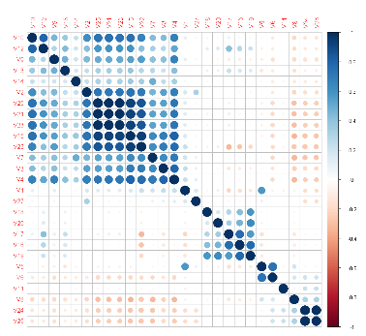
Different groups and types of KPIs have been identified
We have a mixture of demographic, temporal, crime and network KPIs
  e.g. Age of Nominal
  e.g. The number of solo crimes committed by a nominal’s associate prior transition
  e.g. One month delta for the number of ‘Violent’ crimes a nominal commits prior transition
  e.g. Number of IMS logs for nominals prior transition
The Univariate Analysis screened the KPIs to show their predictive power using Information Value and Weight of Evidence. The Multivariate analysis was run to test correlation between predictors to select the final set of predictors.
Notes:
1349 KPIS:
Univariate analysis to identify those with greatest predictive power, WOE to support them and their information value.

Slide 102
Among the 1349 KPIs, 32 KPIs have been identified for their strong predictive power
The most important KPIs are related to the social network of the nominal
4 out of the top 10 KPIs are related to network.
Number of co-offending crimes
Crimes committed by the members of your network
Co-offending patterns - followed or before solo crime pattern (specific sequence)
! Social network KPIs are around 3 times more predictive compared to “age of nominal”
! More crimes are committed in your network more risky you are.
Nominals are most likely to turn influencers when they are between age 14.67 and 20.5. The risk of becoming influencer is still high up to age of 29 years. Past this age nominals more and more less likely to become influencers.
Some key KPIs are related to presence across systems (IMS logs and number of times) overtime
Notes:
32 KPIs have very strong predictive power.
Model suggests that KPIs in relation to networks are the most powerful in predicting future behaviours/influencers. 3 times more predictive than age of nominal.
Whereas, at the moment we tend to focus on the individual… IOM?

Slide 103
WMP could target the 100 risky individual achieving a 97% accuracy
The model was built on 70% of the data and validated on 30% (data for 115 235 nominals and validated on test sample of 49 426 nominals). There are 3 291 nominals in test sample who turned influencers.
if we were to target top 100 risky people the model show that will be able to have an accuracy of 97% (97 would have made a transition) based on the statistical testing
By targeting top 200, 183 would have made the transition (still 90%)
Risk score threshold | FPR | # False Positives | TPR | # True Positives | # Nominals | % Error
0.997 | 0.00% | 0 | 0.03% | 1 | 1 | 0.00%
0.993 | 0.00% | 0 | 0.15% | 5 | 5 | 0.00%
0.990 | 0.00% | 0 | 0.33% | 11 | 11 | 0.00%
0.987 | 0.00% | 0 | 0.55% | 18 | 18 | 0.00%
0.983 | 0.00% | 0 | 0.88% | 29 | 29 | 0.00%
0.980 | 0.00% | 1 | 1.12% | 37 | 38 | 2.63%
0.977 | 0.00% | 1 | 1.34% | 44 | 45 | 2.22%
0.973 | 0.01% | 3 | 1.58% | 52 | 55 | 5.45%
0.970 | 0.01% | 3 | 1.98% | 65 | 68 | 4.41%
… | … | … | … | … | … | …
0.900 | 0.21% | 99 | 12.37% | 407 | 506 | 19.57%
0.800 | 1.26% | 583 | 30.93% | 1018 | 1601 | 36.41%
0.700 | 3.58% | 1650 | 48.77% | 1605 | 3255 | 50.69%
0.600 | 7.63% | 3521 | 62.99% | 2073 | 5594 | 62.94%
0.500 | 13.77% | 6353 | 74.11% | 2439 | 8792 | 72.26%
0.400 | 21.85% | 10080 | 83.65% | 2753 | 12833 | 78.55%
0.300 | 32.45% | 14969 | 90.12% | 2966 | 17935 | 83.46%
0.200 | 45.67% | 21071 | 95.23% | 3134 | 24205 | 87.05%
0.100 | 62.76% | 28956 | 98.42% | 3239 | 32195 | 89.94%
All nominals | 100.00% | 46135 | 100.00% | 3291 | 49426 | 93.34%
.
Notes:
This is where the insight begins to gain its scientific credibility.

Slide 104
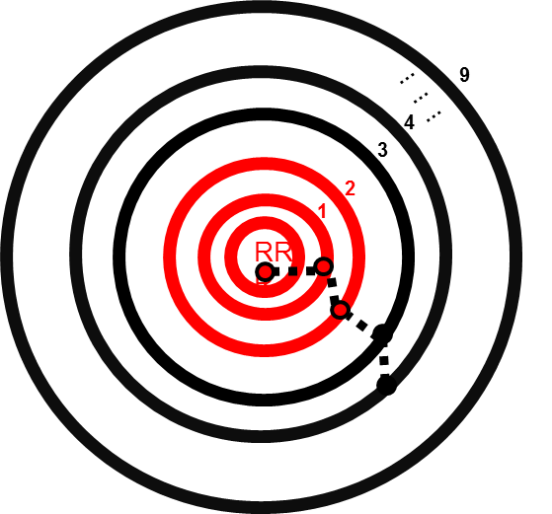
Some immediate operational next steps have been identified
Interventions with existing influencers (reactive)
Comparison with those nominals on IOM radar
Potential Benefits
New nominals identified through Foundation Phase Analytics Lab risk model – work with IOM to understand why not, and identify potential costs/ benefits of applying interventions
Nominals currently subject to IOM interventions not in Analytics Lab risk model – work with IOM to understand why not, and identify potential costs/ benefits of ceasing interventions
Nominals in different positions on both lists – work with IOM to understand why and identify difference in cost of differing levels of interventions
Where nominals appear in both lists, could assess impact of interventions through checking impact of historic IOM interventions on nominals’ co-offending trajectory. Compare with results of OM study on impact of interventions
Potential business application/ putting model into production
TBC
Interventions with soon-to-be influencers (proactive)
Comparison with Neighbourhood Policing or FCID at-risk nominals
Potential Benefits
New nominals identified through Foundation Phase Analytics Lab risk model – work with NPT/ FCID to understand why not, and identify potential costs/ benefits of applying interventions
Nominals currently subject to NPT/FCID interventions not in Analytics Lab risk model – work with IOM to understand why not, and identify potential costs/ benefits of ceasing interventions
Nominals in different positions on both lists – work with NPT/FCID to understand why and identify difference in cost of differing levels of interventions
Where nominals appear in both lists, could assess impact of interventions through checking impact of historic Neighbourhood policing/ FCID interventions on nominals’ co-offending trajectory
Potential business application/ putting model into production
Add markers in source systems to those individuals who reach crime association distance 3 or 4
TBC
FP Analytics Lab risk model
IOM list of nominals requiring interventions
FP Analytics Lab risk model
Neighbourhood Policing list nominals requiring interventions
Notes:
This will give us two lists to consider potential interventions:
Who are the existing influencers and prioritisation of those?
Who are those who we think will soon make the transition to becoming influencers.

Slide 105
Foundation Phase Analytics Lab
Quantitative Benefits
A range of approaches to calculating benefits identify different degrees of potential savings that could be made through addressing the riskiest individuals
Approach 1: Calculate the cost associated with any solo crimes committed by influencer A after their transition to be an influencer.
The total number of solo crimes committed by nominal A post transition is 12,582.
The cost associated with 68% of these crimes is £58.43m over 5 years
The cost associated with 100% of these crimes = £85.92 over 5 years
1
B
A
Approach 2: Calculate the cost associated with any co-offending crimes (#1 and #2) between influencer A and nominals B and C.
The total number of #1 and #2 co-offending crimes, committed by A with either nominal B or C, is 3346 over a period of 5 years.
The cost associated with 77% these crimes is £13.82m over 5 years.
The cost associated with 100% of these crimes = £19.94 over 5 years
3
2
C
Sequence of events
1
2
3
Time
Approach 3: Look for any link #1 and #2 between influencer A and nominals B and C, AND then subsequent co-offending crime (#3) committed between B and C. Calculate the cost associated with crime #3.
The total number of #3 crimes committed between nominals B and C is 533 over a period of 5 years..
The cost associated with 72% these crimes is £2.44m over 5 years.
The cost associated with 100% of these crimes = £3.33m over 5 years
£74.69m (resolved)over 5 years
£109.19m over 5 years
Influencer
Associate
Notes:
Only counted offences once a is an influencer.

Slide 106
Additional benefits of organising data
Home office offender management project
By organising the data in this way it has been used by a Home Office Data Scientist to evaluate the success of a project they are running.
The project itself is looking at the application of nudge theory in the offender management space.

Slide 107
Conclusion
We all have the opportunity to exploit an already available pool of information/intelligence. | PNC, Intelligence, custody, crimes prions. No extra collection was needed.
To derive scientifically reliable insight from it. | Predictive model to predict co offending
To use it to drive policy and decision making | What next?

Slide 108
Conference 2017
Creating a Culture of Curiosity: Why Failure is a Good Thing
In association with:

