Slide 1
Conference 2017 Creating a Culture of Curiosity: Why Failure is a Good Thing
In association with:

Slide 2
Conference 2017 Creating a Culture of Curiosity: Why Failure is a Good Thing
Behavioural Insights in Policing:
nudges that work…
and nudges that do not
Simon Ruda
Director, Behavioural Insights Team

Slide 3
Behavioural Insights in Policing
Simon Ruda

Slide 4
Behavioural insights applied to policing
Biases
Assumptions
Rules of thumb
Stereotypes
Emotions
Social influence

Slide 5
Behavioural insights applied to policing
Accepting mental shortcuts and designing policies that accommodate them
Situational/environmental nudges
Timely nudges
Identifying and avoiding susceptibility to mental shortcuts
Decision aids
Cognitive load
Overcoming mental shortcuts
Building resilience
Growth mindsets
Stereo type threat
Correcting negative perceptions

Slide 6
Accommodating mental shortcuts
2. Witness and victim court attendance
4. Body Worn Video
1. Speeding offences
3. Increasing diversity
Avoiding susceptibility to mental shortcuts
Overcoming mental shortcuts
5. Reducing re-offending

Slide 7
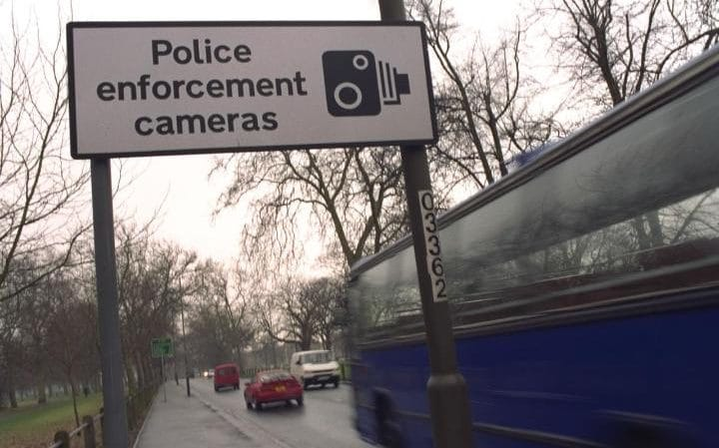
1. Increasing compliance with sanctions for speeding offences

Slide 8
Speeding offences

Slide 9
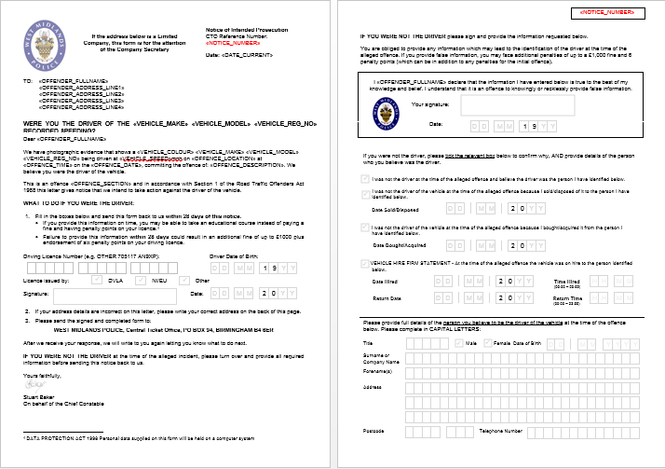

Slide 10
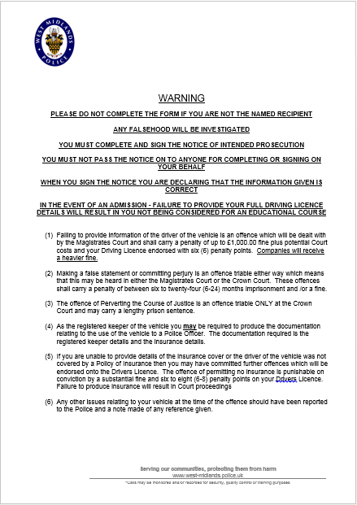
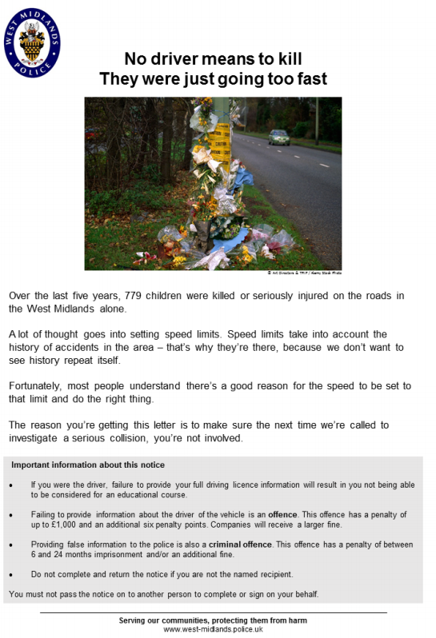

Slide 11
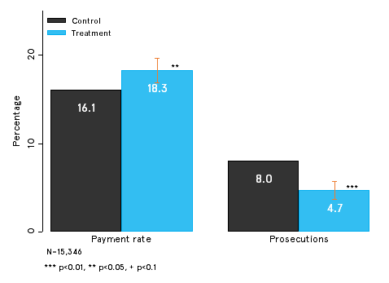
Proportion of people paying fines and eligibility for prosecution
If rolled out across the West Midlands, we estimate this would save £1.5m over 12 months
Notes:
Harackiewicz, J. M., Canning, E. A., Tibbetts, Y., Giffen, C. J., Blair, S. S., Rouse, D. I., & Hyde, J. S. (2014). Closing the social class achievement gap for first-generation students in undergraduate biology. Journal of Educational Psychology, 106, 2, 375-389. doi: 10.1037/a0034679
N=798 (154 first-generation) students
Values affirmation intervention conducted with U.S. students in an introductory biology course. For first-generation students, values affirmation significantly improved final course grades and retention in the 2nd course in the biology sequence, as well as overall grade point average for the semester. This brief intervention narrowed the achievement gap between first-generation and continuing-generation students for course grades by 50% and increased retention in a critical gateway course by 20%.
Details about values affirmation intervention: Each student completed two exercises (value affirmation vs control) of 10-15 minutes per exercise. One early in the semester and one before the second exam. Administered in class with personalised envelopes (study personnel did not know who got which condition)
Values affirmation: list with 12 values; circle two or three values most importance to them. Describe in a few sentences why these are important to you. Then list the top two reasons for why the values are important to you. Finally, indicate agreement with statements like “I try to live up to these values”
Control group circled two or three that were of least importance to them. Describe in a few sentences why these may be important to someone else. Then list the top two reasons for why the values are important to someone else.
Second round of exercise had a list of 16 values – rest remained the same.
The treatment effect for First Generation students was significant, t(789) 2.10, p < .05, reflecting an average grade difference of .24, or approximately a quarter of a grade point, resulting in a 50% reduction in the social class achievement gap.

Slide 12
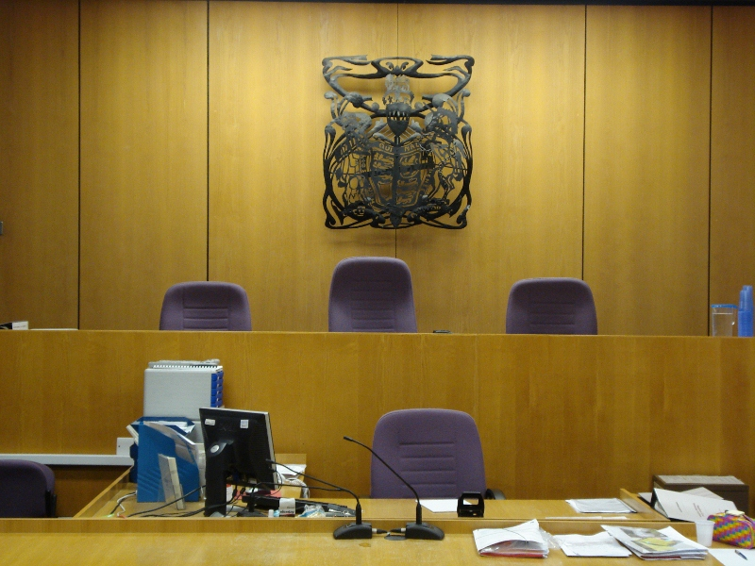
2. Increasing witness and victim attendance at court

Slide 13
Intervention details
A conversation guide for Witness Care Officers when first engaging with witnesses and victims after a hearing date has been set
A redesigned letter for witnesses and victims confirming the details of court proceedings and helping them to plan their attendance
A reminder call and text one week before they are scheduled to attend
Notes:
Encouraged witnesses and victims to plan how they will get to court
emphasised how hard police and lawyers had been working in preparation for court

Slide 14
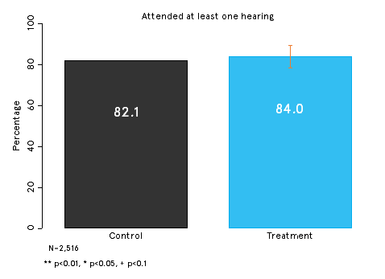
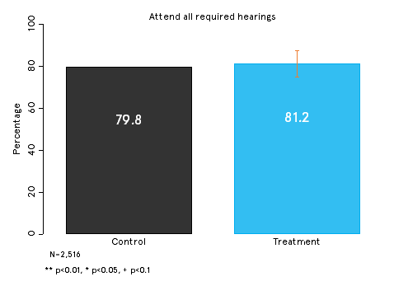
Results

Slide 15
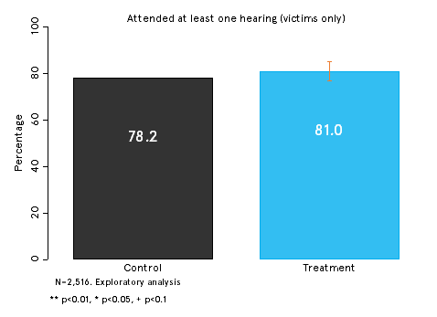
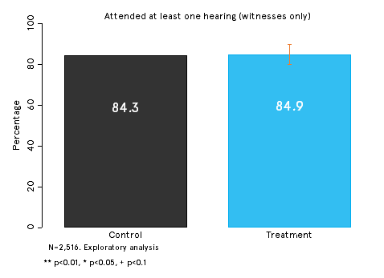
Results

Slide 16
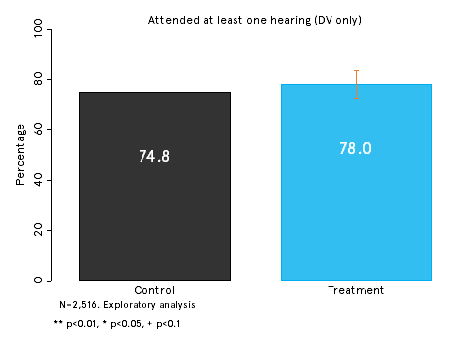
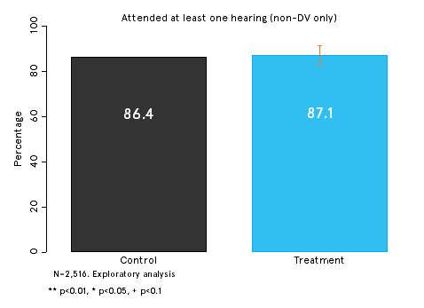
Results

Slide 17
Increasing diversity within Police forces

Slide 18
Values affirmation
Arm | Content
Enhanced | “Before you start the test, I’d like you to take some time to think about why you want to be a police constable. For example, what is it about being a police constable that means the most to you and your community?”
Control | Business as usual email

Slide 19
Test score – BMEs and non-BMEs

Slide 20
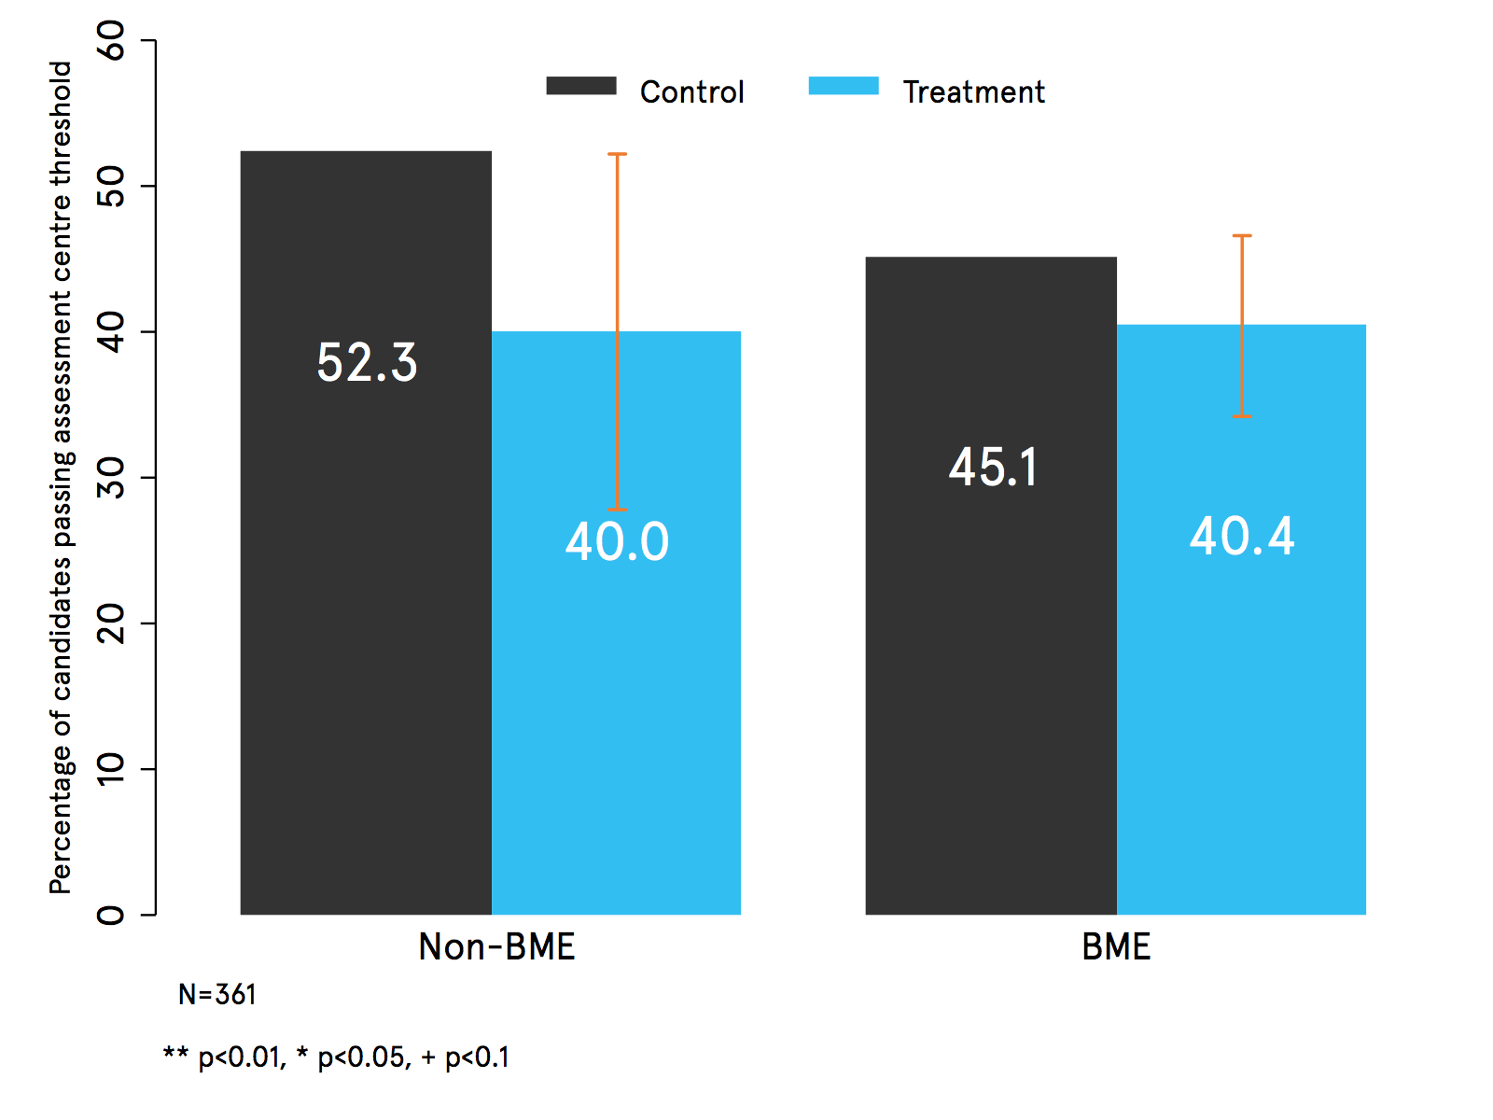
Percentage of candidates passing SEARCH assessment centre threshold

Slide 21
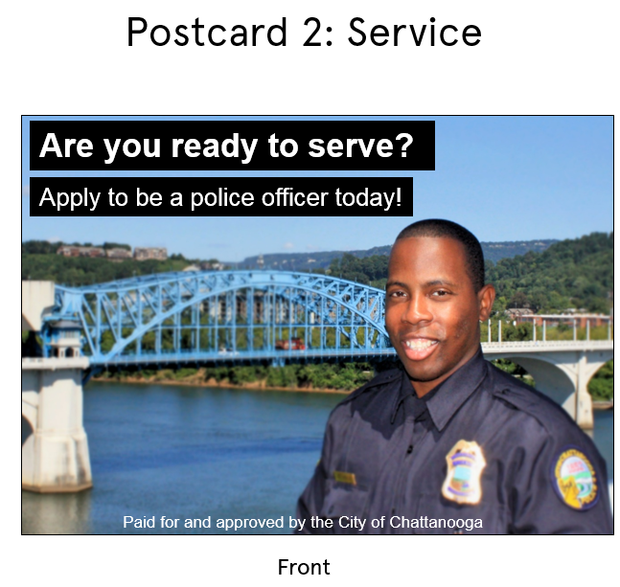
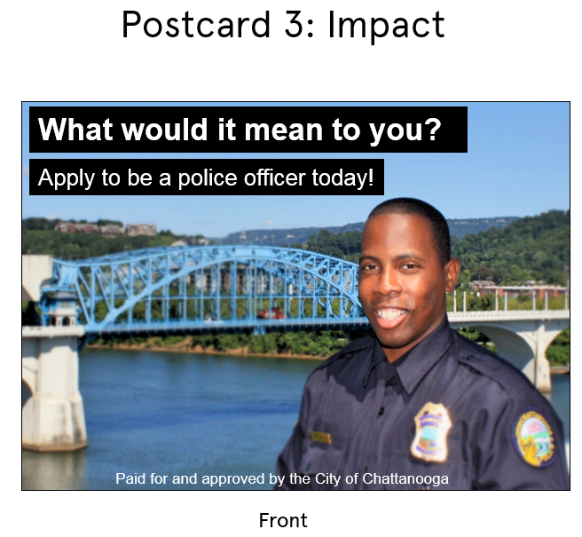
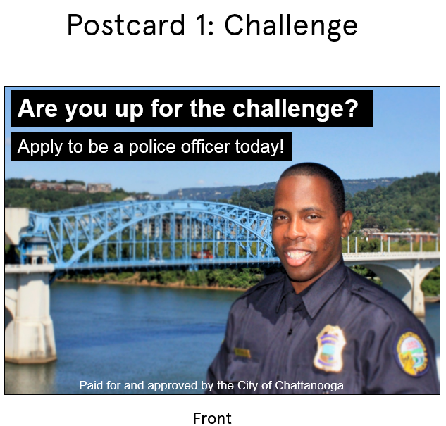
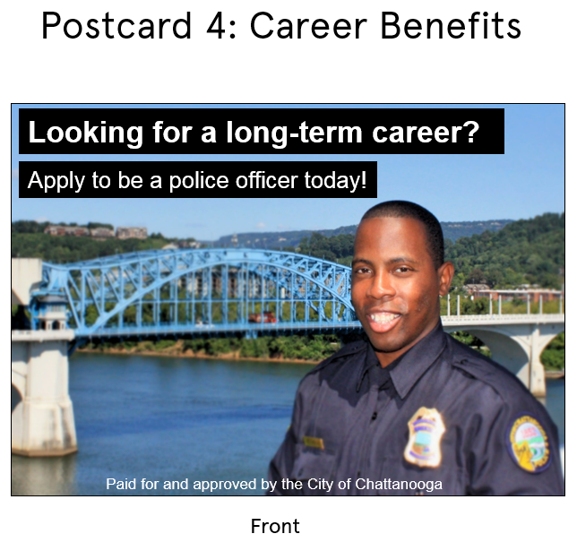
Postcards in Chattanooga
1.0%
.69%
Notes:
Sam

Slide 22
Applications (everyone)
Notes:
Absolute numbers are: 73
No postcard: 25
Serve: 8
Impact: 11
Career: 14
Challenge: 15
(NO DIFFERENCE IN ENGAGEMENT) – Serve: 22, Impact: 17, Challenge: 17; Career: 16

Slide 23
Applications (people of color)
Notes:
Absolute numbers: 34
No postcard: 9
Challenge: 8
Serve: 5
Impact: 4
Career: 8

Slide 24
Body Worn Video
Notes:
Box X. Key features of the PINNACLE PR5
Simple design with one-touch activation
5 hour recording time
12 month battery standby when fully charged
720p HD audio and video quality
Tamper proof design (non-removal battery and memory)
Plug and play enabled
Drop tested from 3 meters onto concrete
IP45 Rating: water resistant and dust resistant

Slide 25
Body Worn Video RCT
1100 Officers assigned to the trial
407 Officers assigned to BWV

Slide 26
Outcomes
Staff outcomes
Stop and search
Arrest outcome
Justice outcome
Complaints (how many times officers were complained about)
Allegations (how many specific incidents were complaints made up of)
Staff spells of absence
Number of days absent
Bradford scores
‘Positive outcome’ as defined by ASC
Likelihood of arrest
Likelihood of BME
Whether or not a caution occurs or not as a result of an arrest
Whether or not a participant is charged with an offence as a result of an arrest
Whether a decision is taken to prosecute
Whether a successful prosecution occurs

Slide 27
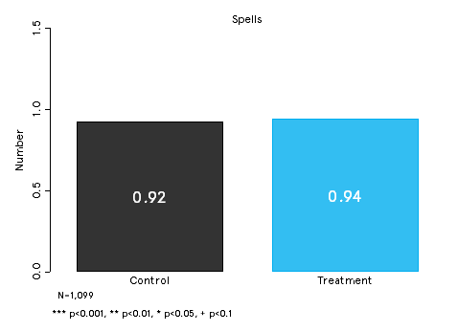
Staff outcomes - sickness

Slide 28
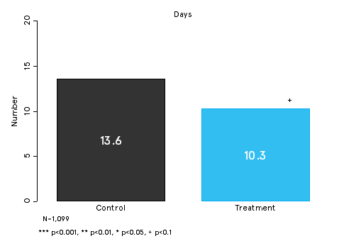
Staff outcomes - sickness
Notes:
Median = 2

Slide 29
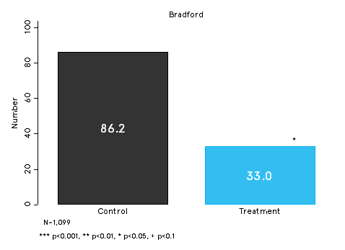
Staff outcomes – Bradford score for absenteeism

Slide 30
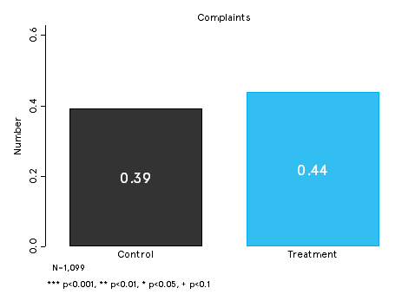
Staff outcomes - complaints

Slide 31
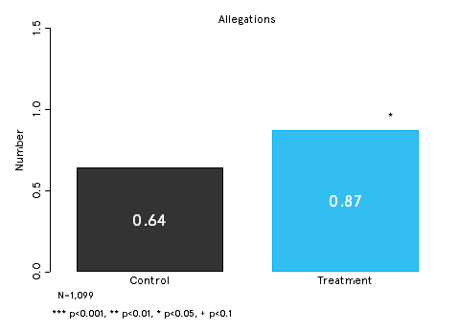
Staff outcomes - complaints

Slide 32
Stop and search – trial pairings
Camera + Camera
Camera + No Camera
No Camera + Camera
No Camera + No Camera
Notes:
Officers in the treatment who were subsequently identified as not being on active duty remained in the treatment group but we randomly drew 63 additional officers from the control group and allocated cameras to them. Because allocation continued to be random, this inflated the size of the treatment group but the groups remained comparable.

Slide 33
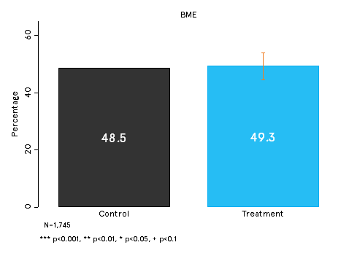
Stop and Search - BME

Slide 34
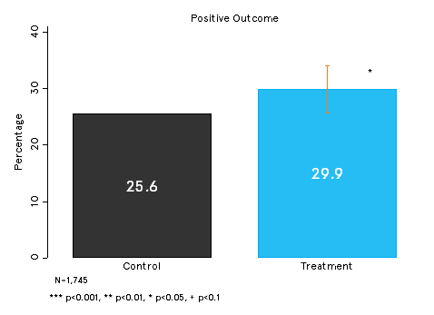
Positive outcome (non-NFA)

Slide 35
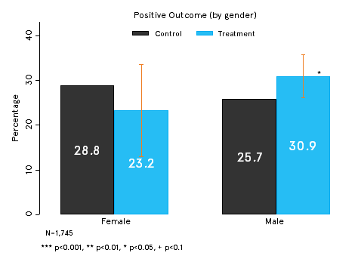
Positive outcome (non-NFA)

Slide 36
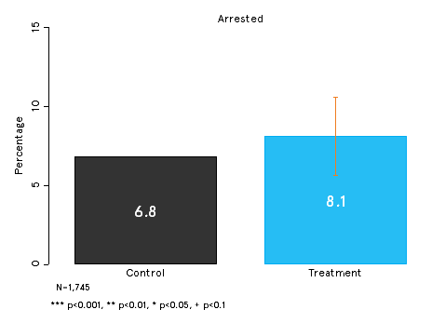
Stop and Search outcomes - arrests

Slide 37
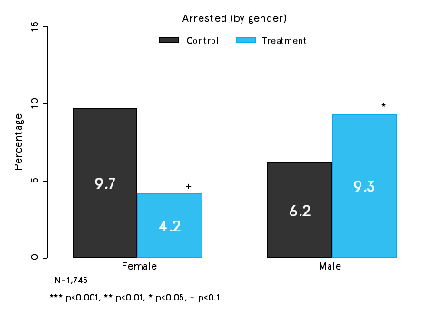
Stop and Search outcomes - arrests

Slide 38
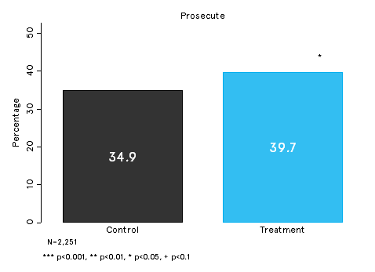
Justice outcomes - prosecution

Slide 39
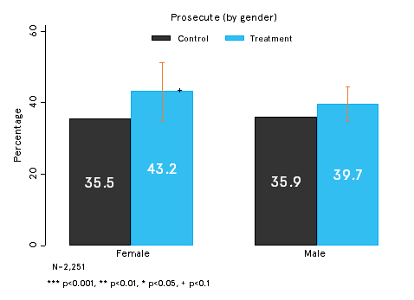
Justice outcomes - prosecution

Slide 40
Reducing reoffending

Slide 41
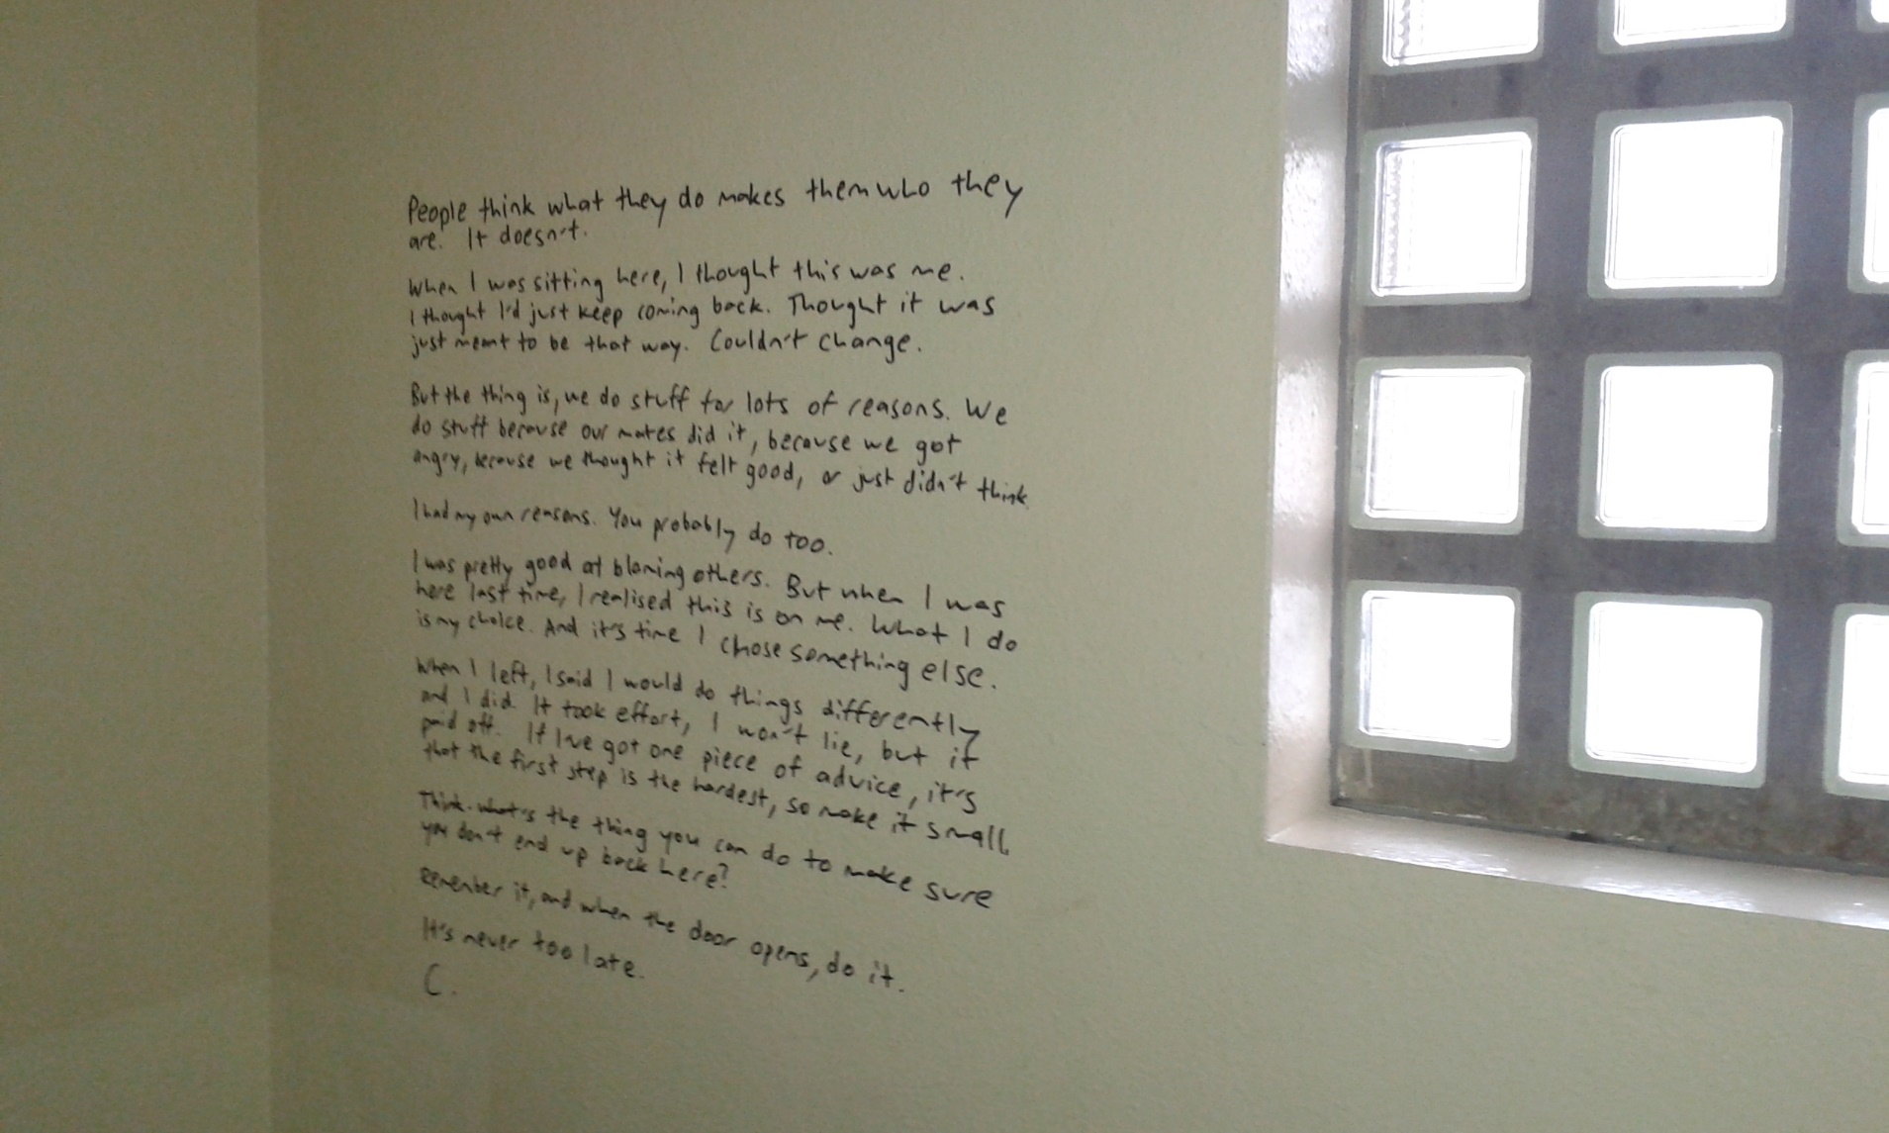
Cell wall message

Slide 42
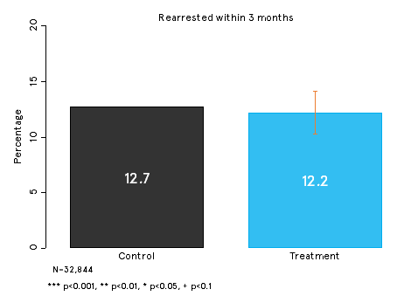
Re arrested within 3 months

Slide 43
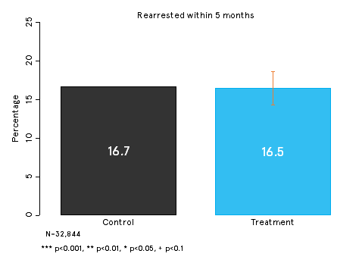
Re arrested within 5 months

Slide 44
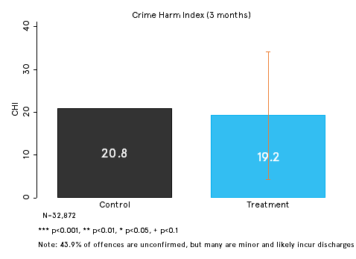
Re arrested within 3 months – CHI

Slide 45
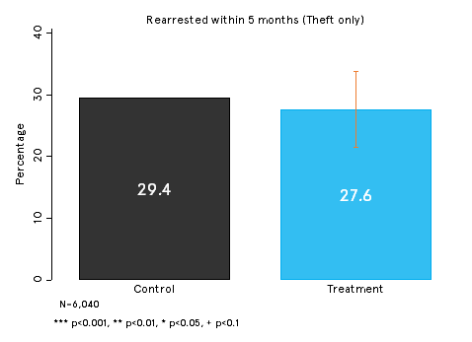
Re arrested within 5 months – theft only

Slide 46
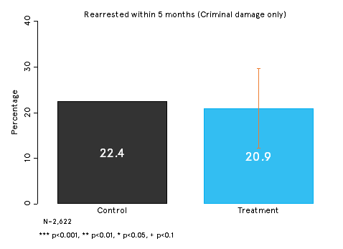
Re arrested within 5 months – criminal damage only

Slide 47
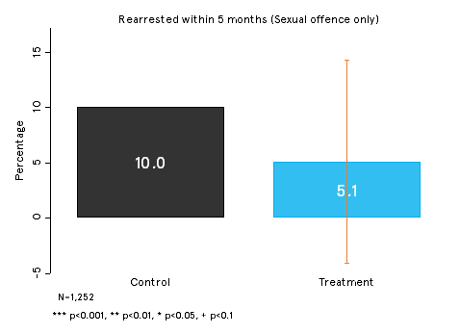
Re arrested within 5 months – sexual offence only

Slide 48
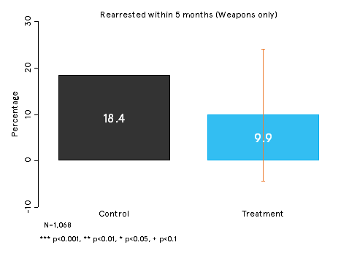
Re arrested within 5 months – weapons only

Slide 49
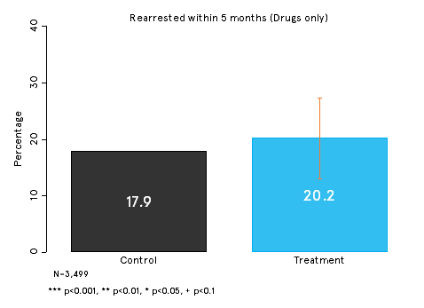
Re arrested within 5 months – drugs only

Slide 50
Forthcoming research – PREVENT + MPS
PREVENT
We’ve evaluated 40 projects in 2 years with over 12000 participants using surveys (attitudinal and knowledge) and behavioural simulations
First time, to our knowledge, an experimental design has been used to evaluate interventions in this policy area in the UK
Standardised, self reported measures linked to extremism
MPS
7 RCTs over 2 years with Barak Ariel
Trials to include:
reducing missing persons
alcohol related violence
mobile phone theft
wanted offenders
domestic abuse
Notes:
Just to recap
We used a split group approach, this is ddifferent rom the previous approach:
It’s a counterfactual, allows to…
2. Uses standardised vmeasures that uses measures that academic RESEARCH SUGGESTES ARE LINKED To extremism
It depends on the the particiaptsn them
In addition to this we are also able to use measure observed behavioural change, as opposed to reported change
Community Cohesion: The sum of response scores of 1a, 1b and 1d;
British Values: The sum of response scores of 1f and 1k;
Authority Worship: The sum of the response scores of 1c and the inverse of 1g;
Propensity for Violence: The sum of response scores of 1h and 1l;
Xenophobia: The sum of response scores of 1j and the inverse of 1e;
Black & White thinking: response score of 1m;

Slide 51
Conference 2017 Creating a Culture of Curiosity: Why Failure is a Good Thing
In association with:

Slide 52
Conference 2017 Creating a Culture of Curiosity: Why Failure is a Good Thing
Officer memory of critical incidents
Justin Ready Griffith University

Slide 53
Society for Evidence Based Policing Annual Conference Officer Involved Shootings: Understanding Officers’ Memory of Critical Incidents Griffith University Prof Geoff Alpert, Dr Louise Porter, Dr Justin Ready Queensland Police Service SSgt Damien Hayden, Mr Darron Haworth, Ins Ray Brownhill

Slide 54
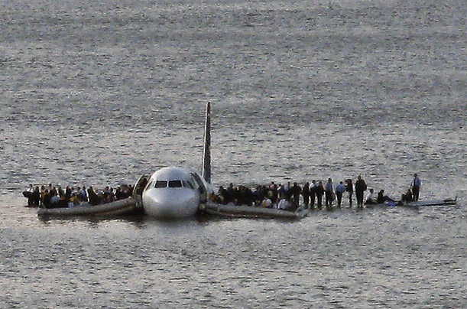
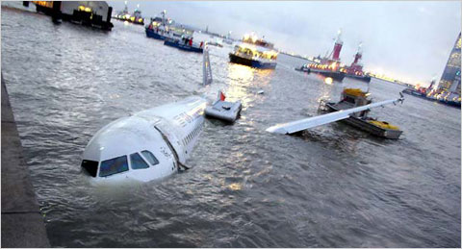
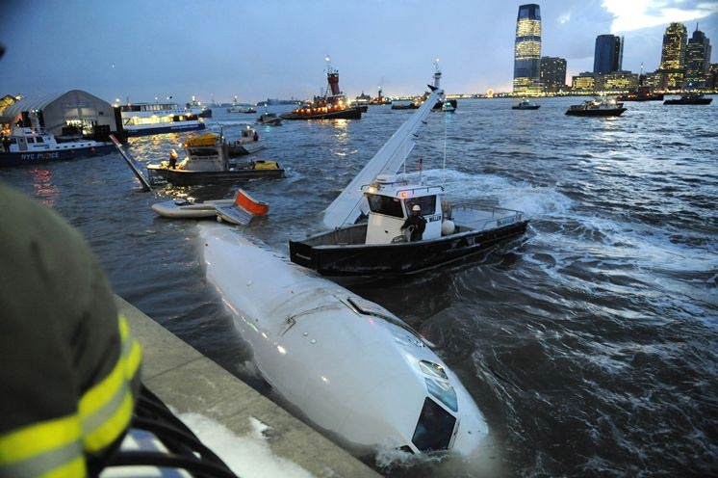

Slide 55
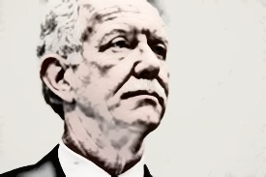

Slide 56
Our team is gathering evidence to solve an important question about how police should investigate traumatic, critical incidents involving active shooters.
The presentation will describe:
The state of knowledge about matters related to the accuracy of memory after police respond to active shooting situations.
The unknown aspects of this important issue – in other words, the current gaps in knowledge.
How our team has gathered evidence in a scientific manner to help fill that gap.
How the new knowledge will improve police practice and public safety.

Slide 57
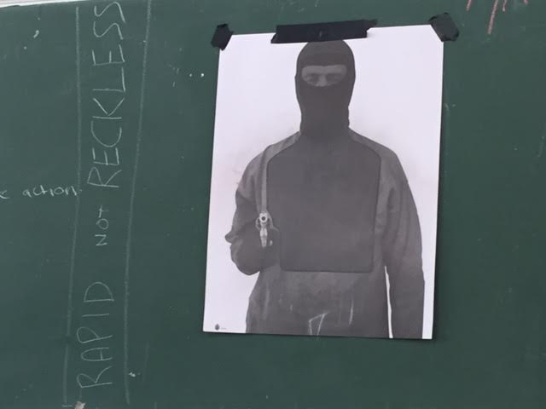
QPS Active Shooter Training

Slide 58
QPS Griffith University Collaboration

Slide 59
Research Question 1
Are there significant differences in how much detail police officers remember about active shooter situations depending on whether they are interviewed immediately after the event or two sleep cycles later?

Slide 60
Research Question 2
Are there significant differences in general cognitive functioning depending on whether police officers are interviewed immediately after active shooter situations or two sleep cycles later?

Slide 61
Research Question 3
Is there are relationship between police officers’ general cognition and how much they are able to remember after active shooter situations? Is this process mediated by whether they are interviewed immediately after the event or two sleep cycles later?

Slide 62
Independent and Dependent Variables
Dependent Variables:
Memory of critical incident (based on memory survey)
Cognitive functioning (based on cognitive tests)
Independent Variable:
When the police officers are interviewed about the active shooter incident (immediately after the incident or two sleep cycles later)
Control Variables
Eliminate their influence through randomization

Slide 63
Officers were randomly assigned to two groups…
 | Stage 1 (Tuesday) | Stage 2 (Tuesday) | Stage 3 (Thursday)
Experimental Group 1 (n40): | Participate in Active Shooter Scenario | 5-10 minutes after Scenario: Administer Memory and Cognition Tests | 2 Sleep Cycles after Scenario: Administer Memory and Cognition Tests
Experimental Group 2 (n40): | Participate in Active Shooter Scenario | 5-10 minutes after Scenario: Do Nothing | 2 Sleep Cycles after Scenario: Administer Memory and Cognition Tests

Slide 64
Logic of Random Assignment
If one group does better on the memory and cognition tests, we want to be able to say that was due to the treatment (the timing of the interview) – not other things.
However, if one group does better than the other, it may be because one group has better memory or more policing experience – these are confounding or spurious variables.
But if we randomly assign officers to the two groups, the average characteristics of the officers will become equivalent (age, memory scores, years experience, etc.)
Once these spurious variables are made irrelevant, then if we find cognitive differences across the two groups, it must be due to the treatment (the timing of the interview).

Slide 65
Measuring Cognition: Cognitive Tests
The cognitive tests that we are doing include a series of quick and simple tasks that measure concentration, memory and speed of learning.
For example, in some of the tests we will ask you to repeat a series of numbers backwards or remember a short list of words.
We will be doing a total of three different tests, which will take about 20 minutes.

Slide 66
Hopkins Verbal Learning Test
I’m going to read you a list of words.
When I am finished, I want you to repeat back to me as many as you can remember.
They can be in any order, just give me as many as you can.
Are you ready? Okay.

Slide 67
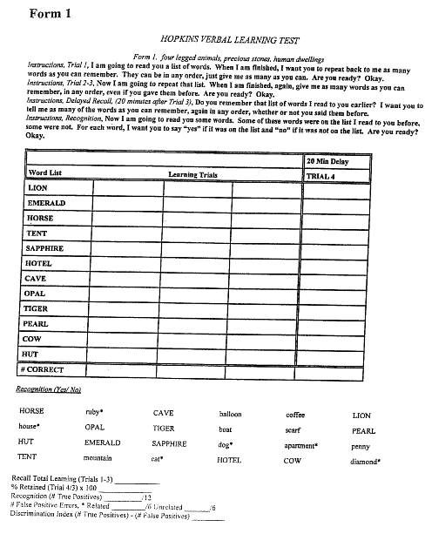
Hopkins Verbal Learning Test

Slide 68
Trail Making Test (Part A)
On this page are some numbers.
Begin at number 1, and draw a line from 1 to 2, 2 to 3, 3 to 4, and so on, in order, until you reach the end.
Draw the lines as fast as you can.
Ready? Begin!

Slide 69
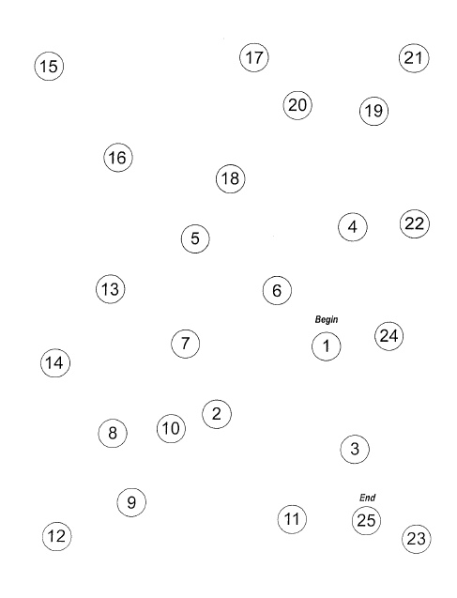
Trail Making Test A

Slide 70
Trail Making Test (Part B)
On this page are some numbers and letters.
Begin at number 1, and draw a line from 1 to A, A to 2, 2 to B, B to 3, 3 to C, and so on, in order, until you reach the end.
Remember, first you have a number, then a letter, then a number, then a letter, and so on.
Draw the lines as fast as you can.
Ready? Begin!

Slide 71
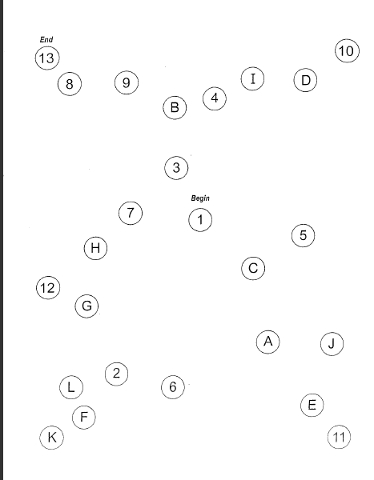
Trail Making Test B

Slide 72
Digit Span (Forward)
I’m going to say some numbers.
Listen carefully, and when I’m through I want you to say them right after me.
Just say what I say.

Slide 73
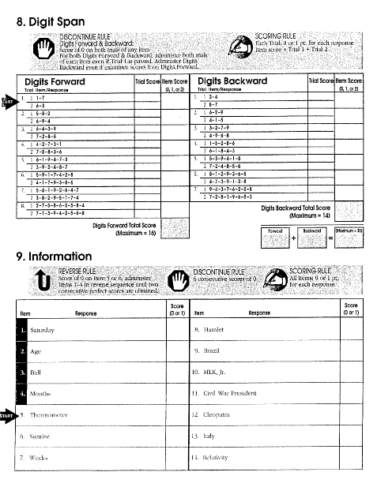
Digit Span Test

Slide 74
Digit Span (Backward)
Now I’m going to say some more numbers.
But this time when I stop, I want you to say them backward.
For example, if I say 7-1-9, what would you say?
That’s right.

Slide 75
Hopkins Verbal Learning (Delayed Recall)
Do you remember that list of words I read to you earlier?
I want you to tell me as many of the words as you can remember, again in any order, whether or not you said them before.

Slide 76
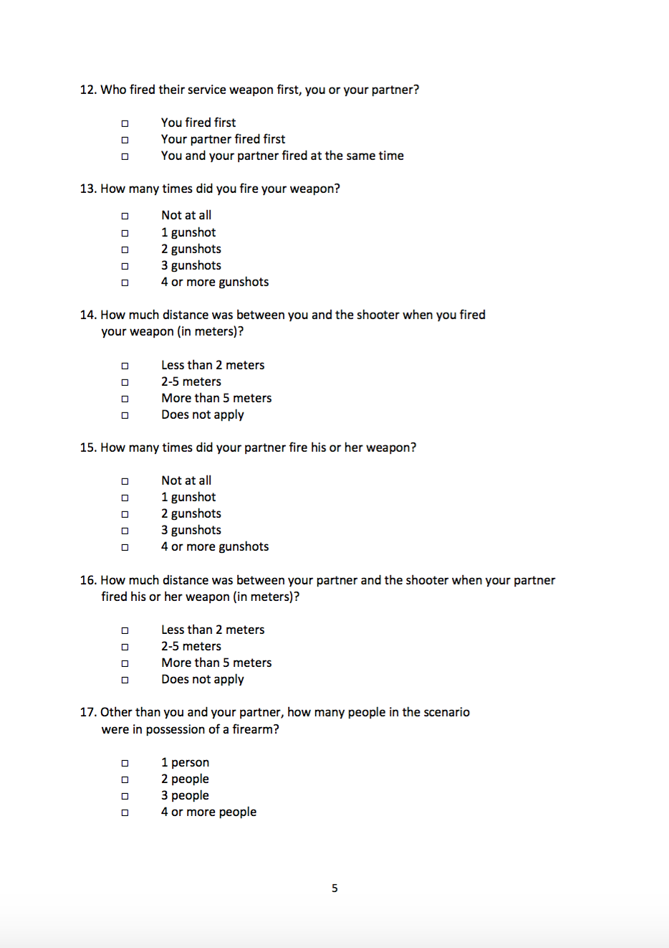
Measuring Memory: Threat Variables

Slide 77
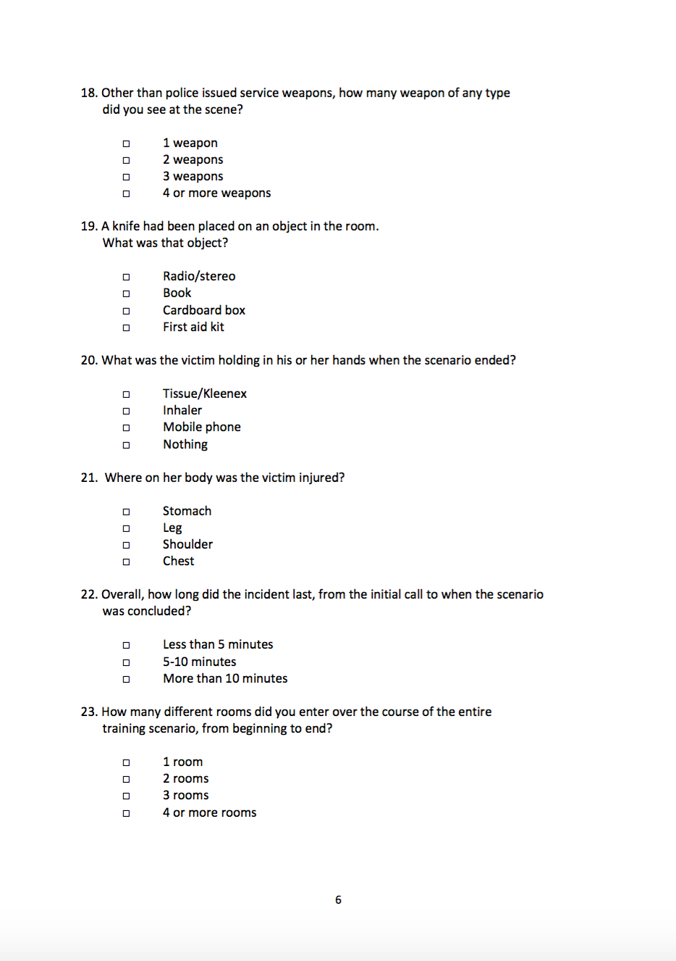
Measuring Memory

Slide 78
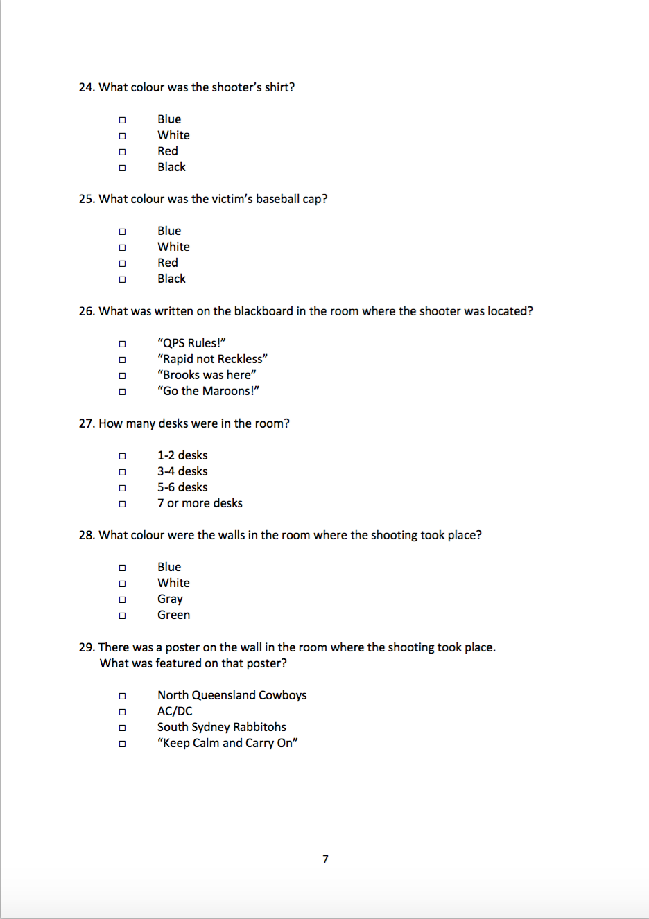
Measuring Memory: Nonthreat Variables

Slide 79
Characteristics of Police Officers in the Study

Slide 80
Results: Cognitive Performance

Slide 81
Differences in Cognitive Performance: Immediately after Critical Incident vs Two Sleep Cycles Later
Cognitive Test | When was test taken? | N | Mean | s.d. | t | df | Sig.
State-Trait Anxiety Test | Immediately after | 48 | 3.83 | 2.18 | 3.35 | 134 | 0.00
(at time of test) | Two sleep cycles later | 88 | 2.65 | 1.86
Digit Span Test | Immediately after | 48 | 16.71 | 3.40 | -2.34 | 134 | 0.02
(forward and backward) | Two sleep cycles later | 88 | 18.11 | 3.31
Trail Making Test | Immediately after | 48 | 72.80 | 19.32 | -0.04 | 133 | 0.97
(total seconds) | Two sleep cycles later | 87 | 72.99 | 27.13
Hopkins Verbal Learning | Immediately after | 48 | 33.10 | 4.11 | -0.96 | 134 | 0.34
(total words) | Two sleep cycles later | 88 | 33.94 | 5.22

Slide 82
Results: Memory of Critical Incident

Slide 83
> two-thirds got it right
< half got it right

Slide 84
Types of Information
Difference is statistically significant

Slide 85
Results: Timing of Interview

Slide 87
Overall Score? (percentage correct out of 24 items)

Slide 88
Types of Information?

Slide 89
Types of Information?
Difference is statistically significant

Slide 90
Validity
Selection bias: our participants were trainers, not average officers
Results could be even more extreme with general duties officers
BROADEN SAMPLE
Artificiality: To what extent do training exercises successfully simulate the stressful conditions that officers experience in the field?
Those tested immediately reported significantly higher levels of anxiety than normal, and higher levels than those tested 2 days later.
ADD HEART RATE MONITORS TO MEASURE STRESS?; ADD MORE STIMULUS SCENARIOS?

Slide 91
Validity (cont.)
Survey questions was highly structured with multiple choice options
Results could be more pronounced with free recall (as opposed to recognition-based recall of multiple choice)
Effects of cognitive interviewing?
Effects of walkthroughs and access to video evidence?

Slide 92
Threat to Validity: Contamination

Slide 93
Summary
Cognitive tests showed that officers interviewed two days later had significantly lower anxiety scores and better short term recall as measured by the digit span test.
But there were no differences in verbal learning and problem solving as measured by the Hopkins and trail making tests.
Timing of interview made no difference in the recall of threat relevant information
But recall for non-threat related information was significantly worse for the group interviewed 2 days later.
Implications for timing of interview
Delay is better anxiety experienced by first responders.
Delaying for welfare reasons may not significantly impair recall for threat relevant details, but does decay memory for non-threat.

Slide 94
Lessons Learned and Next Steps
Through the pilot study we learned a lot about optimizing the methodology
e.g. Avoiding contamination effects
Our scenario was in a different building from the rest of their training
We asked them not to discuss it with each other
But, they did several training scenarios and 2 days later some had difficulty distinguishing them
NEXT STEP: Participants only do one scenario

Slide 95
Applied Research: Implications for Policy

Slide 96
Acknowledgements
We would like to thank QPS for supporting this research collaboration. We are particularly grateful to the trainers who delivered the scenarios and those officers who participated in the research.

Slide 97
Conference 2017 Creating a Culture of Curiosity: Why Failure is a Good Thing
Breakout sessions
Room Number Session 1 15:30 Session 2 16:45
Members Bar (70 people) Key findings from a century of police RCT’s Domestic Burglary Risk and Prevention Peter Neyroud CBE QPM Professor Andromachi Tseloni and Dr. James Hunter (Nottingham Trent University)
Sturridge Suite (70 people) How do immigrants view crime differently and so what? Professor
Ken Pease (UCL), Dr. Dainis Ignatans
(University of Huddersfield) and
Greg Los (University of Kent)
Room 3 (40 people) EMPAC – Confidence in dealing with digital EMPAC - Cyber crime Systematic Evidence Review
evidence: Issues and Challenges Dr. Dave Hicks, Mr. Nir Tolkovsky and
Dr. Laura Knight (University of Northampton) Mr. Craig Hughes (University of Derby)
and Detective Sergeant Mark Booth
(Northamptonshire Police)
EMPAC - Arrested Development: Beyond EMPAC - Exploring Anti-Social Behaviour Risk traditional methods Dr. Rebecca Thompson (Nottingham Trent University) Emma Williams and Ian Hesketh (Christchurch)
Room 4 (40 people) EMPAC – Interactions between police and NGOs CONNECT - The effectiveness of a bespoke mental health
in relation to modern slavery training package for North Yorkshire Police: Findings
Amy Rutland (Loughborough University) from an RCT
Dr. Nicola Moran and Dr. Arabella Scantlebury (University of York)
EMPAC - Using hypothesis testing for evidence-
based analysis of organised crime
Matt Ashby (Nottingham Trent University)

Slide 98
Conference 2017 Creating a Culture of Curiosity: Why Failure is a Good Thing
In association with:

Slide 99
Conference 2017 Creating a Culture of Curiosity: Why Failure is a Good Thing
After dinner speaker
Alex Marshall
Chief Executive, College of Policing

Slide 100
Conference 2017 Creating a Culture of Curiosity: Why Failure is a Good Thing
In association with:

